Slide 3
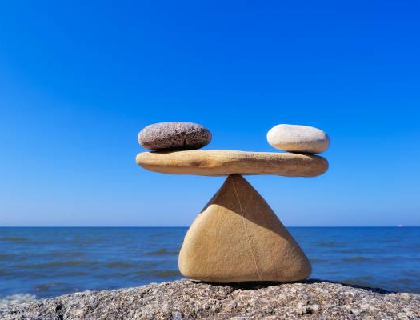
What do you notice?
This Photo by Unknown Author is licensed under CC BY-SA-NC

Slide 4
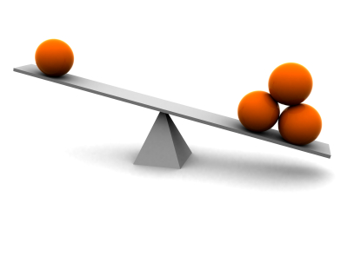
What do you notice?
This Photo by Unknown Author is licensed under CC BY-NC-ND

Slide 5
How can we make it balanced?
This Photo by Unknown Author is licensed under CC BY-NC-ND

Slide 6
Could we give the square
a number value?
What do you notice
about this balance?

Slide 7
What would be
the value of the triangles?
10

Slide 8
8
= ___
___ = ___

Slide 9
3
7
= ___
___ = ___

Slide 10
8
= ___
___ = ___

Slide 11
2
7
7
= ___
___ = ___

Slide 12
2
8
= ___
___ = ___

Slide 13
Pass the Problem

Slide 14
Draw an Equation
Camden had 9 gumballs. He got more from the gumball machine. He now has 29 gumballs. How many did he get from the gumball machine?

Slide 15
0
1
2
3
4
5
5
6
7
8
9
10

Slide 16
Draw an Equation
Mavis received 3 packages of bubbles for her birthday. Each package contains some bottles. She has 12 bottles. How many bottles were in each package?

Slide 17
0
1
2
3
4
5
5
6
7
8
9
10

Slide 18
Draw an Equation
Luke received 2 boxes of movies for Christmas. Each box has some movies in it. He has a total of 12 movies. How many movies are in each box?

Slide 19
0
1
2
3
4
5
5
6
7
8
9
10

Slide 20
Draw an Equation
Parker went to the store and purchased 2 packages of baseball cards to add to the 5 cards he had at home. Each package contained some cards. He now has 25 baseball cards. How many cards were in each package?

Slide 21
0
1
2
3
4
5
5
6
7
8
9
10

