Slide 1
Feelin’ the Phenomena
ICAP Science: Weather

Slide 2
Essential Questions
How can you use weather and climate models to predict tornadic activity?
How do meteorologists use these models?

Slide 3
Learning Objectives
After this lesson, you will be able to:
Investigate weather conditions related to tornadic activity.
Use evidence to predict when a tornado touched down.
Compare your personal experiences to what a meteorologist does.

Slide 4
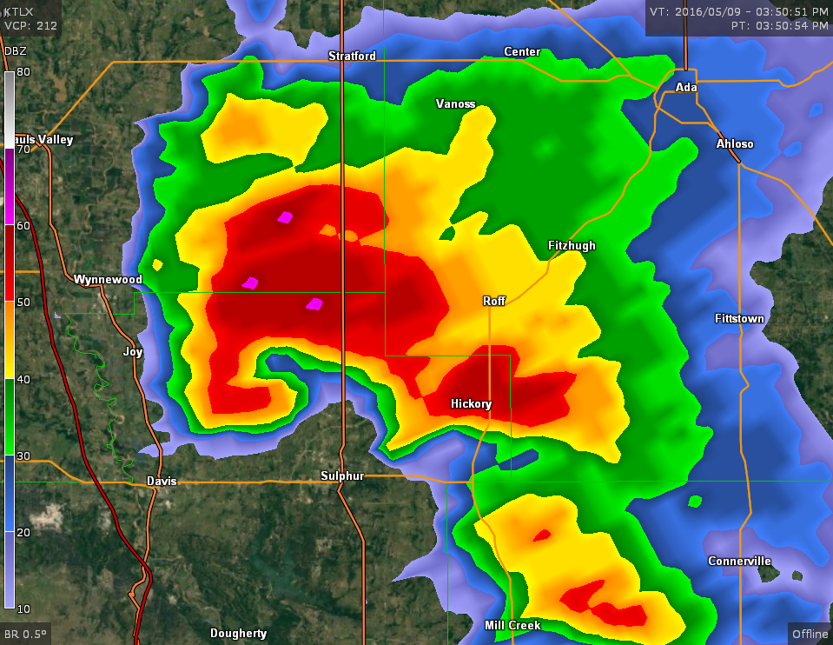
Image Analysis
How does this image make you feel?
What experiences do you have with images like this?
What information does this image provide that wouldn’t be available to you otherwise?
Notes:
Present each question one at a time
With each question, read it aloud, then ask students to discuss their thoughts with their elbow partners.
Image Source: National Weather Service. (2016, May 9). Radar imagery for the Oklahoma tornado outbreak of May 9, 2016. https://www.weather.gov/oun/events-20160509-radar

Slide 5
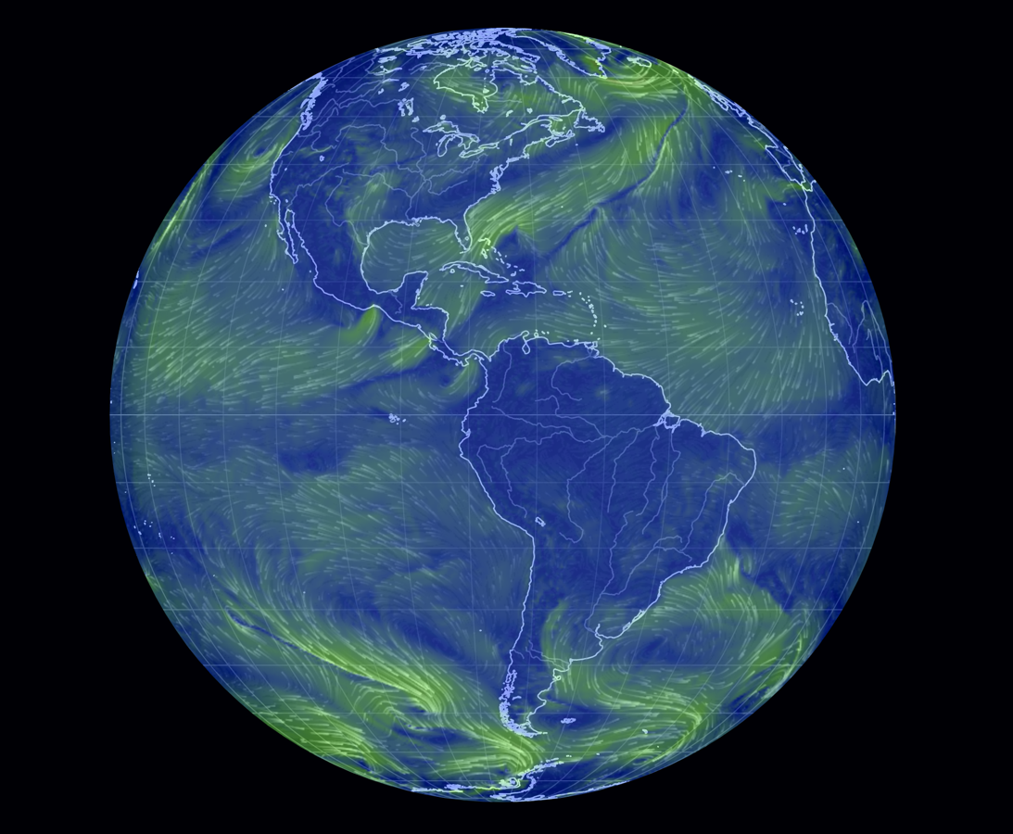
Exploring a Simulation
Go to https://earth.nullschool.net/
Refer to the Simulation Variables Cheat Sheet.
Notes:
Source: Beccario, C. (2020). Earth: A global map of wind, weather, and ocean conditions. https://earth.nullschool.net
Direct students to https://earth.nullschool.net/ . The website and basic instructions are included on the back/second page of the Simulations Cheat Sheet handout.
Have students follow along on their own devices as you demonstrate how to find the basic functions in the menu.
The next slide shows a static image of the menu with these same functions annotated. Work time for the four Explore tasks begins after you transition to the static image slide and point out the annotations.
Desmos Graphing
Detailed instructions for handling the basic Desmos functions are included on the Using Desmos handout. When it comes time to use Desmos in a given task, we recommend that one partner or group member has the Desmos graph open on their device while other partner(s) have the simulation on theirs to facilitate plotting data with more ease and efficiency.
N.a. (n.d.). Earth: a global map of wind, weather, and ocean conditions. Earth.nullschool.net. https://earth.nullschool.net

Slide 6
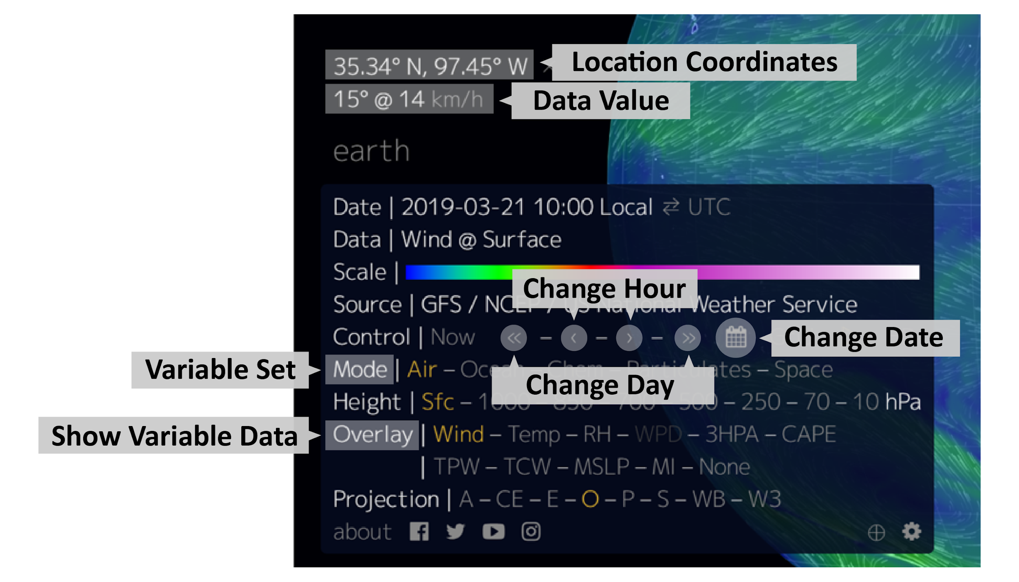
Notes:
Source: Beccario, C. (2020). Earth: A global map of wind, weather, and ocean conditions. https://earth.nullschool.net

Slide 7
Presenting Your Findings
Using your findings from #3 on the Science Simulation Tasks handout, make a short presentation to share:
your claim about what time the tornado likely touched down;
the evidence that supports your claim;
and the reasoning for how your evidence supports your claim.
Please limit your presentation to 5 minutes.

Slide 8
Presentations
Focus question: Which variables seem to be the best indicators for predicting tornadic activity?

Slide 9
Meteorology Connection
Why do scientists use models and simulations?
What other ways could they use the Earth simulation data?
What else could they predict using the data from the Earth simulation?

Slide 10
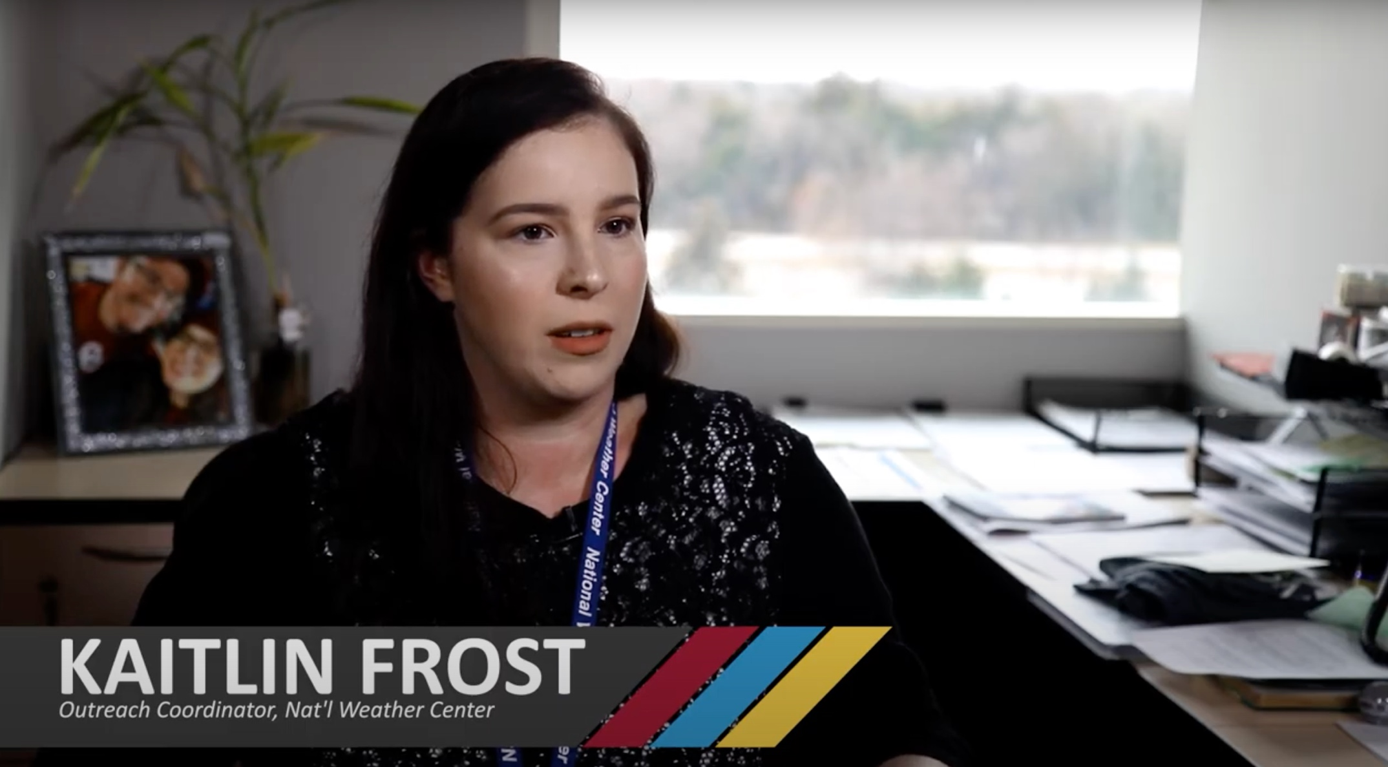
Interview with a Meteorologist
Notes:
Source: K20 Center. (2020, April 22). ICAP - feelin' the phenomena - job content [Video]. YouTube. https://youtu.be/wtj0o8GjgVk

Slide 11
I Used to Think...
Write your answers to these questions on the left side of your chart:
What do you think a meteorologist does?
How do meteorologists understand and use weather phenomena?

Slide 12
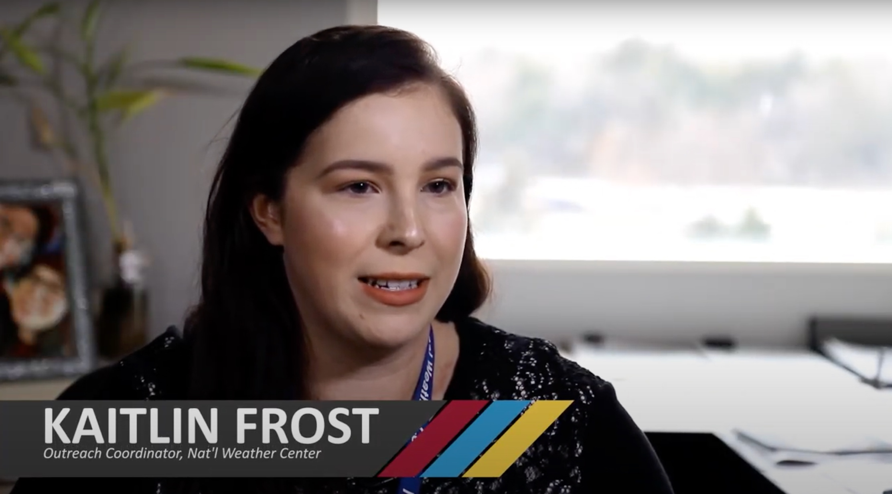
Interview with a Meteorologist
Notes:
Source: K20 Center. (2020, April 22). ICAP - feelin' the phenomena – lesson content [Video]. YouTube. https://youtu.be/2arUwaluIV8

Slide 13
...But Now I Know
Write your answers to these questions on the right side of your chart:
What do you think a meteorologist does?
How do meteorologists understand and use weather phenomena?

Slide 14
Make a Forecast
Write, act out, and record a weather forecast with your group based on the variables that are the best indicators for predicting tornadic activity.
Everyone should work together to develop the script.
The forecast should be less than 5 minutes.
Make sure each group member fills a role: meteorologist, storm chaser, or cameraman.

