Slide 1
A U.S. GOVERNMENT LESSON
What are the qualifications to be president of the United States?
What are the powers of the president?

Slide 2
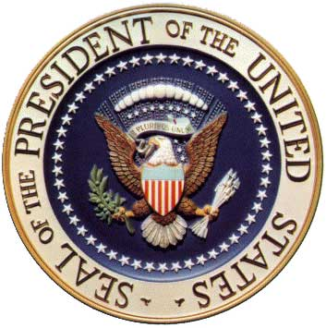
What qualifications make a good president?
Think about the qualities that might be needed for the presidency.
Be prepared to discuss and explain your answer.

Slide 3
Constitutional Qualifications of the President
The constitution states these requirements to be president:
Must be at least 35 years old.
Must be a United States citizen.
Must have been a United States resident for at least 14 years.

Slide 4
Qualifications to be President
Constitutional Qualifications:
Must be at least 35 years old.
Must be a United States citizen.
Must have been a United States resident for at least 14 years.
Questions:
1. Why do you believe the framers chose these particular qualifications for the presidency?
2. In looking at the qualifications, what seemed most important to the framers?
3. In comparing these constitutional qualifications with those listed on the board, what is different?
4. Why do you think the framers did NOT include certain qualifications?

Slide 5
What are the Powers of the President? Justified List
Look at the list of promises that President-Elect Trump proposed during his campaign.
Before reading: Check ONLY activities that you believe are supported by the constitution. Some are. Some are not.
During reading: Read about executive powers in the constitution. Change your answers as you determine what activities are supported by the constitution. Write down proof for what you checked.

Slide 6
What are the Powers of the President? Justified List
The following statements ARE supported by the constitution.
2. Nominate a Supreme Court Judge to replace Antony Scalia. (Article II, Section 2)
5. Appoint people he trusts for the head of federal agencies. (Article II, Section 2).
8. Make new economic treaties with other countries. (Article II, Section 2).
9. Not take his salary or a vacation during his presidency. (Article II, Section 1).
10. Increase and strengthen the military as a world power. (Article II, Section 2).

Slide 7
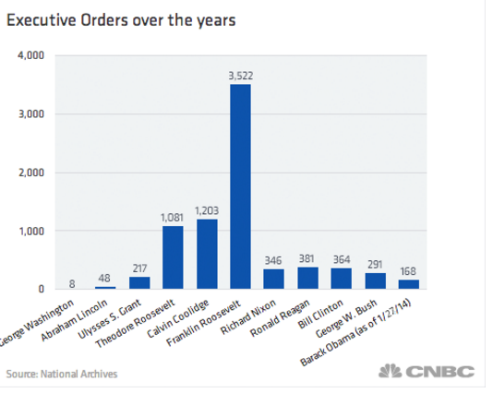
Executive Orders Over the Years
All presidents have issued executive orders since the time of George Washington.

Slide 8
Questions about Executive Orders
1. What are some of the reasons that past presidents chose to use executive orders?
2. Who has issued the most executive orders? Why do you think this president has the most orders?
3. When might an executive order be rescinded or eliminated?

Slide 9
President-Elect Donald Trump Campaign Promises
The following campaign promises are NOT directly supported by the constitution. Do they merit an executive order?
Strip U.S. citizens of their citizenship if they burn the American flag.
Build a wall between Mexico and the United States border to stop illegal immigration.
Ban foreign Muslims from entering the United States.
Control parts of the Internet that recruit Americans to ISIS.

Slide 10
Would these promises violate the Constitution?
Strip U.S. citizens of their citizenship if they burn the American flag.
Build a wall between Mexico and the United States border to stop illegal immigration.
Ban foreign Muslims from entering the United States.
Control parts of the Internet that recruit Americans to ISIS.
This has already been protected by the First Amendment and upheld by court cases.
Might be protected by First Amendment (freedom of religion) and by existing immigration laws.
Might be protected by the First Amendment (freedom of the speech) and press, or media.

Slide 11
Constitutional Qualifications of the President:
Must be at least 35 years old.
Must be a United States resident for at least 14 years.
Must be a United States citizen.
Constitutional powers of the President:
Commander and Chief of the military
Can appoint Supreme Court judges, foreign ministers and ambassadors, and heads to federal agencies.
Make treaties with other countries.
Can grant pardons or reprieves to prisoners.
Must report annual progress to Congress.

Slide 12
Color, Symbol and Image (CSI) Activity
What are the qualifications to be president of the United States?
What are the powers of the president?
On your handout, create a color, a symbol, and an image that represents the qualifications and the powers of the president.
Explain your reasoning for your choices.

Slide 13
Compare and Contrast
How does your color, symbol, and image compare to the official seal of the president?
Notes:
The Seal of the President of the United States. (2015). In Wikimedia Commons. Retrieved from: https://upload.wikimedia.org/wikipedia/commons/a/a7/USPresidentialSeal.jpg

