Slide 2
The Great Gatsby and the Sense of Sound
It’s My Party and I’ll Hear What I Want To:
How can music help establish mood and tone?

Slide 3
Quickwrite
Mrs. Doubtfire original trailer
How did the trailer make you feel?
What specific words would you use to describe how you felt and the atmosphere created by the trailer?
What was the attitude of the maker of this trailer toward the film and content of Mrs. Doubtfire?

Slide 4
PAIR up with an elbow partner and read your quick write.
Engage

Slide 5
SHARE your ideas with the whole class.
Engage

Slide 6
Quickwrite
Mrs. Doubtfire trailer recut
How did the trailer make you feel?
What specific words would you use to describe how you felt and the atmosphere created by the trailer?
What was the attitude of the maker of this trailer toward the film and content of Mrs. Doubtfire?

Slide 7
PAIR up with an elbow partner and read your quick write.
Engage

Slide 8
SHARE your ideas with the whole class.
Engage

Slide 9
Explore
The Great Gatsby and the Sense of Sound
How can music help establish mood and tone?

Slide 10
Mood
The feeling or atmosphere a piece of literature
Calm
Cheerful
Gloomy
Hopeful
Sympathetic

Slide 11
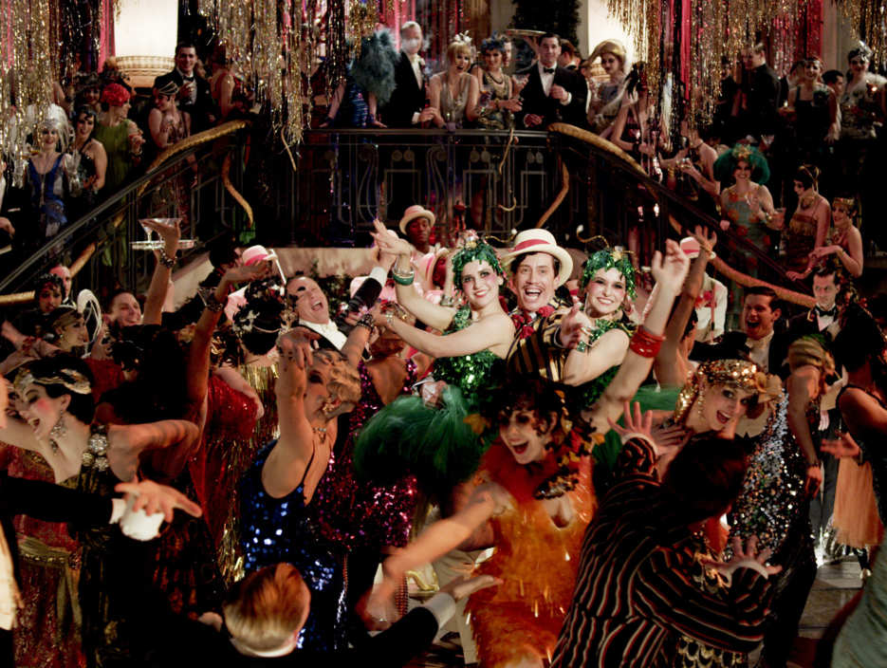
What is the atmosphere created by this photo?
Mood examples:

Slide 12
Tone
The attitude of a writer toward their subject or audience
Solemn
Ironic
Arrogant
Sentimental
Foreboding

Slide 13
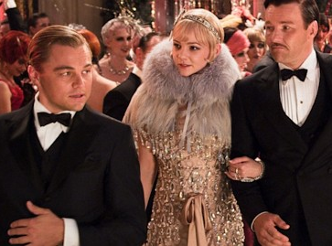
What attitude toward the characters does the filmmaker convey?
Tone examples:

Slide 14
Explain
How can music help establish mood and tone?

Slide 15
Party Playlists
Examine your notes over the mood and tone of the parties in Chapters 3 and 6:
1. What songs do you think would be appropriate to be playing?”
2. "Why would you choose certain songs to play at these parties of Gatsby's?"

Slide 16
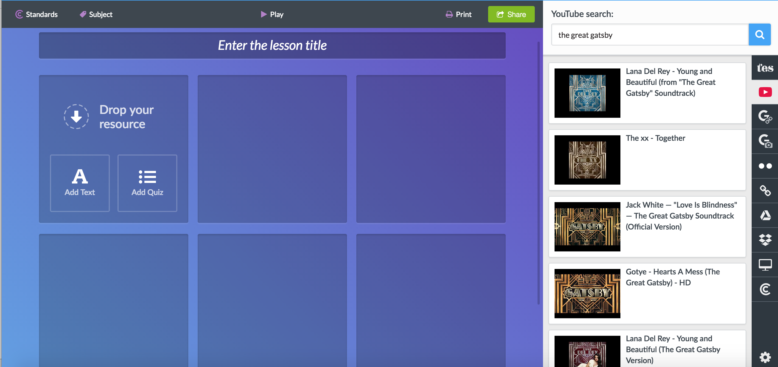
Playlist Presentation
Blendspace
Choose 6 songs/
3 from each party
For each song, add your text evidence and justification of how it fits mood/tone

Slide 17
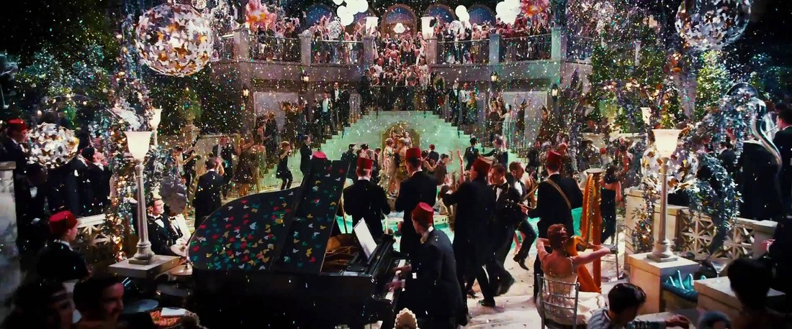
How will music establish mood and tone of Gatsby’s parties?
Your final project will include:
  1. Blendspace playlist of 6 songs
  2. Completed handout with analysis question fully answered
  3. Rubric

