Slide 1
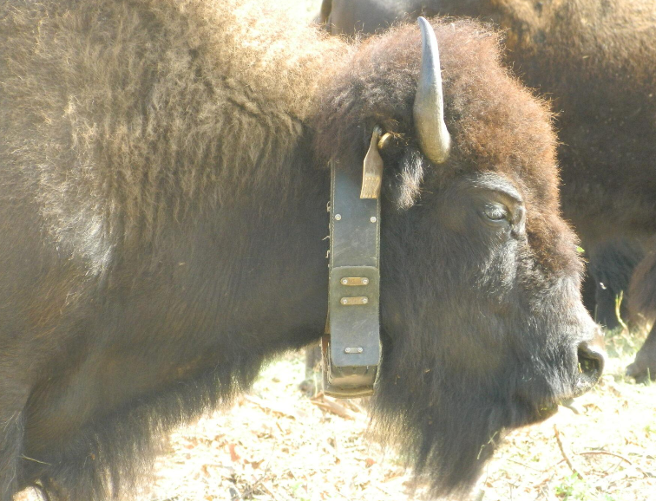
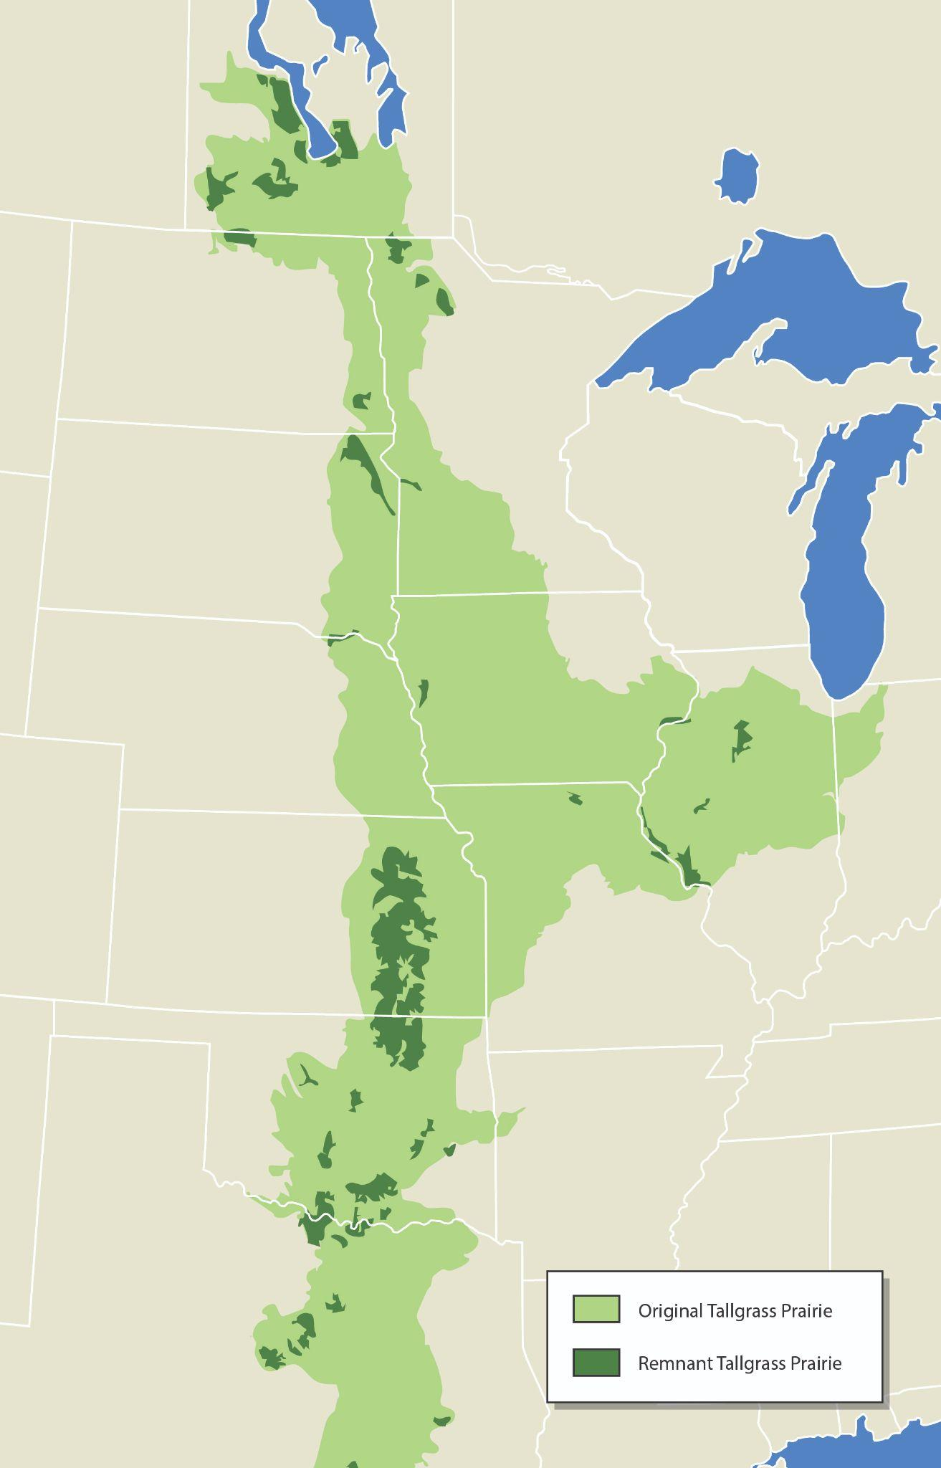
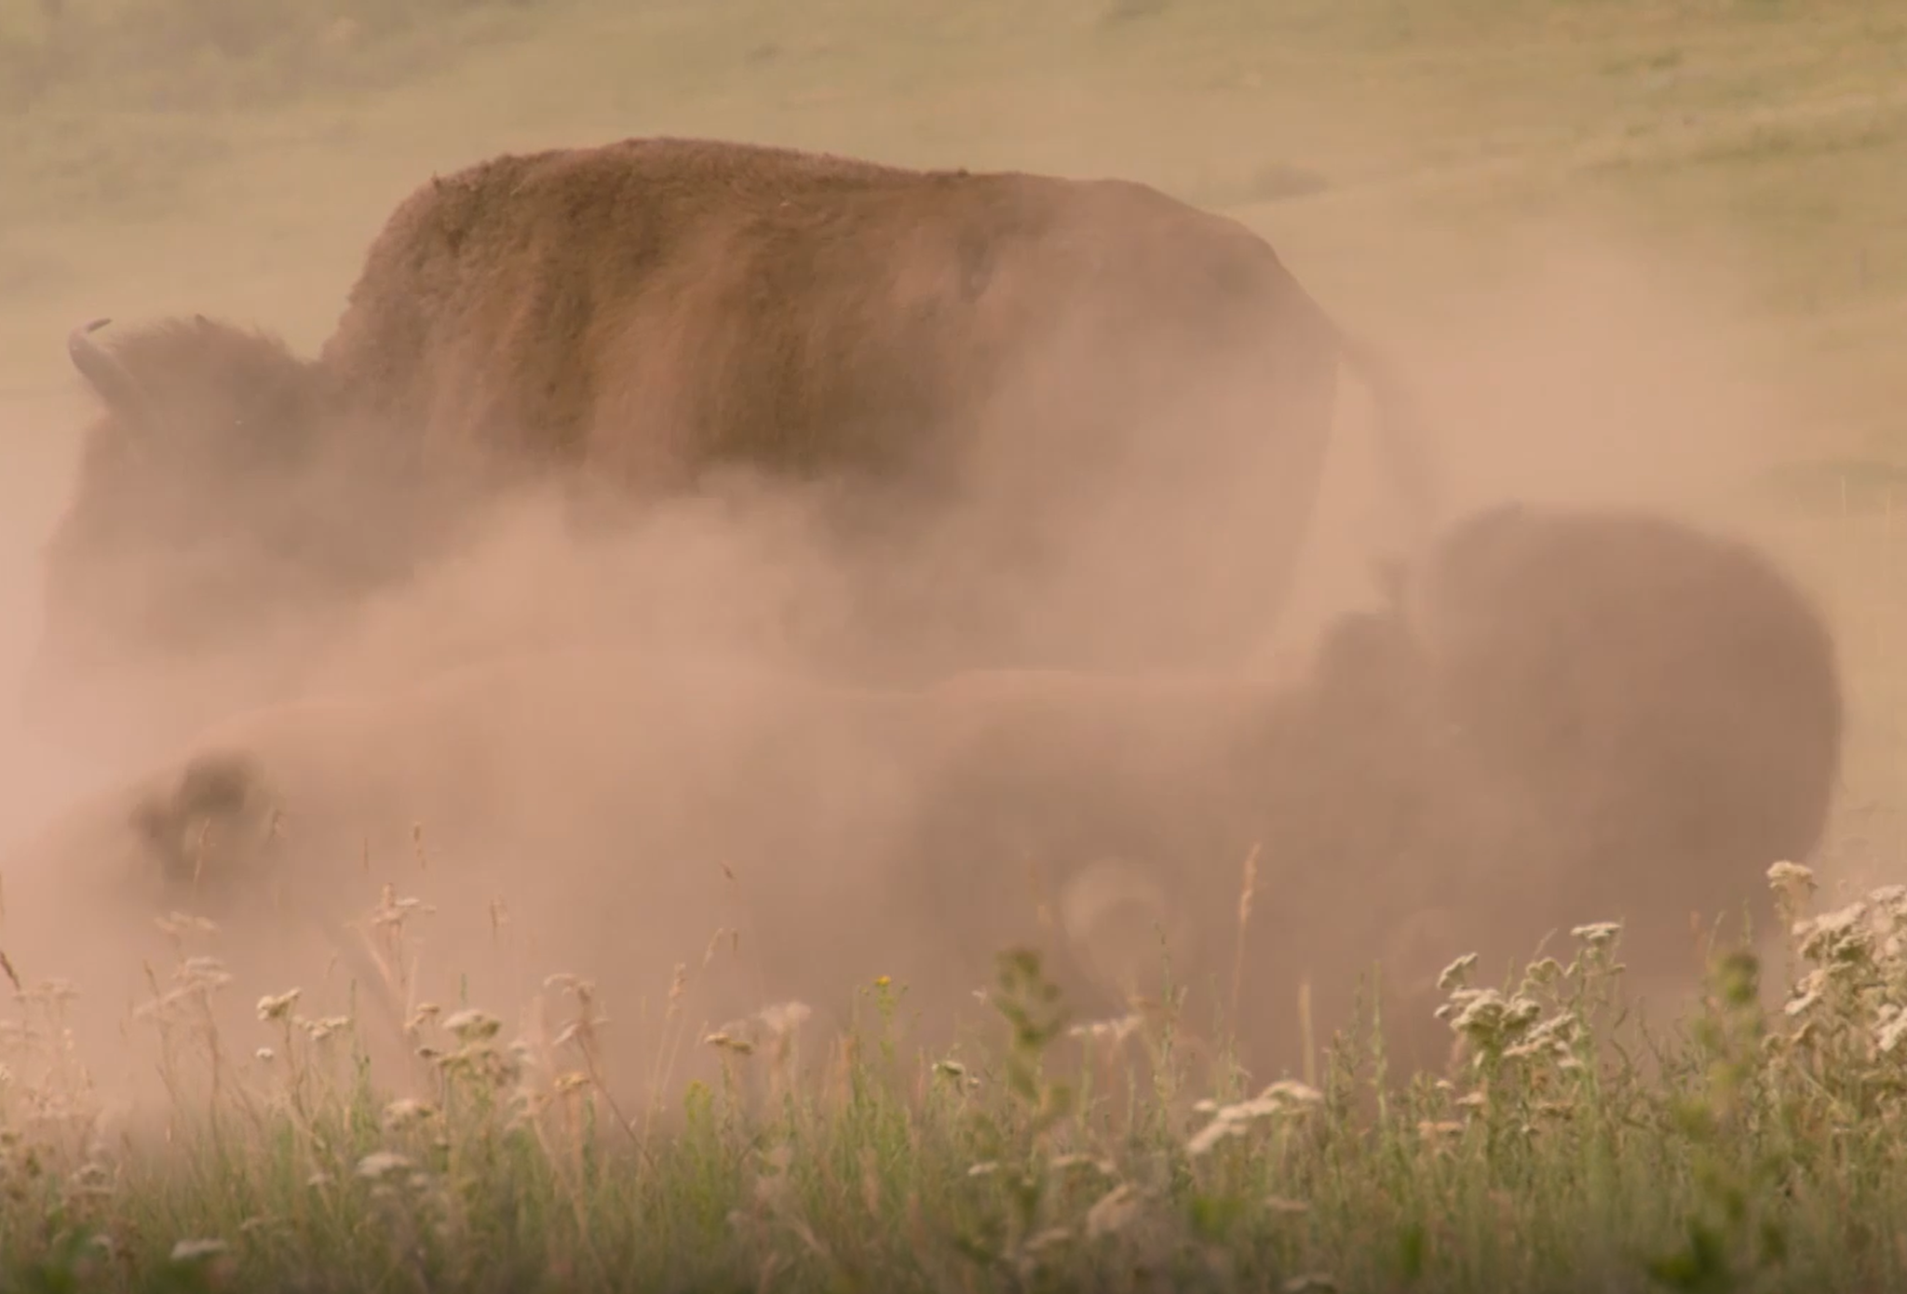
Caption This
Choose 1 image from the right.
Copy/Paste the image to a new slide.
Write a caption describing what you see.
Feel free to provide feedback to other groups’ captions by copy/pasting the emoji icons to their page!
🤣 | Funny | 🤩 | Inspiring
😎 | Cool | 🤨 | Clever
Notes:
Calvin, D. (n.d.). Catalina Island bison GPS collars. Wildlife Detections. https://wildlifedetections.com/catalina-island-bison-gps-collars/
Peaco, J. (2015, March). Bison wallowing in dry mud [Photograph]. Flickr. https://www.flickr.com/photos/yellowstonenps/
Pixabay. (2012, November 11). Sky blue grass skyline summer [Photograph]. Pixabay. https://pixabay.com/photos/sky-blue-grass-skyline-summer-65672/

Slide 2
SAMPLE
🤣
This bison looks like it’s preparing for a podcast series on prairie life, complete with its high-tech radio collar. Maybe it's about to drop some wisdom on migration routes or where to find the best grass!

Slide 3

Group 1
[Insert Caption Here]

Slide 4
Group 2
[Insert Caption Here]

Slide 5
Group 3
[Insert Caption Here]

Slide 6
Group 4
[Insert Caption Here]

Slide 7
Group 5
[Insert Caption Here]

Slide 8
Group 6
[Insert Caption Here]

Slide 9
Group 7
[Insert Caption Here]

