Slide 2
Bison Across Time
Response to Fire

Slide 3
Essential Question
How can GIS help us better understand the effects prescribed fires have on bison?

Slide 4
Learning Objectives
Design and analyze/interpret a basic GIS map about bison response to fire.
Explain the importance of fire as a disturbance in the tallgrass prairie ecoregion.
Define vocabulary associated with fire ecology.

Slide 5
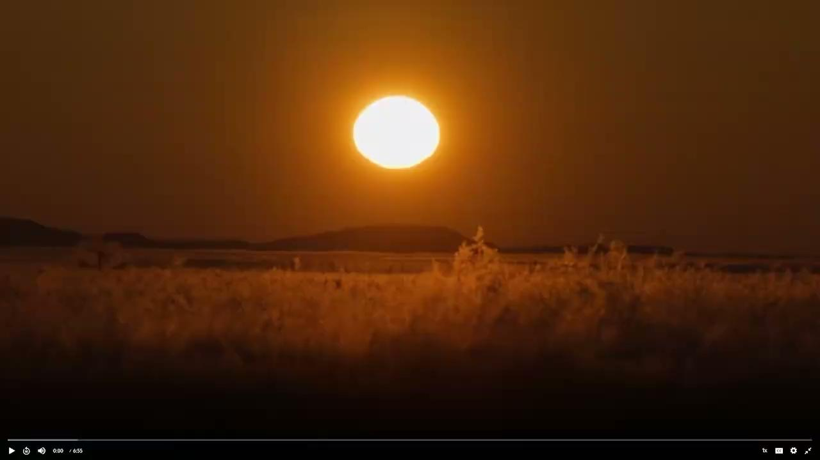
Bison and Humans: A Shared Story
Bison and Humans
Notes:
Burns, K. (2023, December 19). Bison and Humans: A Shared Story. The American Buffalo: Ecosystem Engineers. PBS Learning Media. https://oeta.pbslearningmedia.org/resource/american-buffalo-ecosystem-engineers-video-gallery/the-american-buffalo/kenburnsclassroom/

Slide 6
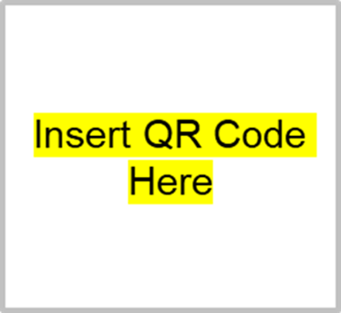
Caption This
Create a Caption that describes what’s happening in the image.
Get into small groups.
Access the “Caption This” Google Slides.
Type in [insert url]
Scan QR code
Find your assigned slide.
As a group, choose an image from slide 1 and copy/paste it to your assigned slide. Write a caption!
Notes:
K20 Center. (n.d.). Caption this. Strategies. https://learn.k20center.ou.edu/strategy/82

Slide 7
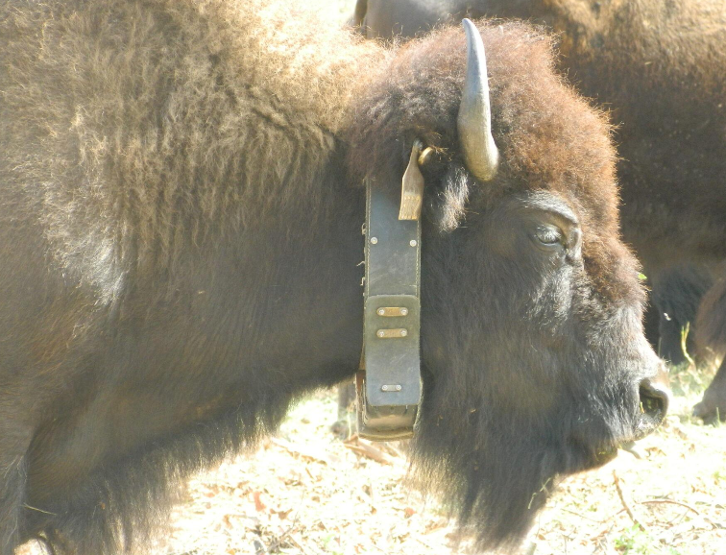
Discussion
What did you notice about the bison? Why do you think it was wearing a collar?

Slide 8
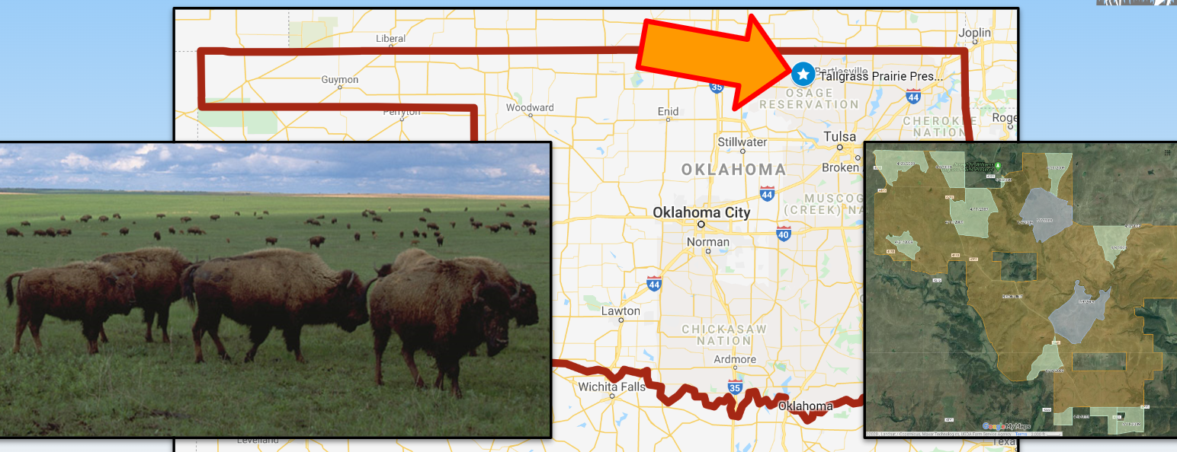
Background
Largest area of protected tallgrass prairie located in Pawhuska, OK.
Around 2,500 bison are allowed to roam and graze freely over most of the 62-square mile preserve.
Bison were fitted with global positioning system [GPS] collars to study their movement.
Notes:
Yokers, B. (n.d.). Response of Bison to Fire. JenksFERST. https://sites.google.com/view/jenksferst/lessons/gis-lessons/response-of-bison-to-fire?authuser=0

Slide 9
Preparing Files for Map
The following files contain locations for 3 GPS-collared bison (#149, #150, and #155) during the months of March, April, and May of 2009.
Download each file as an Excel file.
Save as a Google Sheets file in your Google Drive.
March
April
May
Notes:
Yokers, B. (n.d.). Response of bison to fire. JenksFERST. https://sites.google.com/view/jenksferst/lessons/gis-lessons/response-of-bison-to-fire?authuser=0

Slide 10
Creating a Map
Follow the “Student Guide” on your Mapping Bison handout to upload your data files into the provided Google map.
Explore the different features to artistically display your GIS data. You may want to consider the following:
Changing the colors
Adding icons

Slide 11
Creating a Map Tutorial
Map Tutorial
Notes:
Yokers, B. (n.d.). Response of Bison to Fire. JenksFERST. https://sites.google.com/view/jenksferst/lessons/gis-lessons/response-of-bison-to-fire?authuser=0

Slide 12
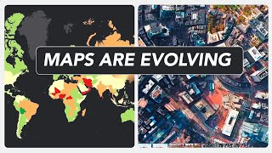
What is GIS?
What is GIS?
Notes:
Esri. (2024). What is GIS?. YouTube. https://youtu.be/WpoSofhf9Y0

Slide 13
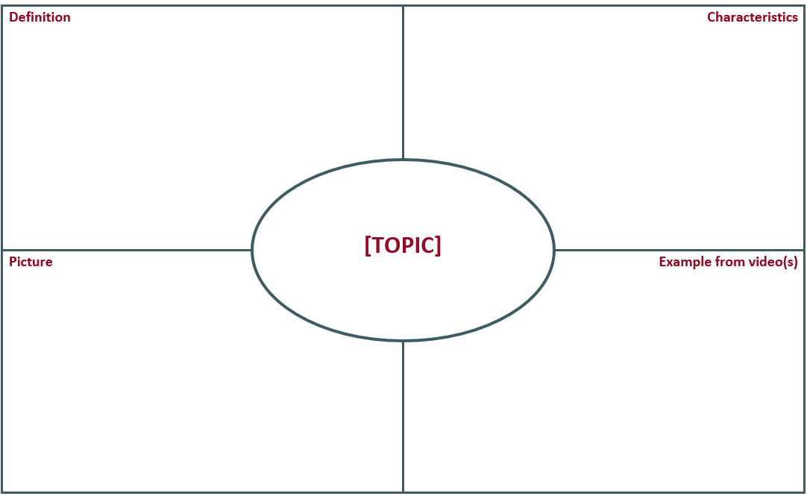
Frayer Model
Draw the following Frayer Model.
Label your model using your assigned topic.
Complete each box using notes and outside research.
Notes:
K20 Center. (n.d.). Frayer model. Strategies. https://learn.k20center.ou.edu/strategy/126

Slide 14
Vocabulary Terms
Spatial - Related to space or the arrangement of things in a specific area or environment. It's about how objects, locations, or features are positioned concerning each other.
GIS (Geographic Information System) - Computer mapping software system that links geographically referenced data with graphic map features.
Here's how it works: GIS uses computers to gather, store, analyze, and display geographic information. It can take data from satellites, maps, surveys, and even things like social media check-ins to create detailed maps and solve problems.
For instance, it can help urban planners decide where to build new roads or parks, or help scientists track wildlife habitats.

Slide 15
Vocabulary Terms
GPS (Global Positioning System) - High-tech navigation tool that uses satellites to help pinpoint specific locations on Earth.
Ecoregion - Ageographical area that has similar ecosystems, plants, animals, and climate pattern
Prescribed fire - Deliberate and carefully planned fire that is intentionally set under specific conditions to achieve certain goals in land management

Slide 16
Vocabulary Terms
Tallgrass Prairie - A type of grassland ecosystem characterized by its tall grass species, which can grow several feet high. It is found in regions with a moderate climate and fertile soils, primarily in the central part of North America, such as the Great Plains.
Temporal - Related to time or the passage of time. It describes events, changes, or phenomena as they occur over a period, whether short or long.

Slide 17
Map Analysis
Access your Google Bison GIS map.
Experiment with the different layers to complete your Map Analysis handout.

Slide 18
K20 ICAP Video: Is GIS for Me?
Notes:
https://www.youtube.com/watch?v=IlVLyQC6hTE

Slide 19
Exit Ticket
Why is GIS an important tool for conservation?
“Data is the new oil” was a statement in the video. What do you think that means?
Based on your maps, is fire a positive or negative factor affecting the bison on the Tallgrass Prairie? Justify your answer.
Notes:
K20 Center. (n.d.). Bell ringers and exit tickets. Strategies. https://learn.k20center.ou.edu/strategy/125

