Slide 2
Bison Across Time
Response to Fire

Slide 3
Lesson Objectives:
Design and analyze/interpret a basic GIS map about bison response to fire.
Explain the importance of fire as a disturbance in tallgrass prairie ecoregion.
Define vocabulary associated with fire ecology.

Slide 4
Essential Question:
How can GIS help us better understand the effects prescribed fires have on bison?

Slide 5
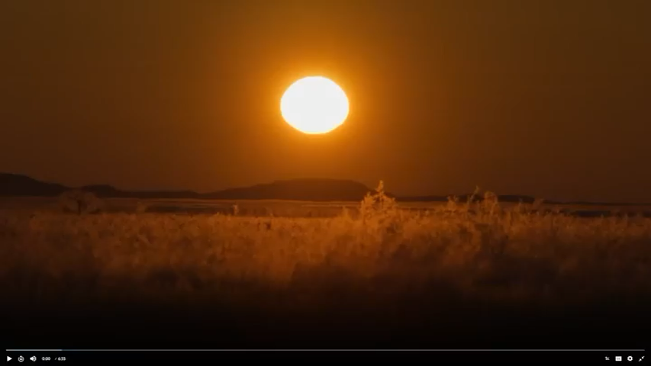
Notes:
Go to https://oeta.pbslearningmedia.org/resource/american-buffalo-ecosystem-engineers-video-gallery/the-american-buffalo/kenburnsclassroom/ and choose the first of five videos in the series, “Bisons and Humans: A Shared Story”. When playing the video from the website, stop at 03:34.
Florentine Films & WETA. (n.d.). Bison and humans: A shared story [Video]. PBS LearningMedia. https://oeta.pbslearningmedia.org/resource/american-buffalo-ecosystem-engineers-video-gallery/the-american-buffalo/kenburnsclassroom/

Slide 6

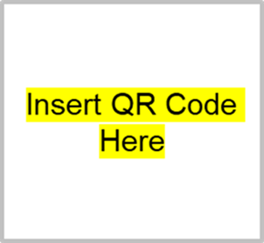
Caption This
Create a caption that describes what’s happening in the image.
Get into small groups.
Access the “Caption This” Google Slides.
  Type in [insert url]
  Scan QR code
Find your assigned slide.
As a group, choose an image from slide 1 and copy/paste it to your assigned slide. Write a caption!

Slide 7
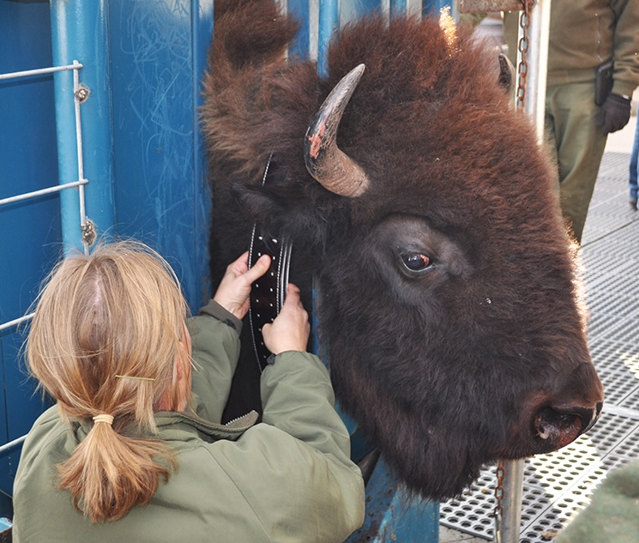
Discussion
What do you notice about the bison?
Why is the biologist putting a collar on the bison?
Notes:
National Park Service. (2019, October 25). Satellites used to track bison movements at Wind Cave National Park [Photograph]. U.S. National Park Service. https://www.nps.gov/wica/learn/news/10252019pr.htm

Slide 8
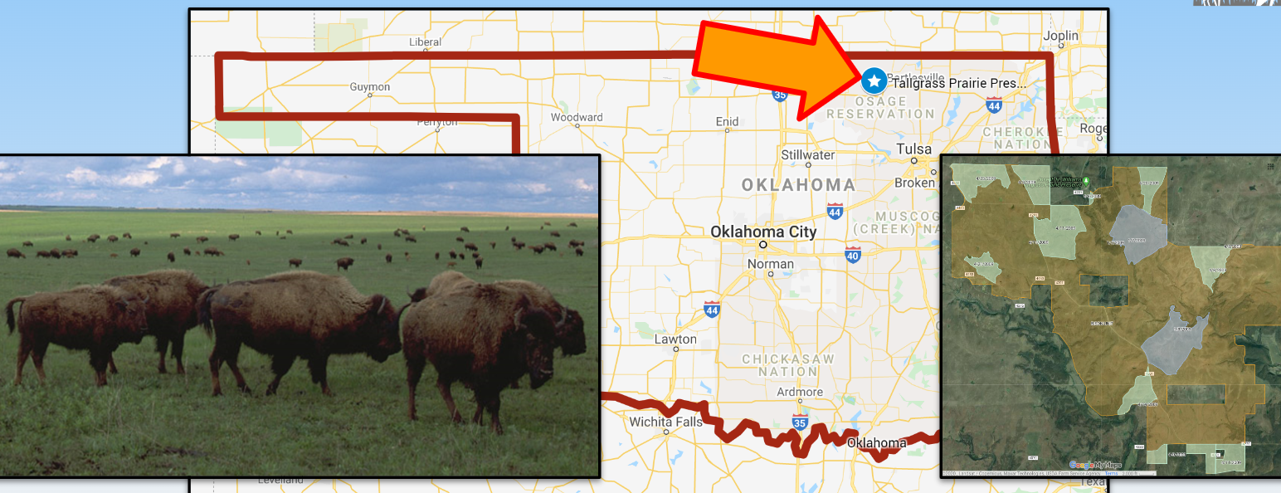
Background
Largest area of protected tallgrass prairie located near Pawhuska, OK.
Around 2,500 bison roam and graze freely over most of the 62-square mile preserve.
Bison were fitted with global positioning system [GPS] collars to study their movement.
Notes:
Yokers, B. (n.d.). Response of bison to fire. JenksFERST. https://sites.google.com/view/jenksferst/lessons/gis-lessons/response-of-bison-to-fire?authuser=0

Slide 9



Preparing Files for Map
The following files contain locations for 3 GPS-collared bison (#149, 150, and 155) during the months of March, April, and May of 2009.
Download each file as an Excel file.
Save as a Google Sheets file in your Google Drive.
March
April
May
k20.ou.edu/75
k20.ou.edu/76
k20.ou.edu/78
Notes:
Yokers, B. (n.d.). Response of bison to fire. JenksFERST. https://sites.google.com/view/jenksferst/lessons/gis-lessons/response-of-bison-to-fire?authuser=0

Slide 10
Creating a Map
Follow the “Student Guide” on your Mapping Bison handout to upload your data files into the provided Google map.
Explore the different features to artistically display your GIS data.
    Change the colors
    Add icons

Slide 11
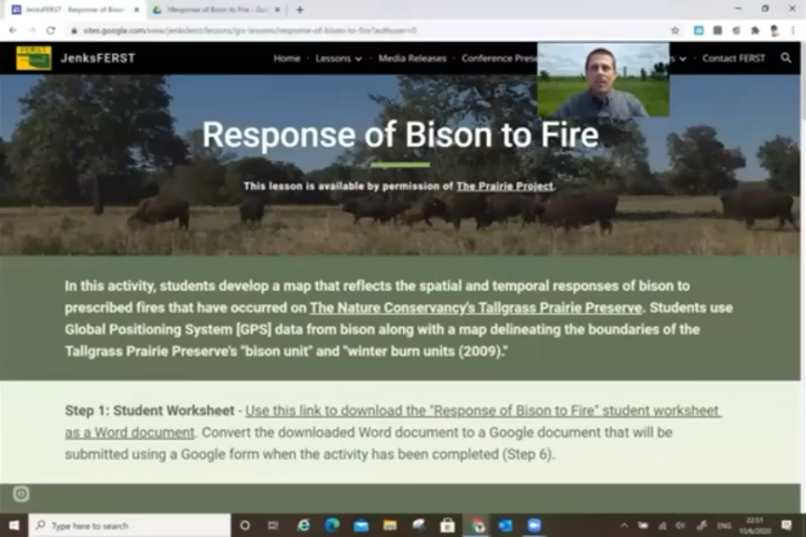
Notes:
See Step 4 at https://sites.google.com/view/jenksferst/lessons/gis-lessons/response-of-bison-to-fire?authuser=0 for this video.
Yokers, B. (n.d.). Response of bison to fire. JenksFERST. https://sites.google.com/view/jenksferst/lessons/gis-lessons/response-of-bison-to-fire?authuser=0

Slide 12

What is GIS?
Notes:
Click this poster image to go directly to the video online.
Esri. (2024). What is GIS?. YouTube. https://youtu.be/WpoSofhf9Y0

Slide 13
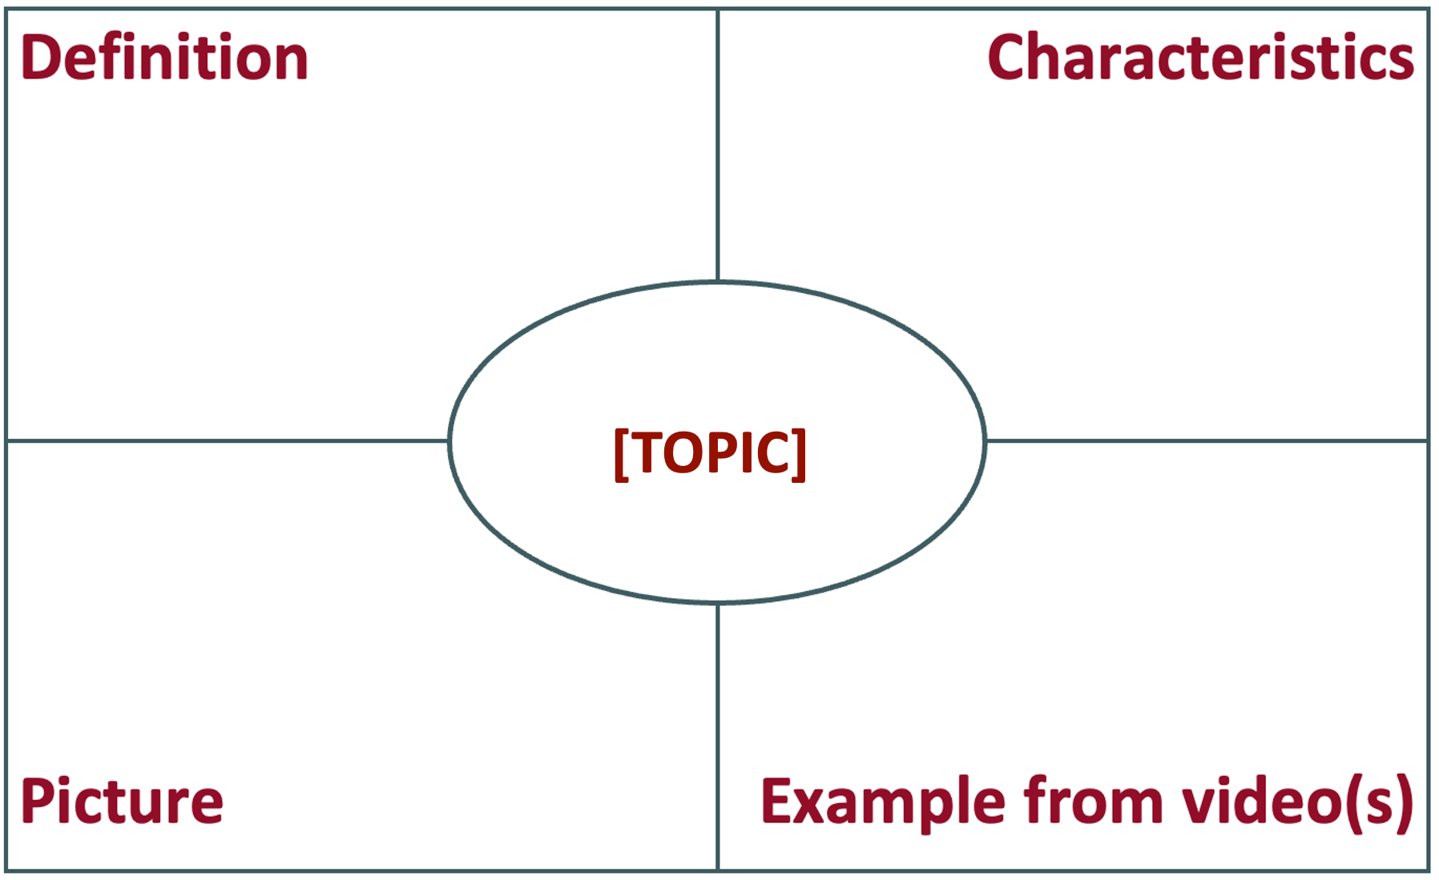
Frayer Model
Draw a Frayer Model.
Label your model using your assigned topic.
Complete each box using notes and outside research.
Notes:
K20 Center.(n.d.). Frayer model. Strategies. https://learn.k20center.ou.edu/strategy/126

Slide 14
Vocabulary Terms
Spatial – The way objects or things are arranged and posi-tioned. It's about where they are are in relation to one another.
GIS (Geographic Information System) – A computer-based tool that collects, stores, and analyzes information about places on Earth.
  GIS gathers information from satellites, maps, surveys, and even things like social media check-ins to create detailed maps and solve problems.
  For instance, GIS can help urban planners decide where to build new roads or parks.
Notes:
For instance, GIS can help urban planners decide where to build new roads or parks.

Slide 15
Vocabulary Terms
GPS (Global Positioning System) – A high-tech navigation tool that uses satellites to help pinpoint specific locations on Earth.
Ecoregion – A geographical area that has similar ecosystems, plants, animals, and climate pattern.
Prescribed fire – Deliberate and carefully planned fire that is intentionally set under specific conditions to achieve certain goals in land management.

Slide 16
Vocabulary Terms
Tallgrass Prairie – A type of grassland ecosystem characterized by its tall grass species, which can grow several feet high. It's found in regions with a moderate climate and fertile soils, primarily in North America’s Great Plains region.
Temporal – Related to time or the passage of time. It describes events, changes, or phenomena as they occur over a period, whether short or long.

Slide 17
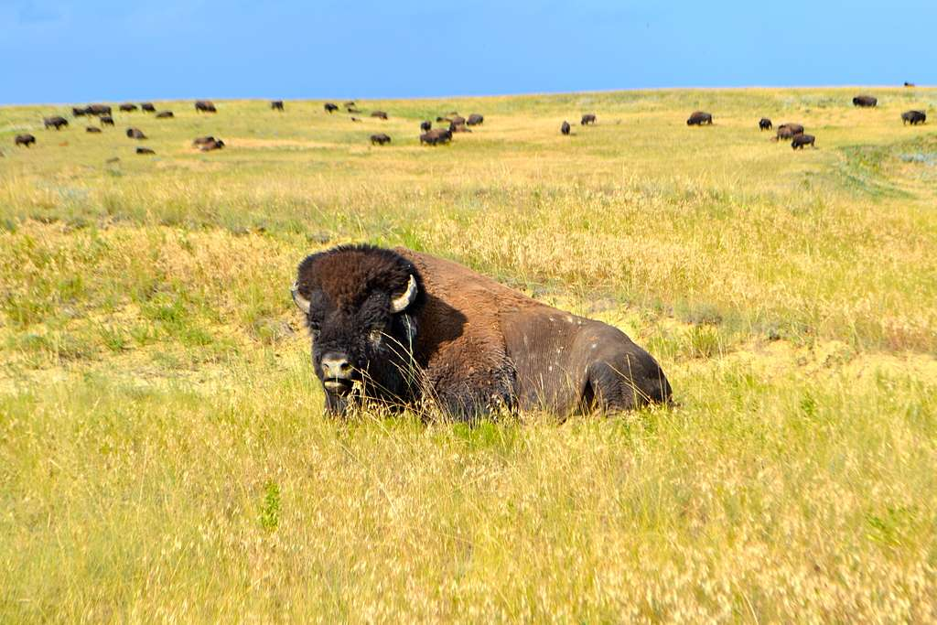
Map Analysis
Access the Google Bison GIS map you created.
Use the different layers to complete your Map Analysis handout.
Notes:
McCoy, D. (2013). Bull bison with herd in the distance [Photograph]. National Park Service, National Parks Gallery. https://npgallery.nps.gov/

Slide 18
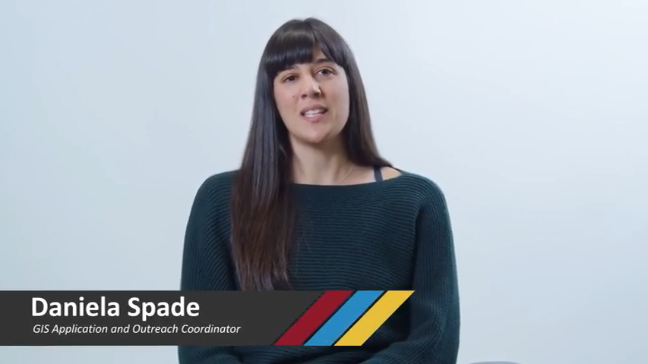
Is GIS for Me?
Notes:
K20 Center. (2024, December 2). K20 ICAP - Is GIS for me? with Daniela Spade [Video]. YouTube. https://youtu.be/IlVLyQC6hTE?feature=shared

Slide 19

Exit Ticket
Why is GIS an important tool for conservation?
“Data is the new oil” was a statement in the video. What do you think that means?
Based on your maps, is fire a positive or negative factor affecting the bison on the Tallgrass Prairie? Justify your answer.
Notes:
K20 Center. (n.d.). Bell ringers and exit tickets. Strategies. https://learn.k20center.ou.edu/strategy/125

