Slide 2

Family Ties
Exploring Families of Functions

Slide 3
Essential Questions
What is a family of functions?
How can we identify the family a function belongs to?

Slide 4
Learning Objective
Identify families of functions using characteristics of graphs.

Slide 5
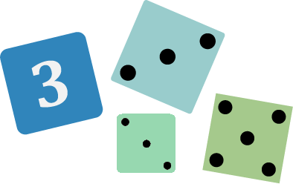
Not Like the Others
Which of the following is not like the others?
Graph #1 | Graph #2 | Graph #3 | Graph #4
Notes:
K20 Center. (n.d.). Not like the others. Strategies. https://learn.k20center.ou.edu/strategy/77

Slide 6

Card Sort
Sort your cards into sets, following these rules:
Each set must have more than one card in it.
All cards within a set must share a single characteristic.
  Example: They are all lines.
  Example: They all contain the point (0, 3).
No card may belong to more than one set.
Notes:
K20 Center. (n.d.). Card sort. Strategies. https://learn.k20center.ou.edu/strategy/147

Slide 7
Card Sort Sets
Complete the table, summarizing how you sorted
your cards. Use this table for quick reference later.
Set # | Graphs in This Set | Set Characteristic
1 | #, #, … | These graphs all had [this characteristic] in common.
2 | #, #, … | These graphs were all …
… | ... | …
Notes:
K20 Center. (n.d.). Card sort. Strategies. https://learn.k20center.ou.edu/strategy/147

Slide 8
Groups Share Their
Card Sets
Teacher’s Link to Digital Option:
Go to Amplify Classroom: Card Sort Sets.
Notes:
Eike, M. & Matchell, C. (n.d.) Amplify Classroom: Card Sort Sets [Interactive activity]. Amplify Classroom. https://classroom.amplify.com/activity/6a75edd076083fe50900e1d0

Slide 9
Family of Functions
Your deck of cards has 7 families of functions.
Discuss with your group:
  What do you think a family of functions is?
Be ready to share your group’s definition with the class.

Slide 10
Family of Functions
Each family of functions has 1 parent function.
Look at the equations for each family of functions and identify the parent function.
How would you define parent function?
Be ready to share with the class.

Slide 11
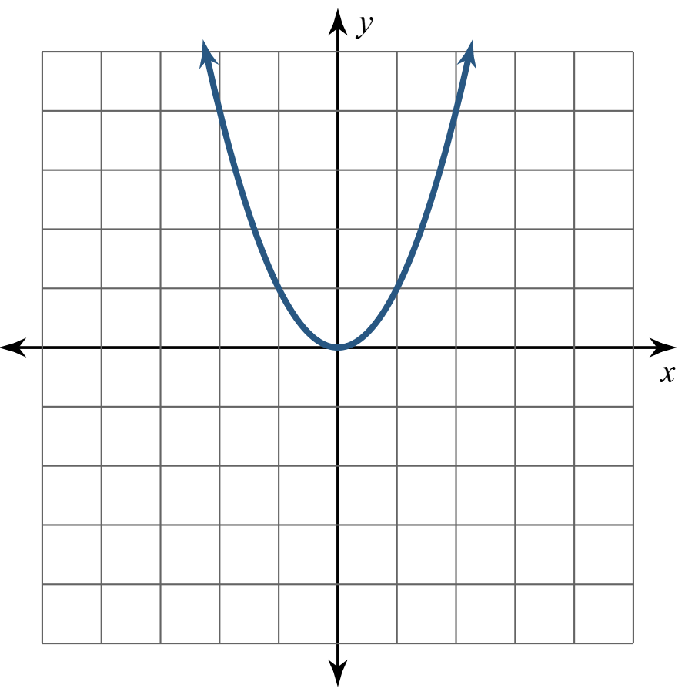
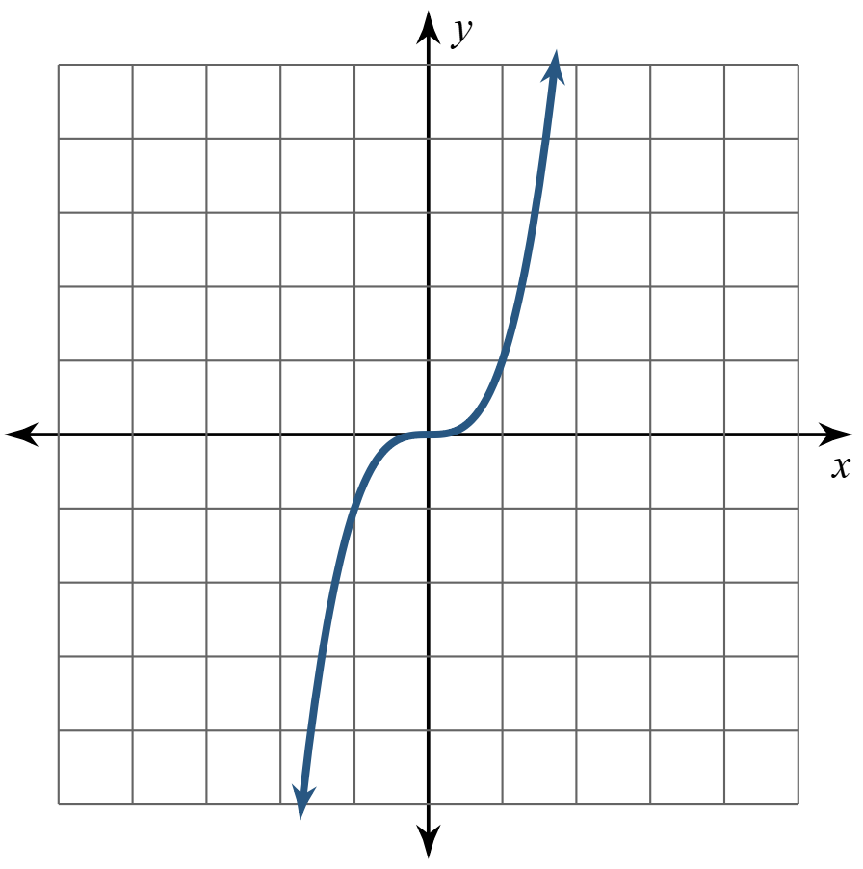
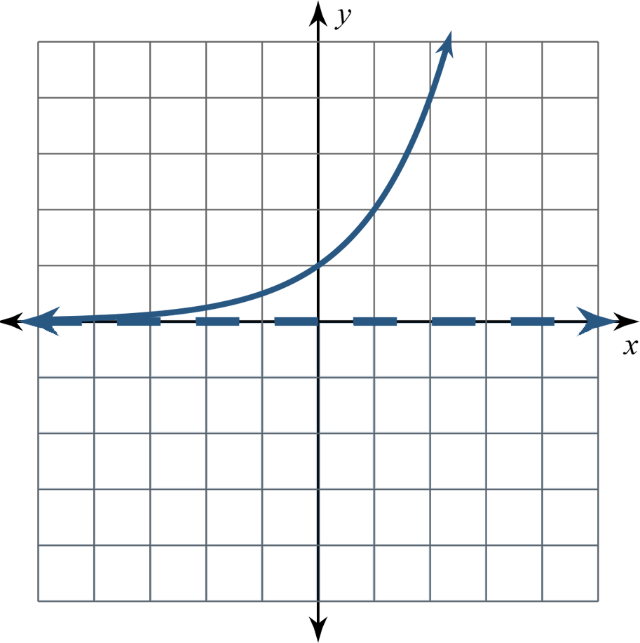
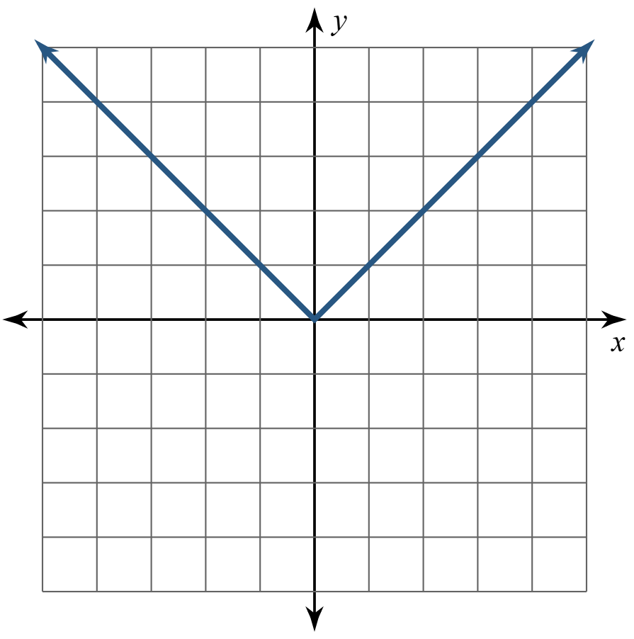




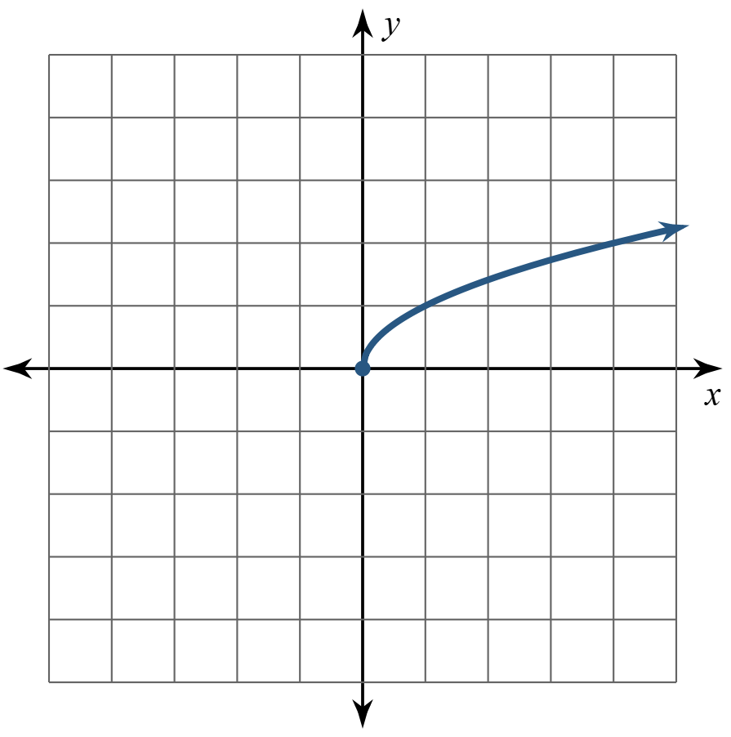
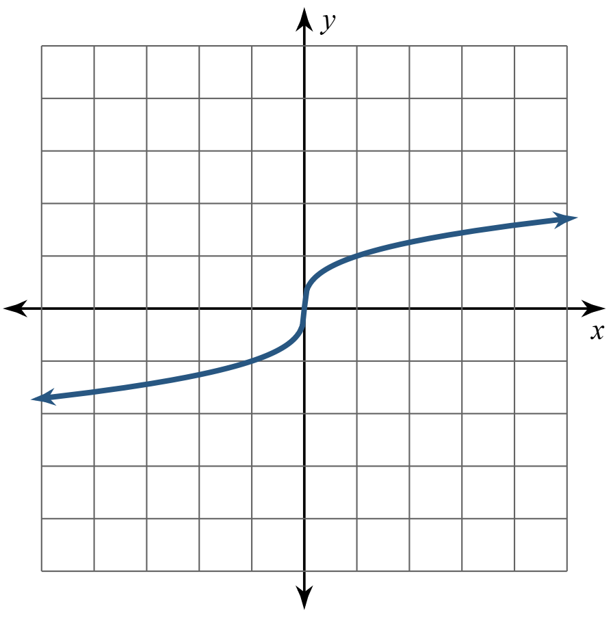
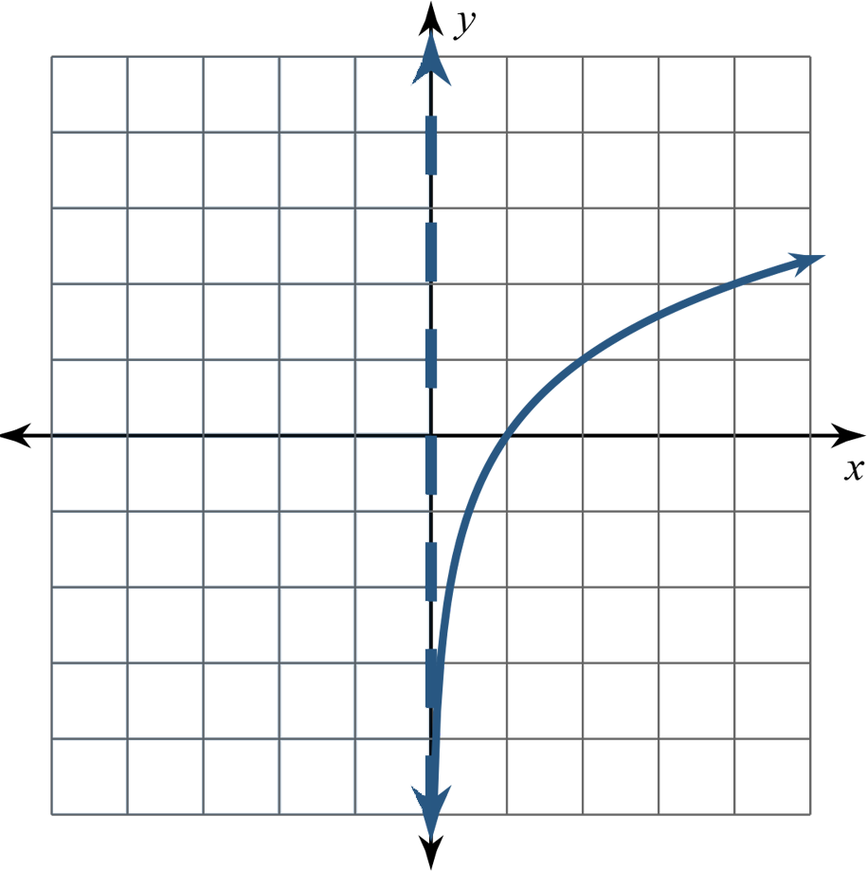



Parent Functions

Slide 12
Modeling the Story
Read the story.
Sketch a graph that represents the story.
  Be sure to label axes and indicate a scale.
Decide which family of functions your sketch
belongs to.
  Justify your thinking.

Slide 13
Parent Functions
quadratic
cubic
exponential
absolute value
square root
cube
root
logarithmic

Slide 14

Anchor Chart
  Function Name
In your group, create a poster for your family of functions that includes:
Function name
Equation of parent function
Sketch of parent graph
  Label the key characteristics of your graph (Intercepts, asymptotes, etc.)
  y = x²
Label the key details.
Notes:
K20 Center. (n.d.). Anchor chart. Strategies. https://learn.k20center.ou.edu/strategy/58

