Slide 2
Kickin’ It in the Industrial Revolution
Industrial Revolution and Industrialization

Slide 3
Learning Objective
Examine the transformation of American society and economy during the American Industrial Revolution.

Slide 4
Essential Questions
How do technological change and innovation impact societal change?
How did industrialization transform the United States?

Slide 5

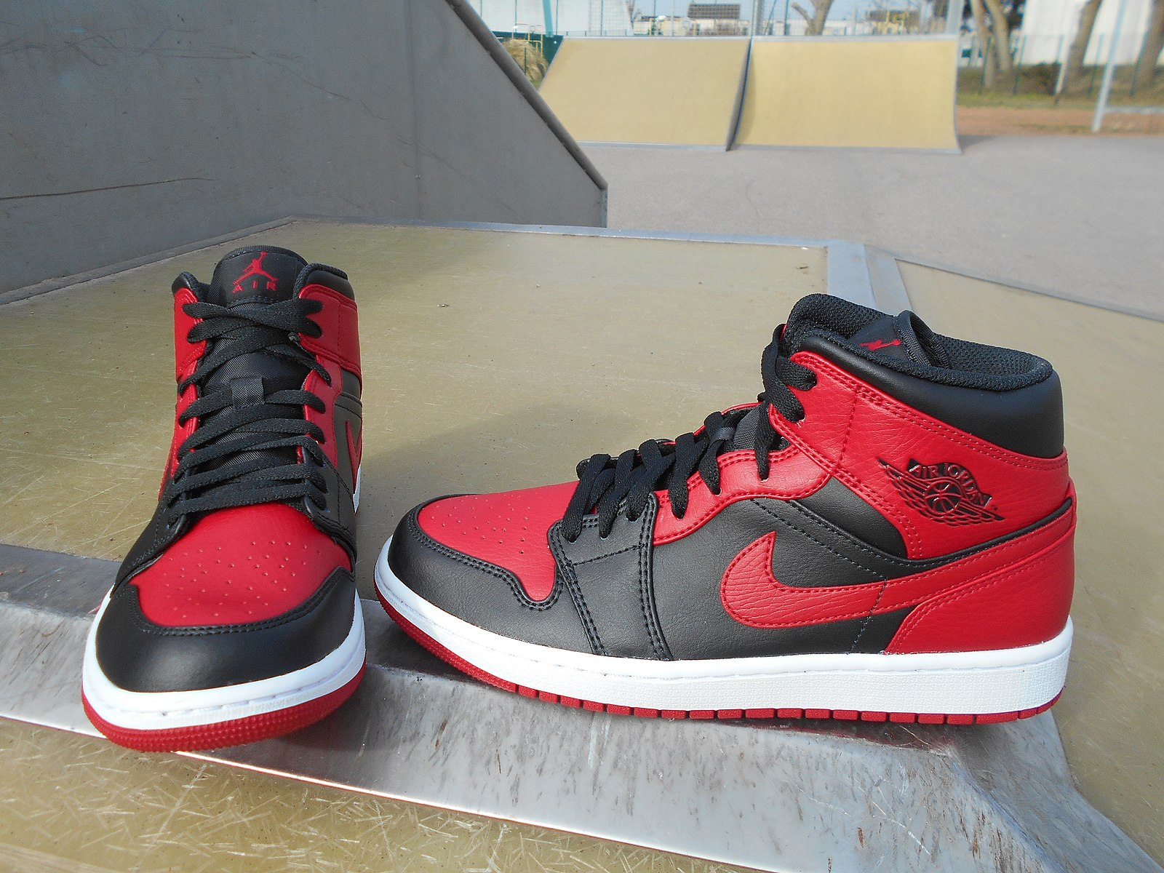
Tell Me Everything
Tell me everything you know about the shoes in the picture.
Notes:
HI 622. (2021). Air Jordan 1 Banned. Wikimedia Commons. Retrieved February 16, 2023, from https://commons.wikimedia.org/wiki/File:Air_Jordan_1_Banned.jpg.
K20 Center. (n.d.). Tell me everything. Strategies. https://learn.k20center.ou.edu/strategy/107

Slide 6
Tell Me Everything
Would you consider these shoes unique, or do others like these exist?
Notes:
HI 622. (2021). Air Jordan 1 Banned. Wikimedia Commons. Retrieved February 16, 2023, from https://commons.wikimedia.org/wiki/File:Air_Jordan_1_Banned.jpg.
K20 Center. (n.d.). Tell me everything. Strategies. https://learn.k20center.ou.edu/strategy/107

Slide 7
Tell Me Everything
How many pairs like this one do you think exist?
Keeping that in mind, how do you think these shoes were made?
Notes:
HI 622. (2021). Air Jordan 1 Banned. Wikimedia Commons. Retrieved February 16, 2023, from https://commons.wikimedia.org/wiki/File:Air_Jordan_1_Banned.jpg.
K20 Center. (n.d.). Tell me everything. Strategies. https://learn.k20center.ou.edu/strategy/107

Slide 8
Tell Me Everything
Where do you think shoes like these were made? Explain your reasoning.
Notes:
HI 622. (2021). Air Jordan 1 Banned. Wikimedia Commons. Retrieved February 16, 2023, from https://commons.wikimedia.org/wiki/File:Air_Jordan_1_Banned.jpg.
K20 Center. (n.d.). Tell me everything. Strategies. https://learn.k20center.ou.edu/strategy/107

Slide 9
Kick20s Shoe Factory
Retro is popular again, especially in the sneaker industry. There is a craze for the Kick20s Shoe all over the world. The Kick20s Shoe Factory has started to increase their production to keep up with the constant demand.
There are several assembly lines within this factory. To cash in on this craze, there are independent laborers and artists who are also making the shoes independently of the factory.

Slide 10
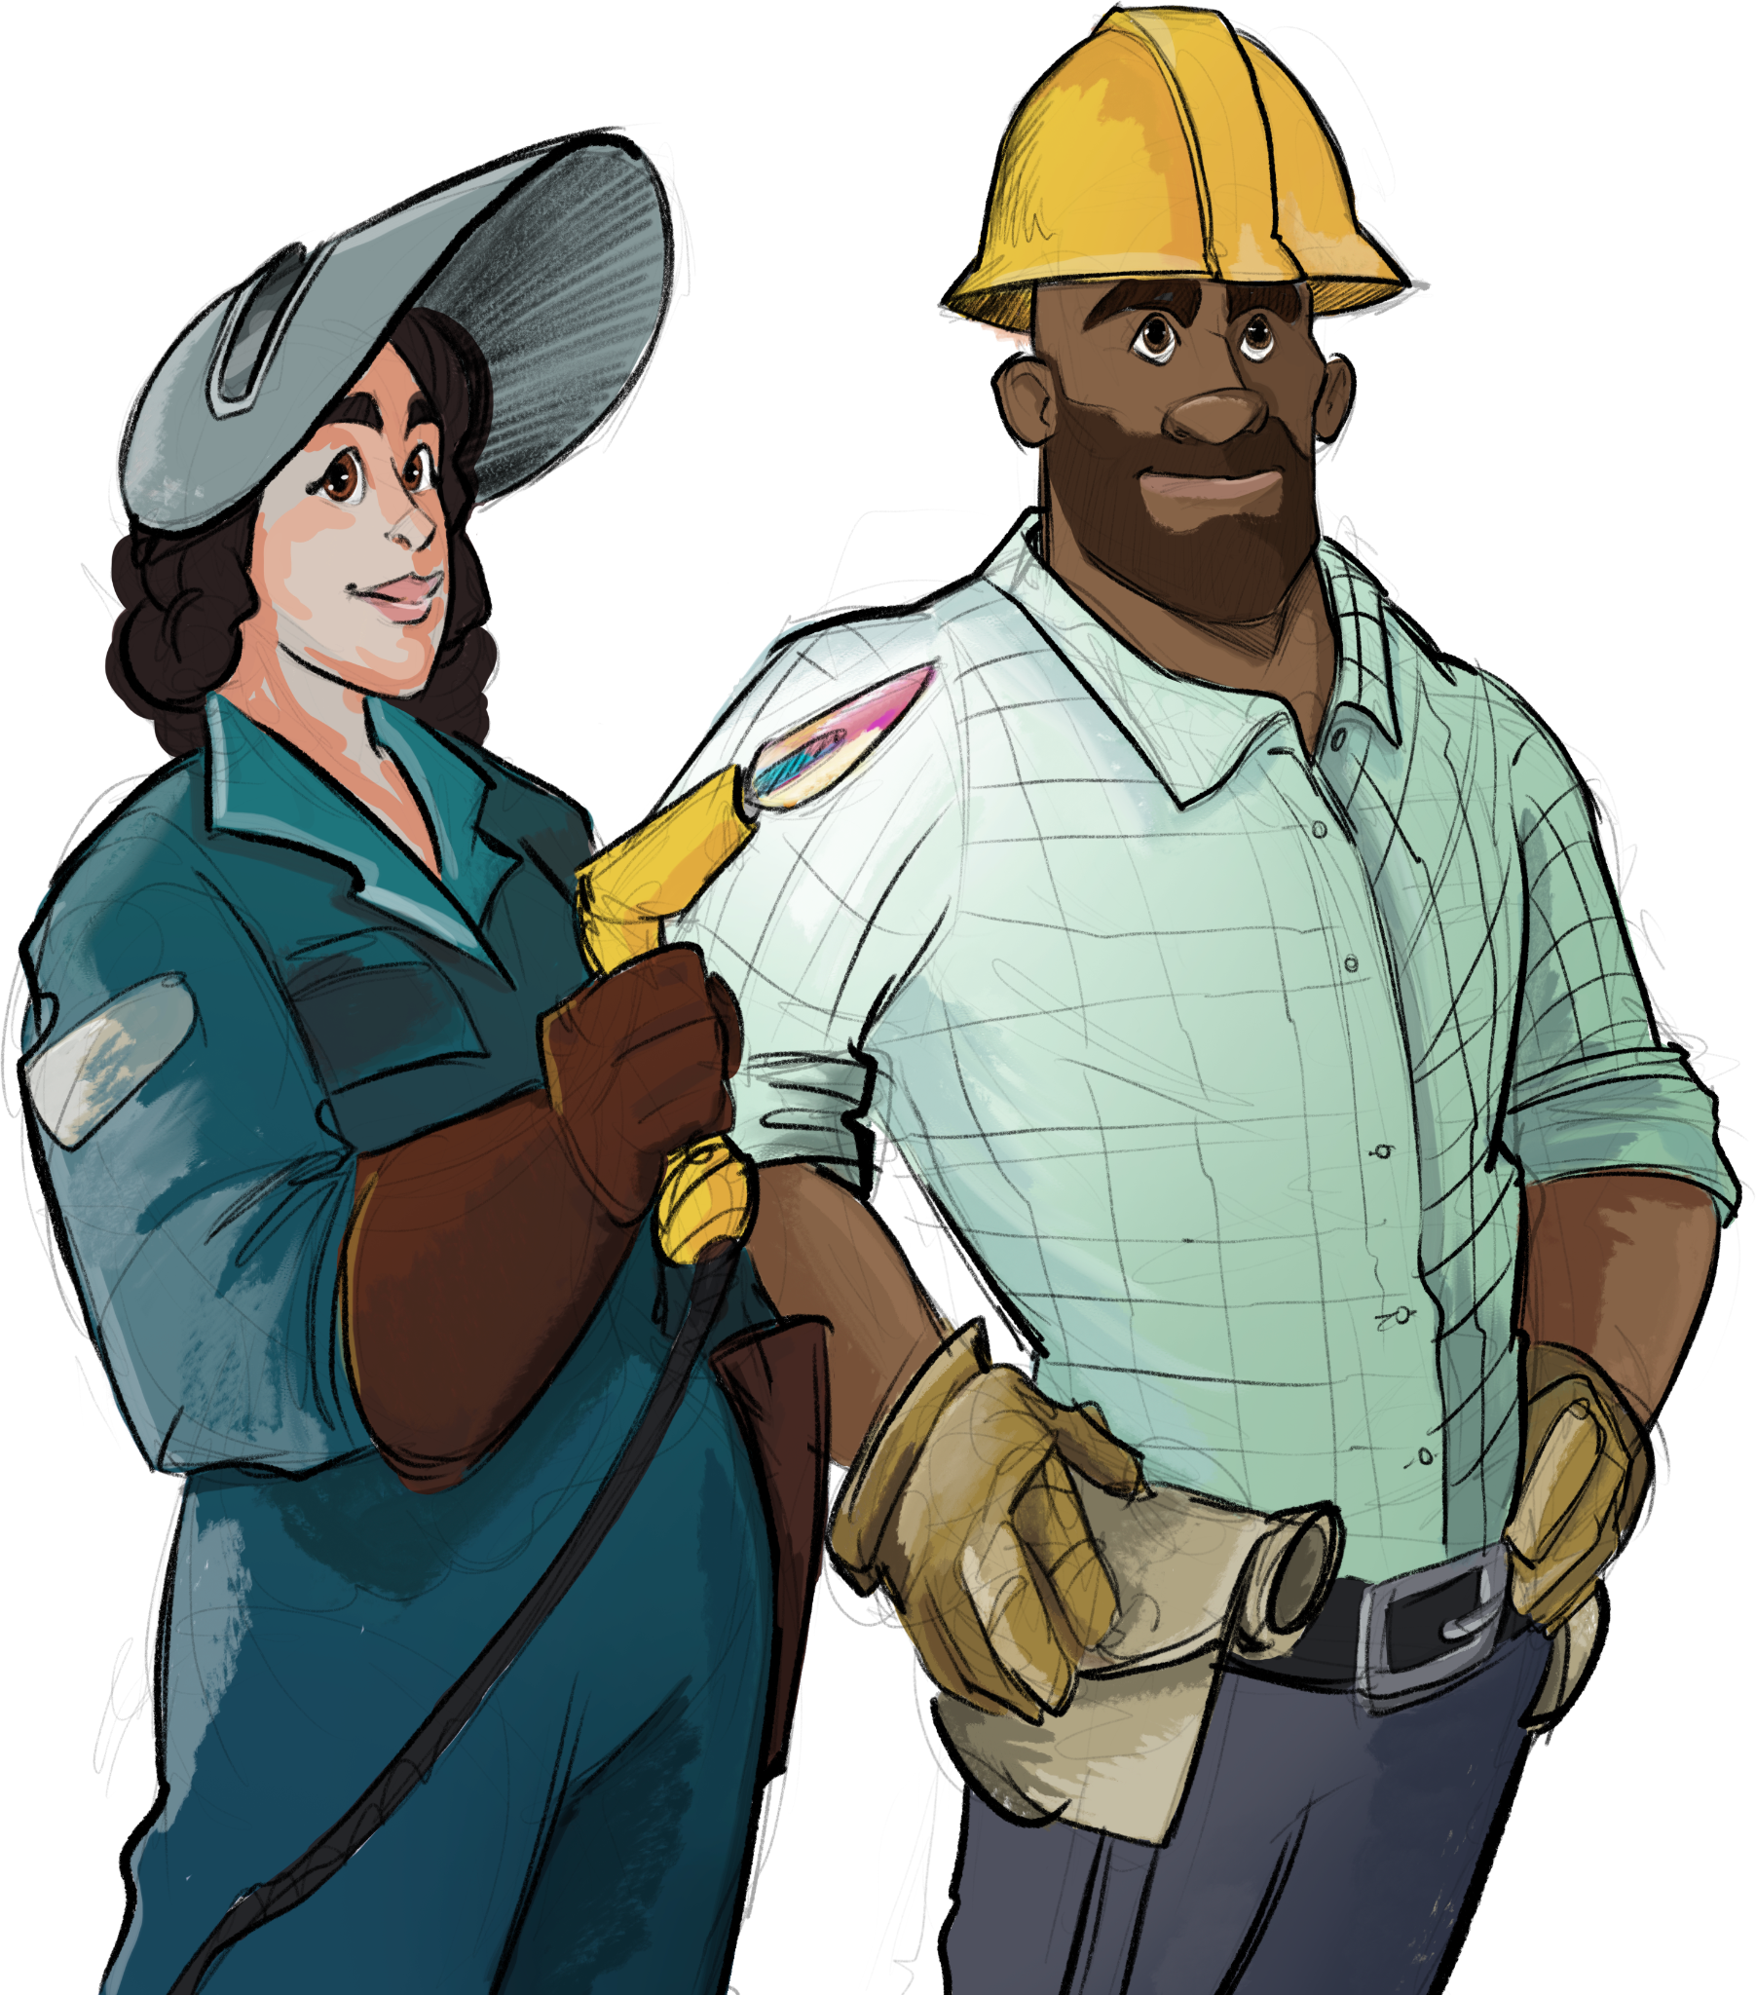
Factory Labor
Each person will have one task.
Once you complete the task, send the product down to the next person so they can complete their task.
* Your goal, as a group, is quantity.

Slide 11

Self-Employed Artists
You will work independently to assemble your shoe.
* Your goal is quality.

Slide 12

Kick20s Shoe Factory
Factory Labor
Self-Employed Artist
Each person will have one task.
Once you complete the task, send the product down to the next person so they can complete their task.
* Your goal, as a group, is quantity.
You will work independently to assemble your shoe.
* Your goal is quality.
Notes:
K20 Center. (2022, April 6). 20 minute timer [Video]. YouTube. https://www.youtube.com/watch?v=bjcwzinQlEE

Slide 13
Kick20s Shoe Factory
What are some benefits of mass producing a product?
What are some benefits of independently made products?
Are there any drawbacks to either type of production?

Slide 14

Fishbone
The effect -or- “fish head” - Industrialization transformed the United States
As you read the article, consider the factors that contributed to industrialization.
Add these causes to each of the six “fishbones.”
Notes:
K20 Center. (n.d.). Fishbone. Strategies. https://learn.k20center.ou.edu/strategy/1664

Slide 15
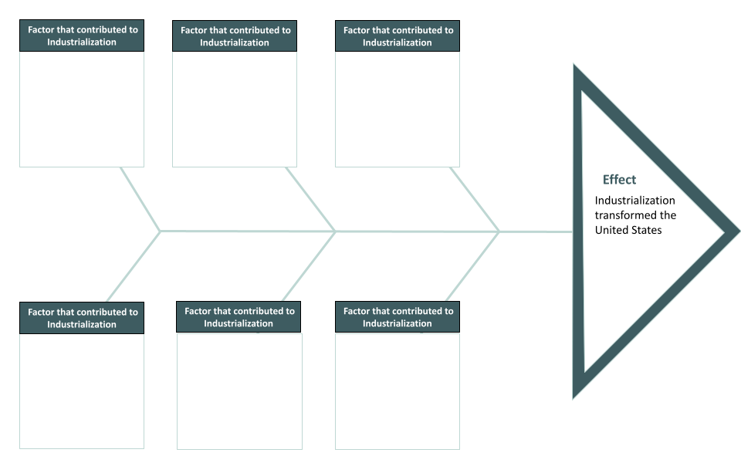
Fishbone

Slide 16
Essential Question
How do technological change and innovation impact societal change?

Slide 17
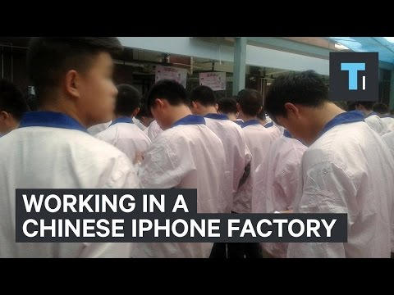
Notes:
To play the video, click the link on the slide or paste the following link into your web browser: https://www.youtube.com/watch?v=5ItLIywwepY
Video source: Insider Tech. (2017, April 20). This man worked undercover in a Chinese iPhone factory [Video]. YouTube. Retrieved February 16, 2023, from https://www.youtube.com/watch?v=5ItLIywwepY

Slide 18
Essential Question
How do technological change and innovation impact societal change?

Slide 19

3-2-1
On your completed shoe handout, answer the following questions:
What are three things you learned?
What are two questions you still have?
What is one thing you found surprising?
Notes:
K20 Center. (n.d.). 3-2-1. Strategies. https://learn.k20center.ou.edu/strategy/117

