Slide 2
5W Cube
Find your group.
Take turns rolling your group’s cube and answering the relevant questions using your favorite quote(s).
If you need help, use the Popular Quotes handout.
After choosing a quote from the handout return it to the center.
Pay attention to what words or kinds of words your group finds impactful.
Notes:
K20 Center. (n.d.). 5w cube. Strategies. https://learn.k20center.ou.edu/strategy/81

Slide 3
5W Cube
WHO is the author of your favorite quote (or something you will never forget)?
WHAT is a quote that means something to you?
WHEN do you find that quotes have the most power (or are the most memorable)?
WHERE do you often see quotes or words of wisdom?
WHY do you share or remember quotes or memes?
HOW do the words of others impact you?
K20 10-Minute Timer
Notes:
K20 Center. (n.d.). 5w cube. Strategies. https://learn.k20center.ou.edu/strategy/81
K20 Center. (2021, September 21). 10 Minute Timer. YouTube. https://youtu.be/9gy-1Z2Sa-c?feature=shared

Slide 4
Under the Bridge
Identifying Author's Purpose and Intended Response

Slide 5
Essential Question
What choices do authors make?
Why do they make them?

Slide 6
Learning Objectives
Understand the power of an author's word choice and its connection to the audience.
Identify figurative language.
Construct a deeper understanding of a text.

Slide 7
Suno
Navigate to Suno.com.
Create a free account.
Select “Create” from the left-hand menu.
In the “Song Description” box, describe which song your group wants to create using some of the mood words on your designated card.
Hit the “Create” button.
If needed, adjust your description to make the version of the song your group likes best.
Notes:
K20 Center. (n.d.). Suno. Tech tools. https://learn.k20center.ou.edu/tech-tool/3870

Slide 8
Guess the Mood
SAD Sorrowful Gloomy Heartbroken Woeful Somber Depressed | HAPPY Content Cheerful Jubilant Gleeful Joyful Jolly | JEALOUS Envious Resentful Bitter Spiteful Green Covetous | LOVING Fond Adoring Caring Passionate Affectionate Devoted | ANXIOUS Nervous Worried Concerned Apprehensive Troubled Distressed | CALM Easy Peaceful Tranquil Relaxed Quiet Serene
ANGRY Irate Annoyed Irritated Displeased Enraged Infuriated | AMUSED Entertaining Funny Comical Humorous Lighthearted Witty | EXHAUSTED Tired Weary Drained Depleted Fatigued Empty | ENERGETIC Active Lively Dynamic Spirited Vibrant Bright | SCARED Frightened Afraid Fearful Alarmed Terrified Intimidated | THANKFUL Pleased Grateful Glad Relieved Satisfied Appreciative

Slide 9
Switch It Up
Swap your mood card with another group.
Keep your song description the same but swap out the mood words.
Discuss the following with your group:
How did your song change?
What new emotions are present?
Do you like or dislike the change? Why?
Notes:
K20 Center. (n.d.). Suno. Tech tools. https://learn.k20center.ou.edu/tech-tool/3870

Slide 10
Under the Bridge
Discover Austin
Credit Christopher Sherman.
Notes:
Bat watching in Austin: Visit Austin, TX. (n.d.). Visit Austin. https://www.austintexas.org/things-to-do/outdoors/bat-watching/
Discover Austin with Craig Smyser. (2019, April 18). Discover Austin: The Bats - Episode 41. YouTube. https://youtu.be/ubJKkAWKGfA?si=-H14J25fS20vLZS2

Slide 11
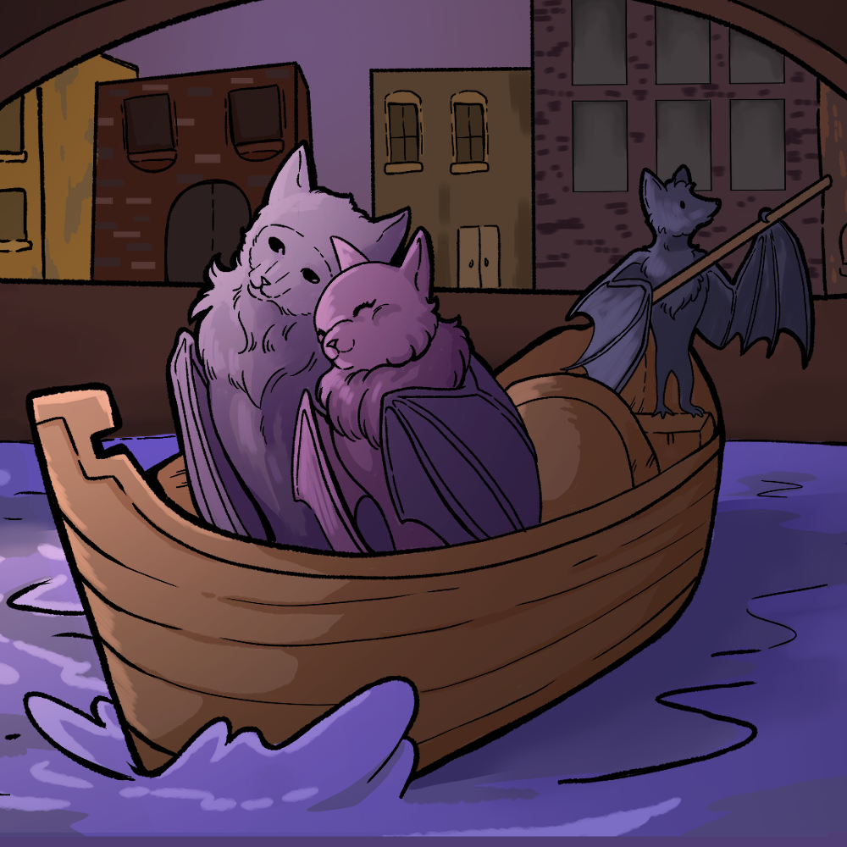
Categorical Highlighting
As we read and analyze the first paragraph in “In Praise of Bats,” highlight the following elements with a different color or underline:
Similes and metaphors.
Words or phrases that create imagery.
Personification of the bat.
Alliteration.
Notes:
K20 Center. (n.d.). Categorical highlighting. Strategies. https://learn.k20center.ou.edu/strategy/192

Slide 12
“In Praise of Bats” by Diane Ackerman
“What’s the best way to show affection to a bat?” I asked Tuttle, who carefully considered the question, then said, “I’m not even sure I know the best way to show affection to a person.” Laughs went around the room. Margaret Perry suggested petting him in the direction the fur grew right behind the neck. Lifting Zuri onto one finger, I petted his soft neck, and then we put him back in the cage. At once he scuttled over to Rafiki, snuggled rump to rump, and when settled, he began a long, thorough cleaning of his wings, chest, and body, licking methodically like a cat, to get rid of the minute oils, salt, perfume, and human essence he found on me. It was obvious that he felt dirtied. He washed up slowly, good-naturedly eyeing us, then closed his eyes and began to doze. After all, it was sleep time for bats. Nonetheless, when anyone drew near, he opened one eye and peeked out over his arm to see who was there.
Notes:
Source: Ackerman, D. (1992). “In Praise of Bats.” The Moon by Whale Light. NY: Vintage Books.

Slide 13
“In Praise of Bats” by Diane Ackerman
“What’s the best way to show affection to a bat?” I asked Tuttle, who carefully considered the question, then said, “I’m not even sure I know the best way to show affection to a person.” Laughs went around the room. Margaret Perry suggested petting him in the direction the fur grew right behind the neck. Lifting Zuri onto one finger, I petted his soft neck, and then we put him back in the cage. At once he scuttled over to Rafiki, snuggled rump to rump, and when settled, he began a long, thorough cleaning of his wings, chest, and body, licking methodically like a cat, to get rid of the minute oils, salt, perfume, and human essence he found on me. It was obvious that he felt dirtied. He washed up slowly, good-naturedly eyeing us, then closed his eyes and began to doze. After all, it was sleep time for bats. Nonetheless, when anyone drew
near, he opened one eye and peeked out over his arm to see who was there.
Notes:
Source: Ackerman, D. (1992). “In Praise of Bats.” The Moon by Whale Light. NY: Vintage Books.

Slide 14
Categorical Highlighting
As we read and analyze the second paragraph in “In Praise of Bats,” highlight the following elements:
Similes and metaphors.
Words or phrases that create imagery.
Personification of the bat.
Alliteration .
Notes:
K20 Center. (n.d.). Categorical highlighting. Strategies. https://learn.k20center.ou.edu/strategy/192

Slide 15
At dinnertime, Tuttle and I tried the patio of the Four Seasons Hotel downtown, on the Colorado River, a few blocks from the pink-granite capitol building and right across from the Congress Avenue Bridge. We had not come for the margaritas or the lobster enchiladas but to watch the emergence as dazzling as the one we had seen at Bracken Cave. Tucked inside the crevices under the bridge were three quarters of a million bachelor free-tailed bats. They made Austin the summer home of the largest urban bat population in the world. As the sun ladled thick pastels into the river, two crew boats pulled gently, side by side. Could they see the bats when they passed under the bridge, I wondered? Sweethearts had begun to stroll across the bridge hand in hand, waiting for the emergence. Sodium lights from the Hyatt Hotel cast a trail of copper coins across the water. Suddenly, smoke billowed from underneath the bridge. No, not smoke but a column of bats. Then two columns soared high and flew in parallel, like the long black reins of an invisible sleigh. Bats kept surging out, and soon four columns stretched miles across the sky. A few strays looped and fed near us, passing like shuttles through the weave of the trees. The night was noticeably free from insects, but that was no surprise. These bats would eat five thousand pounds of insects that one night alone.
Notes:
Source: Ackerman, D. (1992). “In Praise of Bats.” The Moon by Whale Light. NY: Vintage Books.

Slide 16
Categorical Highlighting
As we read and analyze the third paragraph in “In Praise of Bats,” highlight the following elements:
Similes and metaphors.
Words or phrases that create imagery.
Personification of the bat.
Alliteration.
Notes:
K20 Center. (n.d.). Categorical highlighting. Strategies. https://learn.k20center.ou.edu/strategy/192

Slide 17
In Praise of Bats by Diane Ackerman
In a medieval simile of the Venerable Bede’s, life is depicted as a beautiful and strange winged creature that appears at a window, flies swiftly through the half-lit banquet hall, and is gone. That seems about right for a vision of creation as beautiful as this one was, which soon included the city lights, the sunset doing a shadow dance over the water, and four columns of bats undulating across the sky.
Notes:
Source: Ackerman, D. (1992). “In Praise of Bats.” The Moon by Whale Light. NY: Vintage Books.

Slide 18
Discussion Questions
Are bats usually seen as pets?
Why is this abnormal?
Do people generally think bats are romantic?
Why does this event seem romantic?
What does this event have to do with the main idea from the last paragraph?
What could these ideas reveal about the author’s purpose?

Slide 19
“In Praise Of”
Pick an object that isn’t normally admired. Consider everyday items or unusual objects that may not receive enough praise.
Examples: a pair of socks, a favorite ink pen, a threadbare t-shirt
Describe the object as if you were writing about someone you deeply admire. Consider the following questions:
What qualities make this object special?
How can you use figurative language (metaphors, similes, personification) to elevate it?
What emotions does the object evoke in you?
What memories or feelings does it remind you of?

Slide 20
“In Praise Of”
3. Compose a paragraph of 5–7 sentences praising your chosen object.
Capture a sense of love, beauty, or admiration, even if the object itself seems unworthy of such praise.
Add sensory details: sight, sound, touch, smell, etc.
Remember: Describe the object as if you were writing about someone you deeply admire.
What qualities make this object special?
How can you use figurative language to elevate it?
What emotions does the object evoke in you?
What memories or feelings does it remind you of?

Slide 21
I Used to Think… But Now I Know
Divide a piece of paper into two columns.
Write the headings "I Used to Think..." on the left side and "But Now I Know" on the right.
Reflect on what you know about how an author creates purpose through their text by completing the left side of the table.
Notes:
K20 Center. (n.d.). I used to think . . . but now I know. Strategies. https://learn.k20center.ou.edu/strategy/137

Slide 22
K20 ICAP - Writing with Purpose
Notes:
K20 Center. (2024, October 23). K20 ICAP - Writing with Purpose (with Prof. Rilla Askew) [Video]. YouYube. https://www.youtube.com/watch?v=ZHwhQJAfWwM

Slide 23
I Used to Think… But Now I Know
After watching the interview, reflect on the writing process and how an author creates purpose again, completing the right side of the column with your thoughts.
Notes:
K20 Center. (n.d.). I used to think . . . but now I know. Strategies. https://learn.k20center.ou.edu/strategy/137

Slide 24
Elevator Speech
Read “Heaven and Earth in Jest.”
Highlight examples of the author’s choices like we did before.
Reflect on the following questions:
What is the text’s deeper meaning?
What choices did the author make to create the meaning?
How does the text connect with you?
Notes:
K20 Center. (n.d.). Elevator speech. Strategies. https://learn.k20center.ou.edu/strategy/57

Slide 25
Elevator Speech
4. Write down all of your ideas to the following questions:
What is the text’s deeper meaning?
What choices did the author make to create the meaning?
How does the text connect with me?
5. Cut out any unnecessary details and flesh out remaining
ideas.
6. Connect your thoughts with transition words. Try for
8-10 sentences or 3 minutes.
7. Practice your speech!
Notes:
K20 Center. (n.d.). Elevator speech. Strategies. https://learn.k20center.ou.edu/strategy/57

Slide 26
Elevator Speech + Padlet
Access our Padlet by scanning the QR code or typing in…
Upload your video to Padlet.
Notes:
K20 Center. (n.d.). Canva. Tech tools. https://learn.k20center.ou.edu/tech-tool/612
K20 Center. (n.d.). Elevator speech. Strategies. https://learn.k20center.ou.edu/strategy/57
K20 Center. (n.d.). Padlet. Tech tools. https://learn.k20center.ou.edu/tech-tool/1077

Slide 27
Video in Padlet
Select the “+12” button on the right side of the post box. This will show all options for attachment types.
Select the “Video recorder” option. Record a video up to two minutes long.
Make sure you have the correct camera and microphone options at the bottom of the window.
Select the camera icon at the bottom of the window when you are ready to record.
When your video is ready, select the “Playback and save” button in the top right corner of the window. Then select “Save” again.
Add a “Subject” then hit “Publish.”
Notes:
K20 Center. (n.d.). Video in Padlet. Tech tools. https://learn.k20center.ou.edu/tech-tool/4077

