Slide 2
Location Matters: The Geography of Business
Importance of Location in Industry

Slide 3
Essential Questions
How does Least Cost Theory influence industrialization?
How can location create economic (dis)advantages for companies and surrounding communities?

Slide 4
Lesson Objectives
Explain how businesses utilize Least Cost Theory to maximize profits and expand their economic influence.
Describe how a location can provide advantages or disadvantages for businesses and industries.

Slide 5
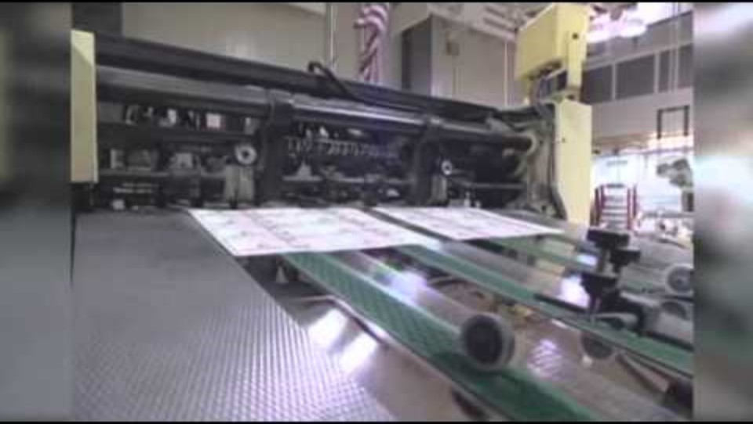
Job Outsourcing
Why It Matters: Outsourcing Jobs
Notes:
Associated Press. (2012, October 24). Why it matters: outsourcing jobs. [Video]. YouTube. https://youtu.be/ymT1W-g_FCY?si=9qZw1xXAeBlNbTpp

Slide 6
Video Reflection
What are some examples of how job outsourcing can impact the global economy?
Why do companies outsource jobs?
What are some potential solutions for countries to prevent companies from outsourcing jobs abroad?

Slide 7
Huffman Company T-Chart
Fold your paper in half, lengthwise.
Label each column:
Helped the Huffman Company
Hindered the Huffman Company
Helped the Huffman Company | Hindered the Huffman Company
Notes:
K20 Center. (n.d.). T-chart. Strategies. Retrieved from https://learn.k20center.ou.edu/strategy/86

Slide 8
Huffman Company T-Chart
As you read about Huffy bikes, decide which factors contributed to the growth or downfall of the Huffman Company.
Record each factor under the corresponding column.
Helped the Huffman Company | Hindered the Huffman Company
Notes:
K20 Center. (n.d.). T-chart. Strategies. Retrieved from https://learn.k20center.ou.edu/strategy/86

Slide 9
Mentimeter
Access menti.com or scan QR code
Type in code: ___
Answer the following: Was location a factor that helped or hindered the Huffman Company?
Be prepared to share your reasoning.
Notes:
K20 Center. (n.d.). Mentimeter. Tech Tools. https://learn.k20center.ou.edu/tech-tool/645

Slide 10
Least Cost Theory
Labor: A location is chosen because of the workforce nearby. This can be either cheap labor or highly skilled labor.
Agglomeration of Economies: The location has other industries nearby that helps a company to grow.
Transportation: The location supports keeping transportation costs low.

Slide 11
Huffy Bicycles: Revisited
Reread the story about Huffy Bicycles.
As you read, fill in the 3rd column by writing examples for each factor.

Slide 12
Braum’s Corporation
Read the story about Braum’s Corporation.
As you read, fill in the 4th column by writing examples for each factor.

Slide 13
Choice Board
Location matters! Explore different ways Least Cost Theory can be used to understand the uneven distribution of industries.
Choose 1 of the following options.
Option 1: Business Memo
Option 2: Hometown Advertisement
Option 3: Research a Modern Company
Use the suggested templates or “Least Cost Research Organizer” to complete the activity.
Notes:
K20 Center. (n.d.). Choice boards. Strategies. Retrieved from https://learn.k20center.ou.edu/strategy/73

Slide 14
Quick Write
Write non-stop for 2-3 minutes on the prompt provided:
How does least cost theory influence industrialization?
How can location create economic (dis)advantages for companies and surrounding communities?
Notes:
K20 Center. (n.d.). Quick write. Strategies. https://learn.k20center.ou.edu/strategy/1127

