Slide 2
The New Colossus
ELA 7th or 8th Grade

Slide 3
Essential Questions:
How does the text inform us of the author's perspective?
What is the poem's message about the Statue of Liberty?

Slide 4
Collective Brain Dump activity
With your group, brainstorm everything you know about the Statue of Liberty.
You have five minutes.
Online Timer
Online stopwatch (n.d.) Online stopwatch.com Retrieved from https://www.online-stopwatch.com/
Notes:
https://www.online-stopwatch.com/

Slide 5
Vocabulary Builder Activity
Identify seven unfamiliar words in the poem.
Using the poem’s phrases as clues, try to predict what these words mean.
Look up the meaning to see if your prediction matches.

Slide 6
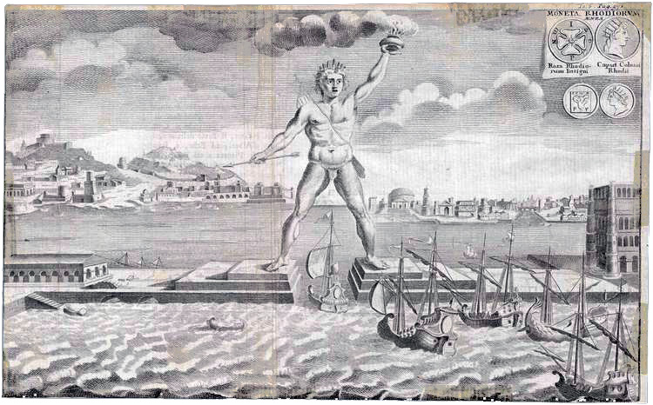
The First “Colossus”
Colossus of Rhodes built in 280 BC
Stood in the harbor of Rhodes so that ships could only enter through its feet
Constructed to celebrate a military victory over Cyprus
The same height as the Statue of Liberty
Considered one of the seven wonders of the ancient world
Image source: File: Colossus of Rhodes 1745.jpg. (n.d.). In Wikimedia commons. Retrieved from https://commons.wikimedia.org/wiki/File:Colossus_of_Rhodes_1745.jpg
Notes:
Image source: Colossus of Rhodes Wikimedia.

Slide 7
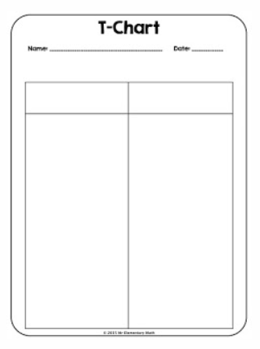
T-Chart
Look for positive words or phrases in the poem.
Look for negative words or phrases in the poem.
Write these in the appropriate column on the T-Chart.
Image source: How to use t charts in math vlass. (n.d.). Retrieved from http://whoswhoandnew.blogspot.com/2015/08/how-to-use-t-charts-in-math-class.html

Slide 8
T Chart Summary
Create a group summary of the poem and its meaning.
Include:
What is the author’s viewpoint of the Statue of Liberty?
What is the author’s viewpoint of new immigrants coming to the U.S.?

Slide 9
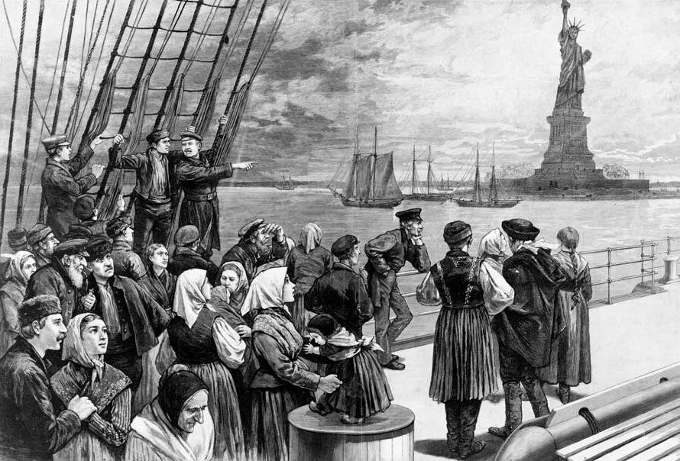
Wordle activity
Imagine you are a new immigrant to the U.S.
Think about your thoughts coming to a new country and entering New York harbor. Your first sight is the Statue of Liberty.
Jot down one or two words about your thoughts or feelings.
Source: Welcome to the land of freedom (1187). Image. Wikimedia commons. Retrieved from: https://commons.wikimedia.org/wiki/File:Welcome_to_the_land_of_freedom.png

Slide 10
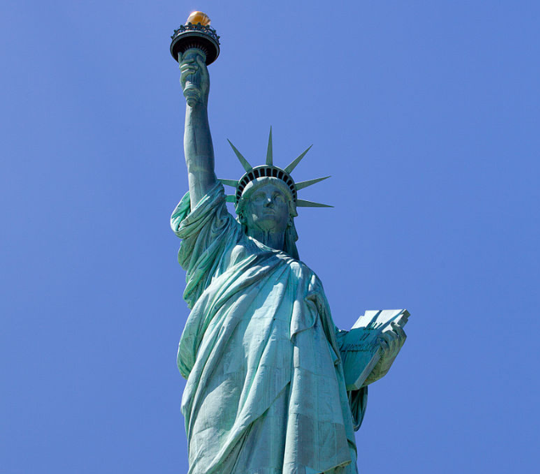
Essay
OPTIONAL
Imagine yourself as a newly-arrived immigrant entering New York Harbor. You see the Statue of Liberty for the first time.
What are your thoughts and feelings?
What are the sights, smells, and sounds you are experiencing?
Write about your experience.
Image source: File: Statue-of-liberty.jpg. (n.d.). In Wikimedia commons.
Retrieved from https://commons.wikimedia.org/wiki/File:Statue-Of-Liberty.jpg

