Slide 2
The New Colossus
ELA 7th or 8th Grade

Slide 3
Essential Questions
How does the text inform us of the author's perspective?
What is the poem's message about the Statue of Liberty?

Slide 4

Collective Brain Dump activity
With your group, brainstorm everything you know about the Statue of Liberty.
You have five minutes.
Timer
Notes:
https://timer.k20center.ou.edu/

Slide 5


Vocabulary Builder Activity
Identify seven unfamiliar words in the poem.
Using the poem’s phrases as clues, try to predict what these words mean.
Look up the meaning to see if your prediction matches.

Slide 6
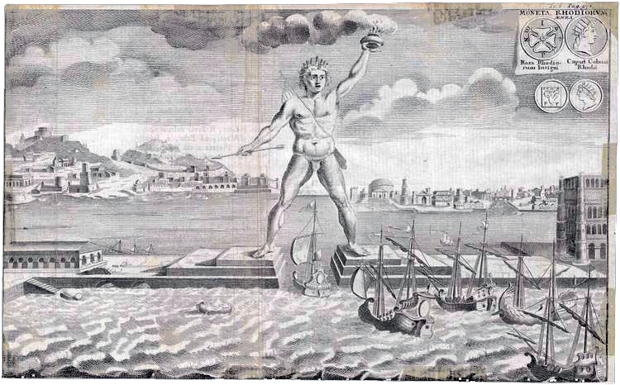
The First
“Colossus”
The Colossus of Rhodes was built in 280 BC.
It stood in the harbor of Rhodes so that ships could only enter through its feet.
It was constructed to celebrate a military victory over Cyprus.
It was the same height as the Statue of Liberty.
It is considered one of the seven wonders of the ancient world.
Notes:
Image source: File: Colossus of Rhodes 1745.jpg. (n.d.). In Wikimedia commons.
Retrieved from https://commons.wikimedia.org/wiki/File:Colossus_of_Rhodes_1745.jpg

Slide 7
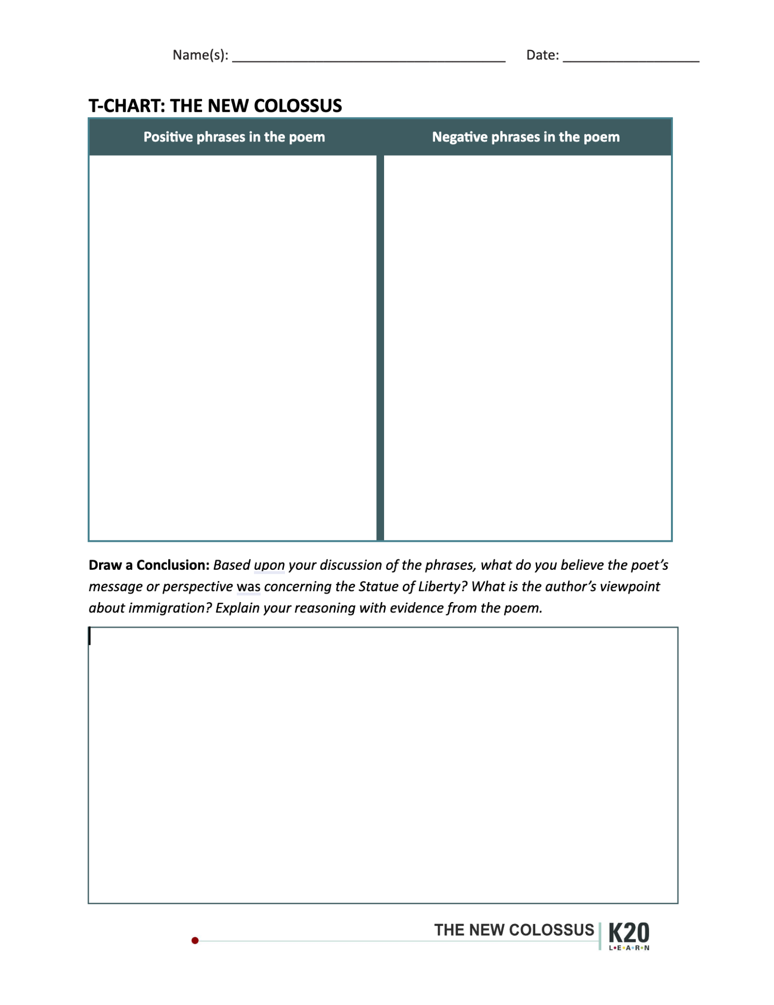
T-Chart
Look for positive words or phrases in the poem.
Look for negative words or phrases in the poem.
Write these in the appropriate columns on the T-Chart.

Slide 8
T-Chart Summary
Create a group summary of the poem and its meaning.
Include:
What is the author’s viewpoint of the Statue of Liberty?
What is the author’s viewpoint of new immigrants coming to the U.S.?

Slide 9
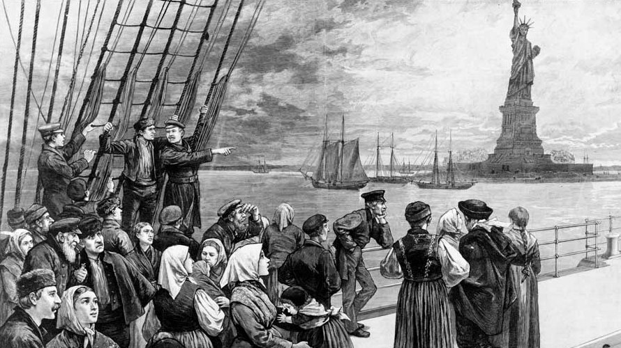
Imagine you are a new immigrant to the U.S.
What are your thoughts coming to a new country and entering New York harbor? Your first sight is the Statue of Liberty.
Jot down one or two words about your thoughts or feelings.
Notes:
Wordle Activity
Source: Welcome to the land of freedom (1187). Image. Wikimedia commons. Retrieved from: https://commons.wikimedia.org/wiki/File:Welcome_to_the_land_of_freedom.png

Slide 10

Immigrants at Ellis Island
Notes:
https://www.youtube.com/watch?v=bDNKHWzQiz8

Slide 11

Statue of Liberty 4k Drone
Notes:
https://www.youtube.com/watch?v=gLoT9OD_0cw

Slide 12
Letter to Your Home Country
Letters should include the following:
At least 300 words;
At least 3 words from the Vocabulary Builder;
At least 5 words that have a clear positive or negative connotation;
At least 3 details from the videos;
A greeting and a closing.

Slide 13
Letter Review
Circle the words used from the Vocabulary builder.
Highlight the words that have a clear positive or negative connotation and write in the margin which they are (positive or negative).
Underline the details used from the video.

