Slide 2
Rikki-Tikki-Types of Sentences
7th and 8th Grade ELA

Slide 3
Essential Questions
How do punctuation and sentence mood convey meaning to the reader?
What are indicative, imperative, and interrogative sentences?

Slide 4

Think-Pair-Share
What feeling does this emoji convey?
Source: Smiley emjoi (2019). Pixabay.com. Retrieved from
https://pixabay.com/illustrations/emoticon-emoji-smile-happy-1610573/
Notes:
Source: Smiley emjoi (2019). Pixabay.com. Retrieved from: https://pixabay.com/illustrations/emoticon-emoji-smile-happy-1610573/

Slide 5
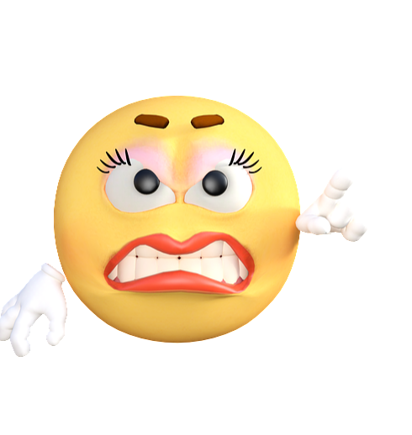
Think-Pair-Share
What feeling does this emoji convey?
Emoticon angry emoji (2019). Pixabay.com Retrieved from
https://pixabay.com/illustrations/emoticon-emoji-angry-cartoon-1659234/
Notes:
Emoticon angry emoji (2019). Pixabay.com Retrieved from: https://pixabay.com/illustrations/emoticon-emoji-angry-cartoon-1659234/

Slide 6

Think-Pair-Share
What feeling does this emoji convey?
Question mark emoji clip art (n.d.) Wikiclipart.com. Retrieved from
https://wikiclipart.com/question-mark-clipart_3756/
Notes:
Question mark emoji clip art (n.d.) Wikiclipart.com Retrieved from https://wikiclipart.com/question-mark-clipart_3756/

Slide 7
Sentence Moods
Imperative Sentences | Indicative Sentences | Interrogative Sentences
Makes a request or command Sentence may end with a period or an exclamation point The subject of the sentence is (you) although it is not always stated | Makes a factual statement Sentence ends in a period or an exclamation point | Asks a question Sentence ends in a question mark (?)

Slide 8
Matching
Match the sentences that best fit with each emoji and its mood type.
Be prepared to share your reasoning.

Slide 9



INDICATIVE MOOD | IMPERATIVE MOOD | INTERROGATIVE MOOD
It’s a great day for a movie. I’m satisfied with that grade. You are a good friend. I will be back soon. Today is so cool! | You better do as I say! Please get me some water. Get back in line! Come back here. Please listen. | What were you thinking about just now? Where are you going? When will I study for that test?

Slide 10

Labeling Activity
Look at the underlined sentences from the story, “Rikki-Tikki-Tavi.”
Label each underlined sentence on your notebook paper as imperative, interrogative, or indicative.
This Photo by Unknown Author is licensed under CC BY-SA

Slide 11
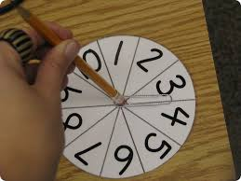
Let’s Spin-A-Sentence
With your group:
Part I—Create three sentences together.
Part II—Play the game according to the directions on the student handout.

