Slide 2
IF I HAD…
Conditional and Subjunctive Sentences
7th and 8th Grade ELA

Slide 4
Guiding Questions
What is the difference between subjunctive mood and conditional mood in sentences?
How are conditional and subjunctive moods used in sentences?

Slide 5
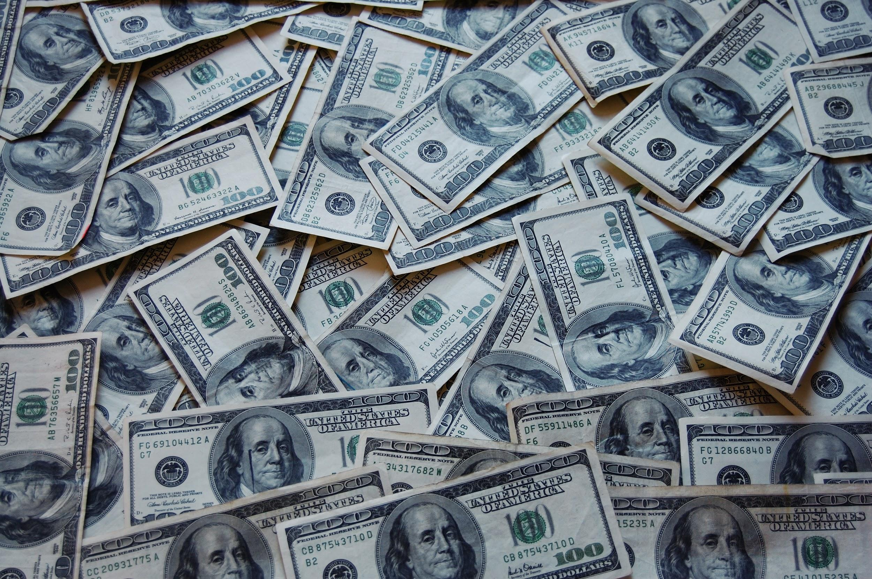
If I Had $1,000,000
Notes:
Timer is on the next slide.

Slide 6
Focused Free-Write
On a sheet of notebook paper:
Write for five minutes about how you would spend one million dollars.
Notes:
Timer is on the next slide.

Slide 7
Free Write Activity
How would you spend a million dollars?
Notes:
https://drive.google.com/file/d/17lldEYAq6c4iROLwWlDBqzhbunv-QZIU/view

Slide 8
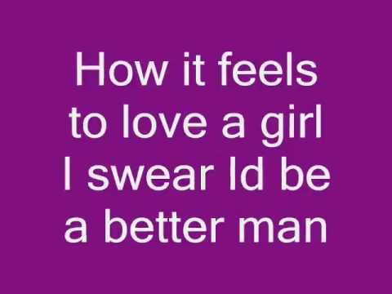
Beyonce: If I Were a Boy
Source: cute21ella. (2008, October 17). Beyonce-If I were a boy(lyrics). Retrieved from http://www.youtube.com/watch?v=Pd6FXOTapMM.
Notes:
http://www.youtube.com/watch?v=Pd6FXOTapMM
:46-1:05 Beyonce If were a boy is subjunctive mood.

Slide 9
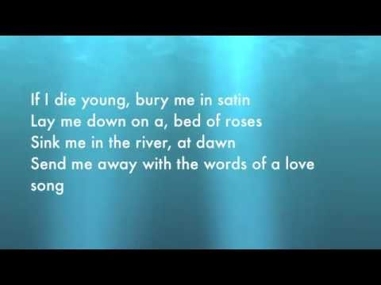
The Band Perry: If I Die Young
Source: Rollo, G. (2010, October 17). If i die young-The Band Perry (LYRICS). Retrieved from http://www.youtube.com/watch?v=c0iEj7alzAI..
Notes:
http://www.youtube.com/watch?v=c0iEj7alzAI
:08-:22 Conditional mood because it is possible to die young and be buried in satin.

Slide 10
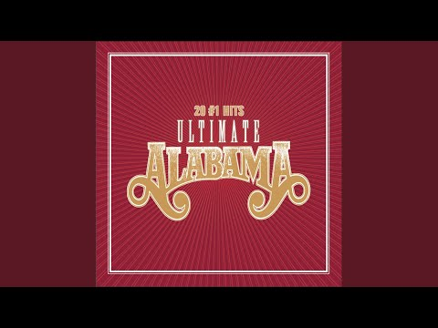
Alabama: If You’re Gonna Play in Texas
Source: Band, A. (2017, February 19). If You're Gonna Play in Texas (You Gotta Have a Fiddle in the Band). Retrieved from http://www.youtube.com/watch?v=6Recfoa0_9k.
Notes:
http://www.youtube.com/watch?v=6Recfoa0_9k
:05-:10 Conditional

Slide 11
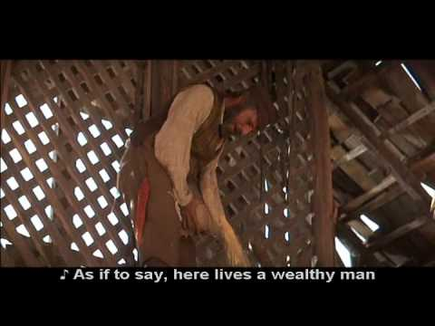
“Fiddler On the Roof”: If I Were a Rich Man
Source: guru006. (2006, August 19). Fiddler on the roof - If I were a rich man (with subtitles). Retrieved from http://www.youtube.com/watch?v=RBHZFYpQ6nc.
Notes:
http://www.youtube.com/watch?v=RBHZFYpQ6nc
Subjunctive

Slide 12
Cyndi Lauper: Time After Time
Source: Rnk5918, J. S. (2010, June 20). time after time (lyrics) by cyndi lauper ft. sarah mclachlan. Retrieved from http://www.youtube.com/watch?v=JZwwT2gXBVY.
Notes:
http://www.youtube.com/watch?v=JZwwT2gXBVY

Slide 13
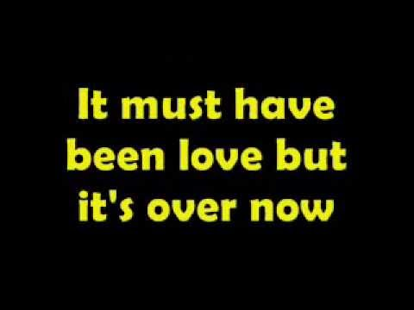
Roxette: It Must Have Been Love
Source: epchaniago. (2013, September 16). It Must Have Been Love Lyrics On Screen by Roxette. Retrieved from http://www.youtube.com/watch?v=rZ76eAYhNGE.
Notes:
http://www.youtube.com/watch?v=rZ76eAYhNGE

Slide 14
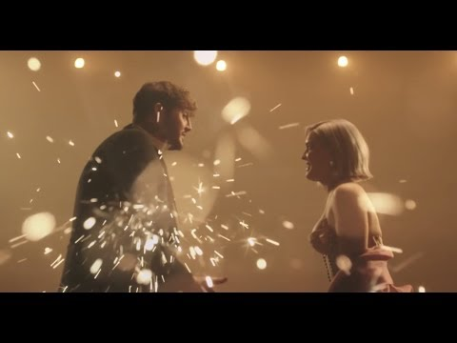
James Arthur & Anne-Marie: What If We Rewrite The Stars
Source: Anne-Marie. (2018, November 16). Anne-Marie & James Arthur - Rewrite The Stars [from The Greatest Showman: Reimagined]. Retrieved from http://www.youtube.com/watch?v=pRfmrE0ToTo.
Notes:
http://www.youtube.com/watch?v=pRfmrE0ToTo

Slide 16
Card Sort Activity
Look for patterns in the sentences that suggest one group of sentences is different from another.
With your partner, discuss what differences you notice.
Sort the sentences into two groups.

Slide 17
Conditional Mood
IF
THEN
Indicates a conditional state that will cause something else to happen (something has to happen before something else can happen).
Word Clues:
If
May, Might
Can, Could
Will, Would
Example: If I can get tickets, I will go to the concert.

Slide 18
Subjunctive Mood
Indicates a wish, a command, a suggestion, or condition that is contrary to or doubtful of the facts.
Verb Clues:
I wish
If I were
If I had
It must be
Would have
It may be
Example: If I were him, I would have gone to the concert.

Slide 19
Card Sort Check
Conditional Mood Sentences
If I die young, bury me in satin.
I’ll buy you a diamond ring my friend, if it makes you feel alright.
If you could only see the way she loves me, then maybe you would understand.
If it makes you happy, then it can’t be that bad.
If you’re lost, you can look, and you will find me, time after time.

Slide 20
Card Sort Check
Subjunctive Mood Sentences
If I had a million dollars, I would buy you a house.
If I were a boy, I would chase after girls.
If I were a rich man, then I would have all the money in the world.
It must have been love, but it’s over now.
I won’t give up on us, even if the skies get rough.

Slide 22
Which is subjunctive? Which is conditional?
If you ate fruits and vegetables, you would be healthier.
If she had loved me more, we would have still been together.
Notes:
Which is conditional and which is subjunctive?

Slide 23
Can you tell the difference?
If you ate fruits and vegetables, you would be healthier.
Conditional
Something has to happen first before the second thing can happen.
This could really happen.
If she had loved me more, we would have still been together.
Subjunctive
This is a wish that is doubtful of the facts or hypothetical.
Uses verbs like “might have been” or “would have been” or “will be”.
Notes:
Which is conditional and which is subjunctive?

Slide 24
Partner Work
Work together to complete the handout.
Raise your hand if you have questions or need assistance.

Slide 26
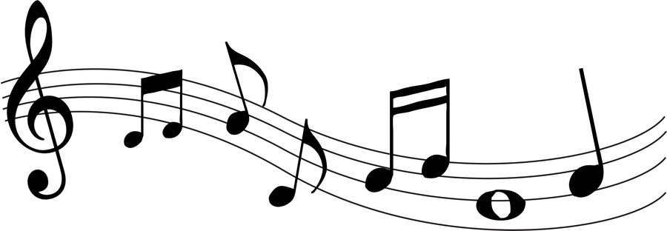
If I Had a Million Dollars...
Create a song verse from your earlier free write.
Include at least one subjunctive mood sentence in your verse.
Include at least one conditional mood sentence in your verse.
This Photo by Unknown Author is licensed under CC BY

Slide 28
Chant It, Sing It, Rap It
Combine your group’s verses to create a hit song.
Create a group melody to sing together or create a rap to present to the class.
This Photo by Unknown Author is licensed under CC BY

