Slide 2
Walking the Line: The Math Spectrum
Mathematics, Grades 6–12

Slide 3
Essential Questions:
What is the relationship between students’ mathematical knowledge and their perception of mathematics?
How can this perception be used to develop a growth mindset?

Slide 5
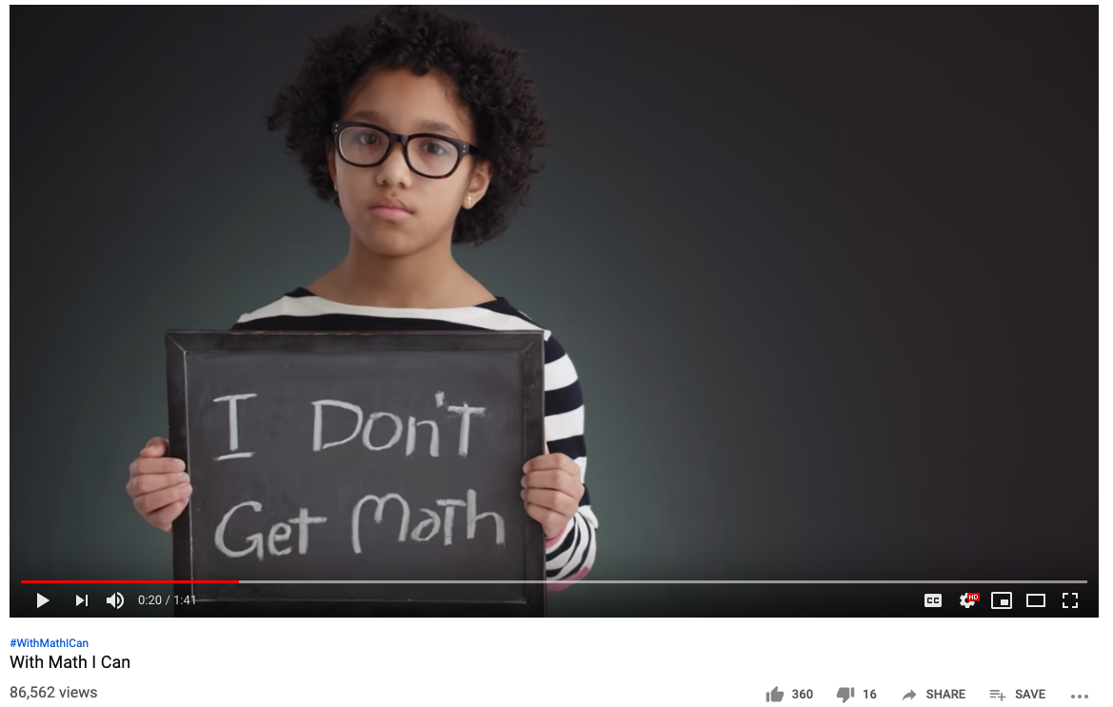
With Math I Can...
Notes:
https://youtu.be/sLPFaOvhlKw

Slide 6
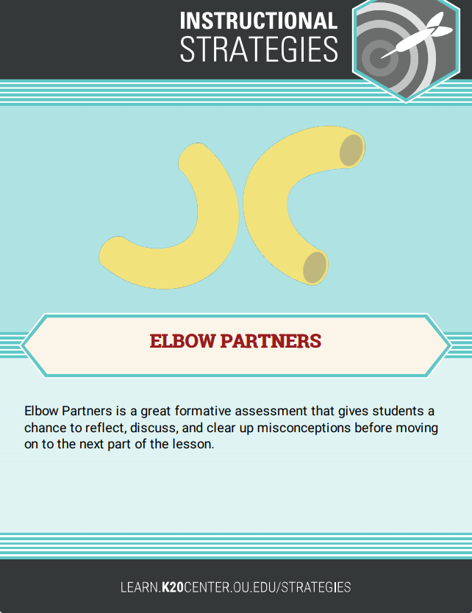
Video Reflection
Take a moment to talk to your elbow partner and reflect on the video.
What did you like about the video?
What did you not like about the video?
What one takeaway that really caught your attention?

Slide 7
How much math do you know?
Take a sticky note and place it on the Math Spectrum Line:
Far Left =
No Knowledge
Far Right =
Math Expert

Slide 9
Let the Research Begin!
Individually, start to list every math concept you remember learning. They can be from elementary school up to today.
Pick two math topics and start researching the material using the Math Concepts handout.
Note: You will be presenting this to a peer, so be sure to write as much detail as you can!

Slide 11
Let Your Knowledge Be Known!
Find a partner who did not research the same topic you did.
Present to your partner what you researched and what new knowledge you gained.
After each person has presented, write how your two topics are connected in a summary statement.

Slide 12
Notes:
Brittany and Amber

Slide 13
How much math do you know NOW?
Take your sticky note and change your position on the math spectrum line after hearing the presentations if you feel like you know more math than you thought!
Far Left =
No Knowledge
Far Right =
Math Expert

Slide 14
In order to see, you must have a vision!
Think back to last year. Write down successes and failures on the Math Goals Sheet.
Once you have reflected on the previous year, decide on your new goals to make this year successful!

Slide 15
Breaking Down Barriers
Going back to the Goal Sheet, were there any barriers that kept you from performing at your best?
Example: Fear of Failure. “My family is not good at math, so I am not good at math.”
Write down your barriers on a separate piece of paper.
Does anyone want to share out a barrier?

Slide 16
Breaking Down Barriers.
Now, take your piece of paper and shred it into tiny pieces!
This symbolizes that the old ways are gone and the new you with a new mindset is ready to succeed!

Slide 18
Exit Ticket
On a piece of paper or on a sticky note, reflect for a moment and then respond to the following question and statement:
What did you learn about your relationship with math today?
This year in math will be a success if…
Turn in your response when you are done.

