Slide 2
Close Shaves in Colombia
Characterization Through Conflict

Slide 3
The Dilemma of Choice
Scenario 1: Should I sit with my best friend or my crush at lunch?
Scenario 2: Do I finish my homework or watch a couple of episodes of my favorite show?
Scenario 3: Do I risk wearing expensive, new shoes to school, knowing someone might step on them?
Scenario 4: Should I tell the cashier if she gave me an extra $5 in change?

Slide 4
Defining Dilemma
How would you define dilemma?

Slide 5
The Dilemma of Choice
Move to the scenario that most attracts you (the scenario that would be the easiest to deal with).
Scenario 1: …sit with best friend or crush at lunch?
Scenario 2: …finish my homework or watch a show?
Scenario 3: …wear expensive, new shoes to school?
Scenario 4: …tell cashier about an extra $5?
Notes:
K20 Center. (n.d.). Magnetic statements. Strategies. https://learn.k20center.ou.edu/strategy/166

Slide 6
The Dilemma of Choice: Reflection
Think about the dilemma you chose. What does your choice reveal about you?
Does this choice imply something about your personality?
Does it say something about what you like or dislike?
Does your choice communicate anything about you?
Notes:
K20 Center. (n.d.). Magnetic statements. Strategies. https://learn.k20center.ou.edu/strategy/166

Slide 7
The Dilemma of Choice
Move to the scenario that most repels you (the scenario that would be the hardest to deal with).
Scenario 1: …sit with best friend or crush at lunch?
Scenario 2: …finish my homework or watch a show?
Scenario 3: …wear expensive, new shoes to school?
Scenario 4: …tell cashier about an extra $5?
Notes:
K20 Center. (n.d.). Magnetic statements. Strategies. https://learn.k20center.ou.edu/strategy/166

Slide 8
The Dilemma of Choice: Reflection
Think about the dilemma you chose. What does your choice reveal about you?
Does this choice imply something about your personality?
Does it say something about what you like or dislike?
Does your choice communicate anything about you?
Notes:
K20 Center. (n.d.). Magnetic statements. Strategies. https://learn.k20center.ou.edu/strategy/166

Slide 9
Essential Question
How can conflict bring a character to life?

Slide 10
Lesson Objectives
Compare and contrast characters from different stories.
Identify conflict and critical details that affect how a reader learns about a character.

Slide 11
Fictional Dilemmas
What could be a benefit of a dilemma in a fictional story?
Why would an author write a dilemma for a character in a fictional story?

Slide 12
Dentist Details
Read the short story “One of These Days” written by Gabriel García Márquez in 1962.
While you read, complete your assigned quadrant on your handout.

Slide 13
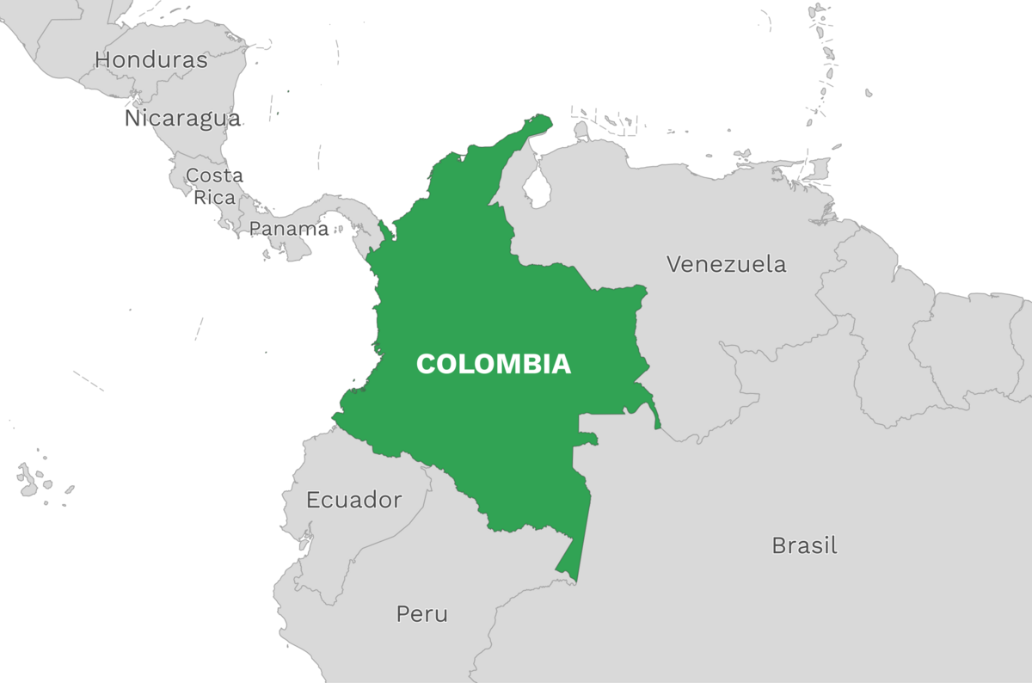
Story Setting
During the time period of the story, “La Violencia” had been going on in Columbia for approximately 20 years.
Notes:
Large Norwegian Encyclopedia. (n.d.). Adapted from Colombia and neighboring countries [Image]. Store Norske Leksikon. https://snl.no/Colombia

Slide 14
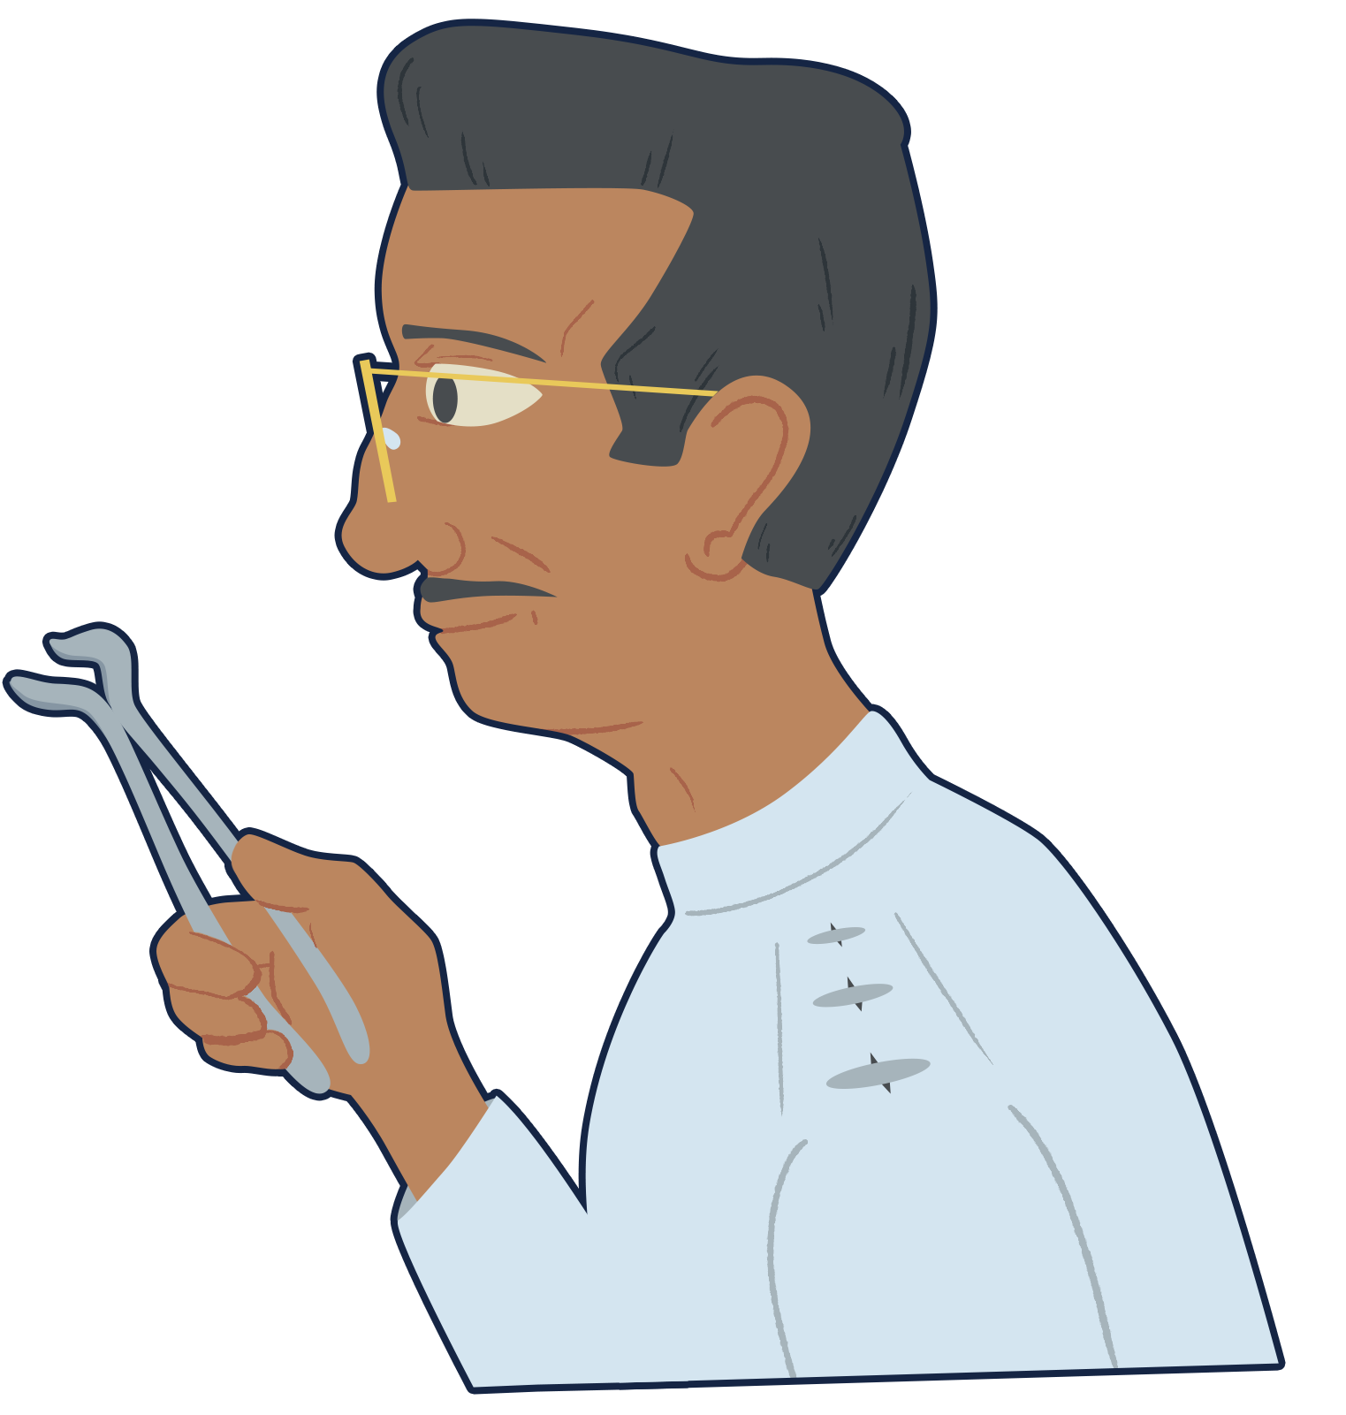
“One of These Days”
Read this story about a dentist and his town’s mayor.
As you read the story, take notes and complete your assigned quadrant on the Dentist Details handout.
Notes:
García Márquez, G. (1962). One of these days. CommonLit. https://www.commonlit.org/en/texts/one-of-these-days

Slide 15
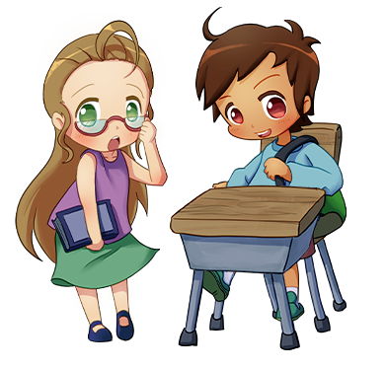
Stand Up, Sit Down
Stand up.
Share your favorite response from your assigned quadrant.
If someone shares something you also wrote in your quadrant, sit down.
Write down your peers’ responses to complete your handout.
Notes:
K20 Center. (n.d.). Stand up, sit down. Strategies. https://learn.k20center.ou.edu/strategy/1771

Slide 16
Dentist Details: Share Out
(1) Why Questions | (2) Descriptive Details
(3) Inferred Details | (4) Dentist’s Dilemmas

Slide 17
Conflict
a struggle the character faces
External Conflict | Internal Conflict
against external forces: another person nature society technology | within the character’s own mind: thoughts emotions dilemmas

Slide 18
Characterization
Direct and Indirect Characterization
Notes:
The ELA Connection. (2021, July 27). Direct and indirect characterization: Show and tell [Video]. YouTube. https://youtu.be/KWYPzVveuKY?si=AzuArGvDycbQ8UJ1

Slide 19
Characterization
Says: What do they say? How do they speak?
Thinks: What are they thinking or feeling?
Effects (on Others): How do others react to them?
Actions: What do they do? How do they behave?
Looks: What do they look like?

Slide 20
Why-Lighting
Read the short story “Lather and Nothing Else” written by Hernando Téllez in 1950.
While you read, highlight examples of the following:
indirect characterization
direct characterization
internal conflicts
external conflicts
Notes:
K20 Center. (n.d.). Why-lighting. Strategies. https://learn.k20center.ou.edu/strategy/128
Téllez, H. (2007). Lather and nothing else (J. Edwards, Trans.). CommonLit. https://www.commonlit.org/en/texts/fyc-lather-and-nothing-else (Original work published in 1950)

Slide 21
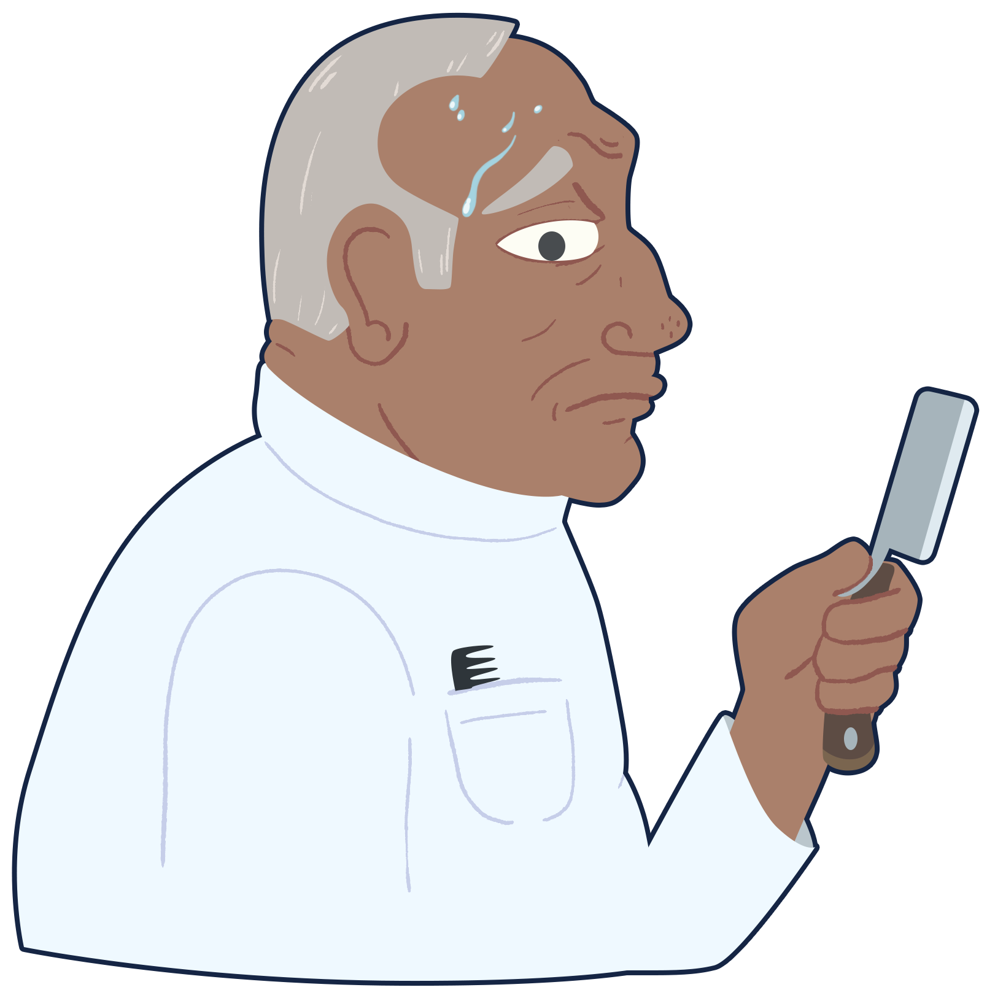
“Lather and Nothing Else”
“Lather and Nothing Else” is about a barber and a military captain.
This story is also set in Colombia, during the same time period—“La Violencia.”
As you read, highlight examples of characterization and conflicts.
Notes:
Téllez, H. (2007). Lather and nothing else (J. Edwards, Trans.). CommonLit. https://www.commonlit.org/en/texts/fyc-lather-and-nothing-else (Original work published in 1950)

Slide 22
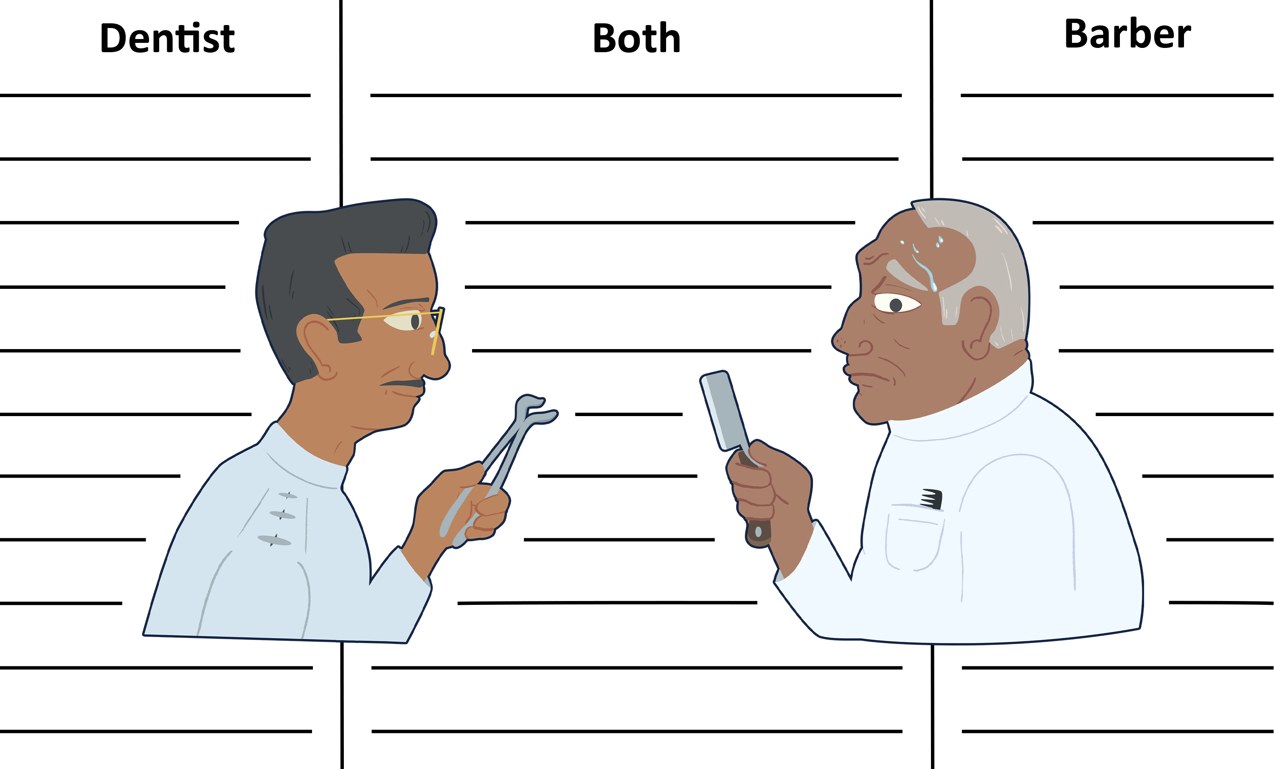
Comparing Characters
Write details about each character in the corresponding column.
10-Minute Timer
Notes:
K20 Center. (2021, September 21). K20 Center 10 minute timer [Video]. YouTube. https://youtu.be/9gy-1Z2Sa-c?si=pueHP4Cb8l2OmucQ

Slide 23
Comparing Characters
Would you rather have the dentist or the barber as your substitute teacher? Why?

Slide 24
The Dilemma of Choice
Scenario 1: Should I sit with my best friend or my crush at lunch?
Scenario 2: Do I finish my homework or watch a couple of episodes of my favorite show?
Scenario 3: Do I risk wearing expensive, new shoes to school, knowing someone might step on them?
Scenario 4: Should I tell the cashier if she gave me an extra $5 in change?

Slide 25
Cognitive Comic
Pick one of the main characters from the stories you read.
Pick one of the dilemmas.
Create a comic strip that illustrates how you think the dentist or the barber would handle that dilemma.
Notes:
K20 Center. (n.d.). Cognitive comics. Strategies. https://learn.k20center.ou.edu/strategy/198

Slide 26
Cognitive Comic
How do you think the dentist or the barber would handle that dilemma?
Use at least 3 cells to show:
Intro: the characters sees the dilemma
Choice: the character decides how to handle the dilemma
Conclusion: the outcome of their choice
Use speech and/or thought bubbles.
Notes:
K20 Center. (n.d.). Cognitive comics. Strategies. https://learn.k20center.ou.edu/strategy/198

Slide 27
Cognitive Comic: Explanation
Write a brief paragraph (at least 4 sentences) that explains how you determined how your character would handle the dilemma.
Mention at least two details from the stories that you used to make your decision.
Notes:
K20 Center. (n.d.). Cognitive comics. Strategies. https://learn.k20center.ou.edu/strategy/198

