Slide 2
Probability in Sports
Probability

Slide 3
Essential Question
How can probability inform coaching staff decision-making for sporting events?

Slide 4
Lesson Objective
Calculate the probability of making a specific shot in basketball.

Slide 5


Basketball Brain Dump
On scratch paper, write down everything you know about basketball.
Prepare to share with the class.
Notes:
K20 Center. (n.d.). Collective brain dump. Strategies. https://learn.k20center.ou.edu/strategy/111
K20 Center. (2021, September 21). K20 4 minute timer [Video]. YouTube. https://www.youtube.com/watch?app=desktop&v=kpCsfuvzQeY

Slide 6
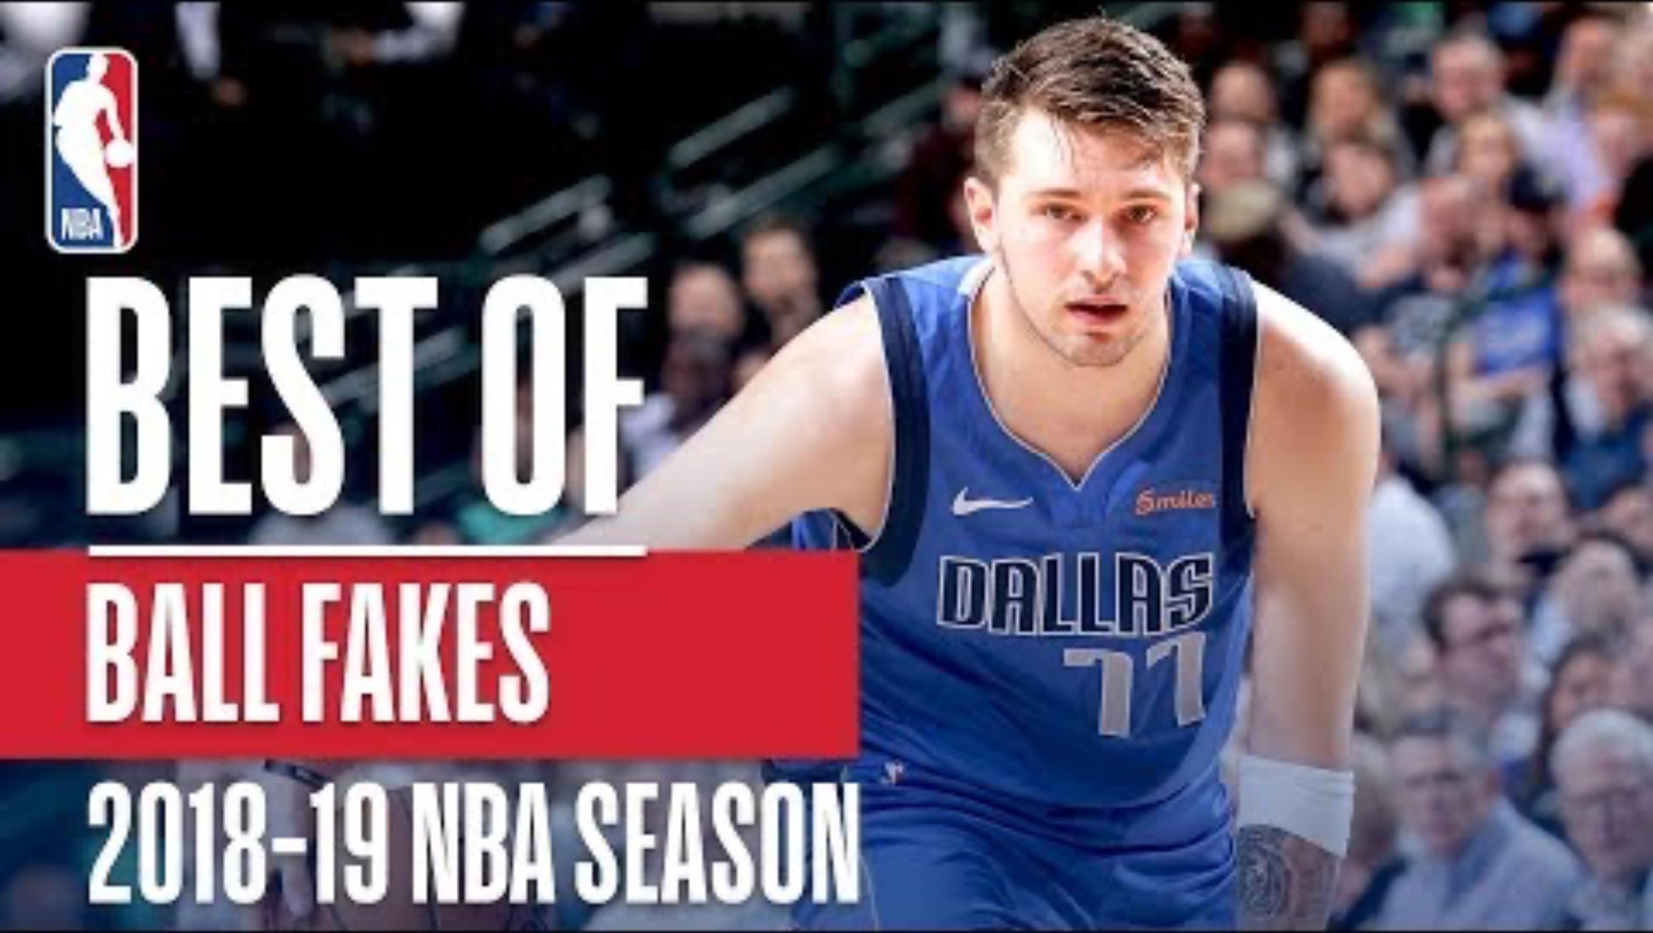
NBA’s Best Ball Fakes 2018-2019
https://www.youtube.com/watch?v=4FdIRPiL5vA
Notes:
NBA. (2019, July 29). NBA’s best ball fakes [Video]. YouTube. https://www.youtube.com/watch?v=4FdIRPiL5vA

Slide 7

Shot Statistics: Collecting Your Data
It’s your turn on the court!
Decide which partner will shoot first and which one will record the data.
The first player shoots 10 times. The second player records how many shots were successful or missed on the Shot Statistics handout.
Switch roles and shoot 10 more times.
Calculate your probability of making a successful shot.
Notes:
Johnston, K. (2017). Basketball net [Photograph]. Pixabay. https://pixabay.com/photos/basketball-net-score-rim-hoop-2099656/

Slide 8
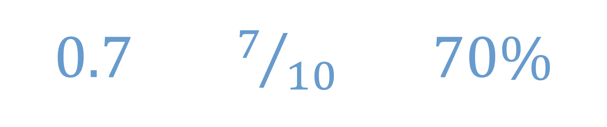
Shot Statistics: Class Discussion
How did you calculate the probability?
Who has the highest chance of making a successful shot?
Which form of probability (decimal, fraction, or percentage) would be most helpful to a basketball coach? Why?

Slide 9

You Are the Statistician
Today is your first day as an NBA statistician.
Navigate to http://www.basketball-reference.com/boxscores/ or scan the QR code.
Find your team.
On your Statistician’s First Day handout, record data from the last four games your team played. Use data for 2-point shots and 3-point shots.
Find the probability of those shots. Write them as fractions and as percentages.
Notes:
Scores. (n.d.). Basketball Reference. https://www.basketball-reference.com/boxscores/

Slide 10
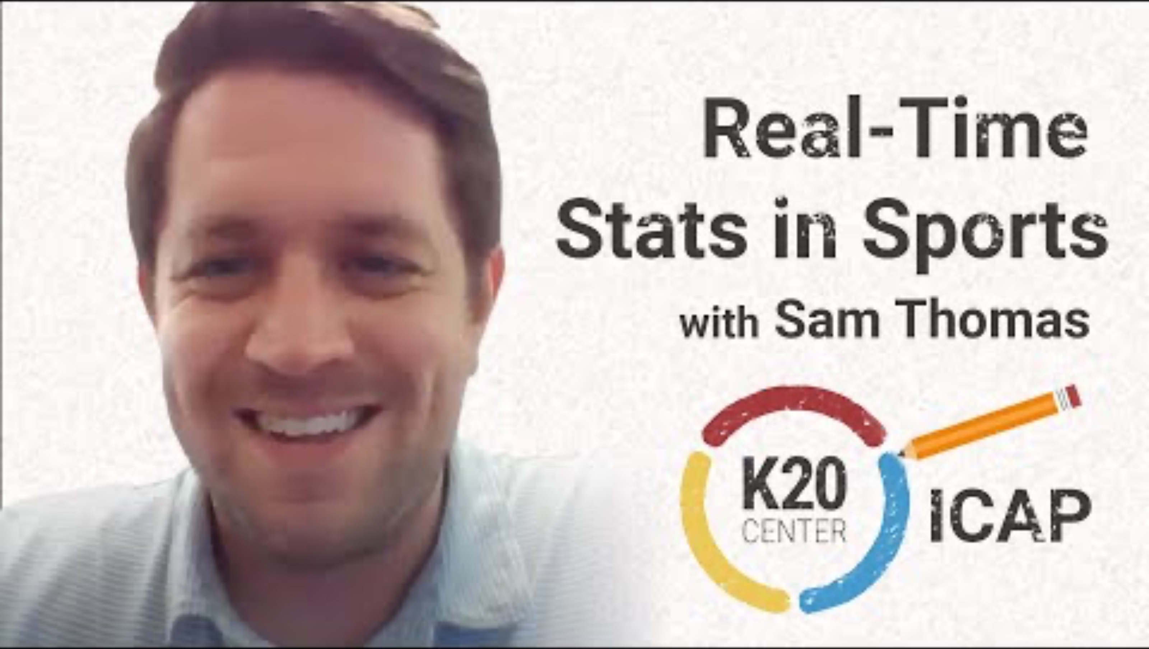
https://www.youtube.com/watch?v=rGI8PX4UbNI
Notes:
K20 Center. (April 12, 2023). K20 ICAP - Sports statistician - Real-time stats in sports [Video]. YouTube. https://www.youtube.com/watch?v=rGI8PX4UbNI

Slide 11
You Are the Statistician
Your team’s coach has asked you to use your data to identify which shots the team should practice.
What would you recommend, based on your understanding of probability?
Write a letter to the coach using at least five complete sentences to explain which specific shots the team should practice.

