Slide 2
What does your name mean?
Take a minute to enter your name into the following website www.behindthename.com (You may have to click on the other form of your name to see it.)
Share your name with an elbow partner and tell them what it means according to the website.
Do you think that accurately represents who you are?
Have your parents told you why they named you and what they meant when they did?
If you had to pick another name, which one would you choose and why?

Slide 3
Pictionary
With the same elbow partner, you are going to play 2 rounds of Pictionary.
Each person will take turns being the drawer and the guesser.
The drawer picks a word they can draw that they think the guesser can guess.
The drawer will have 30 seconds to draw until the timer expires or the correct guess is made.
After each round, fill out the signifier and signified portion of the handout.
Switch roles and repeat.
Notes:
K20center. (2021, September 21). K20 Center 30 second timer. YouTube. Retrieved August 25, 2022, from https://www.youtube.com/watch?v=HcEEAnwOt2c

Slide 4
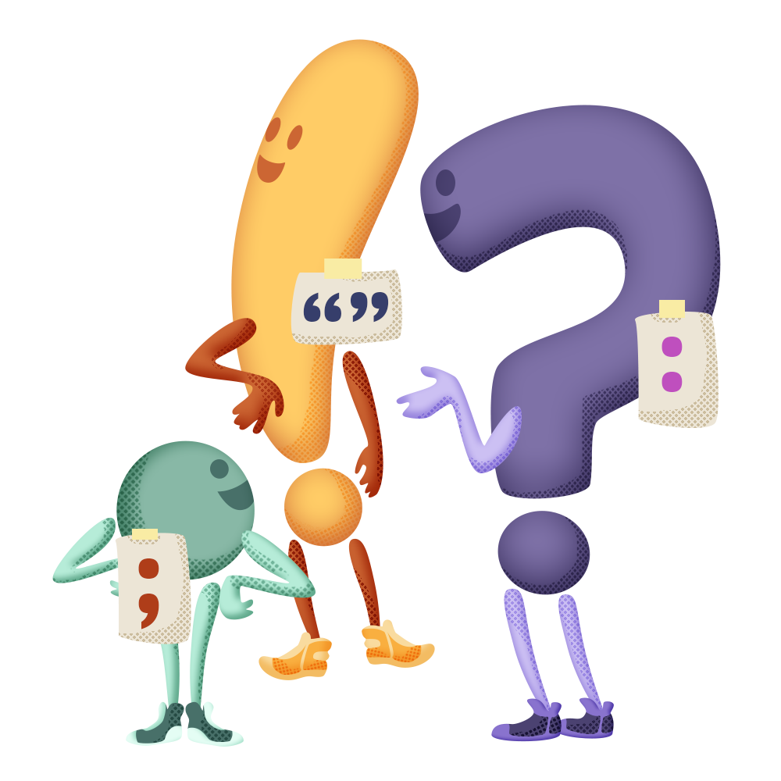
20 Questions
Choose an object in the room for your partner to guess.
Take turns asking questions until you have figured out your partner’s item.
Notes:
K20 Center. (n.d.). Twenty question mingle. Strategies. https://learn.k20center.ou.edu/strategy/3615

Slide 5
“I Saw the Sign”
Introducing Semiotics

Slide 6
Essential Question
How does language function?

Slide 7
Lesson Objectives
Students are exposed to new concepts and ways of thinking about how language operates in different mediums (oral and visual).
Students are able to catalog and articulate how the different parts of an advertisement work together to articulate a complex meaning.

Slide 8
Why-lighting
As you read through the Semiotics Why-Lighting Passage, complete the following:
Read through the text, highlighting passages you deem important to your understanding of the text as you read.
Write why you highlighted a passage in the margins next to each highlighted passage.
In small or large group discussion, explain why you chose the passages you did.
Notes:
K20 Center. (n.d.). Why-Lighting. Strategies. https://learn.k20center.ou.edu/strategy/128

Slide 9
Analyzing Images
Consider the differences between the following two images.
How would you describe them?
Do they seem like they have a coherent message?

Slide 10
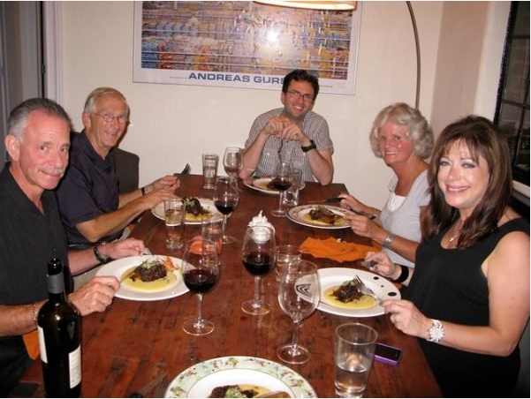
Notes:
Photo Credit: https://www.amateurgourmet.com/blog/2010/10/it_gets_better_cooking_for_my_boyfriend.html

Slide 11
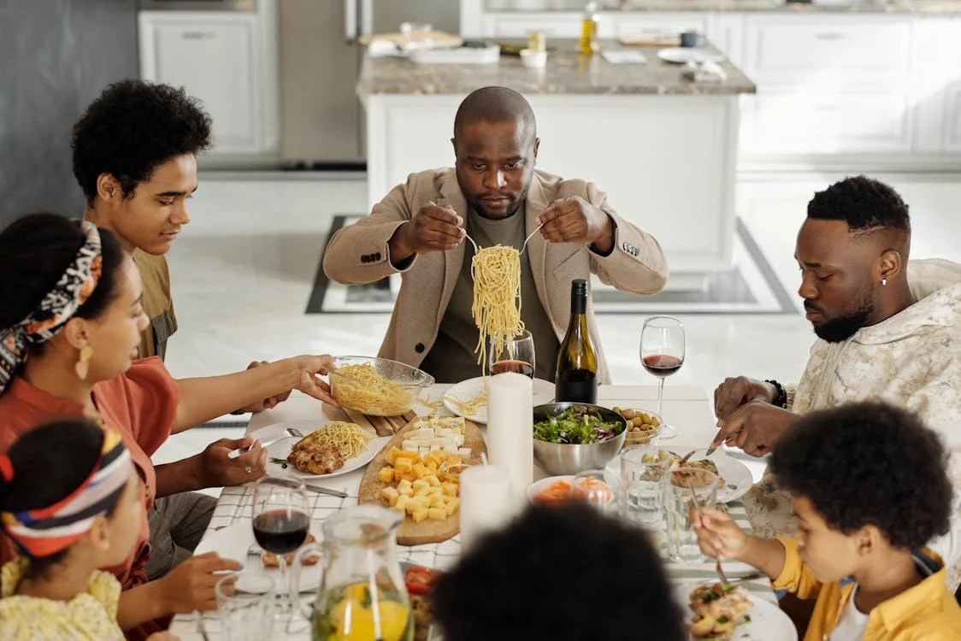
Notes:
Photo Credit: https://www.pexels.com/photo/family-having-dinner-together-4262174/

Slide 12
Picking and Detailing an Advertisement
The following image is from a national magazine campaign. For this advertisement, you will fill out the top section of your Signs Chart by picking any three signs within the image.

Slide 13
Notes:
Stouffers (2012). During dinner. [Advertisement]. Better Homes and Gardens, 2010(3), 37.

Slide 14
What’s the Difference?

Slide 15
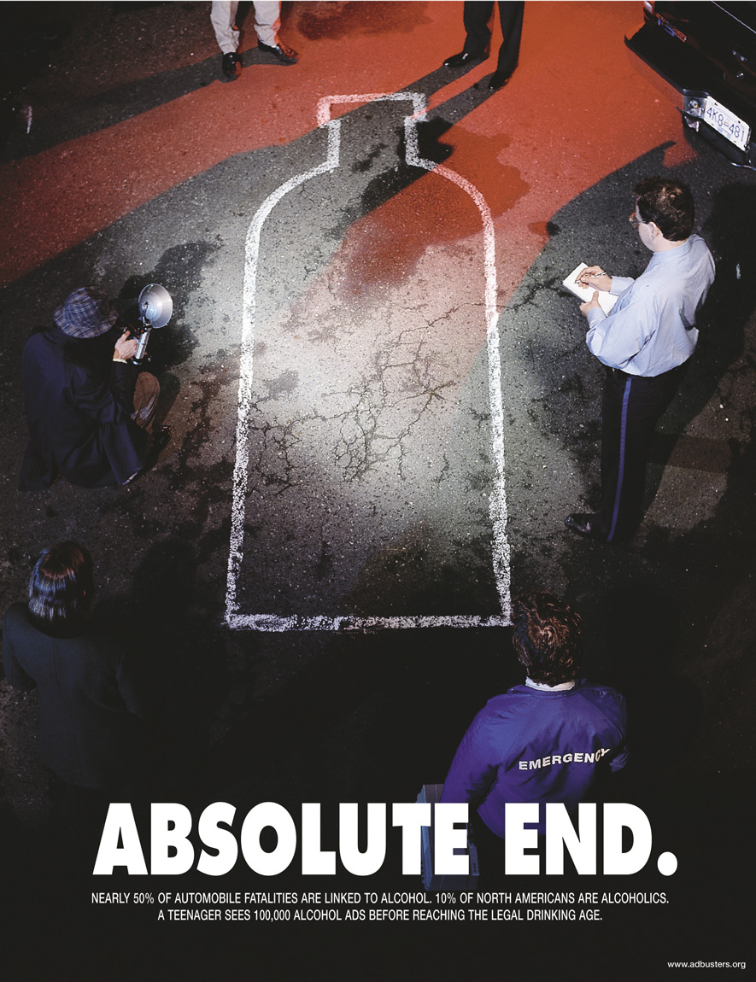
Text reads:
“Absolute end.”
“Nearly 50% of Automobile fatalities are linked to alcohol. 10% of North Americans are alcoholics. A teenager sees 100,000 alcohol ads before reaching the legal drinking age.”
(Adbusters.org – a parody of Absolut Vodka magazine ad)
Notes:
Adbusters (2011). Absolute end. [Advertisement]..

Slide 16
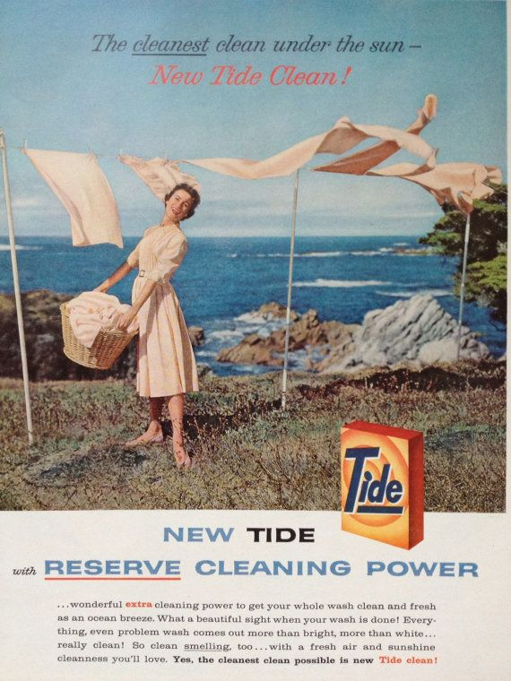
Text reads:
The cleanest clean under the sun—New Tide Clean!
NEW TIDE with RESERVE CLEANING POWER.
… wonderful extra cleaning power to get your whole wash clean and fresh as an ocean breeze. What a beautiful sight when your wash is done! Everything, even problem wash comes out more than bright, more than white…really clean! So clean smelling, too…with a fresh air and sunshine cleanness you’ll love. Yes, the cleanest clean possible is new Tide clean!
Notes:
Tide (1958). New Tide with reserve cleaning power. [Advertisement]. McCall’s Magazine.

Slide 17
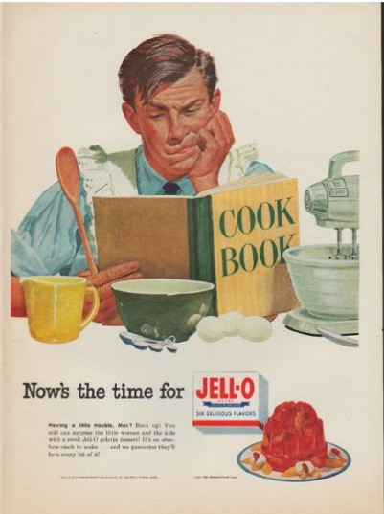
Text reads:
Now’s the time for JELL-O (SIX DELICIOUS FLAVORS)
Having a little trouble, Mac? Buck up! You still can surprise the little woman and kids with a swell Jell-O gelatin desert! It’s an absolute cinch to make… and we guarantee they’ll love every bit of it!
Notes:
Jell-o (1952). Now’s the time for Jell-o. [Advertisement].

Slide 18
Pick Your Own Advertisement
Find an advertisement that you find interesting. Be sure to copy and paste the image onto the From Assignment portion of the Signs Chart.

Slide 19
Two Stars and a Wish
What are TWO key things you learned about how language functions?
What is ONE question that you still have about today’s lesson?
Notes:
K20 Center. (n.d.). Two Stars and a Wish. Strategies. https://learn.k20center.ou.edu/strategy/83

