Slide 2
Change, Challenges, and Careers
Researching Careers and Controversies

Slide 3
Essential Question
How can researching and weighing the pros and cons of different careers help us make smarter decisions about our future jobs?

Slide 4
Lesson Objectives
Identify key aspects of a chosen career by gathering information on job responsibilities, salary prospects, educational requirements, and industry outlook.
Assess the positives and negatives of a selected career, considering factors such as job satisfaction, work-life balance, and societal impact
Construct an argumentative paper to present findings and defending your perspective on your chosen career.

Slide 5

Career Clusters Survey
Scan the QR Code or type in the link below.
Complete the survey by selecting statements that apply to you.
When you receive your results at the end, take a screenshot or picture to save them.
http://k20.ou.edu/careerclustersurvey
Notes:
http://k20.ou.edu/careerclustersurvey
Shortened URL: https://bit.ly/3zIgO9O

Slide 6
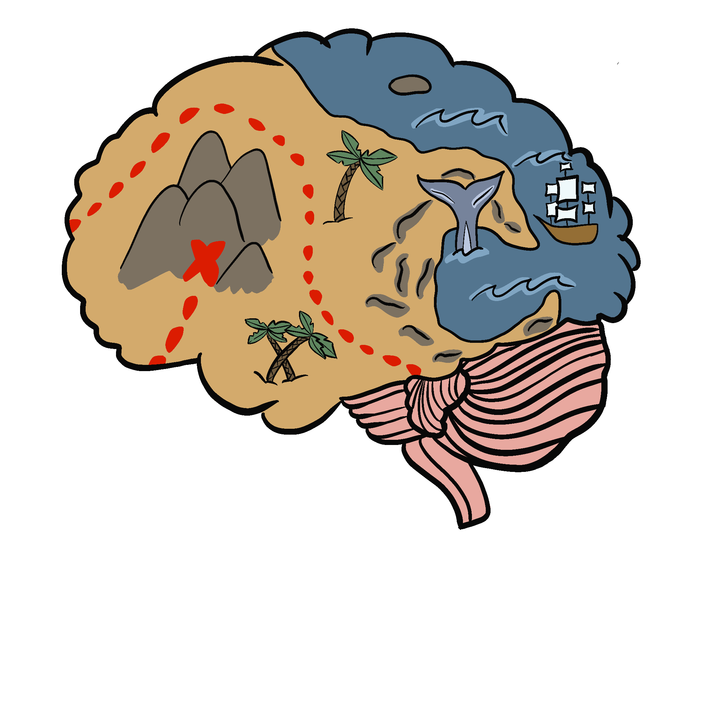
Mind Maps
Topic: Careers
List your top three career clusters from your survey in the square bubbles. From those clusters, list possible careers of interest to you in the oval bubbles.

Slide 7
Architect
Data Scientist
Carpenter
Architecture & Construction
Information Technology
Video Game Producer
My Careers
My Careers
Health Science
Dental Hygienist
Athletic Trainer
Notes:
When presenting, click once to make cluster examples appear. Click a second time to make possible careers for each cluster appear.

Slide 8
Career Research
Bureau of Labor Statistics Occupational Outlook Handbook
  https://www.bls.gov/ooh
K20 Center LEARN Resources
  https://learn.k20center.ou.edu
K20 Center YouTube Channel
  https://www.youtube.com/k20center
Living Wage
  https://livingwage.mit.edu
My Next Move
  https://www.mynextmove.org
O*Net OnLine
  https://www.onetonline.org/find/career
Big Future
  https://bigfuture.collegeboard.org/

Slide 9
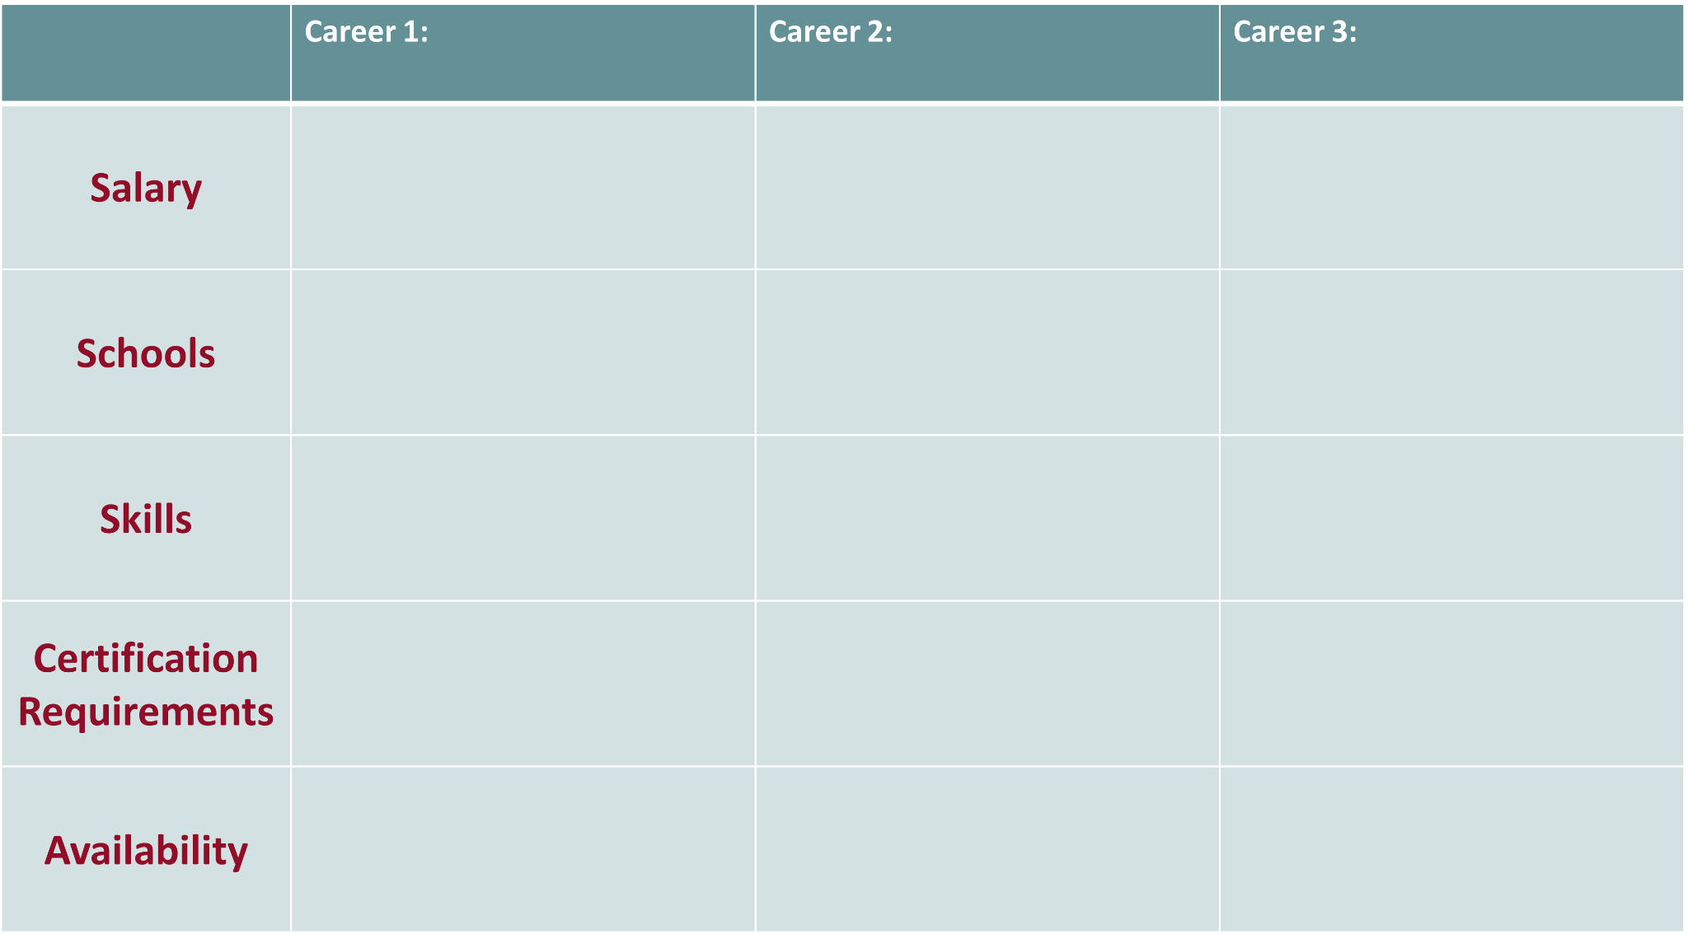
Embalmer
$52,000
Associate’s Degree
Bachelor’s Degree
University of Central Oklahoma
Basic Skills
talking to others
listening to others, not interrupting, and asking good questions
Stand-alone license
Third-party exam required
Degree required
Continuing education required
Experience required
No criminal record requirements
Above average
No job openings were found in Oklahoma.

Slide 10
Career Research
Bureau of Labor Statistics Occupational Outlook Handbook
  https://www.bls.gov/ooh
K20 Center LEARN Resources
  https://learn.k20center.ou.edu
K20 Center YouTube Channel
  https://www.youtube.com/k20center
Living Wage
  https://livingwage.mit.edu
My Next Move
  https://www.mynextmove.org
O*Net OnLine
  https://www.onetonline.org/find/career
Big Future
  https://bigfuture.collegeboard.org/

Slide 11
Career Controversy
Journalism
The situation: Many newspapers were forced to move their platform from a print-based medium to a digital medium. However, to stay in operation they need to put their content behind an online paywall.
The controversy: News is a community good. Should citizens really have to pay to access important information?

Slide 12
Career Controversy
Education
The situation: Many districts are moving to no-cell phone policies. This places teachers in the role of policing cell phone use by students.
The controversy: Why should teachers have to police phone usage? Why should all students have to hand over their phones?

Slide 13
Career Controversy
Construction
The situation: Many new construction projects have a positive community impact. New highways provide better access.
The controversy: Eminent domain means families have to give up property they’ve been on for generations. What about the environmental impact?

Slide 14
Career Controversy
Technology
The situation: New apps and digital resources are constantly being developed and released. Many are designed to make our lives easier.
The controversy: Many digital platforms collect and sell the data of their users.

Slide 15
Example CER
Claim: Healthcare workers should be required to get vaccinated.
Evidence: Studies show that vaccinated healthcare workers are less likely to spread infectious diseases to vulnerable patients.
Reasoning: Since healthcare workers are in close contact with people who may have weakened immune systems, getting vaccinated helps reduce the risk of exposing patients to serious illnesses.
Notes:
Open AI. (2024). ChatGPT (October 28 version). [Large language model]. ChatGPT. https://chat.openai.com/chat

Slide 16
Argumentative Essay Outline
Introduction Paragraph Hook/Attention Grabber: Thesis: | Body Paragraph 1, 2, & 3 Claim: Evidence: Reasoning: | Conclusion Restate Thesis: Wrap up the topic:

Slide 17
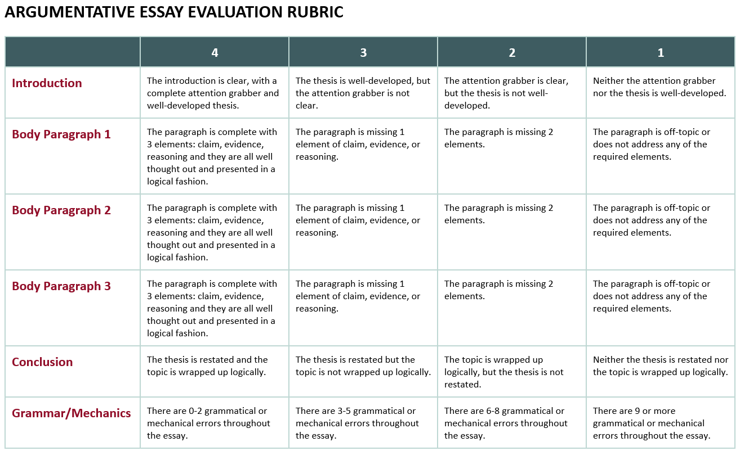

Slide 18
Present Your Research
Use your paper and note catcher to share your new knowledge, discuss next steps, and ask advice with a significant person in your life, such as:
    Parent
    Grandparent
    Guardian
    Mentor/Coach
    Another teacher
After the discussion, complete the Sentence Stem on the back of the Note Catcher.
Based on my research and discussion with a significant person in my life, my next steps toward a successful career are...

