Slide 2
The Great Gatsby and the Sense of Taste
Character Recipe Cards:
What is the relationship between taste and character?

Slide 3
In your groups…
There are 5 basic tastes. Working together with your group, see if you can list all five.
(Note: 4 of them will be more obvious, but 1 isn’t a taste that most are familiar with.)

Slide 4
Two-Minute Paper
In your comp books, answer the following:
Describe, in your own words, what the 5 tastes are that your groups decided were most basic. Try to describe each taste either through examples or reactions to the tastes.
After two minutes, one member from each group will share. See if the rest of the class has listed the same, or different, tastes than you.

Slide 5
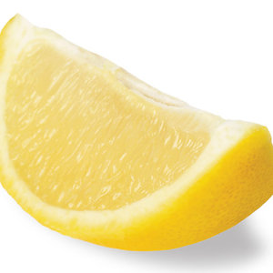
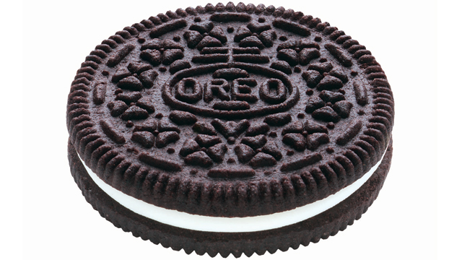
Describe the tastes of each food

Slide 6
The 5 Basic Tastes
SOUR
SOUR
SALTY
BITTER
“UMAMI”
SWEET

Slide 7
Explore
The Great Gatsby and the Sense of Taste
What is the relationship between taste and character?

Slide 8
Which taste goes with which character?
SWEET
SALTY
SOUR
BITTER
DAISY
TOM
JAY
JORDAN
NICK
MYRTLE
GEORGE
WOLFSHEIM

Slide 9
Which taste goes with which character?
Identify your character.
Identify the “taste” or “tastes” that best describe your character’s personality, relationships, and/or actions.
Find supporting evidence through a direct quote from the text that shows this taste/character connection.
If there was a dish/recipe named after this connection between taste and your character, what would it be called?

Slide 10
Which taste goes with which character?
Harry Potter
Sour and Bitter- these tastes describe his attitudes toward and relationship with Draco Malfoy.
“Malfoy? Revenge? What can he do about it?”
“That’s my point, I don’t know!” said Harry, frustrated. “But he’s up to something and I think we should take it seriously!”
“Revenge is a Dish Best Served Cold.”

Slide 11
Which taste goes with which character?
Identify your character.
Identify the “taste” or “tastes” that best describe your character’s personality, relationships, and/or actions.
Find supporting evidence through a direct quote from the text that shows this taste/character connection.
If there was a dish/recipe named after this connection between taste and your character, what would it be called?

Slide 12
THINK 1. What are standard characteristics of all recipes? 2. Include what is typically on a recipe card, including units of measure and typical directions.
Explore

Slide 13
PAIR Pair up with an elbow partner and read your quick write.
Explore

Slide 14
SHARE Share your ideas with the whole class.
Explore

Slide 15
What’s in a recipe?
Sample recipes
Units of measure in cooking
Examples of cooking directions

Slide 16
How much should I add?
Harry Potter
Bitter and Sour in his relationship with Draco
“Revenge is a Dish Best Served Cold.”
Which ingredients would go in this dish?
How much of each would Harry add?
How might Harry incorporate spices? How would he cook this dish? How would it be served?

Slide 17
How much should I add? continued
Which ingredients would go in this dish?
How much of each would Harry add?
How might Harry incorporate spices? How would he cook this dish?
Bitter: vinegar, Sour: dill pickles
2 cups vinegar to establish bitter notes to the broth
4 dill pickles, finely chopped to permeate the broth with a sour flavor
Wisk with fury until the soupy mixture begins to boil as hot as your fury. Taste the mix as it develops a deep green color: a satisfying chill should run down your back as you imagine your foe with a bowl full of this ghastly gruel.
Serve chilled: remember, revenge is best served cold.

Slide 18
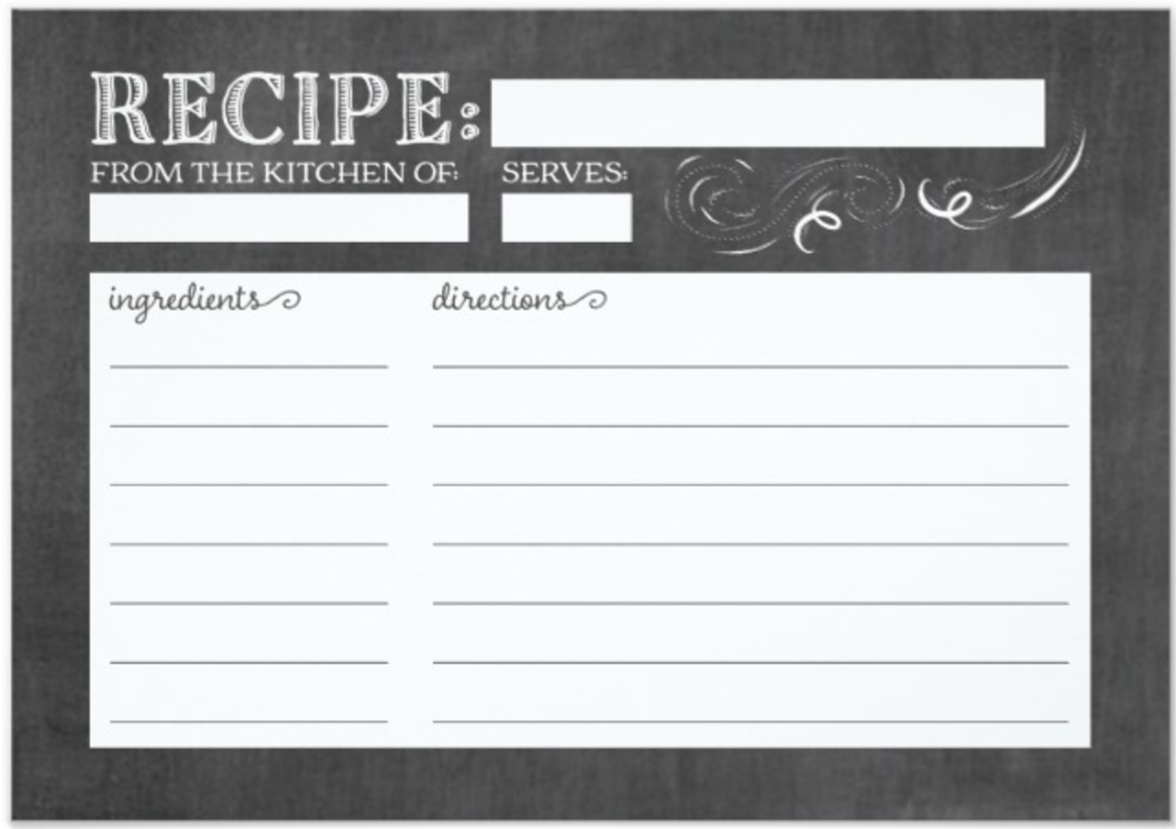
Character Recipe Card
Choose ONE character about whom to write.
Next, choose ONE or TWO tastes on which to focus (if you choose two tastes, find a way for them to creatively compliment each other in your recipe)
While you should use all of the recipe card requirements on the handout, you may be flexible with the format and draw inspiration from real recipe cards. Use standard recipe measurements and play off of standard recipe directions, while always keeping your character and the text in mind.

Slide 19
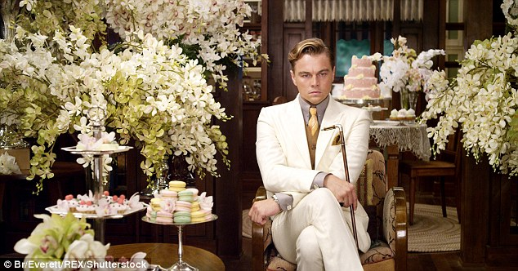
Your final project will include:
1. Character Recipe Card (composed realistically (using hints from the handout) and cut out of a separate sheet of paper or cardstock)
2. Rubric

