Slide 1
Somebody’s Watching Me
Logical Fallacies and Propaganda in 1984

Slide 2
Essential Questions
How do authors/speakers use logical fallacies to persuade?
How are logical fallacies used in everyday life?

Slide 3
Learning Objectives
Analyze speeches for logical fallacies
Identify logical fallacies from 1984 and from real life

Slide 4
Card Sort
In groups of 2-3, sort the provided cards.
There will be some new terms. Don’t worry if you don’t know them or about getting it right.
Just do your best!
Notes:
K20 Center. (n.d.). Card sort. Strategies. https://learn.k20center.ou.edu/strategy/147

Slide 5
Argument from Ignorance The Party often asserts something as true simply because it cannot be proven false, using this to control information and manipulate reality. | Straw Man Argument By distorting or misrepresenting opposing viewpoints, the Party creates an easy target to attack and discredit dissenting ideas.
Appeal to Authority The Party uses its absolute power and authority to enforce obedience, discourage critical thinking, and encourage acceptance of their pronouncements as truth. | Ad Hominem Attacks The Party often labels individuals who question it as "thought criminals" or "enemies of the people," attacking their character rather than addressing their arguments.

Slide 6
Equivocation The Party often defines terms in a way that reinforces their own power, creating a closed loop where their narrative is always self-consistent. | Contradictory Statements The Party manipulates citizens into believing contradictory statements as truth, exemplified by slogans like "War is Peace," "Freedom is Slavery," and "Ignorance is Strength.”
Bandwagon This technique is used extensively as a tool of control by the Party. This fallacy occurs when something is presented as true or right simply because "everyone else" believes it or does it. The Party exploits this fallacy to ensure conformity and suppress independent thought. | Cherry Picking The Party uses this technique, which presents only selective information, to manipulate perception, control thought, and maintain power. This technique involves emphasizing positive information about a particular cause or leader while omitting or distorting facts that may present an opposing view.

Slide 7
Glittering Generalities Vague, emotionally appealing phrases that lack concrete meaning are used by the Party to manipulate thought and enforce ideological conformity. These slogans and expressions sound positive and inspiring, but they obscure the truth and discourage critical thinking. | Name Calling A key propaganda tool used by the Party to manipulate public perception and suppress dissent. This technique involves attaching negative labels to enemies or opposing ideas to discredit them without providing logical reasoning.
Transfer A propaganda technique that associates the authority, respect, or emotion tied to one symbol with another idea or person is used by the Party to manipulate the people's thoughts and reinforce its power. This technique helps the Party gain unquestioned loyalty by transferring deep emotions onto political figures and ideologies. | Plain Folks This propaganda technique—where leaders or ideas are presented as being aligned with the common people—is used by the Party to create a false sense of connection between the ruling elite and the masses. This technique makes the Party appear relatable and trustworthy, discouraging rebellion by making it seem as though it genuinely represents ordinary citizens.

Slide 8
Magnetic Statements
Read the statements posted around the room and then choose the one that attracts or repels you the most to stand next to.
Discuss with others who chose the same poster. Why did you choose this one?
Notes:
K20 Center. (n.d.). Magnetic statements. Strategies. https://learn.k20center.ou.edu/strategy/166

Slide 9
Magnetic Statement #1
Propaganda is intentionally designed communication that invites us to respond emotionally, immediately, and in an either-or manner.
—Neil Postman

Slide 10
Magnetic Statement #2
Propaganda is a form of purposeful persuasion that attempts to influence the emotions, attitudes, opinions and actions of specified target audiences for ideological, political or commercial purposes through the controlled transmission of one-sided messages (which may or may not be factual) via mass and direct media channels.
—Richard Alan Nelson

Slide 11
Magnetic Statement #3
Propaganda is the deliberate, systematic attempt to shape perceptions, manipulate cognitions, and direct behavior to achieve a response that furthers the desired intent of the propagandist.
—Garth Jowett and Victoria O’Donnell

Slide 12
Magnetic Statement #4
Propaganda is indifferent to truth and truthfulness, knowledge and understanding; it is a form of strategic communication that uses any means to accomplish its ends.
—Walter Cunningham

Slide 13
Magnetic Statement #5
Propaganda is a form of information that panders to our insecurities and anxieties.
—Jacques Ellul

Slide 14
Why-Lighting
Read the speech excerpts.
With a partner, look for and highlight logical fallacies.
Write down next to your highlights what fallacy it is and why.
Notes:
K20 Center. (n.d.). Why-lighting. Strategies. https://learn.k20center.ou.edu/strategy/128

Slide 15
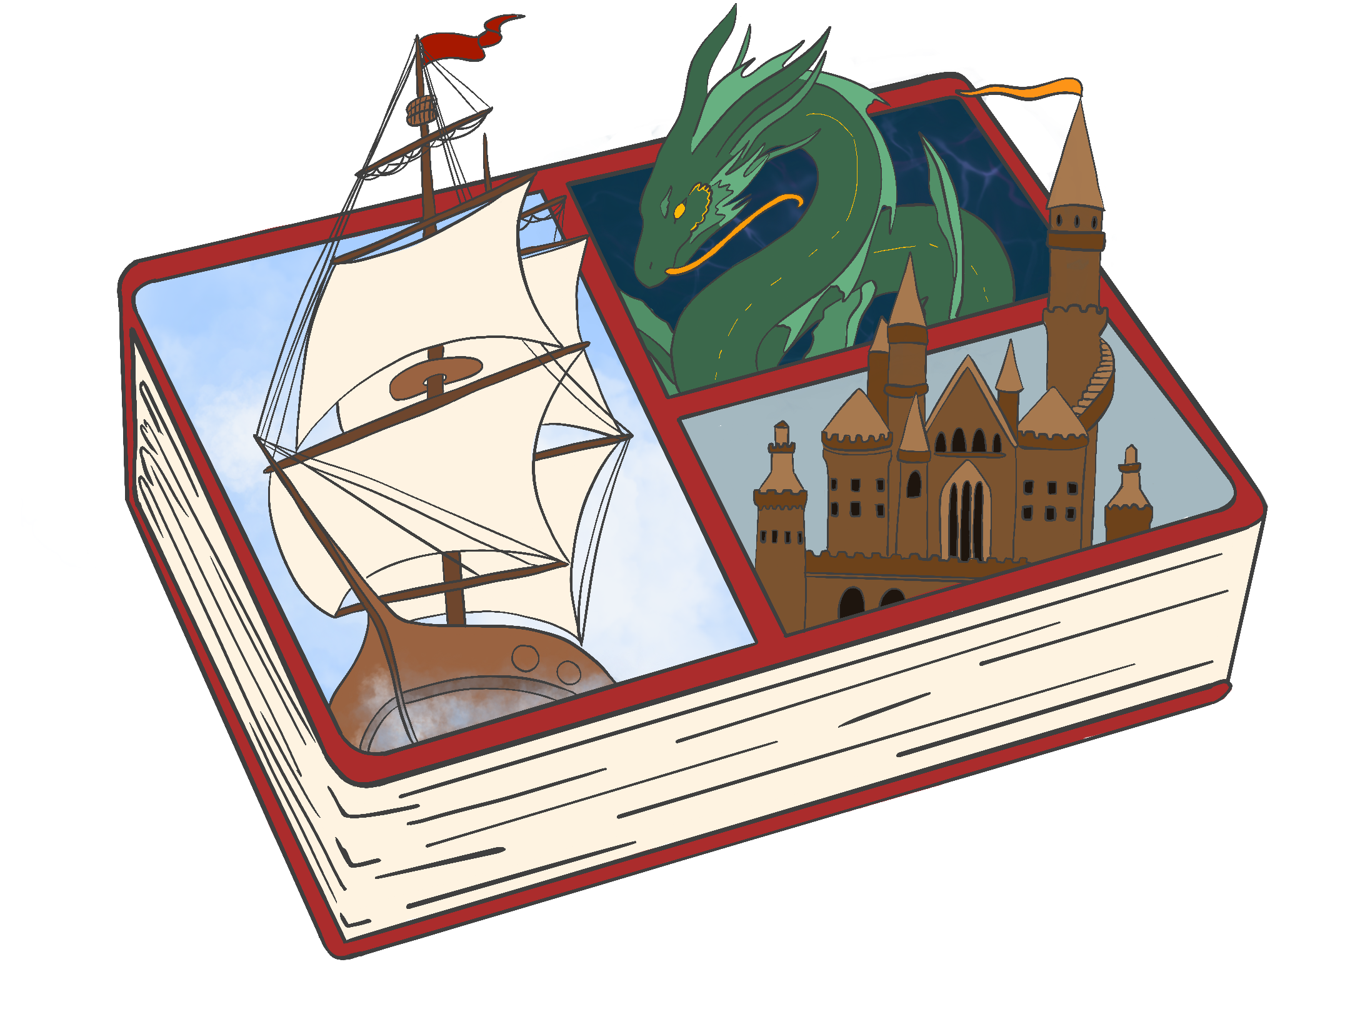
Bento Box
Create a collage with 5–7 examples of propaganda or logical fallacies. Include at least:
3 examples from 1984
2 from real life (commercials, politics, etc.)
Notes:
K20 Center. (n.d.). Bento box. Strategies. https://learn.k20center.ou.edu/strategy/1128

Slide 16
Exit Ticket
On a piece of paper answer the question:
Which logical fallacies or propaganda techniques have you used or had used on you in your day-to-day life?
Notes:
K20 Center. (n.d.). Bell ringers and exit tickets. Strategies. https://learn.k20center.ou.edu/strategy/125

