Slide 2
The Ugly Truths of the Great War
Shell Shock in World War One

Slide 3
Essential Question
What is the effect of war on soldiers and society?

Slide 4
Lesson Objectives
Define shell shock and evaluate the long-term impact on World War I soldiers.
Explore mental health disorders affecting soldiers in past and present times.

Slide 5
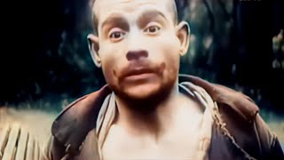
(1918) WWI veterans: shell shock sequels, war neurosis.
Notes:
Video Link: https://www.youtube.com/watch?v=X-elmAeX_4U

Slide 6

How Am I Feeling? What Am I Thinking?
On your sticky note, draw a diagonal line from the top right corner to the bottom left corner.
On the top left corner, take a moment to draw a picture of how you are feeling after watching the video.
On the bottom right corner, write a sentence describing what you are thinking.
Notes:
K20 Center. (n.d.). How am I feeling? What am I thinking?. Strategies. https://learn.k20center.ou.edu/strategy/187

Slide 7
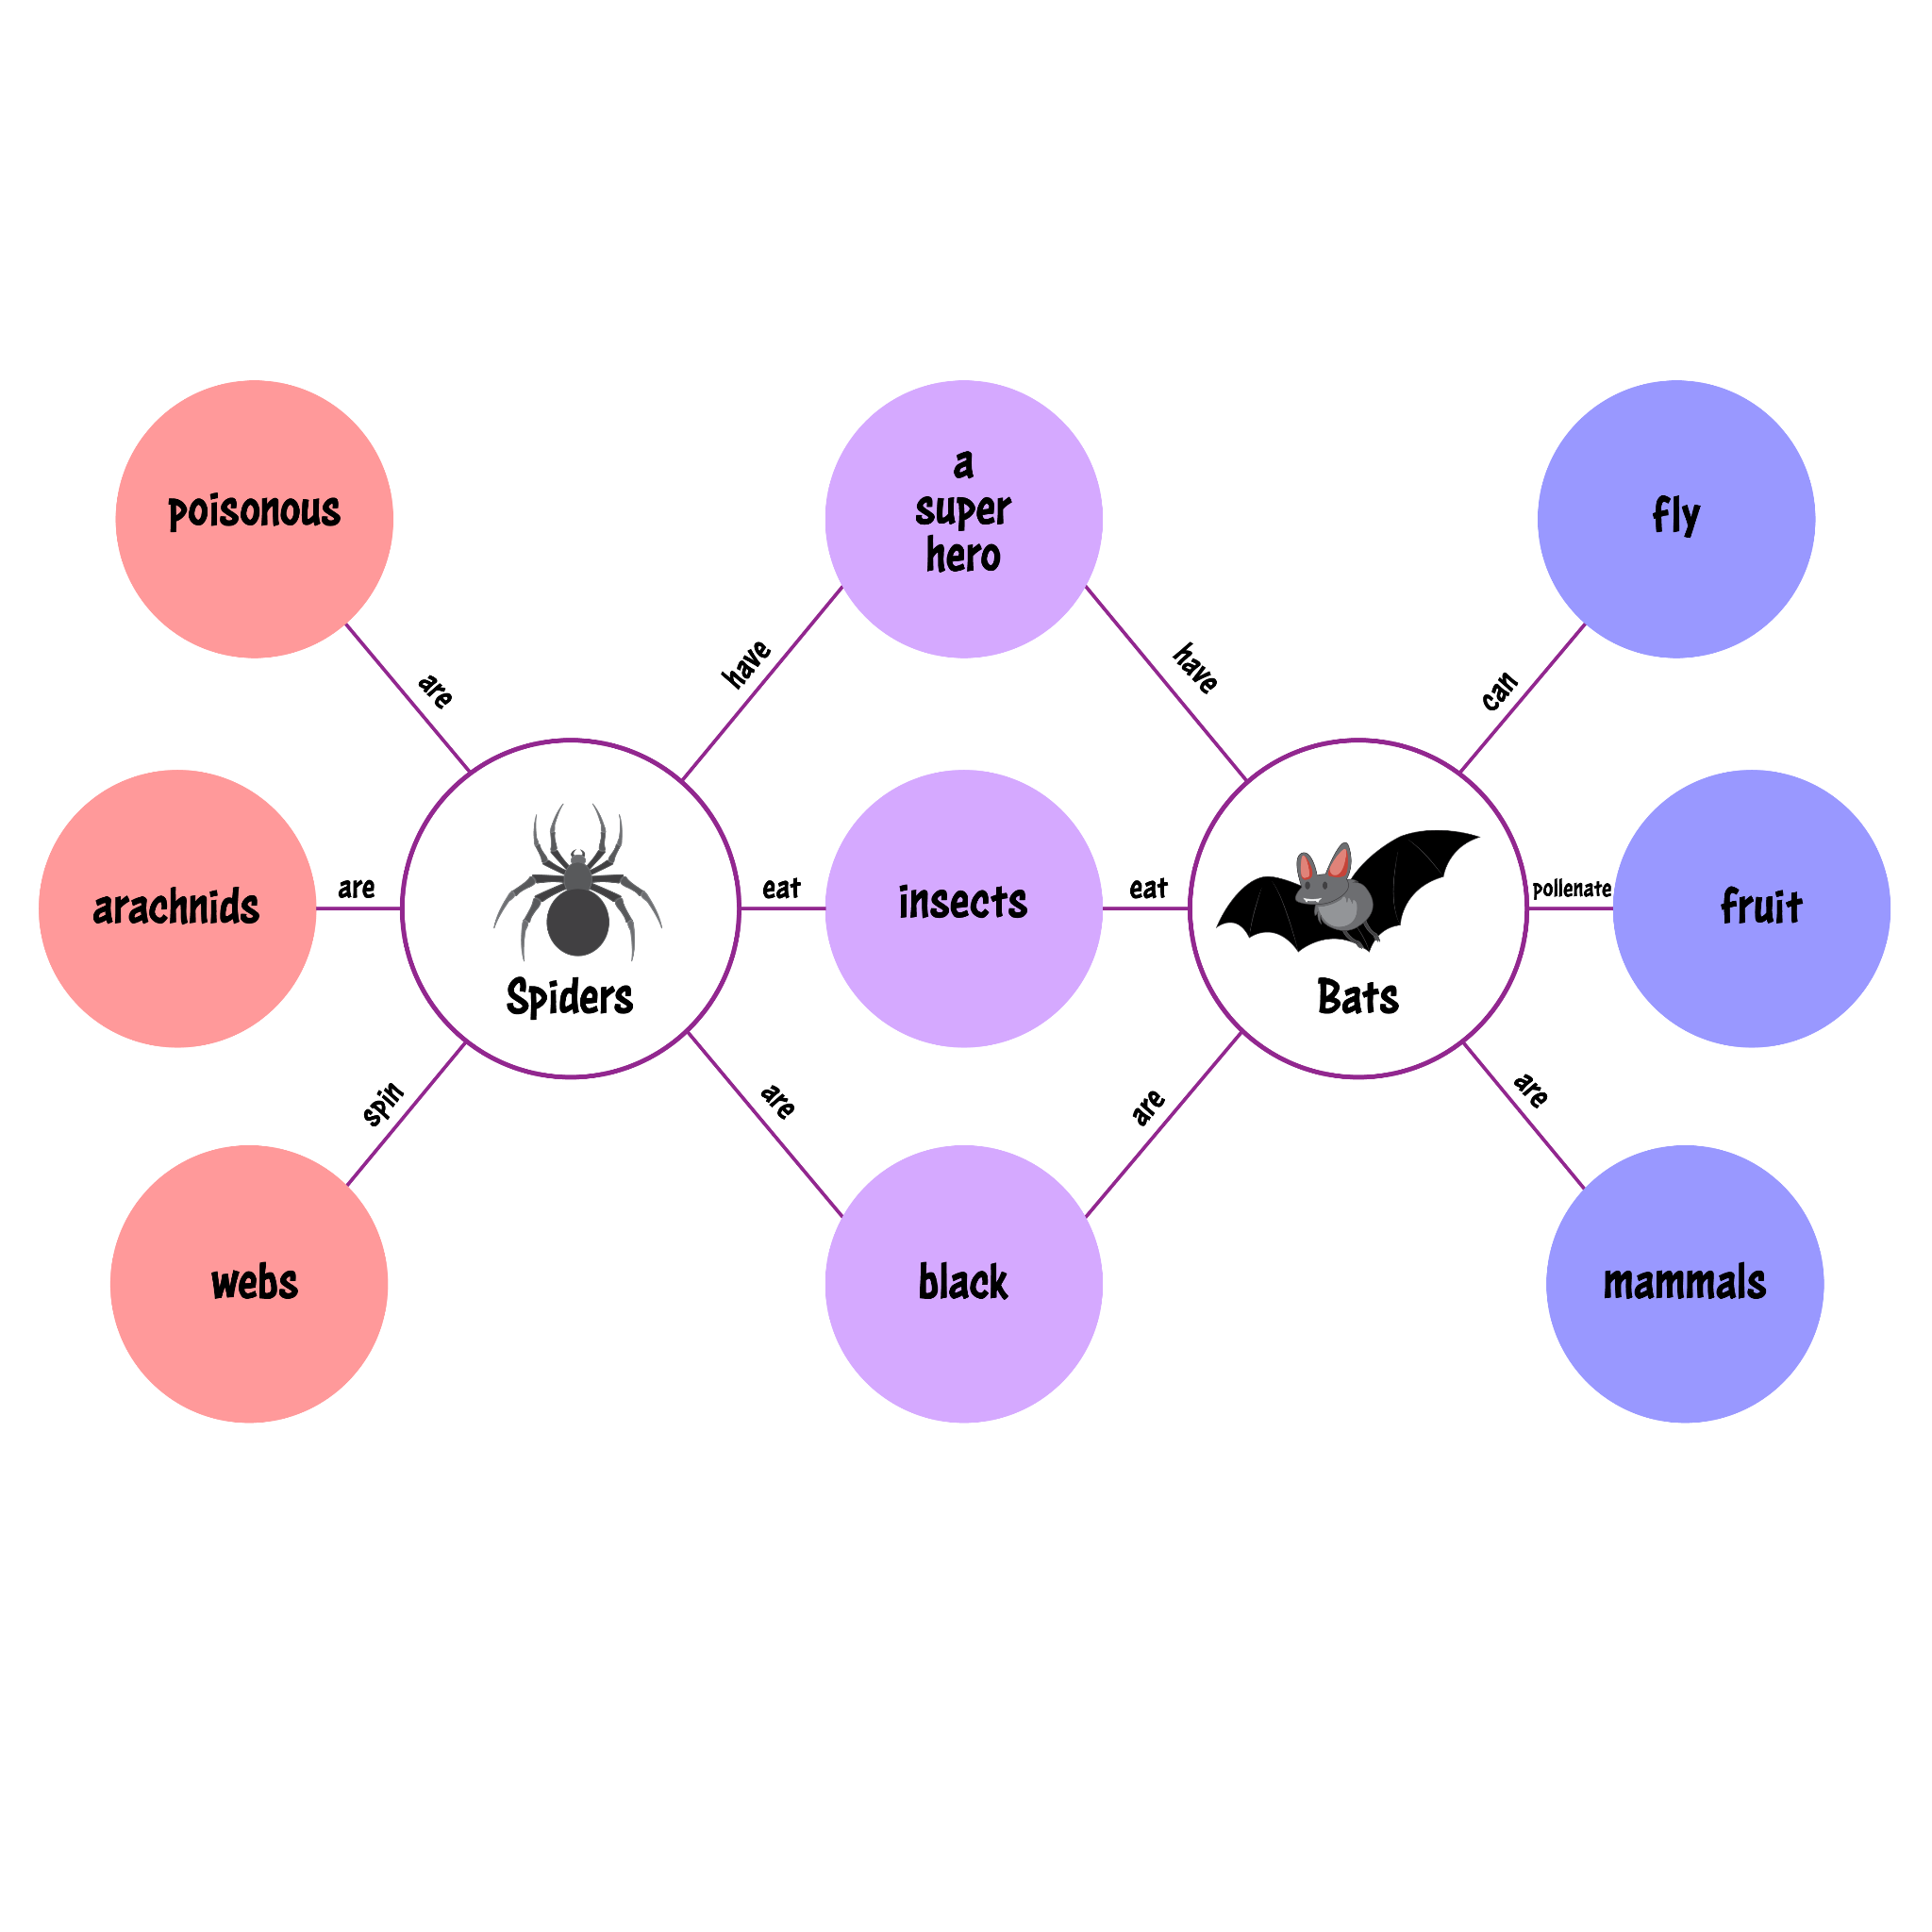
Reflections on the War
With your partner, decide which poem or song you would like to analyze. Your choice should be different from your partner’s.
Write the title of your chosen piece in one of the large bubbles on your map (Name 1 or Name 2).
As you read and analyze your piece, write down characteristics about it in the smaller bubbles on the outside of the map, connected to your larger bubble.
Notes:
K20 Center. (n.d.). Double bubble map. Strategies. https://learn.k20center.ou.edu/strategy/3035

Slide 8
Reflections on the War
With your partner, discuss your chosen piece and the characteristics you wrote down.
When you both have described your piece, take a few minutes to discuss similarities between your two pieces.
Write those similar characteristics in the bubbles connecting your two pieces.
Notes:
K20 Center. (n.d.). Double bubble map. Strategies. https://learn.k20center.ou.edu/strategy/3035

Slide 9

Anticipation Guide
Read through the statements on your handout.
As you read, respond to the statement in the left column titled “Before Reading.”
Respond with “agree” if you agree with the statement.
Respond with “disagree” if you disagree with the statement.
Notes:
K20 Center. (n.d.). Anticipation Guide. Strategies. https://learn.k20center.ou.edu/strategy/58

Slide 10

Common Mental Disorders
As you read through the article, use your sticky notes to do the following:
  Sticky Note 1: Write one word that summarizes the article.
  Sticky Note 2: Write a phrase that summarizes the article.
  Sticky Note 3: Summarize the article in one sentence.
Be prepared to discuss your answers with those around you.
Notes:
K20 Center. (n.d.). Three Post-it notes. Strategies. https://learn.k20center.ou.edu/strategy/153

Slide 11

Jigsaw
Read your assigned portion of the Common Mental Disorders handout.
You will act as the “expert” for your portion of the reading, so take any necessary notes to help you.
Share your notes with your group and listen to others as they share their own.
Notes:
K20 Center. (n.d.). Jigsaw. Strategies. https://learn.k20center.ou.edu/strategy/179

Slide 12
Anticipation Guide
Read through the statements on your handout again.
As you read, respond to the statement in the left column titled “After Reading.”
Respond with “agree” if you agree with the statement.
Respond with “disagree” if you disagree with the statement.
Notes:
K20 Center. (n.d.). Anticipation Guide. Strategies. https://learn.k20center.ou.edu/strategy/58

Slide 13

Shell Shock and PTSD
Work with your partner to research and gather information on the following:
  Shell Shock
  PTSD
  Available treatment for both disorders
  Stigmas associated with each disorder
Once you have gathered your information, work with your partner to compare the two disorders and the treatments used.
Notes:
K20 Center. (n.d.). Research poster. Strategies. https://learn.k20center.ou.edu/strategy/1643efb18793d632c1f6f6639d0068ed

Slide 14
Research Posters
Use your gathered information to create a research poster with your partner.
Use your Research Poster Checklist to guide your work.
Be ready to present your poster to the class.

Slide 15
Research Poster Checklist
Research Summary: Define both shell shock and Post-Traumatic Stress Disorder (PTSD) in your own words. You must use credible sources including the Common Mental Disorders handout.
Available Treatments during WWI: Describe how shell shock was treated during WWI and soldiers’ coping mechanisms.
Available Treatments for PTSD today: Describe what treatments are available for PTSD today.
Society’s Reactions: Describe how society reacts to mental disorders. Compare how shell shock was received during the WWI era and how PTSD is today.
Formatting: Ensure your research poster is neat, organized, free from grammatical errors and uses your own voice.
Organization: Make sure the research poster presents information in an organized way so that someone learning about it will understand how it works.

Slide 16

Exit Ticket
On your paper, write a short paragraph to address the following questions:
  What do you think is most important to understand about shell shock and its impact on soldiers during World War I?
  How has the military improved in diagnosing mental health issues since then?
Notes:
K20 Center. (n.d.). Bell ringers and exit tickets. Strategies. https://learn.k20center.ou.edu/strategy/125

