Slide 2
Here There Be Dragons
Historical Analysis

Slide 3
Magnetic Statements
Read each of the statements around the room.
Choose one of the statements that you are most attracted to.
Discuss your reasons with the others gathered around your statement.
Notes:
K20 Center. (n.d.). Magnetic statements. Strategies. https://learn.k20center.ou.edu/strategy/166

Slide 4
Magnetic Statements
Move to a different statement that most repels you.
Discuss with others in your group why you felt repelled by that statement.
Notes:
K20 Center. (n.d.). Magnetic statements. Strategies. https://learn.k20center.ou.edu/strategy/166

Slide 5
Essential Question
How does the cultural and historical perspective of an author impact the role of dragons in literature?
Notes:
Read aloud

Slide 6
Learning Objectives
Analyze the use of dragons in literature as reflections of the author’s cultural background.
Explain how the cultural origins of different types of dragons influences themes in literature.
Notes:
Read aloud

Slide 7
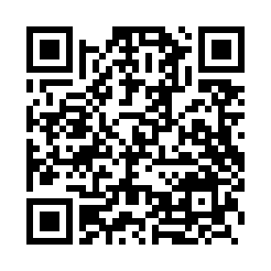
Dragon Media Wakelet
Take a few minutes to browse through the different dragons in media.
Choose one dragon example to focus on.
Determine if the author is portraying the dragon as evil, good, or neutral.
Use the note catcher to record your thoughts.
http://k20.ou.edu/dragons
Notes:
K20 Center. (n.d.). Wakelet. Tech tools. https://learn.k20center.ou.edu/tech-tool/2180

Slide 8
Find a Partner!
With your partner:
Share your conclusions about your chosen example.
Offer feedback regarding those conclusions.
Choose one member to share with the class.
Pair
Share

Slide 9
Jigsaw Reading
Everyone will get a number:
1 - Western Dragons
2 = Companion Dragons
3 = Eastern Dragons
4 = Egyptian Dragons
After reading your assigned part, you will “teach” your section to others.
Notes:
K20 Center. (n.d.). Jigsaw. Strategies. https://learn.k20center.ou.edu/strategy/179

Slide 10
Jigsaw Reading
Read your assigned text and use the Whylighting strategy as you read.
Highlight parts of the text you think are important.
Write why you highlighted each section in the margins of the page.
Notes:
K20 Center. (n.d.). Jigsaw. Strategies. https://learn.k20center.ou.edu/strategy/179
K20 Center. (n.d.). Why-lighting. Strategies. https://learn.k20center.ou.edu/strategy/128

Slide 11
Timer
K20 10 Minute Timer
Notes:
K20 Center. (2021, September 21). 10 Minute Timer. YouTube. https://youtu.be/9gy-1Z2Sa-c?feature=shared

Slide 12
Anchor Chart
Get into groups according to which text you read.
Work with your group to create an Anchor Chart poster that includes the most important information about your dragon.
This may include:
images
text
summary
K20 15 Minute Timer
Notes:
K20 Center. (n.d.). Anchor charts. Strategies. https://learn.k20center.ou.edu/strategy/2364
K20 Center. (2021, September 21). 15 Minute Timer. YouTube. https://youtu.be/m3zT2IxZQaw?feature=shared

Slide 13
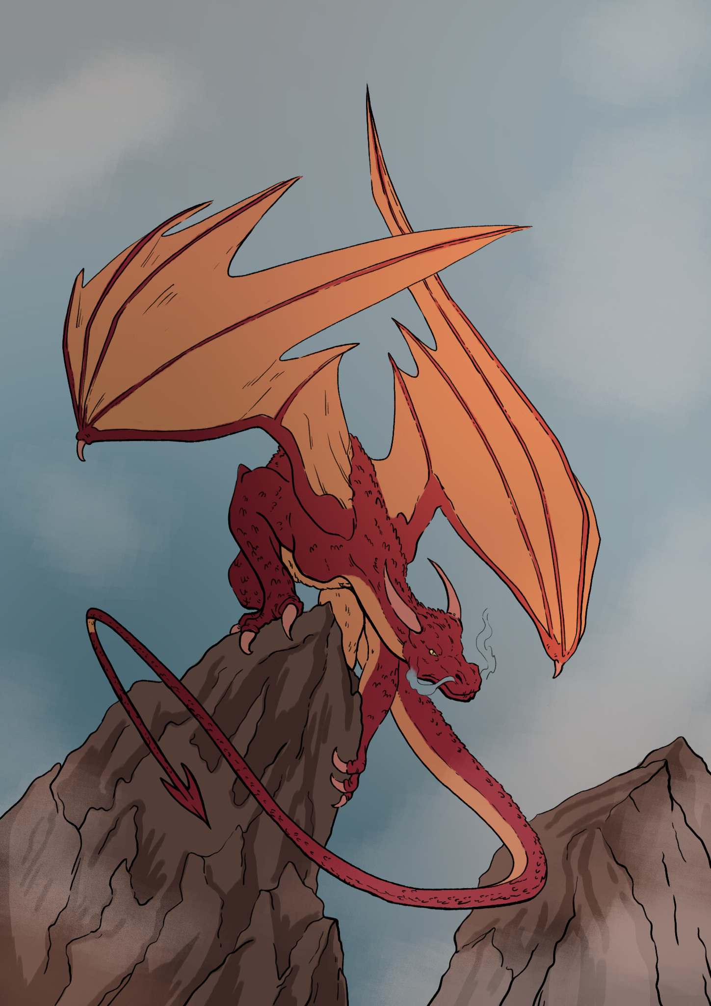
Reflect Back
How has your understanding of dragons changed?

Slide 14
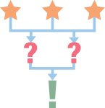
3-2-1
On a sheet of paper, write down:
Three things you have learned.
Two things you found interesting.
One question you still have.
Notes:
K20 Center. (n.d.). 3-2-1. Strategies. https://learn.k20center.ou.edu/strategy/117

Slide 15
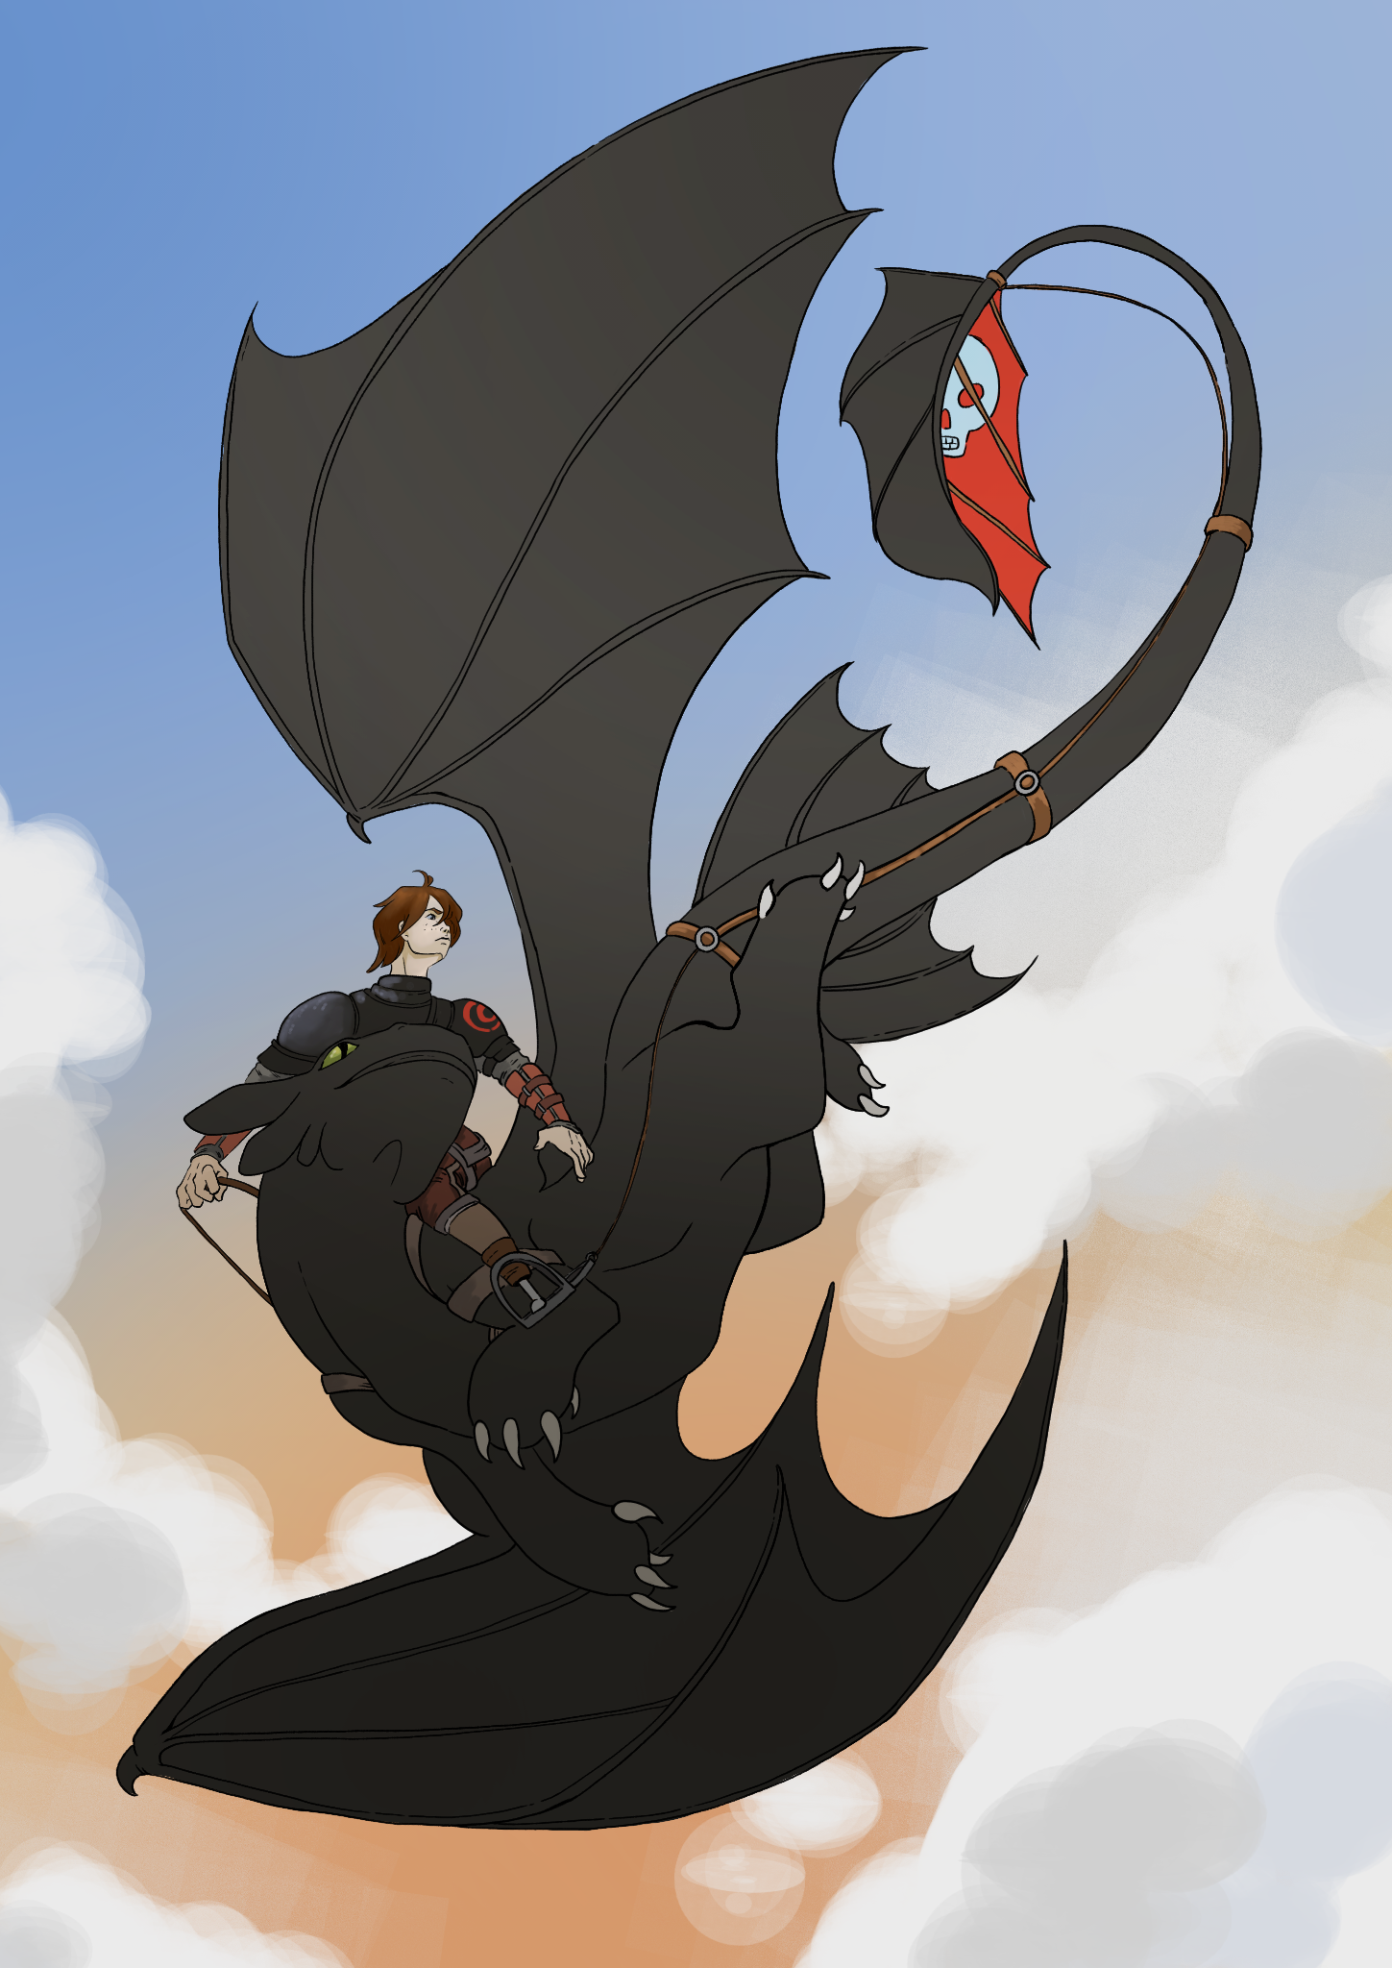
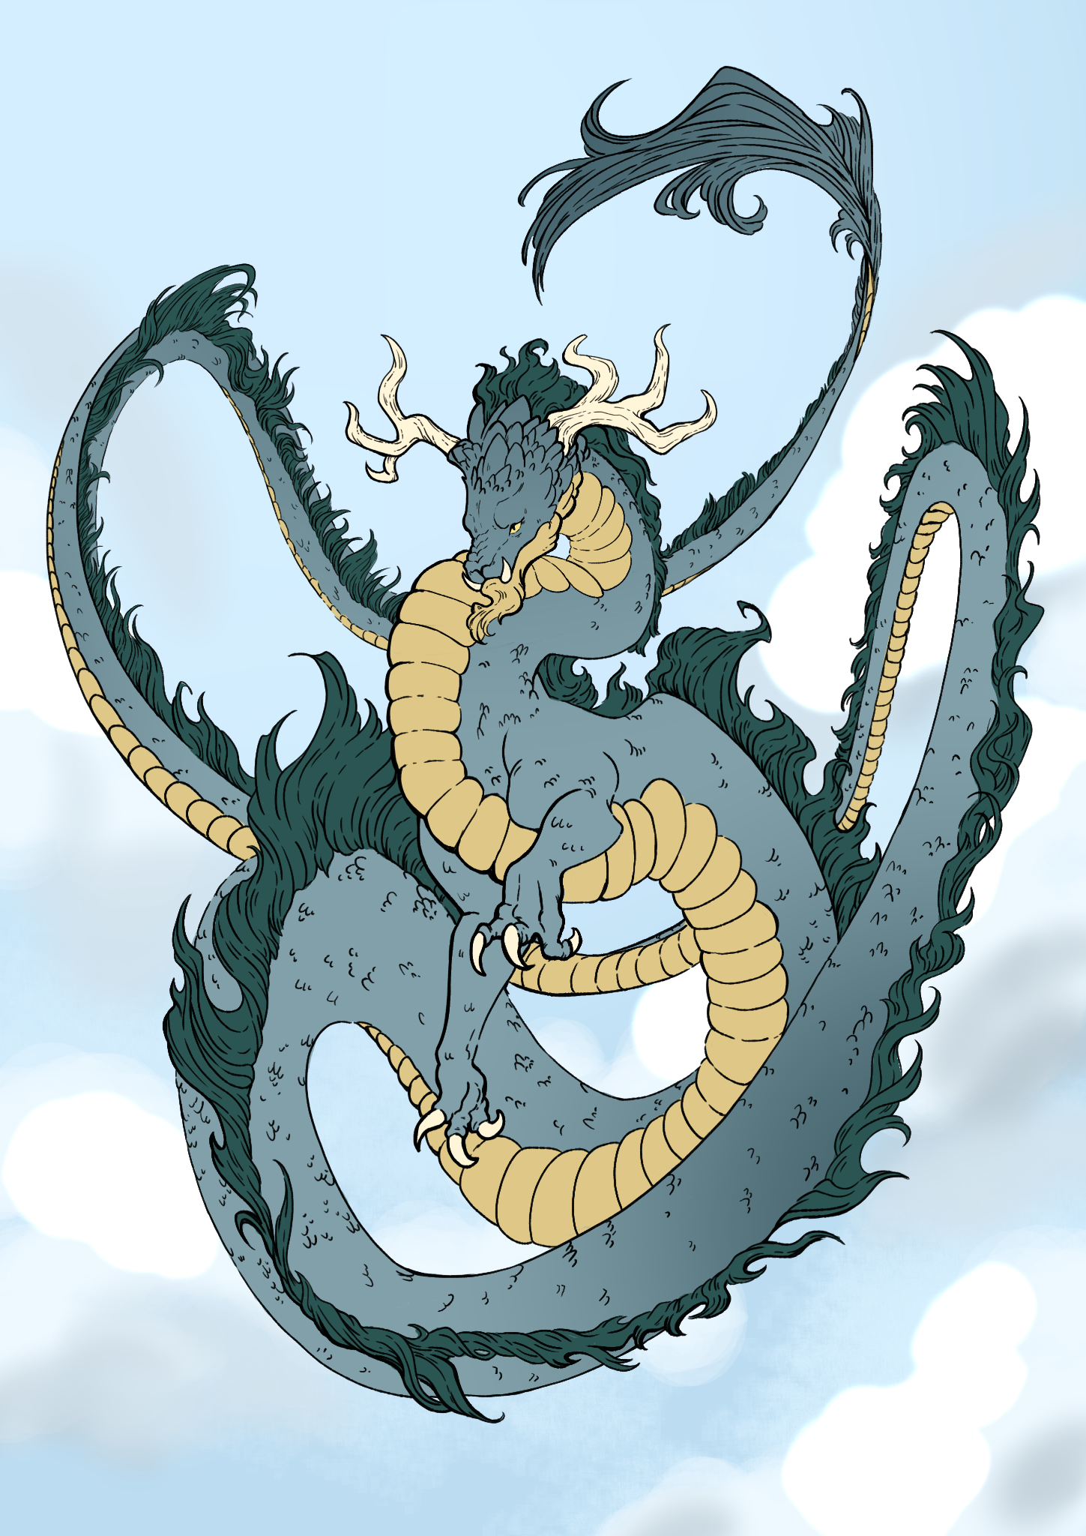
Stop That Dragon!
In an imaginary kingdom, each type of dragon has been accused of stealing a large sum of gold from the royal treasury.
YOU have been hired by the dragon to act as its defense in court and prove its innocence.

Slide 16
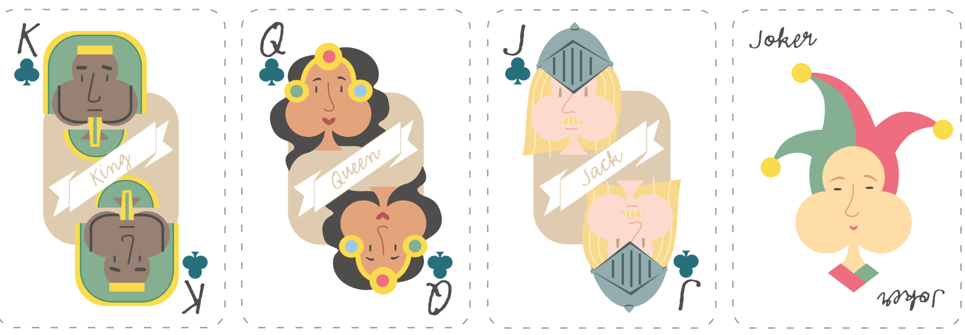
Grouping Cards
King
Eastern
Dragon
Queen
Companion Dragon
Jack
Western Dragon
Joker
Egyptian
Dragon
Notes:
K20 Center. (n.d.). Group Shuffle. Strategies. https://learn.k20center.ou.edu/strategy/4441

Slide 17
CER Example
Claim – Chromebooks are better school technology tools than laptops.
Evidence – Most applications on a Chromebook are web-based and store data online.
Reasoning – Because data is stored online, students can use any device to access it. This prevents loss of student work and provides them with the ability to work both from school and home.
Notes:
K20 Center. (n.d.). Claim, evidence, reasoning (CER). Strategies. https://learn.k20center.ou.edu/strategy/156

Slide 18
Create Your Defense
Get together with your card group (jokers with jokers, queens with queens, etc.).
Fill out the CER handout as a group using any resource from earlier for “evidence”—Wakelet, Jigsaw Articles, and/or Anchor Charts.
Come to a consensus about the defense of your client.
Choose your spokesperson, known as the lead defense attorney.

Slide 19
Timer
K20 15 Minute Timer
Notes:
K20 Center. (2021, September 21). 15 Minute Timer. YouTube. https://youtu.be/m3zT2IxZQaw?feature=shared

Slide 20
HEAR YE! HEAR YE!
ALL RISE!
The Honorable Judge declares that court is in session.
Present your arguments.
“Guilty” “Innocent”

Slide 21
Reflect Back
How did the historical and cultural origins of your dragon influence your defense?

Slide 22
Create Your Own Dragon
On the one-pager template, create your own dragon. You will need to:
Draw a picture of your dragon.
Write a physical description of your dragon.
Describe your dragon's personality.
Describe how your dragon interacts with people.
Describe the cultural significance of your dragon.
Notes:
K20 Center. (n.d.). One-pager. Strategies. https://learn.k20center.ou.edu/strategy/72

Slide 23
Gallery Walk
Place your completed dragons around the room, so they can easily be viewed.
Take a few moments to look at everyone’s original dragons.
Notes:
K20 Center. (n.d.). Gallery walk/carousel. Strategies. https://learn.k20center.ou.edu/strategy/118

