Slide 2
Beyond the Lecture
Exploring Life Lessons through The Last Lecture

Slide 3
Essential Question
What practical lessons about resilience, goal-setting, and building meaningful relationships can be applied to overcome our own challenges and make better life decisions?

Slide 4
Lesson Objectives
Analyze how Randy Pausch's perspectives on resilience in The Last Lecture apply to personal growth and decision-making.
Analyze how Pausch's approach to goal-setting affects achievement through obstacles.
Analyze how Pausch uses anecdotes, humor, and sincerity to connect with his audience, illustrating the value of relationships through his specific language and tone.
Prepare and deliver presentations to convey understanding of Pausch's lessons and application to real-life decision-making, supporting reflections with evidence.

Slide 5
ABC Graffiti
Brainstorm words or phrases that relate to lessons learned in life.
Form words, such as Adversity for the letter A or Wisdom for W…
Or alliterative phrases such as Trials and Tribulations for T.
K20 3-minute timer
Notes:
Have students move to their assigned stations with their colored marker in hand. Remind students to use only their group’s colored marker and pay attention to the focus for each round and rotate when time is called.
K20 Center. (Sep. 21, 2021) K20 Center 3 minute timer [Video]. YouTube. https://www.youtube.com/watch?v=iISP02KPau0

Slide 6
ABC Graffiti
Focus: Add additional words and phrases for the letters that haven’t already been addressed.
K20 2-minute timer
Notes:
K20 Center. (Sep. 21, 2021) K20 Center 2 minute timer [Video]. YouTube. https://www.youtube.com/watch?v=HcEEAnwOt2c
K20 Center. (n.d.). ABC graffiti. Strategies. https://learn.k20center.ou.edu/strategy/96

Slide 7
ABC Graffiti (Optional Round)
Focus: Add more words and phrases for the letters that haven’t already been addressed. You may use outside sources for this round!
K20 3-minute timer
Notes:
K20 Center. (Sep. 21, 2021) K20 Center 3 minute timer [Video]. YouTube. https://www.youtube.com/watch?v=iISP02KPau0

Slide 8
Six-Word Memoir
After the final round of ABC Graffiti, return to your original poster and synthesize the poster’s information into a Six-Word Memoir.
K20 3-minute timer
Notes:
For this activity, incomplete sentences are allowed. Breaking up ideas into chunks makes them easier to remember, like dashes do for phone numbers. Less is more. Aim for accuracy and focus on word choice. (Ex. Fail, learn, grow—repeat without fear.)
K20 Center. (Sep. 21, 2021) K20 Center 3 minute timer [Video]. YouTube. https://www.youtube.com/watch?v=iISP02KPau0
K20 Center. (n.d.). Six-word memoir. Strategies. https://learn.k20center.ou.edu/strategy/75

Slide 9
Last Lecture
Explore the author’s reflections on his life and the lessons he wants to share.
The Last Lecture trailer
Notes:
Nicolson., K. (2012, Mar. 28) The last lecture movie trailer. [Video]. YouTube. https://www.youtube.com/watch?v=TbeCfNWr9Ls&t=75s

Slide 10
Chat Stations
Form groups of three to four.
Read the card at each station and jot down key findings, observations, and predictions.
K20 2-minute timer
Notes:
K20 Center. (Sep. 21, 2021) K20 Center 2 minute timer [Video]. YouTube. https://www.youtube.com/watch?v=HcEEAnwOt2c
K20 Center. (n.d.). Chat stations. Strategies. https://learn.k20center.ou.edu/strategy/944

Slide 11
Novel in a Day
As a class, read Chapter 1, discuss, and create a summary together.
Let’s read!
Then, work with your assigned group to read and summarize your designated chapters.
Notes:
The instructor will need to make a copy of the summary slides so that they can edit it for their assignments. This assignment takes about four days to complete.
K20 Center. (n.d.). Novel in a day. Strategies. https://learn.k20center.ou.edu/strategy/74

Slide 12
Novel in a Day
In your group, Jigsaw the assignment by splitting up chapters.
Read!
When you finish, write a summary of the chapters and add to the corresponding slide in the Last Lecture Summary slide deck.
Connect your ideas from the reading in a reflection statement.
Notes:
K20 Center. (n.d.). Jigsaw. Strategies. https://learn.k20center.ou.edu/strategy/179 See the Jigsaw strategy for the procedure, if necessary. K20 Center. (n.d.). Novel in a day. Strategies. https://learn.k20center.ou.edu/strategy/74

Slide 13
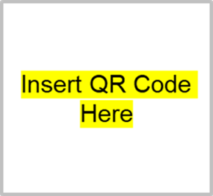
Novel in a Day
To access the “Last Lecture Summary” slide deck:
Type in [insert url]
Scan QR code
Notes:
K20 Center. (n.d.). Novel in a day. Strategies. https://learn.k20center.ou.edu/strategy/74

Slide 14
Novel in a Day
Present your group’s slide to the class.
Use your own words to present the summary without reading the slide.
Notes:
K20 Center. (n.d.). Novel in a day. Strategies. https://learn.k20center.ou.edu/strategy/74

Slide 15
Inverted Pyramid
Collaborate in pairs to answer the discussion questions.
K20 20-minute timer
Notes:
K20 Center. (Sep. 21, 2021) K20 Center 20 minute timer [Video]. YouTube. https://www.youtube.com/watch?v=bjcwzinQlEE
K20 Center. (n.d.). Inverted pyramid. Strategies. https://learn.k20center.ou.edu/strategy/173

Slide 16
Inverted Pyramid Discussion Questions
What key life lessons does Randy Pausch share?
How does Pausch balance humor with serious topics?
What does Pausch mean when discussing "head fakes." How does it relate to life and learning?
What are the core values Pausch emphasizes in the speech?
How does Pausch demonstrate resilience and optimism in the face of adversity?
Which parts of his story resonate with you and why?
What personal experiences or perspectives does Pausch draw from to convey these lessons?
How do the author's cultural, historical, or global influences shape how he presents these lessons?
Notes:
Unhide this slide if you choose not to print the Inverted Pyramid handout.

Slide 17
Inverted Pyramid
Join another partner pair to discuss your answers to the discussion questions.
K20 15-minute timer
Notes:
K20 Center. (Sep. 21, 2021) K20 Center 15 minute timer [Video]. YouTube. https://www.youtube.com/watch?v=m3zT2IxZQaw K20 Center. (n.d.). Inverted pyramid. Strategies. https://learn.k20center.ou.edu/strategy/173

Slide 18
Inverted Pyramid
Collaborate in pairs to answer the discussion questions.
K20 10-minute timer
Notes:
K20 Center. (Sep. 21, 2021) K20 Center 10 minute timer [Video]. YouTube. https://www.youtube.com/watch?v=9gy-1Z2Sa-c
K20 Center. (n.d.). Inverted pyramid. Strategies. https://learn.k20center.ou.edu/strategy/173

Slide 19
Rejection, Failure, and Grit
How do you define the following:
Rejection?
Failure?
Grit?
Rejection and Failure
Notes:
Jiang, J. (2015 May) What I Learned from 100 Days of Rejection [Video]. YouTube. https://www.ted.com/talks/jia_jiang_what_i_learned_from_100_days_of_rejection Watch from 12:34 to end.

Slide 20
Rejection, Failure, and Grit
Grit
Notes:
Angela Lee Duckworth. (2013 Apr) Grit: The Power of Passion and Perseverance [video]. YouTube. https://www.ted.com/talks/angela_lee_duckworth_grit_the_power_of_passion_and_perseverance
Watch from 03:19-05:47

Slide 21
Driving Question Board
What would you do if you weren’t afraid to fail?
How might your life change if you embraced failure as a stepping stone rather than an obstacle?
Notes:
K20 Center. (n.d.). Driving question board. Strategies. https://learn.k20center.ou.edu/strategy/1511

Slide 22
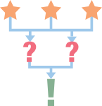
3-2-1
What are three things you learned?
What are two questions you still have?
What is one thing you found interesting?
Notes:
Hand out a sheet of paper or sticky note to each student.
Students will need to write down the answers to these three questions to hand in.
K20 Center. (n.d.). 3-2-1. Strategies. https://learn.k20center.ou.edu/strategy/117

Slide 23
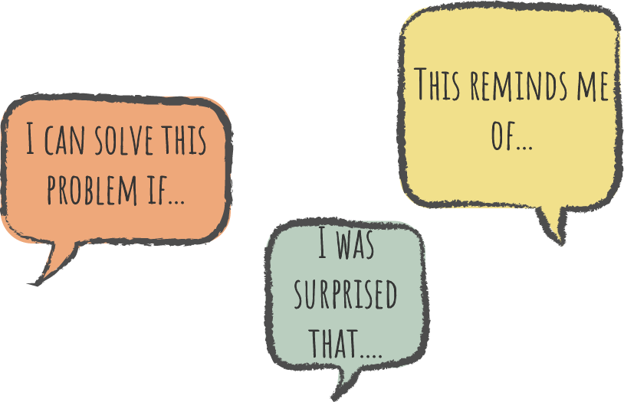
Say Something
Use your Say Something handout to construct probing questions from each section of the handout.
Your questions will form the basis for today’s discussion.
Notes:
K20 Center. (n.d.). Say something. Strategies. https://learn.k20center.ou.edu/strategy/778

Slide 24
Identify…
The main themes or messages that the author is trying to convey;
Specific examples or stories the author uses to illustrate these themes;
How the author's perspective and writing style contribute to the meaning of the text;
Pausch's use of specific language, tone, and narrative techniques and how they impact the reader's understanding and interpretation of the life lessons;
The perspectives or experiences Pausch draws upon which shape how he presents these lessons.
Notes:
Record student observations on the board or in a slide for later reference.

Slide 25
Cognitive Comic
Select one key theme from The Last Lecture to explore further.
Create a visual representation of using Cognitive Comics.
Use quotes and personal reflections to help tell your story.
Notes:
K20 Center. (n.d.). Cognitive comics. Strategies. https://learn.k20center.ou.edu/strategy/198

Slide 27
Mirror, Binoculars, Microscope
Write an answer for each prompt below.
Mirror: (internal reflection): What have I learned about myself by reading this book?
Microscope: (close inspection): What lessons required closer inspection?
Binoculars: (global reflection):What value does The Last Lecture have for the world?
Notes:
K20 Center. (n.d.). Mirror, microscope, binoculars. Strategies. https://learn.k20center.ou.edu/strategy/3020

Slide 28
Vlogit: Your Own “Pearl of Wisdom”
Create a video essay of your “Last Lecture” using VlogIt.
What is your lasting legacy?
What is your advice to underclassmen?
How do you foresee your life milestones in the future as maximizing your potential?
Notes:
K20 Center. (n.d.). VlogIt. Strategies. https://learn.k20center.ou.edu/strategy/2556

Slide 29
Success is not final, failure is not fatal: it is the courage to continue that counts.
– Winston Churchill

Slide 30
So, even if there are failures, it brings experience. Experience is what you get when you didn't get what you wanted. And experience is often the most valuable thing you have to offer.
— Randy Pausch

