Slide 2
Go Ahead, Make My…Number
Order of Operations

Slide 3
Pick a Whole Number Between 0 and 20
Work with your partner to make the number you’ve selected.
You can only use four 4’s to make your number.
You can use any operation you wish.
(addition, subtraction, multiplication, division)
Examples:
For the number 15, you could use 4 x 4 – 4 ÷ 4.
For the number 0, you could use 4 + 4 – 4 – 4.
Notes:
Repeat for a few rounds.

Slide 4
Share Your Solutions
Write out a solution on the board that you found with your partner.

Slide 5
Order of Operations
Parentheses | ()
Exponents | x³
Multiplication | ·
Division | ÷
Addition | +
Subtraction | -
Always work left to right
Work operations in this order →
Example:
4 + 4 ÷ 4 + 4 = 9
  or
(4 + 4) ÷ (4 + 4) = 1
Notes:
With the solutions on the board, you will next add parentheses or brackets around students' operations. Compare the answers to what they would be if they followed the Order of Operations rules so that they can begin seeing how the order of operations works.
For example, if a student comes to the board and writes out 4+4/4 + 4=1, (4+4) and (4+4) to make this equation true. Explain that without the parentheses, if you used order of operations, you'd have to divide 4/4 first to get 1. Then 4+1+4 would be 9.
Explain that without the parentheses, if you used order of operations, you'd have to divide 4/4 first to get 1. Then 4+1+4 would be 9. Adding brackets or parentheses allows us to prioritize certain operations over others. The operation enclosed in parentheses takes precedence in the order of operations.
Image: https://scottiesinfifth.weebly.com/order-of-operations.html

Slide 6
Essential Question
Why does the order of operations matter in mathematics?

Slide 7
Lesson Objective
Evaluate a numerical expression using the Order of Operations.

Slide 8
Practice Order of Operations
Stay with your partner and determine who will be Student 1 and Student 2.
Roll one random polyhedral die.
Roll an operation die, placing it to the right of the first polyhedral die.
Roll another polyhedral dice and place it to the right of the operation die.
Continue this process until all four dice have been rolled.
Insert the parentheses anywhere in the expression.
Student 1 will solve the created problem on their own.

Slide 9

Check Your Work
Student 2 checks Student 1’s work.
Use I Notice/I Wonder to model feedback
Example: "I notice you did _____, I wonder what would happen if you had tried_____."
When both partners are happy with the final solution, be prepared to share your solution with the class.

Slide 10
Switch Roles
Roll one random polyhedral die.
Roll an operation die, placing it to the right of the first polyhedral die.
Roll another polyhedral dice and place it to the right of the operation die.
Continue this process until all four dice have been rolled.
Insert the parentheses anywhere in the expression.
Student 2 will solve the created problem on their own.
Student 1 will check work and use I Notice/I Wonder statements.
Notes:
Switch it up as many times as you think is needed for students to get the concept fully

Slide 11
Target Number
Remain with your partner.
Roll the red target number die and set it aside. This is your Target Number.
Roll remaining dice.
Rearrange the numbers and use operations in any form to get as close to the target number as possible.
Use parentheses as needed.

Slide 12


I Think/ We Think
Watch the Ma and Pa Kettle video twice.
First watch: Write questions you have in the “I Think” column.
Second watch: Talk with partner and take notes in the “We Think” column.
Notes:
https://www.youtube.com/watch?v=jSrPlf4GBHc&t=9s

Slide 13
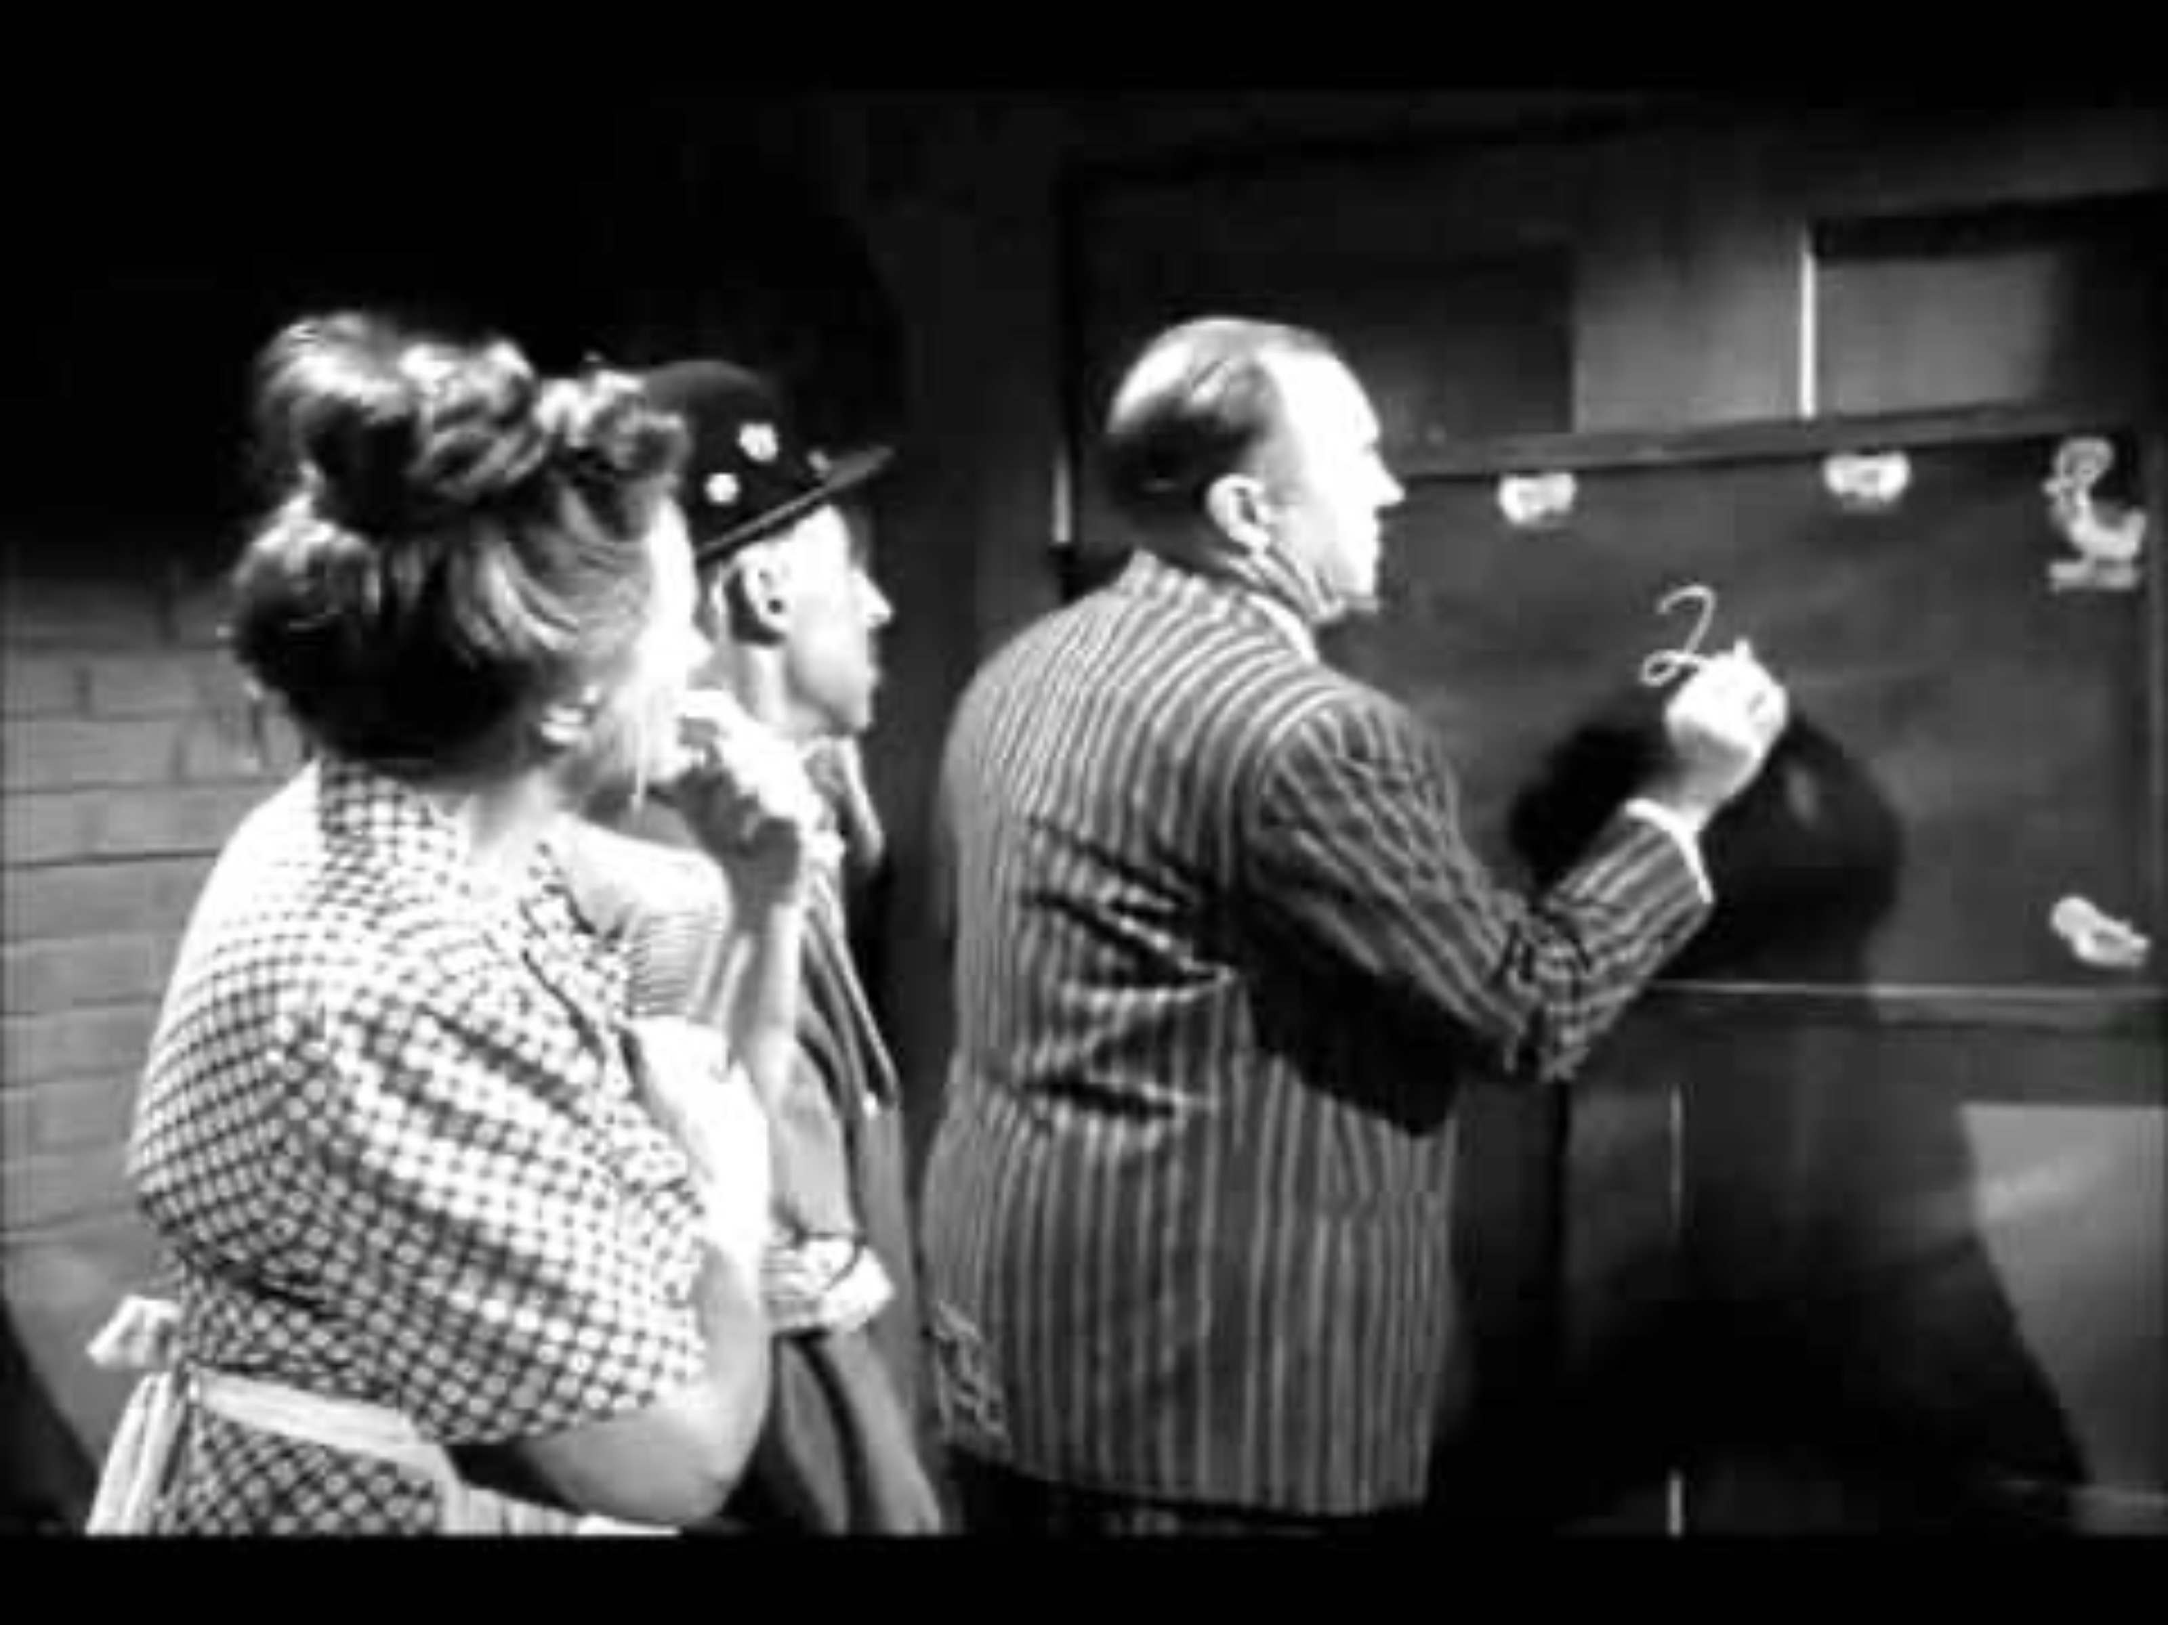
Notes:
https://www.youtube.com/watch?v=jSrPlf4GBHc

