Slide 2
Plotting the Path from Costs to Cash Flow
Business Management and Cost of Production

Slide 3
Essential Question
How do we interpret and compare graphs to show production costs?

Slide 4
Lesson Objectives
Calculate business costs including fixed and variable costs.
Analyze business data showing production costs using charts and graphs.

Slide 5
Card Sort
Work with your group to match each vocabulary word to the correct definition and picture.
Be ready to discuss your choices.
Notes:
K20 Five-Minute Timer. K20 Timer K20 Timer - 00:05:00
K20 Center. (n.d.). Card Sort. Strategies. https://learn.k20center.ou.edu/strategy/147

Slide 6
Vocabulary Term | Definition | Picture
Cost of Production | Expenses of manufacturing a product
Fixed Cost | Prices do not change regardless of production cost
Output | Number of units produced
Variable Cost | Prices change due to production cost
Double Bar Graph | A graph that displays data using two sets of bars
Notes:
K20 Center. (n.d.). Card Sort. Strategies. https://learn.k20center.ou.edu/strategy/147

Slide 7
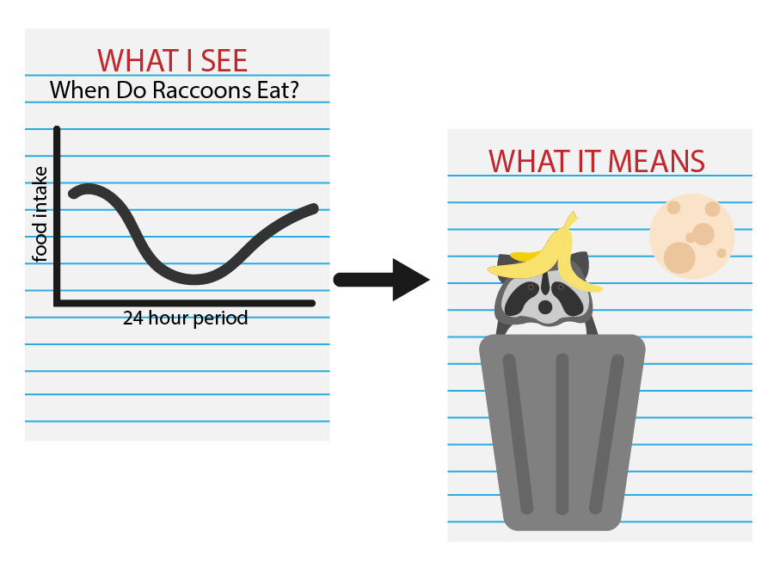
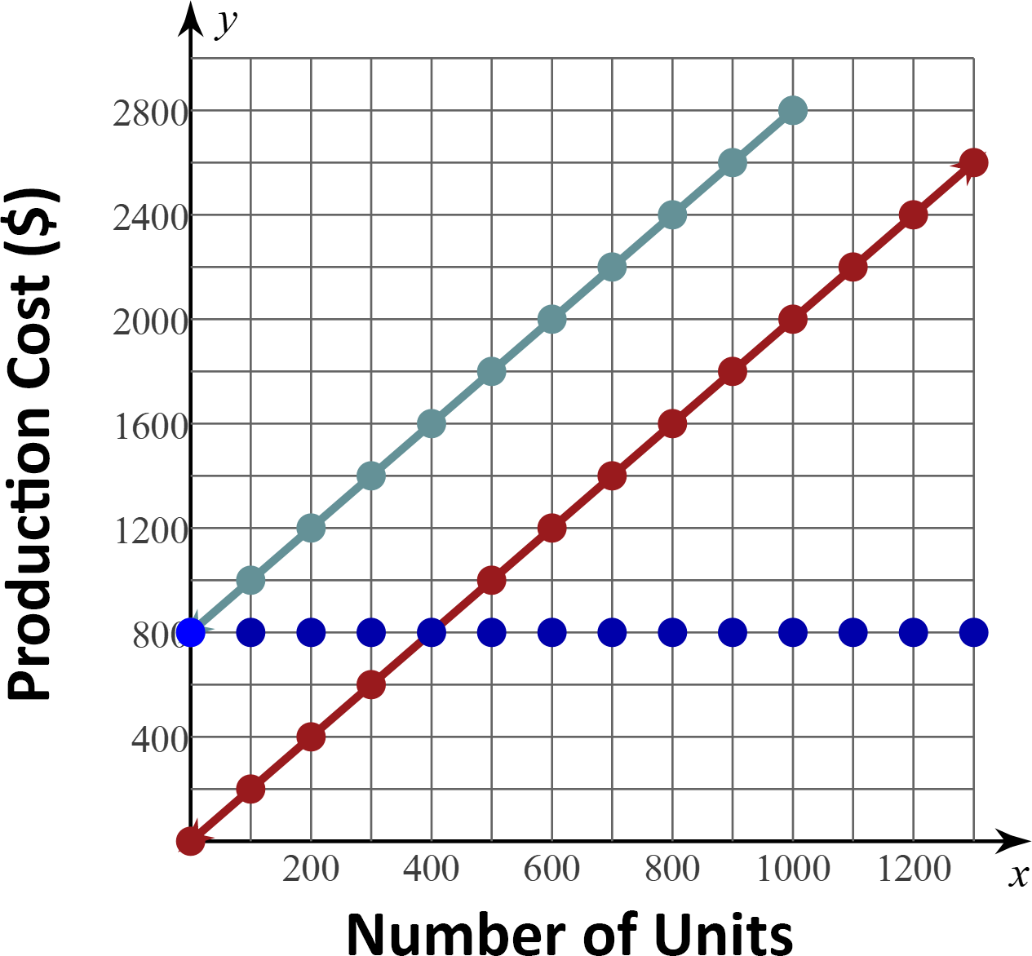
WIS-WIM
What do you see?
What does it mean?
Notes:
K20 Center (n.d.) WIS-WIM. Strategies. https://learn.k20center.ou.edu/strategy/1201

Slide 8
Scenario
Imagine that you are a small business owner who produces and sells a product. You want to take a closer look at your fixed and variable costs and calculate the total cost of production to assess profitability and ensure you are pricing your product correctly.

Slide 9
WIS-WIM
With your partner, chose a station where you want to start.
Answer the question on the poster and record it on your handout.
Once you’ve found the answer, use the instructions at the bottom of the poster to learn which station to visit next.
Notes:
K20 Center (n.d.) WIS-WIM. Strategies. https://learn.k20center.ou.edu/strategy/1201

Slide 10
WIS-WIM
Station 1- $800
Station 3- $1800
Station 2- $800
Station 5- $1200
Station 4- $2600
Station 6- $3400
Notes:
K20 Center (n.d.) WIS-WIM. Strategies. https://learn.k20center.ou.edu/strategy/1201

Slide 11
Let’s Discuss the Questions.
Use your Guided Notes handout to record your thoughts as we discuss.
Use your notes to help you answer the questions at the bottom of your handout.

Slide 12
Let’s Discuss
What do you notice about the graph of the fixed cost?
What is the fixed cost if nothing is produced?
What is the fixed cost if 1000 units are produced?
What is the total cost of producing nothing?
What is the total cost of producing 1000 units?
What is the relationship between the graph of total costs and the graphs of fixed and variable costs?
Notes:
K20 Center. 10-minute timer. YouTube. https://www.bing.com/videos/riverview/relatedvideo?q=K20+timer+10+minutes&refig=3d33ddc2266f4bf0b11e6f4de883e8ea&pc=W099&ru=%2fsearch%3fq%3dK20%2btimer%2b10%2bminutes%26form%3dANNH01%26refig%3d3d33ddc2266f4bf0b11e6f4de883e8ea%26pc%3dW099&mmscn=vwrc&mid=741ABF6B70F27F3DD94A741ABF6B70F27F3DD94A&FORM=WRVORC
Additional guiding questions:
“How would they use the data to project fixed, variable and total costs for outputs over 1200 units?”
“Suppose the variable cost is $3 per unit and the fixed cost is $1,000. What is the total cost to produce 2400 units?”

Slide 13
Scenario
You have taken a closer look at your fixed and variable costs and calculated the total cost of production to assess profitability.
Compare fixed and variable costs for different times of the year.

Slide 14
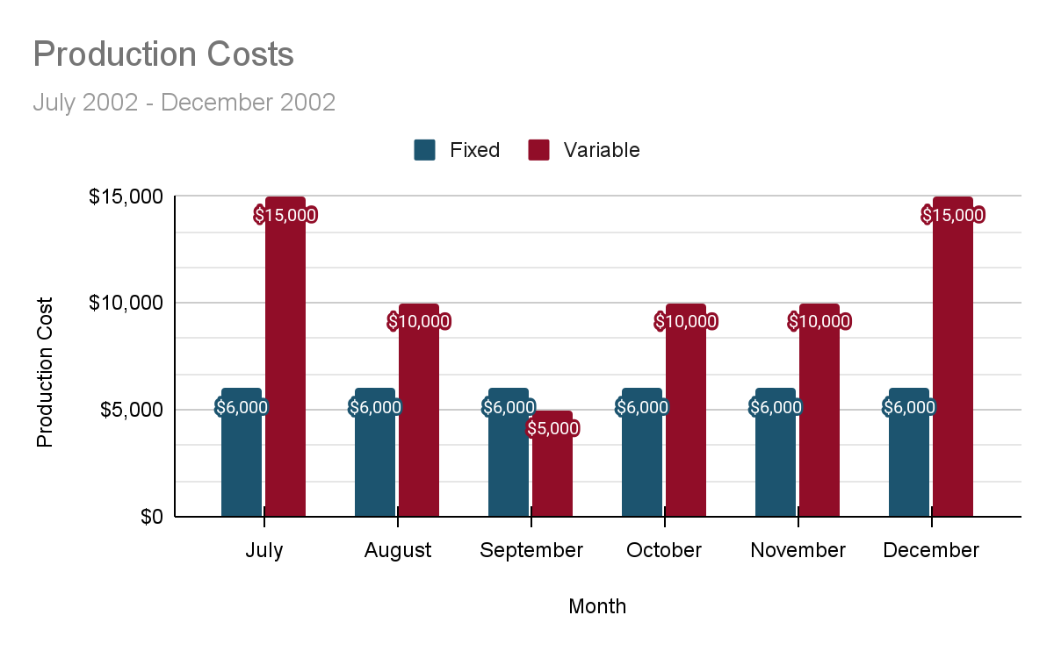
I Notice, I Wonder
What do you notice about the double bar graph?
What do you wonder about the double bar graph?
Notes:
K20 Center. (n.d.). I notice, I wonder. Strategies. https://learn.k20center.ou.edu/strategy/180

Slide 15
Real-World Connections
While watching the video, listen to Megan Cotton and Makeba Griffin discuss the cost of business production and how they use line graphs and bar graphs in their businesses.
Think of the following questions:
What are three things you learned?
What are two questions you still have?
What is one thing you found interesting?
Record your questions on your 3-2-1 handout.
Notes:
K20 Center. (n.d.). 3-2-1. Strategies. https://learn.k20center.ou.edu/strategy/117

Slide 16
ICAP Video
Notes:
https://www.youtube.com/watch?v=RHCaf0eRK40

Slide 17
3-2-1 Share out
What are three things you learned from Megan and Makeba?
What are two questions you still have?
What is one thing you found interesting?
How do Megan and Mekeba use line and bar graphs in their business?
Notes:
K20 Center. (n.d.). 3-2-1. Strategies. https://learn.k20center.ou.edu/strategy/117

Slide 18
Real-World Connections
We will be hosting a community member in our class to discuss the cost of business production.
Take a few minutes to come up with some questions you would like to ask them.
Record your questions on your Note Catcher handout.
Notes:
K20 Center. (n.d.). Cornell notes system. Strategies. https://learn.k20center.ou.edu/strategy/56

Slide 19
I used to think, but now I know
What is one thing you used to think about business and cost of production and what do you know now based on what you have learned?
Notes:
K20 Center. (n.d.). I used to think . . . but now I know. Strategies. https://learn.k20center.ou.edu/strategy/137

