Slide 2
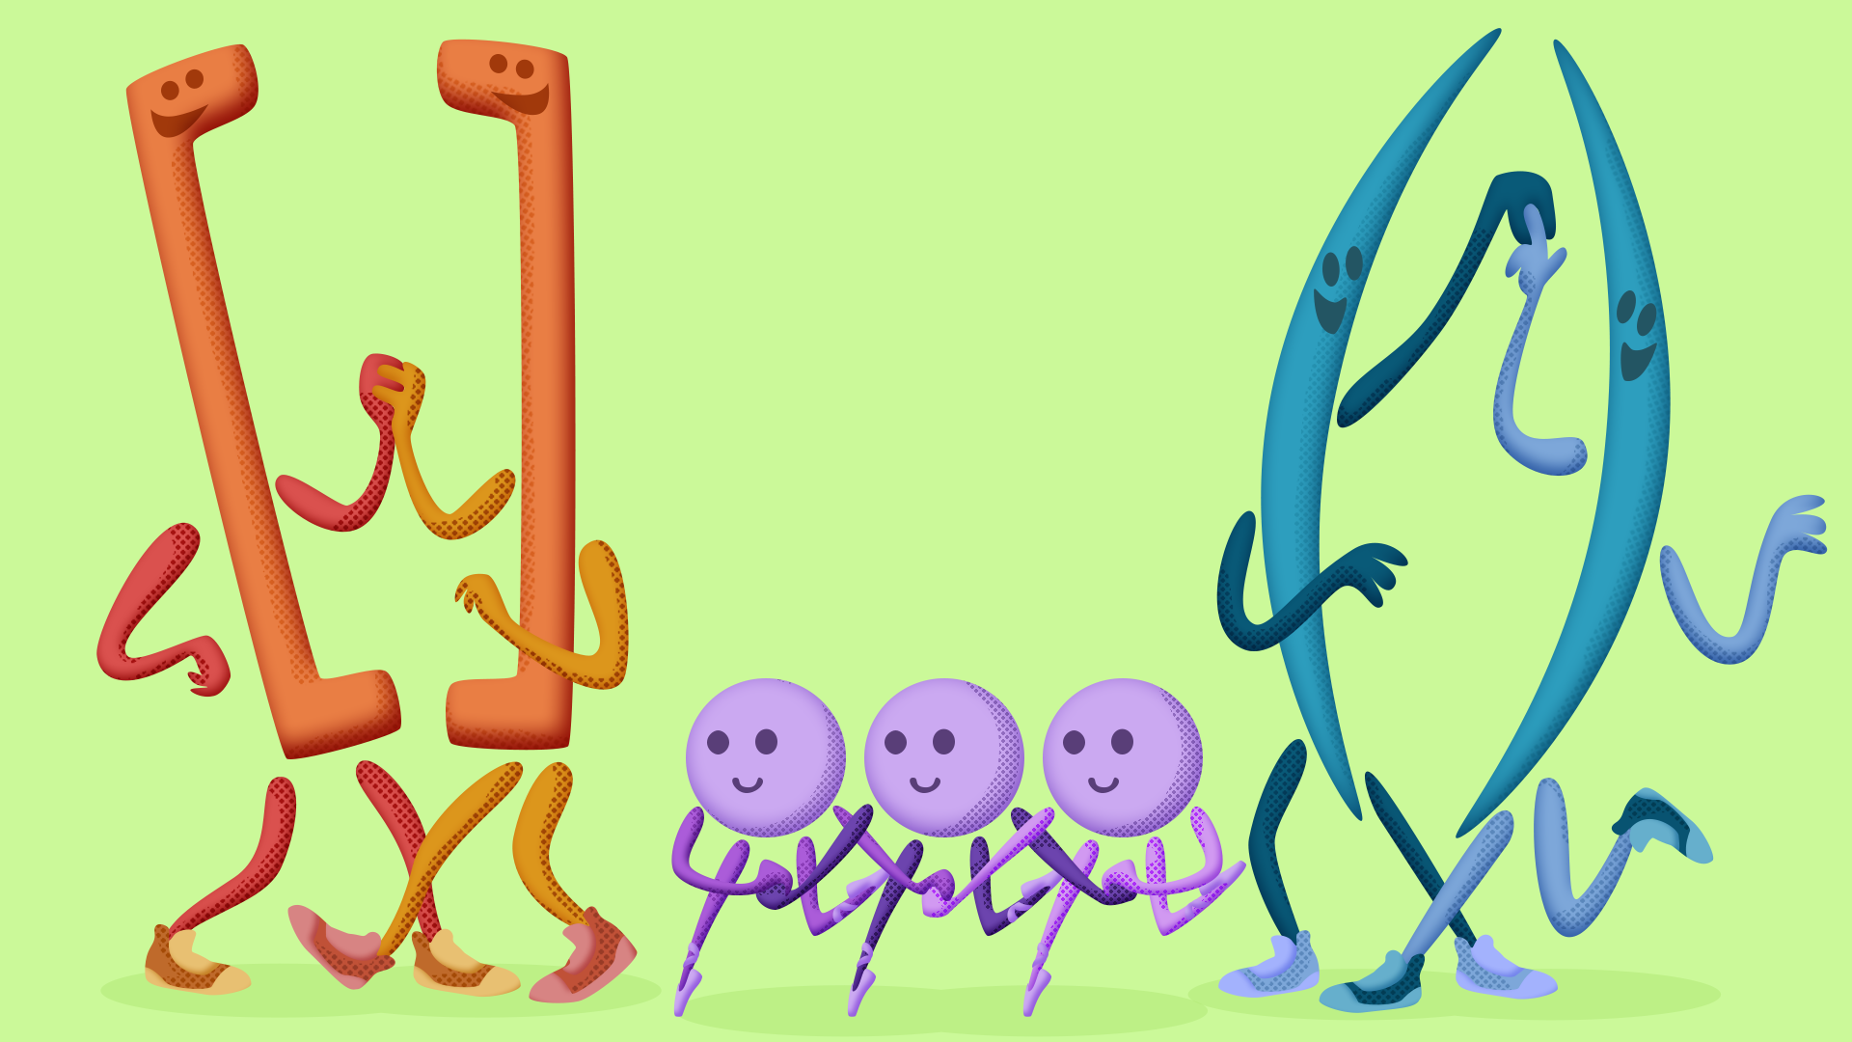
A bracket, a parentheses, and an ellipsis walk into school. The principal looks at them and says, "What are you guys doing here?"
The bracket says, "We're here for structure." The parentheses shrugs, "I’m just here for support." And the ellipsis says, "I’m... just here to leave things open-ended."
Notes:
Joke by ChatGPT

Slide 3
Cooking with Clarity
Special Grammar Ingredients:
Brackets, Parentheses, and Ellipses

Slide 4
Essential Question
How are brackets, parentheses, and ellipses used…
in mathematics?
in science?
in scripts, like plays or closed captioning?
in academic writing?

Slide 5
Lesson Objectives
Explore when and why to use brackets, parentheses, and ellipses.
Explain the use of brackets, parentheses, and ellipses in formal and informal writing.

Slide 6
Mentimeter
Where have you seen,
or where would you expect to see,
examples of
brackets [ ]
parentheses ( )
ellipses …
in everyday language use?

Slide 7
Affinity Process
Think of rules that explain how brackets, parentheses, and ellipses function.
Write one rule on each sticky note. For example,
Use an ellipsis when …

Slide 8
Affinity Process
With a partner, compare sticky notes and group similar notes together. Label each group of notes as a category.

Slide 9
Affinity Process
Work with another partner pair to from a group of four. Compare sticky notes, grouping similar notes together.

Slide 10
Affinity Process
Share the rules you created, grouping them together in a class list.

Slide 11
Sweet Talk
Find the person(s) with the same card as you to form a group.

Slide 12
Strategy: Jigsaw
Move with your assigned group to analyze the samples at each center. Take your Note Catcher with you.
How do the examples at each station validate or adjust the rules the class established earlier?

Slide 13
Lessons in Chemistry
Notes:
Cinematic Wonders. (2023, October 23). Lessons in Chemistry Season 1 Episode 4: Brie Larson’s Elizabeth Zott handles a bully like a Boss! YouTube. https://www.youtube.com/watch?v=nvjdzBLnGho

Slide 14
Lessons in Chemistry
Does the script require added parentheses, brackets, or ellipses?
Notes:
Distribute the episode scripts and have students add parentheses, brackets, and ellipses to the script, if needed.

Slide 15
Lessons in Chemistry
Answer Key
[Elizabeth Zott enters.]
Uh… Nurse auditions are downstairs to your left. (Either ellipse or dash are correct.)
[daughter]
[To Amanda]
[to a secretary in the office]
[running outside]
Uh, no… (A dash is also acceptable here.)

Slide 16
Criteria | Excellent (4 pts) | Proficient (3 pts) | Developing (2 pts) | Emerging (1 pt)
Grammatical Clarity and Punctuation | Precise punctuation and grammar; varied sentence structure | Solid grammar; mostly correct punctuation; few errors that don’t impede meaning | Some grammatical inconsistencies; several punctuation errors; repetitive sentences | Significant errors; frequent punctuation mistakes; unclear sentence structure
Creativity and Thematic Appropriateness | Highly original; sophisticated creative thinking; imaginative and meaningful choices | Creative with original elements; thoughtful narrative; maintains coherence | Some creative elements; predictable narrative; loose connection to themes | Minimal creativity; clichéd choices; fails to engage with themes
Dialogue | Exceptional use of dialogue to reveal character and advance plot; precise, evocative language; seamless collaborative performance | Effective character development through speech; coordinated team presentation; some varied syntax and literary elements | Basic dialogue with limited depth; inconsistent team coordination | Weak or incomprehensible dialogue; flat, unimaginative language; poorly coordinated performance

Slide 17
Tic-Tac-Toe Choice Board
Choose three boxes in any row to complete a Tic-Tac-Toe.

