Slide 2
The Monkey’s Paw: Be Careful What you Wish for
ELA
7th or 8th Grade

Slide 3
Guiding Questions
What is foreshadowing?
How do authors use foreshadowing in their writing?

Slide 4
Have you ever wished for something to come true?
Aladdin Video here
This Photo by Unknown Author is licensed under CC BY-NC-ND
Notes:
https://youtu.be/OczOUJw1Z7k

Slide 5
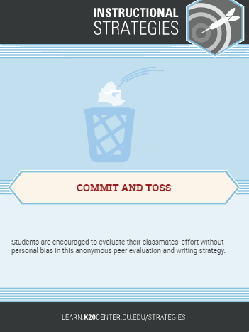
Commit and Toss: What would you wish for?
On your paper, write down something you wish for—for yourself, for someone else, or for the world.
Crumple up your paper and wait for instructions.

Slide 6
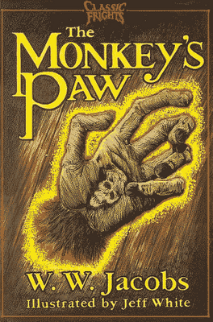
Monkey Paw Audiobook
Audiobook here
This Photo by Unknown Author is licensed under CC BY-SA
Notes:
https://www.youtube.com/watch?v=NmYDQcaB2c8&feature=youtu.be

Slide 7
Foreshadowing
Foreshadowing is a literary device that give readers clues or hints about what might come later in the story.
Example: The author of a mystery novel might use foreshadowing in the first chapter of her book to give readers an idea that a murder is coming in a later chapter.

Slide 8
My Prediction
On the Frayer Model, write out your prediction of how the story might end based on what you have heard so far.
“I think the story will end (happily or badly) because…
This Photo by Unknown Author is licensed under CC BY

Slide 9
Highlighting Activity
With your partner…
Read through the story again.
Look for phrases or sentences that might foreshadow what will happen next.
Highlight these parts.
This Photo by Unknown Author is licensed under CC BY

Slide 10
Class Discussion
Who was knocking on the door?
What was mother's reaction?
What was the father's reaction?
Was the ending what you expected? Why or why not?

Slide 11
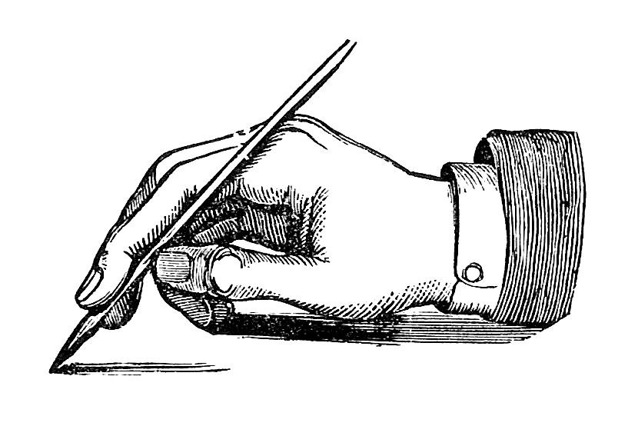
You Be The Author
This Photo by Unknown Author is licensed under CC BY-SA-NC
Choose one of these writing prompts:
Write a new ending where the White family’s life ends happily in spite of the wishes.
There is one more wish left on the monkey’s paw. The paw has been given to you. Do you still want the wish? Why or why not?
Write an ending where Mrs. White manages to open the door. What happens next?

