Slide 2
Hooked on Conics
Introduction to Conic Sections

Slide 3
Essential Question
How do the key features of conic sections help in constructing the equations and graphs?

Slide 4
Lesson Objectives
Identify and define features of each of the types of conic sections.
Write equations for conics using the key features.
Use key features to accurately sketch conic sections on a graph.

Slide 5
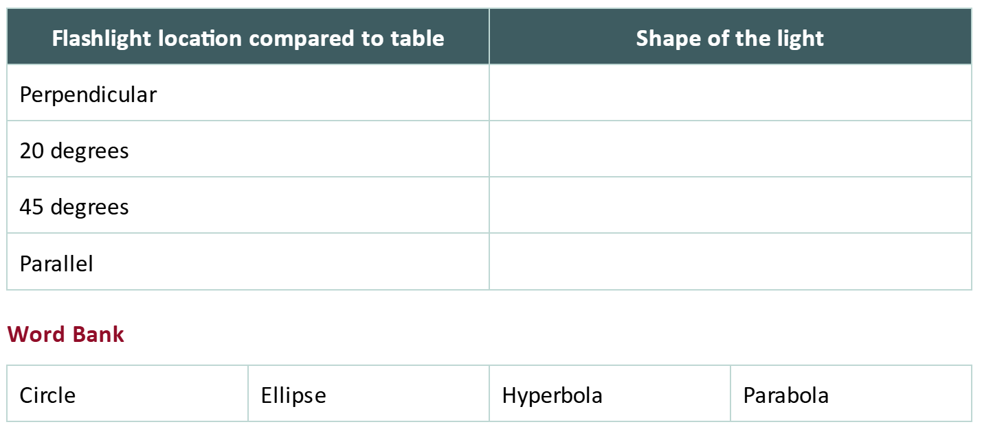
Playing with Light
Use the word bank to record what shape the light is making when holding the flashlight at different angles on the table.

Slide 6
Card Sort
Match the five equations, graphs, and key features together for each conic section.

Slide 7
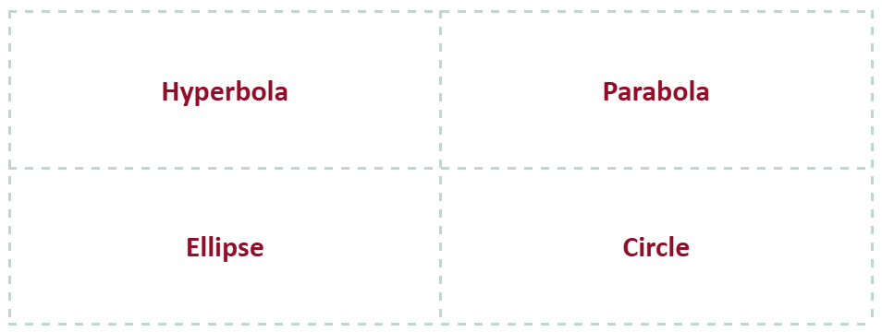
Card Sort
Optional
Locate the category cards.

Slide 8
Card Sort
Optional
Locate the standard form of each conic section.
Match the equation with its correct conic section.
Hint: They are shaded grey.

Slide 9
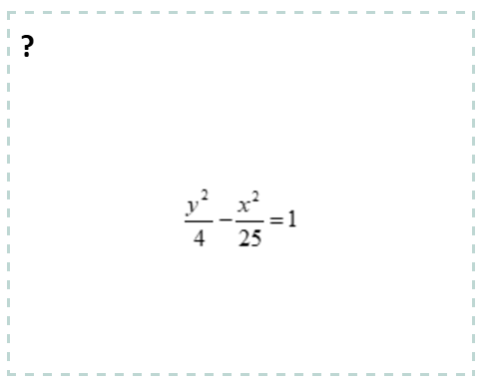
Card Sort
Optional
Locate and match each equation card with its appropriate conic section.

Slide 10
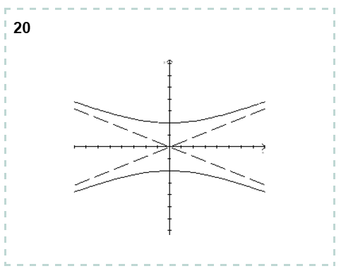
Card Sort
Optional
Classify the graph cards by placing them under one of the four conic sections.

Slide 11
Card Sort
Optional
Circles
How do you identify circles, their equations, and key features from their graphs and equations?
Pull out any key feature cards that belong to circles.

Slide 12
Card Sort
Optional
Parabolas
How do you identify parabolas, their equations, and key features from their graphs and equations?
Pull out any key feature cards that belong to parabolas.

Slide 13
Card Sort
Optional
Hyperbolas and Ellipses
What key features can you identify in hyperbolic and ellipse graphs?
Match the correct equation, graph, and feature cards together for hyperbolas and ellipses.

Slide 14
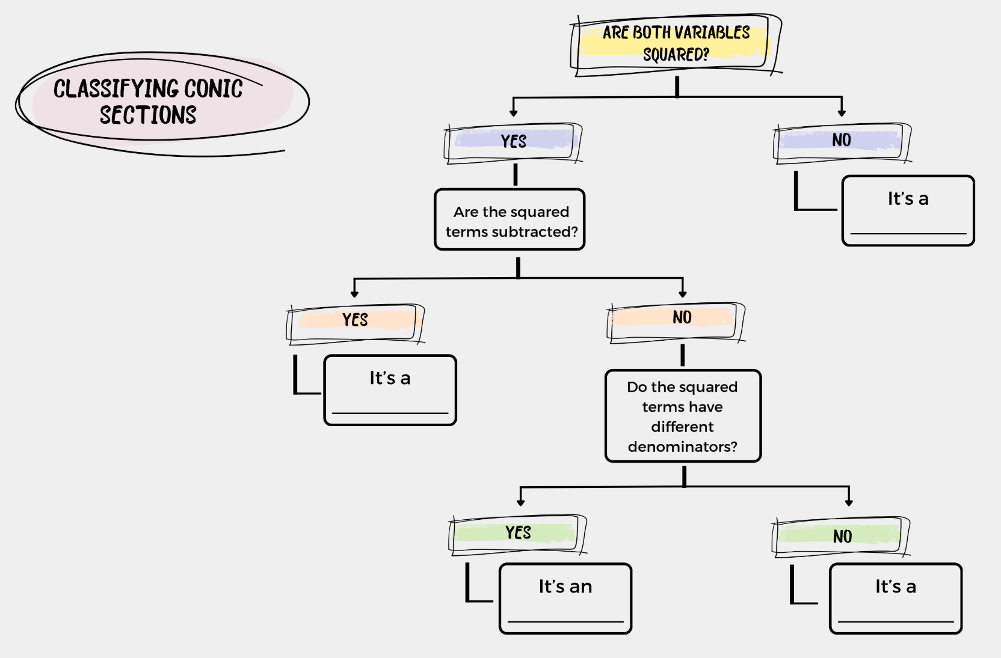
Classifying Conics Flowchart

Slide 15
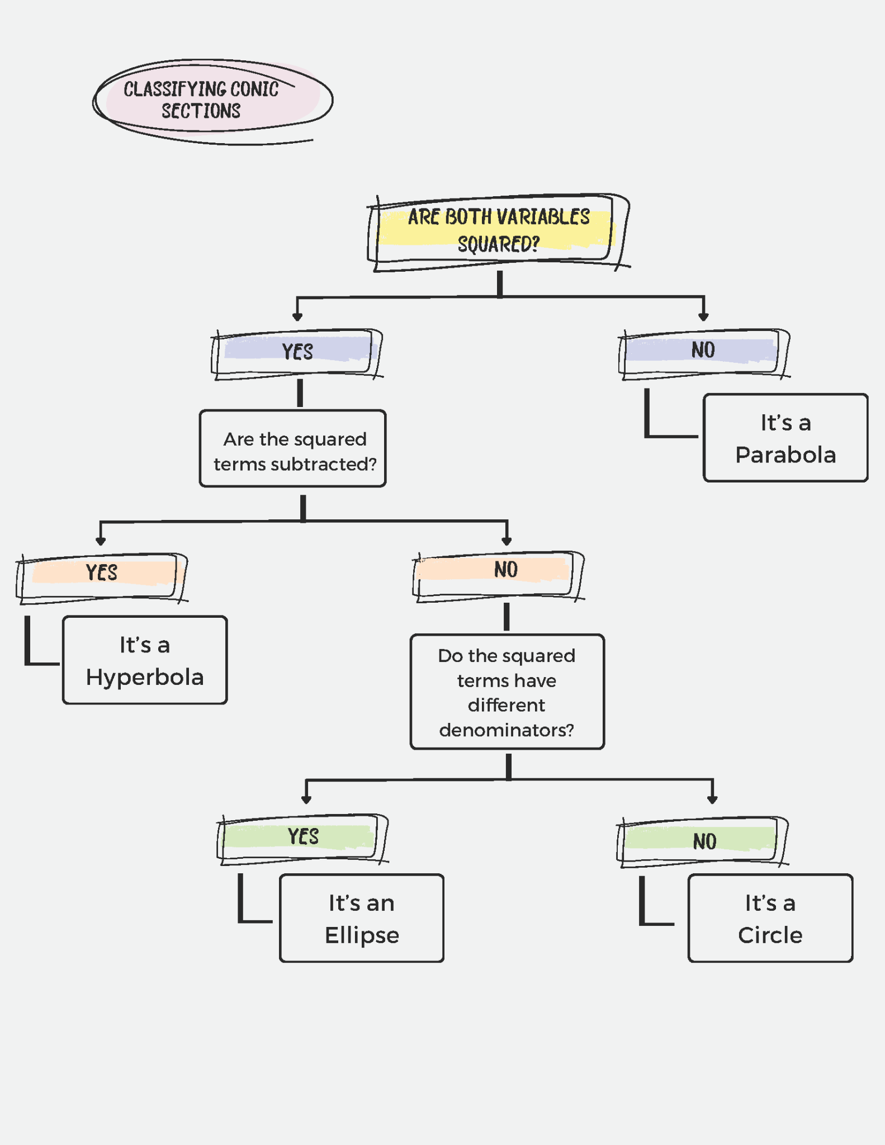
Classifying Conics Flowchart—Answers

Slide 16
Stand Up, Sit Down
Optional
Open up to your Classifying Conics Flowchart.
Write down everything you remember from yesterday.
Stand up.
Share one item from your list.
If a peer shares something on your list, cross it off.
Once you or your peers have shared all items on your list, sit down.

Slide 17
Introduction to Conic Sections

Slide 18
Conic Sections Key Features
Identify key features of your assigned conic section.
Sketch the graph of the equation provided.
Write an equation and identify the key features of graph provided.

Slide 19
Expert Stay and Stray
Round 1: Number 1 is the expert All others stray | Round 2: Number 2 is the expert All others stray
Round 3: Number 3 is the expert All others stray | Round 4: Number 4 is the expert All others stray
Notes:
K20 Center. (2021, September 21). K20 Center 5 minute timer. [Video]. YouTube. https://www.youtube.com/watch?v=EVS_yYQoLJg

Slide 20
Conic Sections Practice Problems
DO NOT write your name on your paper.
Use your notes and graphing technology to solve the four problems on your paper.
Notes:
K20 Center. (2021, September 21). K20 Center 10 minute timer. [Video]. YouTube. https://youtu.be/9gy-1Z2Sa-c?si=kU9BOsDBn5tXYBWd

Slide 21
Conic Sections Practice Problems
DO write your name on your paper.
Review the work on the paper, make any corrections, and complete any remaining work.
Notes:
K20 Center. (2021, September 21). K20 Center 10 minute timer. [Video]. YouTube. https://youtu.be/9gy-1Z2Sa-c?si=kU9BOsDBn5tXYBWd

