Slide 2
Defendants in Denmark
Beowulf on Trial

Slide 3
Essential Questions
How does diction and context affect the perception of an audience towards characters and situations?
How can we change what we say to gain an objective in real life?

Slide 4
Lesson Objectives
Analyze the text from an objective point of view.
Use diction to persuade the audience of a certain standpoint, considering ethos, pathos, and logos, and context.

Slide 5
ABC Graffiti
Brainstorm words for as many letters as possible on your chart that describe the character you were assigned.
You will have five minutes before you rotate to the next poster. Once there, add any additional characteristics team members might know about the other groups’ character.
Notes:
K20 Center. (n.d.). ABC graffiti. Strategies. https://learn.k20center.ou.edu/strategy/96

Slide 6
Timer
Notes:
K20 Center. (2021, September 21). K20 Center 5-minute timer [Video]. YouTube. https://youtu.be/EVS_yYQoLJg?si=ZVrKAFIfuUf_LTzm

Slide 7
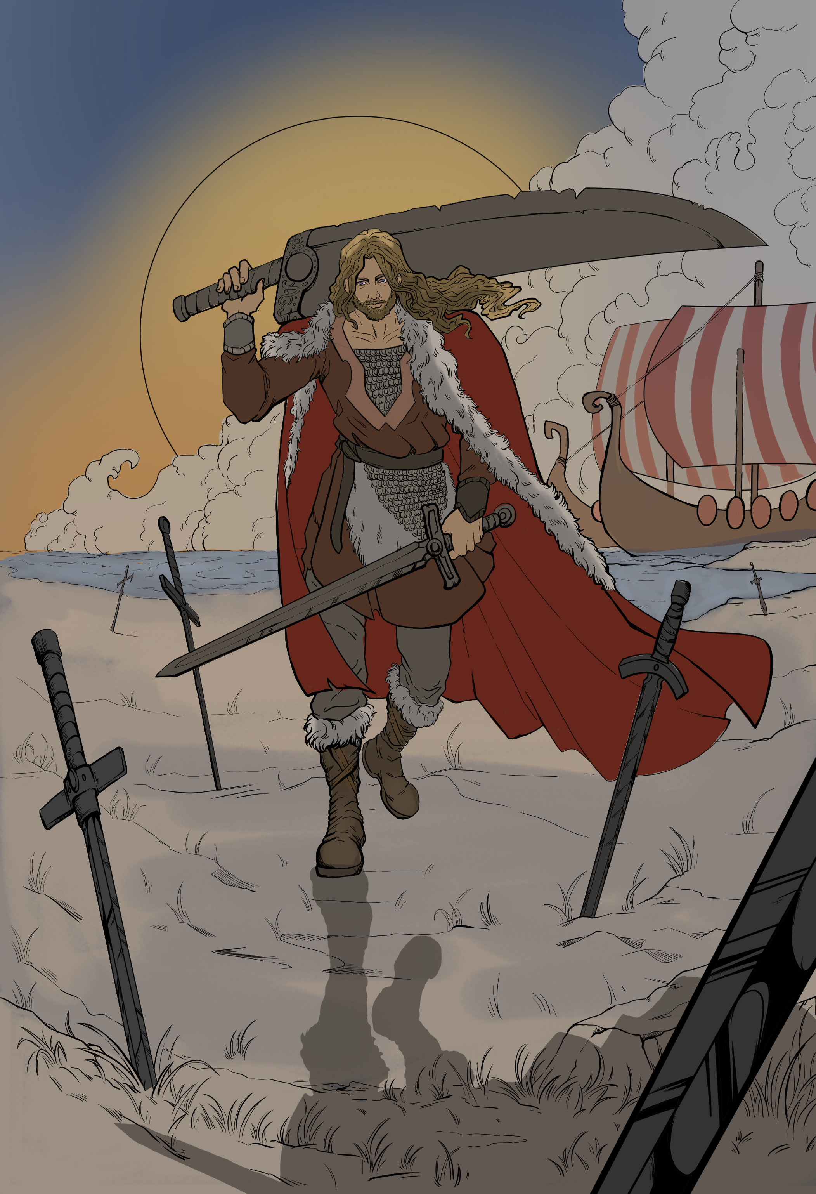
The Charges
In your groups, read your Court Card and determine what character you have.
Then, discuss the crimes they have been accused of.

Slide 8
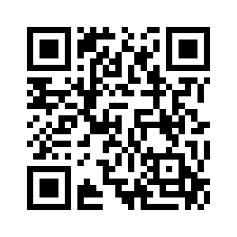
Court Case Basics
Fill in the crimes your character has been accused of on your Law School handout.
Visit the Wakelet to view resources related to court procedures.
Write down any information you found that may be beneficial to your case.
Notes:
https://wakelet.com/wake/d7gHV90XQphKoxwndJZa7

Slide 9
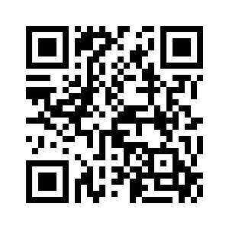
Beowulf Court Crimes
Visit the Wakelet to view resources related to the crimes your clients have been accused of.
Take notes on what you’ve learned that might allow you to defend your client in court.
Notes:
https://wakelet.com/wake/R9h3vbLH8Ls7r1CX42KdQ

Slide 10
ICAP – Judge Dee Graves
Notes:
K20 Center. (2025, January 15). K20 ICAP - Honorable Judge - Defendants in Denmark [Video]. YouTube. https://www.youtube.com/watch?v=PrgUquy4wlE

Slide 11
Defendant T-Chart
As you read through the graphic novel, make note of any mention of your character and the actions taken by your character in the left side of your T-Chart.
Note any emotions or important “adjectives” in the graphics of the graphic novel version of the story, filling in the right side of the T-Chart.
Notes:
K20 Center. (n.d.). T-chart. Strategies. https://learn.k20center.ou.edu/strategy/86

Slide 12
Claim, Evidence, Reasoning (CER)
Individually, prepare to defend your character by making a Claim to their innocence, backing it up with Evidence and then providing Reasoning.
Once everyone in your group has finished, take elements from each and make one group CER.
Notes:
Source: K20 Center. (n.d.). Claim, evidence, reasoning (CER). Strategies. https://learn.k20center.ou.edu/strategy/156

Slide 13
Preparing for Trial – Courtroom Roles
Judge – Keeps court moving and keeps control of courtroom.
Bailiff – Calls the trial to order, announces the judge, and controls any outbursts.
Head Juror – Leads discussion and delivers verdict.

Slide 14
Preparing for Trial - Jury
You will receive three Jury Ethos, Pathos, and Logos handouts, one for each character that is not yours.
As you hear the evidence presented, take notes on the facts, context, and actual behavior of each character. Take notes on arguments made from ethos, pathos, and logos and the diction used in those arguments in the chart.

Slide 15
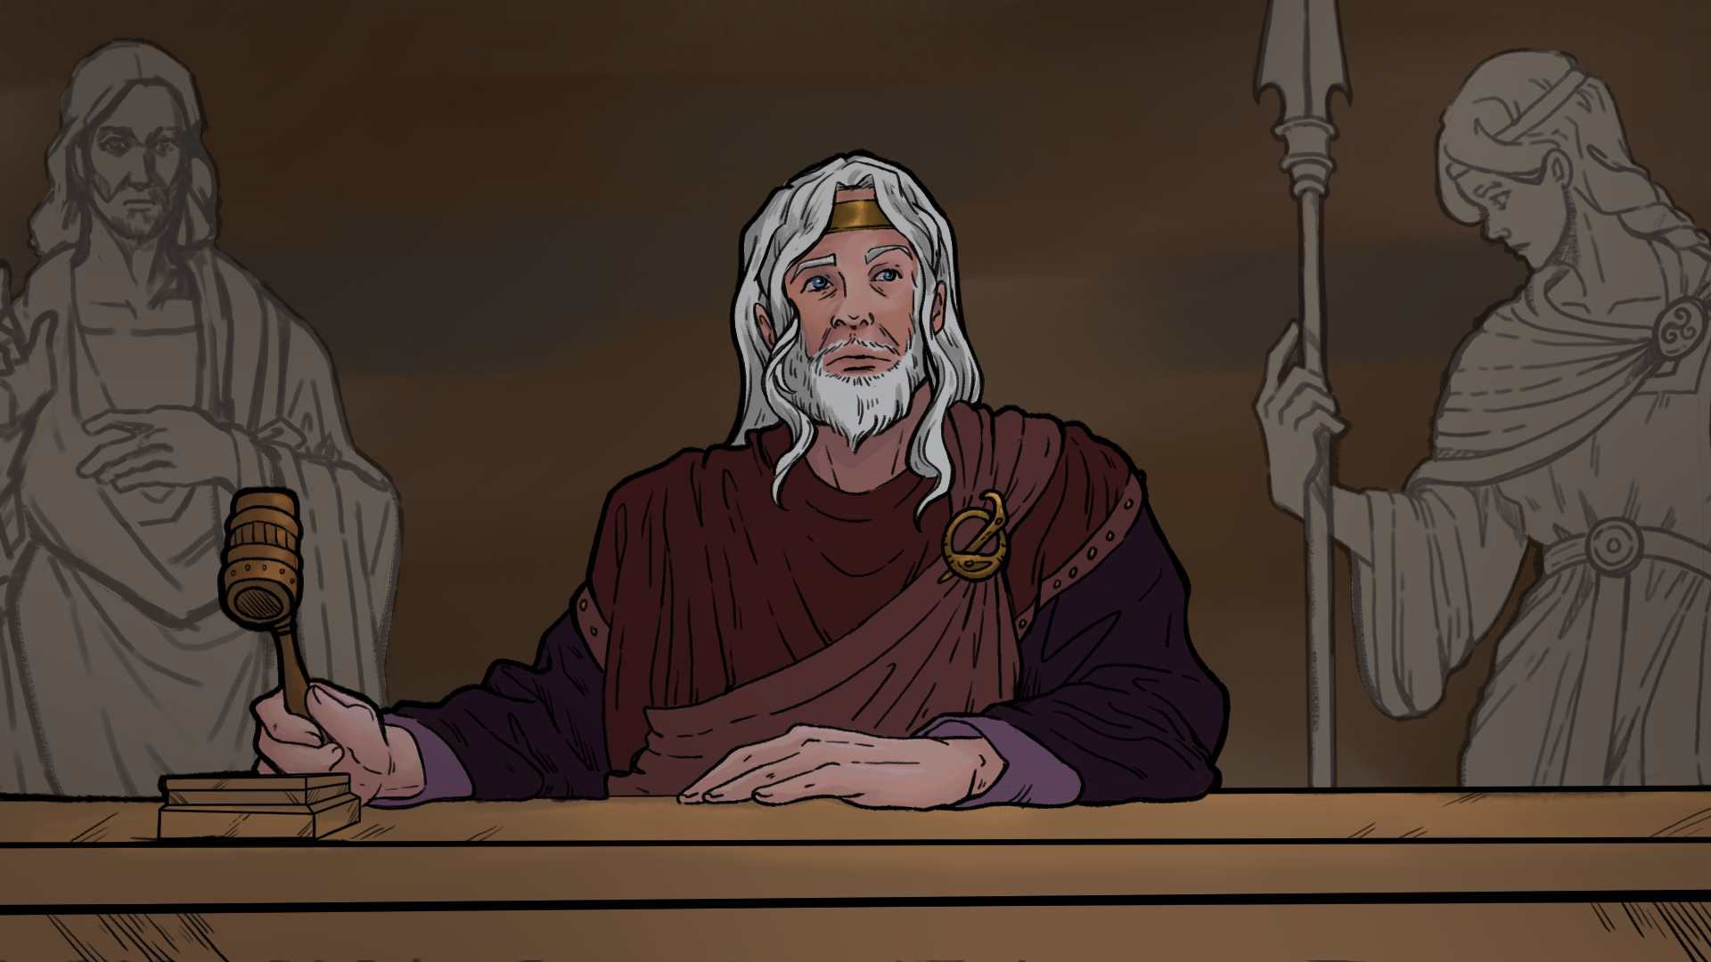
Court is now in Session

Slide 16
Claim, Evidence, Reasoning (CER) - Redux
Now you will write two CERs.
Your claim should state how you used ethos, pathos, or logos during your argument in court.
You can use evidence from the reading, notes, and/or the graphic novel, but that evidence must have been used during their argument.
Notes:
Source: K20 Center. (n.d.). Claim, evidence, reasoning (CER). Strategies. https://learn.k20center.ou.edu/strategy/156

