Slide 2
Watching Big Brother
What George Orwell's 1984 Teaches about Bias and Manipulation

Slide 3
Essential Questions
How does the manipulation of truth and information in 1984 reflect the dangers of media bias in shaping public perception and reality?
In what ways does Orwell’s concept of propaganda and surveillance in 1984 parallel modern challenges in maintaining freedom of thought in an age of biased media?

Slide 4
Learning Objectives
Evaluate text and video to understand how different factors influence the conclusions drawn by authors on the same issue.
Investigate the reasoning authors use and identify any biases or logical fallacies present in their works.
Create multimodal content communicating their findings and reasoning.

Slide 5
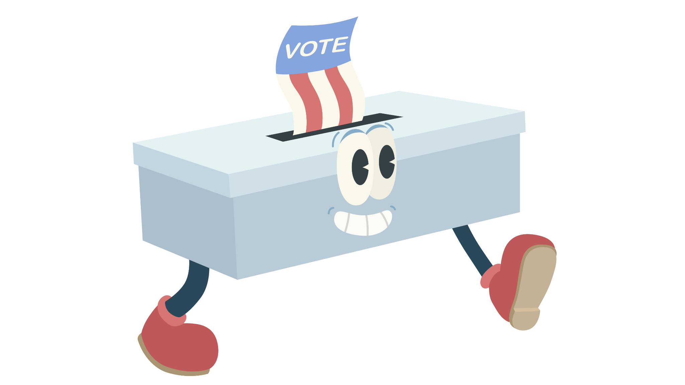
Walking Vote
Do the following headlines represent real, authentic news stories, or manufactured, false news? Move to the side of the room that indicates your answer.

Slide 6
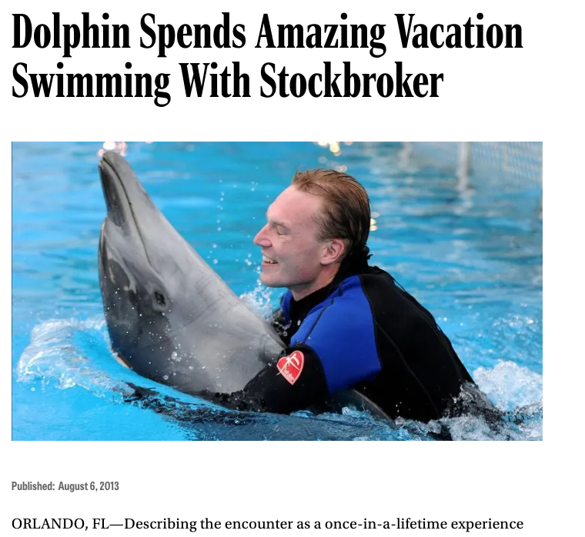
Notes:
False!
The Onion (n.d.). Dolphin spends amazing vacation swimming with stockbrokers [Screenshot]. The Onion. https://theonion.com/dolphin-spends-amazing-vacation-swimming-with-stockbrok-1819575361

Slide 7
Mom Delivers Her Own Baby After Watching YouTube Tutorial
Notes:
True!
Chris and Rosie. (2018, April 30). Mom delivers her own baby after watching YouTube tutorial. Shenandoah Country Q102. https://shenandoahcountryq102.iheart.com/content/2018-04-30-mom-delivers-her-own-baby-after-watching-youtube-tutorial/

Slide 8
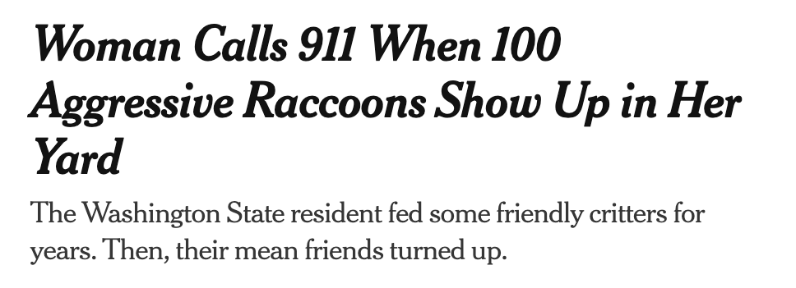
Notes:
True!
Mather, V. (2024, October 10). Raccoons take over Washington home, baffling residents [Screenshot]. The New York Times. https://www.nytimes.com/2024/10/10/us/raccoons-washington-home.html

Slide 9
Notes:
It’s fake news.
The Onion. (2017, October 2). Winner didn’t even know it was pie-eating contest [Screenshot]. The Onion. https://theonion.com/winner-didnt-even-know-it-was-pie-eating-contest-1819586935/

Slide 10
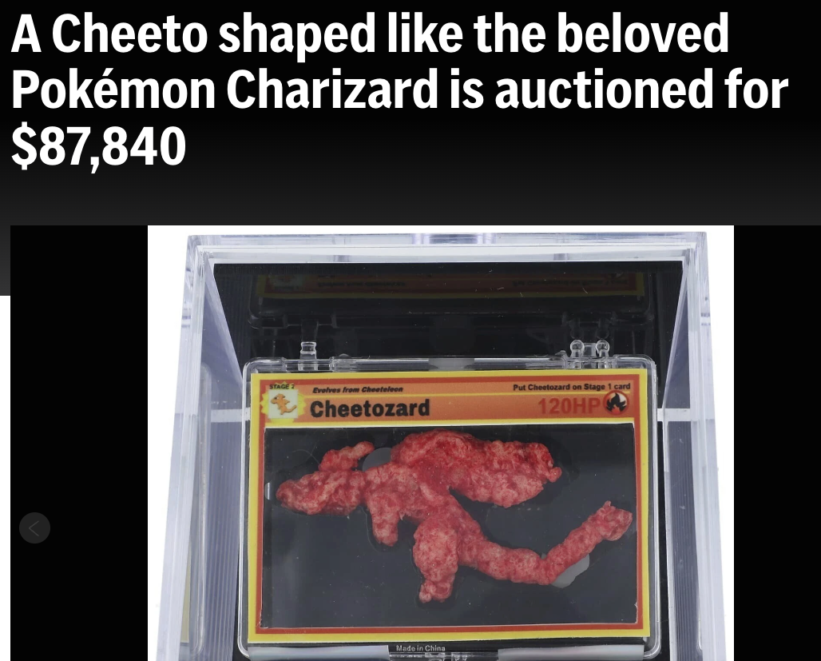
Notes:
True!
AP News. (2025, March 5). A Cheeto shaped like the beloved Pokémon Charizard is auctioned for $87,840. AP News. https://apnews.com/article/pokemon-cheeto-charizard-cheetozard-auction-9619c778aab3d0bb7bd3ed1fbcf5517b

Slide 11
Statue of Liberty Sculpture Built from Ruins of Syrian Man’s House
Notes:
False! The image was created using Photoshop, not ruins from the artist’s home
Goldin, M. (2021, February 25). AP Fact check: ‘Statue of Liberty’ image was created using Photoshop, not ruins from the artist’s home. AP News. https://apnews.com/article/fact-check-statue-of-liberty-syrian-artist-002661858342

Slide 12
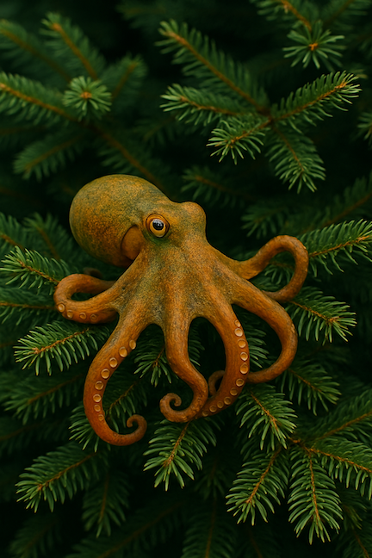
WASHINGTON STATE SENATORS REQUEST HEARINGS ON HARMFUL FORESTRY PRACTICES
Endangered Cascadian Tree Octopus Population at Risk
Notes:
False!
Boston University. (2020). Tree octopus. Artemis. https://www.bu.edu/lernet/artemis/years/2020/projects/StudentWebsites/NadiaWebsite/TreeOctupus.html
OpenAI. (2025, May 2). ChatGPT (April 11 version) [Large language model]. Tree octopus illustration [AI-generated image]. ChatGPT. https://chat.openai.com/chat

Slide 13
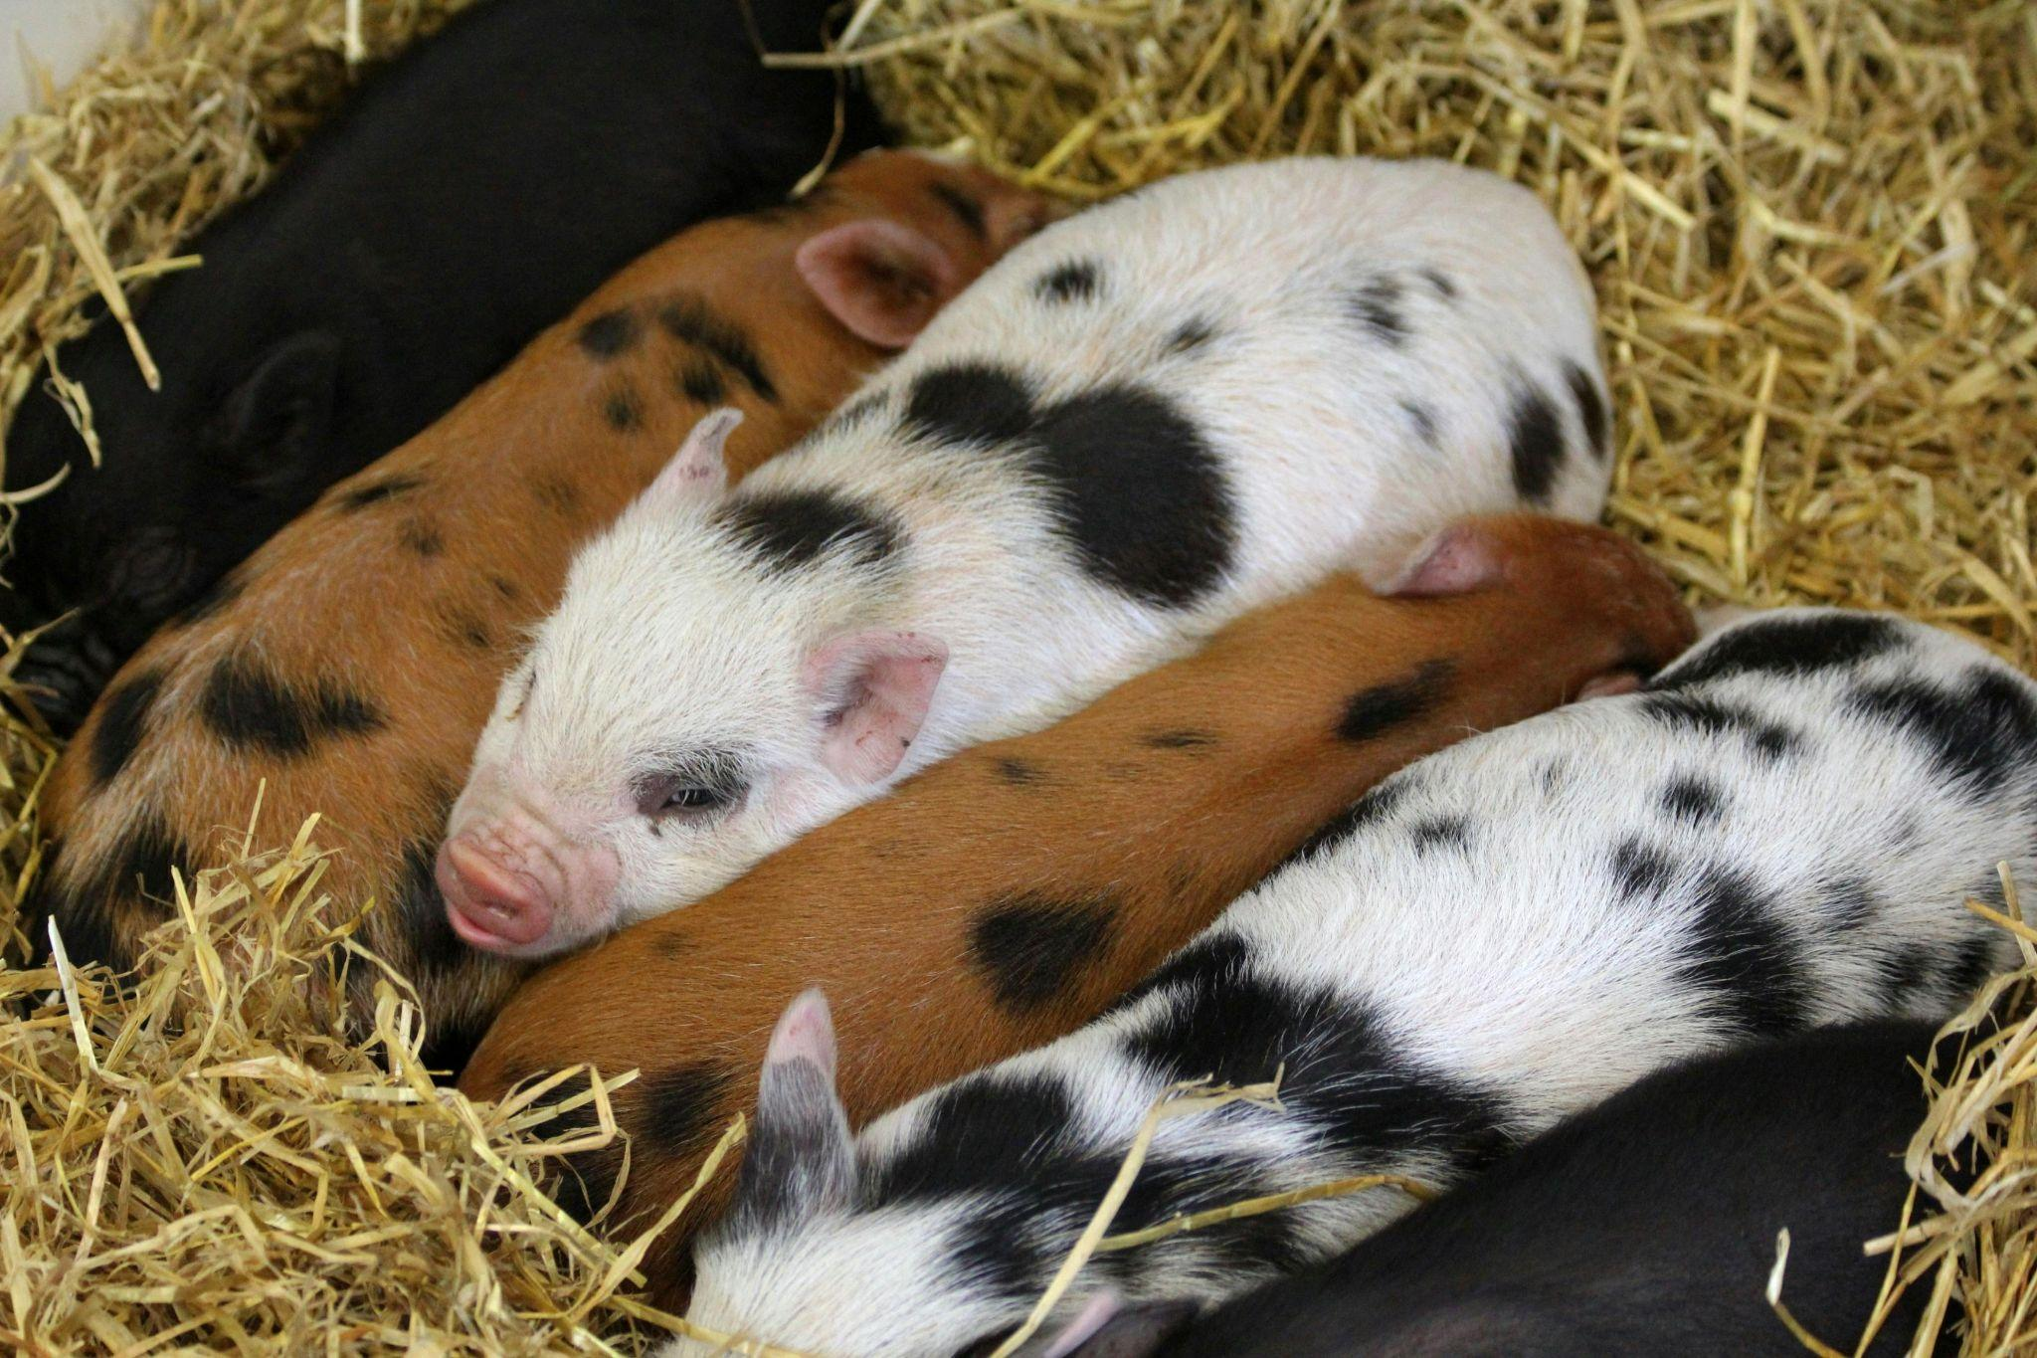
Piglets left to starve as part of a controversial art exhibition in Denmark have been stolen
Notes:
True!
Grieshaber, K. (2025, March 5). Piglets left to starve as part of a controversial art exhibition in Denmark have been stolen. AP News. https://apnews.com/article/denmark-pigs-controversial-art-exhibition-animal-rights-4ed7e96f9274f68dd9f202ed9955748a Photo: Anthony. (n.d.). Group of piglets [Photograph]. Pexels. https://www.pexels.com/photo/group-of-piglets-133468/

Slide 14
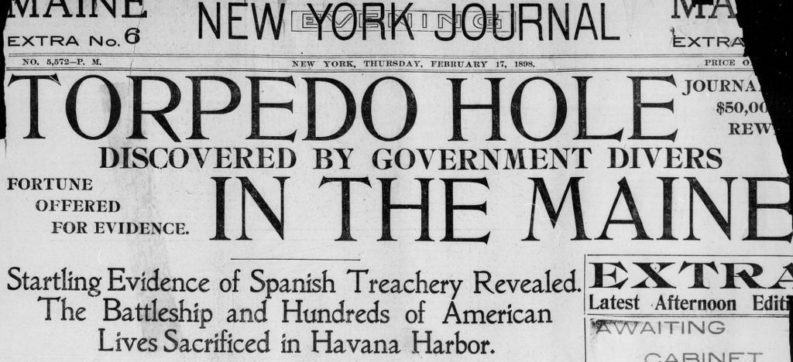
Notes:
False! Explain that the Maine was a U.S. Navy ship that sank in Havana harbor on Feb. 15, 1898, contributing to the outbreak of the Spanish-American War in April.
Library of Congress. (2024, February). The Spanish-American War and the yellow press. Headlines and Heroes. https://blogs.loc.gov/headlinesandheroes/2024/02/the-spanish-american-war-and-the-yellow-press/

Slide 15
Notes:
True!
Gabbatiss, J. (2016, December 7). Incredible physics behind the deadly 1919 Boston molasses flood. New Scientist. https://www.newscientist.com/article/2114116-incredible-physics-behind-the-deadly-1919-boston-molasses-flood/

Slide 16
Missing hiker faces huge bill for rescue operation after he was found in luxury hotel
Notes:
True!
Telegraph Reporters. (2018, May 3). Missing hiker faces huge bill for rescue operation after being found in luxury hotel. The Telegraph. https://www.telegraph.co.uk/news/2018/05/03/missing-hiker-faces-huge-bill-rescue-operation-found-luxury/

Slide 17
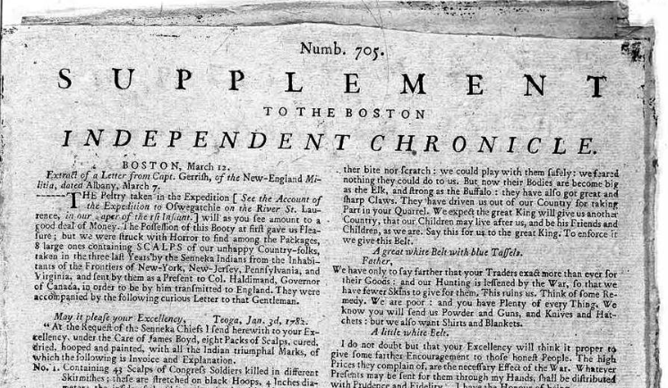
No. 1. 43 Scalps of Congress Soldiers killed in different Skirmishes; these are stretched on black Hoops, 4 Inches diameter; the inside of the Skin painted red, with a small black Spot to note their being killed with Bullets. Also 62 of Farmers, killed in their houses; the Hoops red; the Skin painted brown…
Benjamin Franklin
Notes:
False! Propaganda newspaper: “A Most Dreadful Account of Barbarities Committed by the Savages.” In 1782, while in France, Benjamin Franklin created a counterfeit version of The Boston Independent Chronicle. He hoped the British press would reprint this account of the horrors of war to demonize the colonial British ministry in the eyes of the British public.
Harrington, H. T. (2014, November 10). Benjamin Franklin fakes a newspaper. All Things Liberty. https://allthingsliberty.com/2014/11/propaganda-warfare-benjamin-franklin-fakes-a-newspaper/

Slide 18
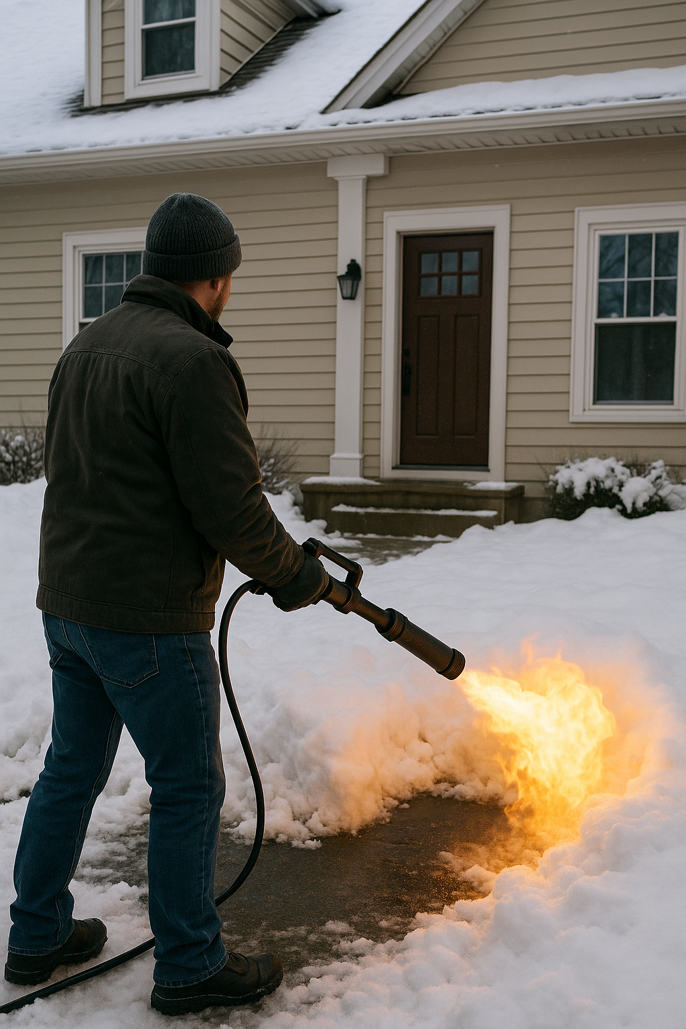
FARGO MAN USES FLAME THROWER TO MELT SNOW IN FRONT YARD
Notes:
Not real.
KIKN. (2025, February 14). Fargo man uses flamethrower to melt snow in front yard. KIKN. https://kikn.com/fargo-man-uses-flamethrower-to-melt-snow-in-front-yard/
OpenAI. (2025). A man using a flamethrower to melt snow in front of a house [AI-generated image]. ChatGPT. https://chat.openai.com/

Slide 19
Notes:
True!
Scutti, S. (2018, March 26). Children with autism less likely to be fully vaccinated, study finds. CNN. https://www.cnn.com/2018/03/26/health/vaccination-rates-children-autism-study/index.html

Slide 20
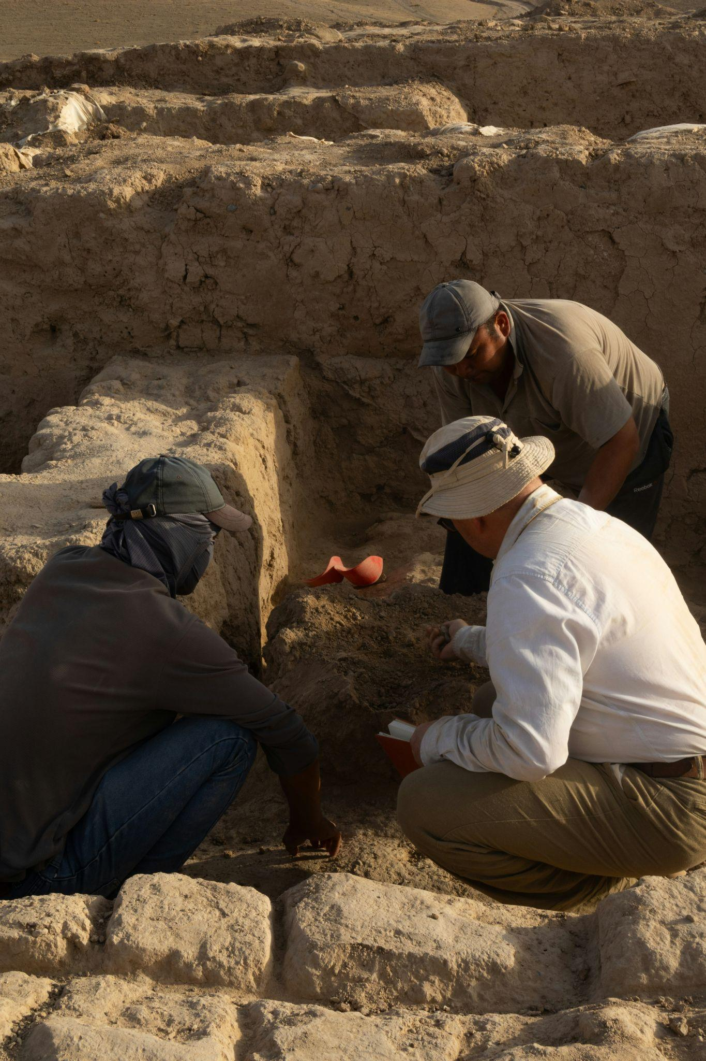
Archaeological Dig Uncovers Ancient Race of Skeleton People
Notes:
Fake.
The Onion. (2017, September 28). Archaeological dig uncovers ancient race of skeleton people. The Onion. https://theonion.com/archaeological-dig-uncovers-ancient-race-of-skeleton-pe-1819565415/
Stypczynski, A. (n.d.). A group of men kneeling down next to each other [Photograph]. Unsplash. https://unsplash.com/photos/a-group-of-men-kneeling-down-next-to-each-other-s-y8QSmpyNI

Slide 21
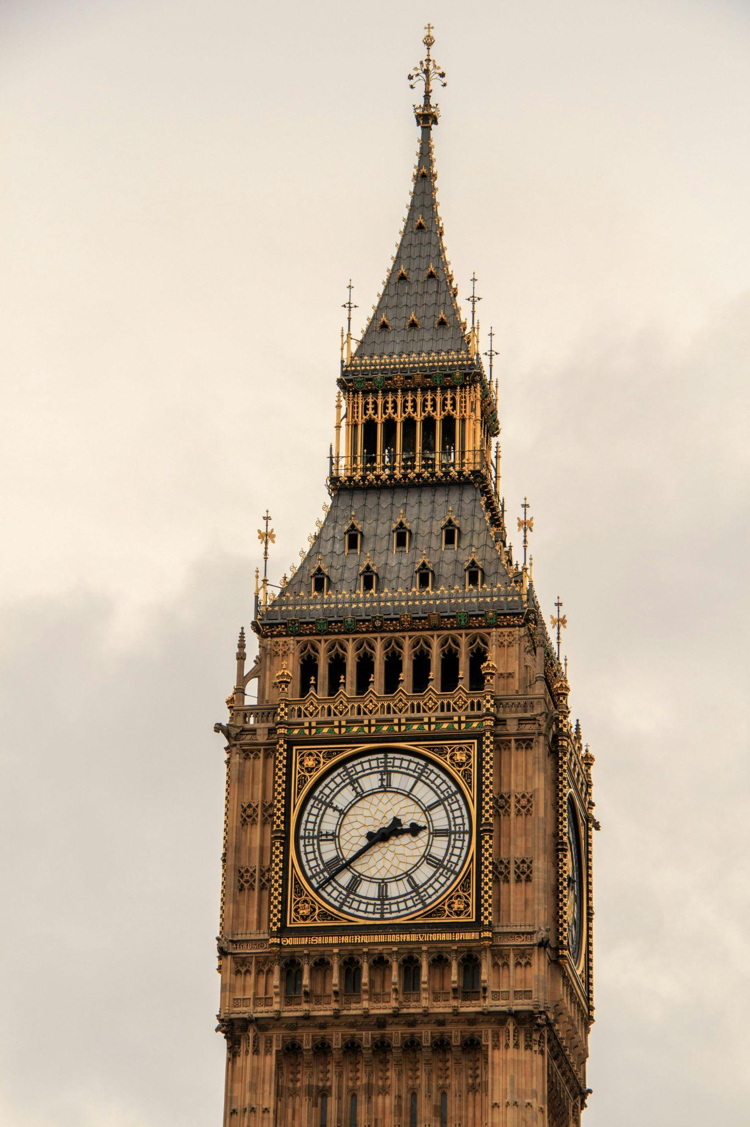
U.K. Schools Getting Rid of Analog Clocks Because Teens “Cannot Tell Time”
Notes:
True!
CBS News. (2018, May 3). U.K. schools getting rid of analog clocks because teens cannot tell time. CBS News. https://www.cbsnews.com/news/u-k-schools-getting-rid-of-analog-clocks-because-teens-cannot-tell-time/
Pixabay. (n.d.). Low-angle photography of Big Ben in London [Photograph]. Pexels. https://www.pexels.com/photo/low-angle-photography-of-big-ben-in-london-280347/

Slide 22
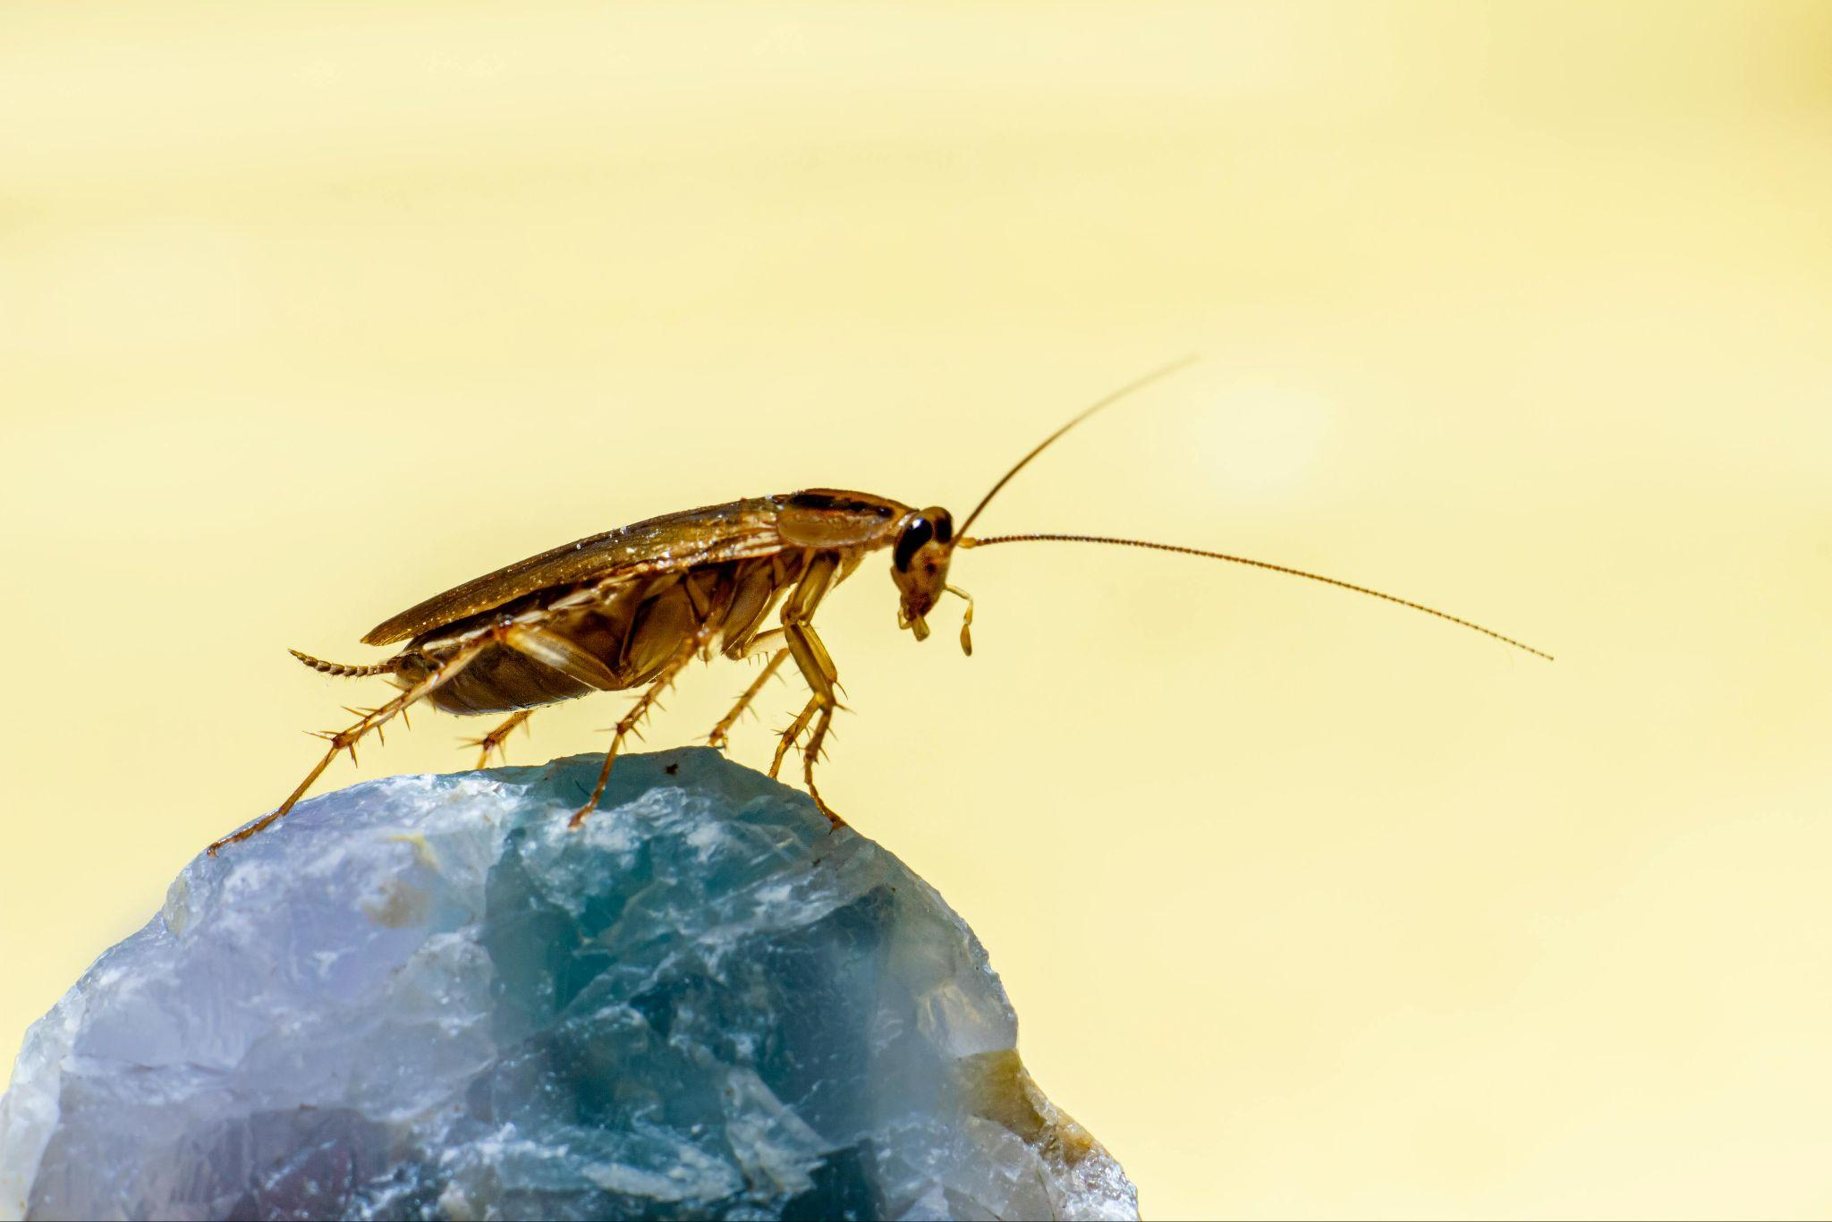
Chinese Farmer Unleashes 300 Million Hungry Cockroaches to Eat Food Waste
Notes:
True!
The Straits Times. (2018, December 3). Chinese farmer unleashes 300 million hungry cockroaches to eat food waste. The Straits Times. https://www.straitstimes.com/asia/east-asia/chinese-farmer-unleashes-300-million-hungry-cockroaches-to-eat-food-waste

Slide 23
Fallacies: Propaganda and false news often rely on logical fallacies to manipulate audiences.
Appeal to Emotion
Ad Hominem
False Dilemma / False Dichotomy
Hasty Generalization
Cherry Picking
Bandwagon Fallacy
Straw Man
Appeal to Authority
Post Hoc Fallacy
Slippery Slope
False Equivalence
Whataboutism
Circular Reasoning

Slide 24
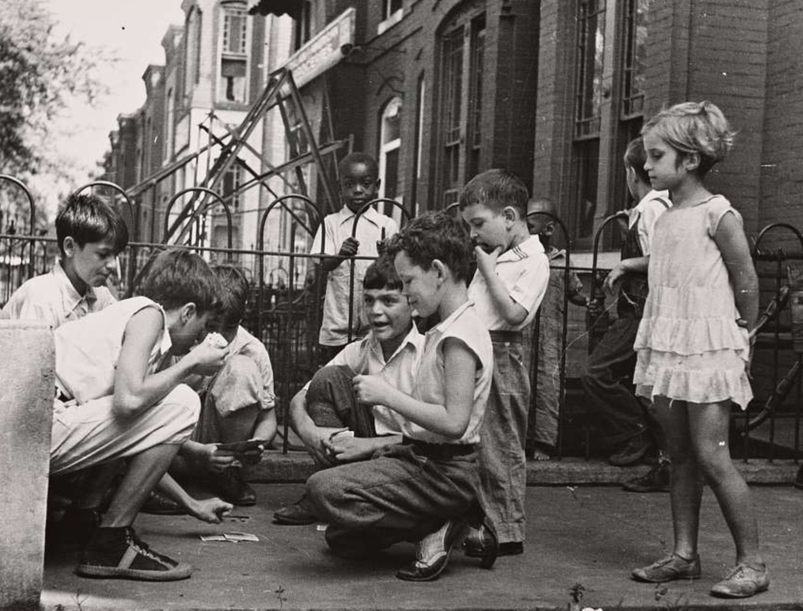
Doublethink Detector
Take turns to choose a card and, with your team, determine what kind of fallacy the example best represents.
Notes:
The New York Public Library. (n.d.). Children playing cards in front yard in slum area near Union Station [Photograph]. NYPL Digital Collections. https://nypl.getarchive.net/media/children-playing-cards-in-front-yard-in-slum-area-near-union-station-section-a51a7a

Slide 25
What is “left” and “right”?
Notes:
CIVIX. (2021, April 26). The Political Spectrum [Video]. YouTube. https://www.youtube.com/watch?v=XJA3EhyVPc0

Slide 26
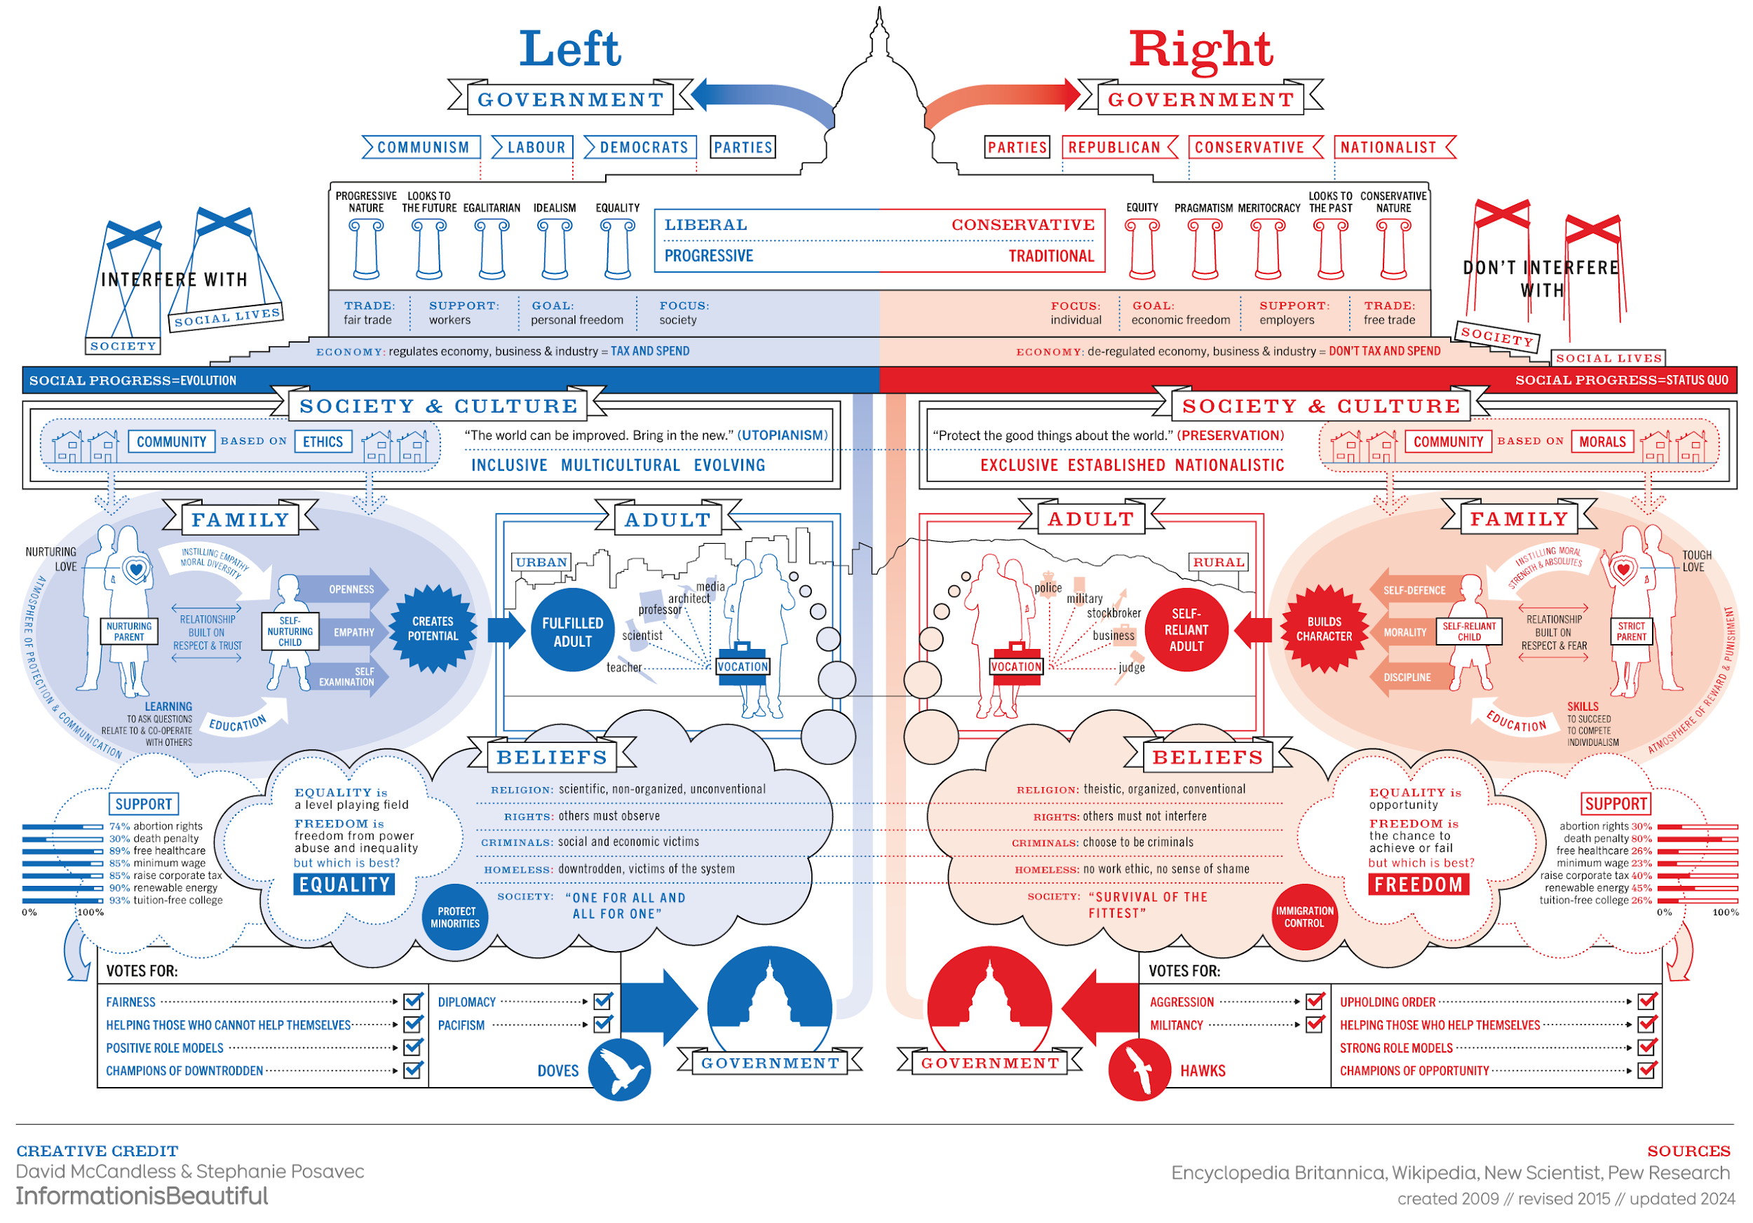
Notes:
McCandless, D., & Posavec, S. (2024). Left vs. Right (US) [Infographic]. Information is Beautiful. https://informationisbeautiful.net/visualizations/left-vs-right-us/

Slide 27
How to Detect Bias in Media
Notes:
Common Craft. (2024, Oct 15). How to detect bias in media - explained by Common Craft [Video]. YouTube. https://www.youtube.com/watch?v=6R6-2_8m4Co

Slide 28
Questions for Bias Analysis: 1
Who’s Speaking?
Whose voices are featured and whose are missing in this story?
Follow the Money:
Who owns this media outlet and how might their interests influence coverage?
Loaded Language:
What emotional or biased words shape how readers view this issue?

Slide 29
Questions for Bias Analysis: 2
Visual Manipulation:
Do the images fairly represent what's actually happening?
Headline vs. Content:
Does the headline accurately reflect what the article actually says?
False Balance:
Is "both sides" framing giving undue credibility to fringe viewpoints?

Slide 30
Wakelet: Looking for Bias
Go to k20.ou.edu/3m
Read two articles in any two columns.
Using your guide, conduct a bias analysis on those four articles and record your findings on the H-Chart.
k20.ou.edu/3m
Notes:
K20 ID Team. (2025). Left, center, right: Detecting bias in news media. Wakelet. https://wakelet.com/wake/HTCvuPuQP0SjcYc0Wt8eF

Slide 31
Categorical Highlighting: Jihyun Park
With one color marker, highlight ideas that relate to 1984, and
with another color, mark ideas that relate to the United States.
Write the Point of Most Significance from the article.

Slide 32
Yeonmi Park: On Freedom
Notes:
TED. (2019, September 26). What I learned about freedom after escaping North Korea | Yeonmi Park | TED [Video]. YouTube. https://www.youtube.com/watch?v=mLzTo-y8Ef0

Slide 33
Manipulation
of Information
Myanmar (Burma)
Turkmenistan
Saudi Arabia
Venezuela
Nicaragua
China
Belarus
Russia
Angola
Iran
Syria
Opposition Suppression | ✓ |  | ✓ |  | ✓ | ✓ | ✓ |  | ✓ |  | ✓
Media Control |  | ✓ | ✓ |  | ✓ | ✓ |  | ✓
Electoral Manipulation | ✓ |  |  |  |  |  |  |  |  | ✓ | ✓
Centralized Power |  | ✓ | ✓ |  | ✓ | ✓ |  |  |  | ✓ | ✓
Force/Violence |  |  |  |  |  |  | ✓ |  | ✓
Punish Critics |  |  | ✓ |  |  | ✓ |  | ✓
Surveillance |  |  | ✓
Ideological Control |  |  |  | ✓ |  |  |  | ✓

Slide 34
Example Country: Eritrea
Article/Video Title (link): UN Should Continue Scrutiny of Rights Crisis in Eritrea
Research 3 countries
Record observations on the Ministries handout
Write a short summary of your observations to be presented in a 30-Second
Expert format.
Miniluv (Ministry of Love) Punishment | Minipax (Ministry of Peace) War | Miniplenty (Ministry of Food) Control | Minitru (Ministry of Truth) Propaganda | Contains Bias | Logical Fallacy
“...enforced disappearances persist unabated…” | “... policy of indefinite national service, including compulsory military conscription…” | N/A | “Civic space within Eritrea is completely closed: no independent media…” | “They should stand with victims of abuses and the courageous Eritrean human rights defenders, not with rights-abusing governments seeking to undermine international protections.”
Similarities: | Bias: | Logical Fallacy:
Notes:
Human Rights Watch. (2023, February 9). Eritrea: Crackdown on draft evaders’ families. Human Rights Watch. https://www.hrw.org/news/2023/02/09/eritrea-crackdown-draft-evaders-families
Human Rights Watch. (2009, April 16). Service for life: State repression and indefinite conscription in Eritrea. Human Rights Watch. https://www.hrw.org/report/2009/04/16/service-life/state-repression-and-indefinite-conscription-Eritrea
Power, H. (2024, July 2). UN should ensure continued scrutiny of rights crisis in Eritrea. Human Rights Watch. https://www.hrw.org/news/2024/07/02/un-should-ensure-continued-scrutiny-rights-crisis-Eritrea

Slide 35
30-Second Expert
Circle up the desks.
Get a sticky note.
Share your 30-Second Expert statement with the circle.
After listening, write two questions you have about your classmates’ statements.
Put your questions in the teacher’s bowl.

Slide 36
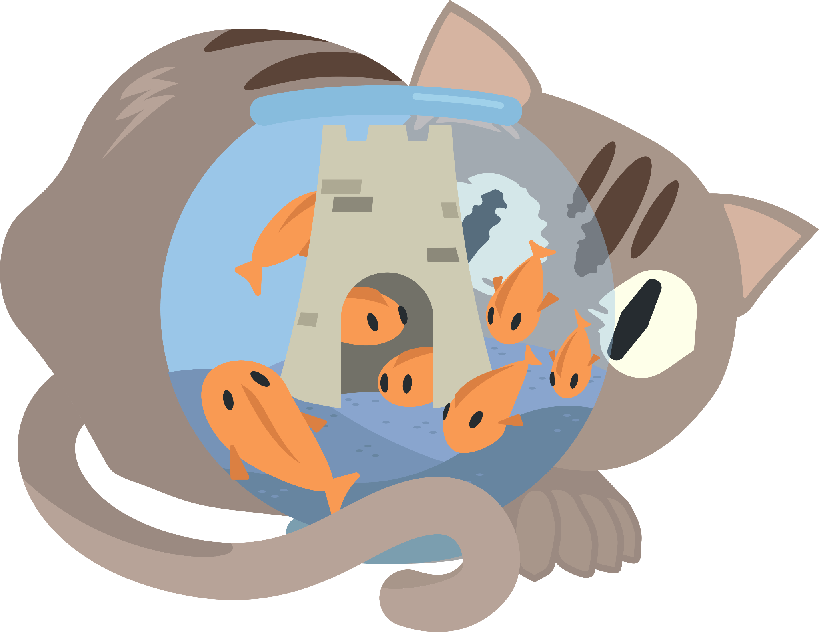
Norms
📢 Listen to Understand 🤝 Engage Respectfully 🗣️ Contribute Equally 🧠 Collaborate for Growth 📜 Honor the Agreements
Discussion Expectations
Listen to the questions.
Participate in the discussion.
Volunteer to facilitate.
Notes:
📢 Listen to Understand → Pay close attention to words, tone, and body language. → Ask questions to clarify meaning and purpose.
🤝 Engage Respectfully → Speak clearly and considerately. → Build on others’ ideas or disagree with respect.
🗣️ Contribute Equally → Share your thoughts—and the air time. → Encourage quiet voices to speak.
🧠 Collaborate for Growth → Work together to explore big ideas. → Be open to changing your mind.
📜 Honor the Agreements → Follow our seminar rules. → Keep the discussion thoughtful, focused, and inclusive

Slide 37
Six-Word Memoir
Write a Six-Word Memoir that summarizes your biggest takeaway from studying 1984, other countries, government, and bias and/or censorship.

Slide 38
Choice Board

