Slide 2
Reduce, Reuse, Represent
Multiple Representations of Linear Functions

Slide 3
Pick a Job Offer
You receive 2 job offers. Which do you choose?
Work for our environmental conservation agency! You will make $25/hour and receive a $1,000 signing bonus.
Work for our chemical plant! You will make $15/hour and a receive $5,000 signing bonus.
Option A
Option B

Slide 4

Philosophical Chairs
In your group, discuss your
reasoning for picking that job offer.
Be ready to share.
Remember, you can switch sides at
any point by sharing your reasoning.
Notes:
K20 Center. (n.d.). Philosophical chairs. Strategies. https://learn.k20center.ou.edu/strategy/71

Slide 5
Essential Question
How can we represent a linear function in different ways?

Slide 6
Lesson Objectives
Translate between equivalent representations of linear functions.
Identify the slope and y-intercept from any given form.

Slide 7
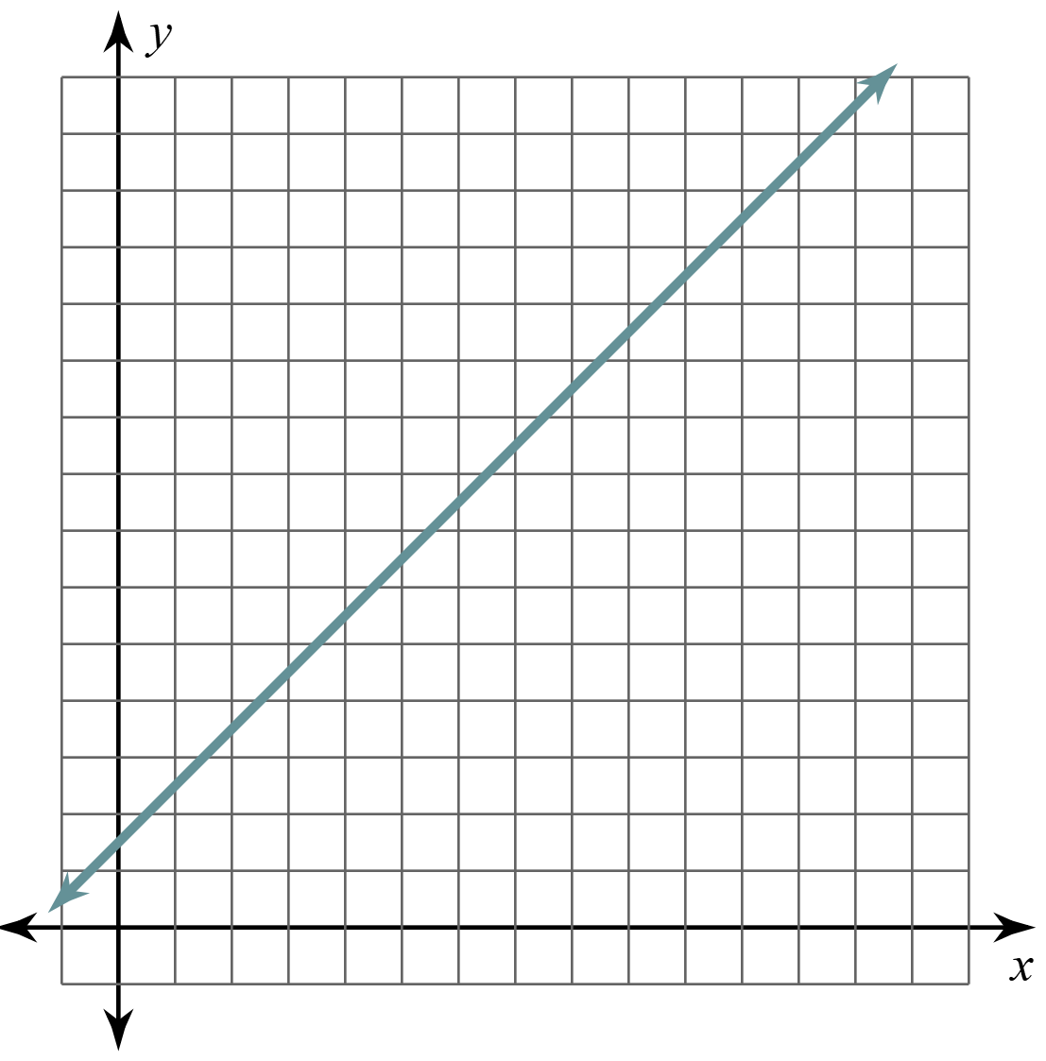
Exploring Linear Relationships
Work with your partner to complete your handout.
You will use your answers to create a poster.
x | y
0 | 3
1 | 5
2 | 7
3 | 9
4 | 11
5 | 13
6 | 15
7 | 17
8 | 19
9 | 21
10 | 23
30
20
10
3
5
10
15
y = 2x + 3

Slide 8
Exploring Linear Relationships: Poster
Create a poster that includes your:
Table
Graph
Equation
Make sure your poster is visually appealing and easy to read.
x | y
0 | 3
1 | 5
2 | 7
3 | 9
4 | 11
5 | 13
6 | 15
7 | 17
8 | 19
9 | 21
10 | 23
30
20
10
3
5
10
15
y = 2x + 3

Slide 9

Gallery Walk: Round 1
Visit a peer’s poster.
Do you see any patterns?
  What do the table, graph, and equation have in common?
Highlight one pattern or similarity you see on their poster.
Notes:
K20 Center. (n.d.). Gallery walk / carousel. Strategies. https://learn.k20center.ou.edu/strategy/118

Slide 10
Gallery Walk (Example)
Round 1
Round 2
x | y
0 | 3
1 | 5
2 | 7
3 | 9
4 | 11
5 | 13
6 | 15
7 | 17
8 | 19
9 | 21
10 | 23
30
x | y
0 | 3
1 | 5
2 | 7
3 | 9
4 | 11
5 | 13
6 | 15
7 | 17
8 | 19
9 | 21
10 | 23
30
20
20
+2
10
10
+2
+2
3
3
5
10
15
5
10
15
+2
y = 2x + 3
y = 2x + 3
+2
Notes:
K20 Center. (n.d.). Gallery walk / carousel. Strategies. https://learn.k20center.ou.edu/strategy/118

Slide 11
Gallery Walk: Round 2
Visit a poster where the last pair used a
different colored highlighter than yours.
Do you agree with the observed pattern
(what’s highlighted)?
Do you see another pattern or similarity?
Highlight that pattern on their poster.
Notes:
K20 Center. (n.d.). Gallery walk / carousel. Strategies. https://learn.k20center.ou.edu/strategy/118

Slide 12
Gallery Walk: Discussion
Where did you observe the value for day 0?
Notes:
K20 Center. (n.d.). Gallery walk / carousel. Strategies. https://learn.k20center.ou.edu/strategy/118

Slide 13
Gallery Walk: Discussion
Where did you observe the change per day?
Notes:
K20 Center. (n.d.). Gallery walk / carousel. Strategies. https://learn.k20center.ou.edu/strategy/118

Slide 14
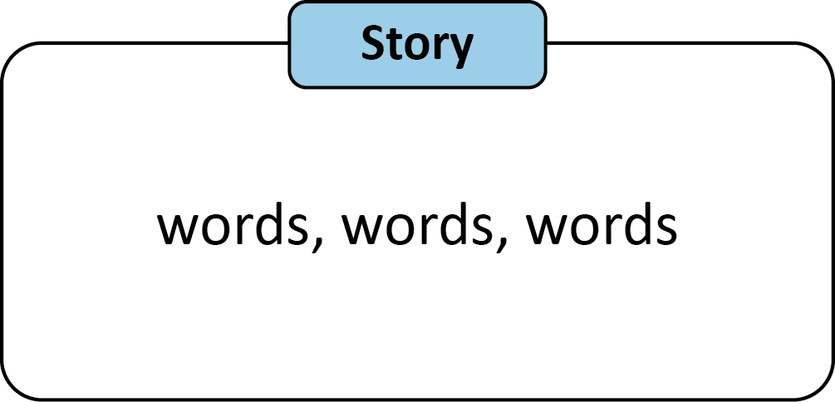
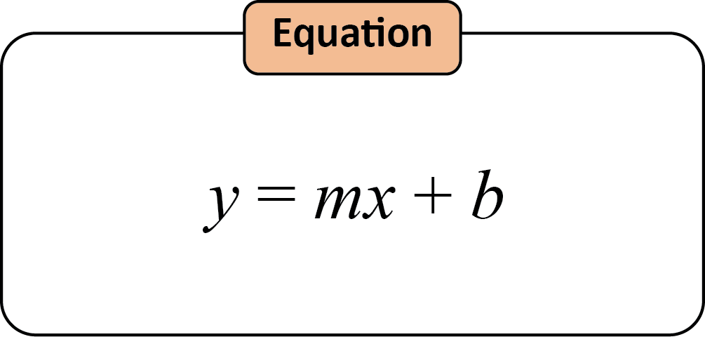
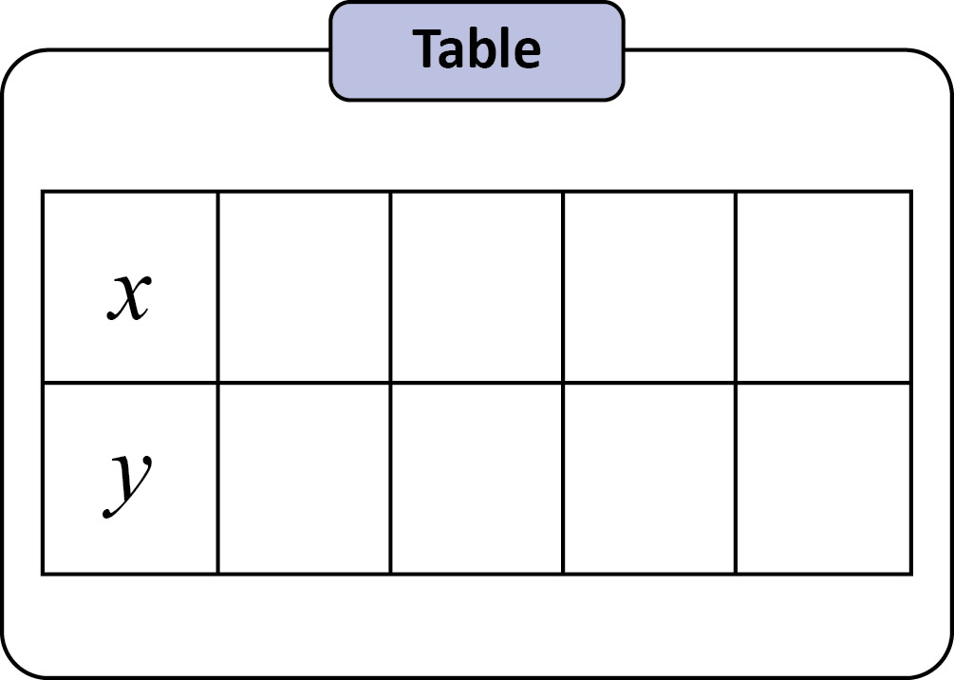
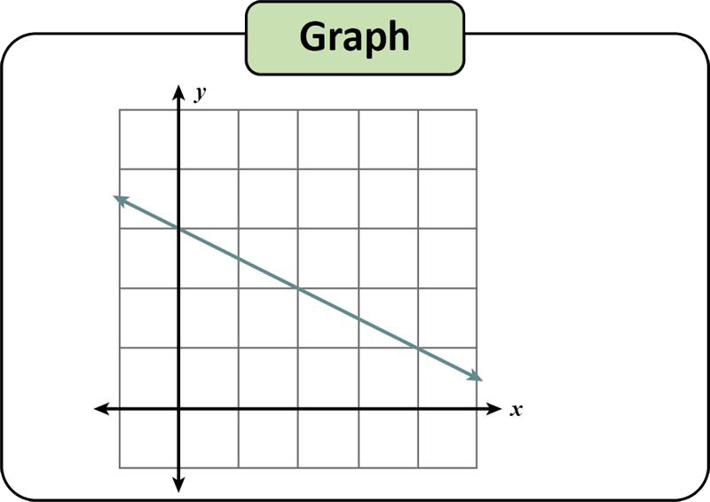

Slide 15
Story and Table

Slide 16
Table and Graph

Slide 17
Graph and Equation

Slide 18
Equation and Story

Slide 19
Translating Between Representations
Story
Table
Graph
Equation
Before, we started with the story and ended with an equation.
Do we have to go in that order?

Slide 20
Table and Equation

Slide 21
Story and Graph

Slide 22
Properties of Linear Equations
slope =
y-intercept =

Slide 23
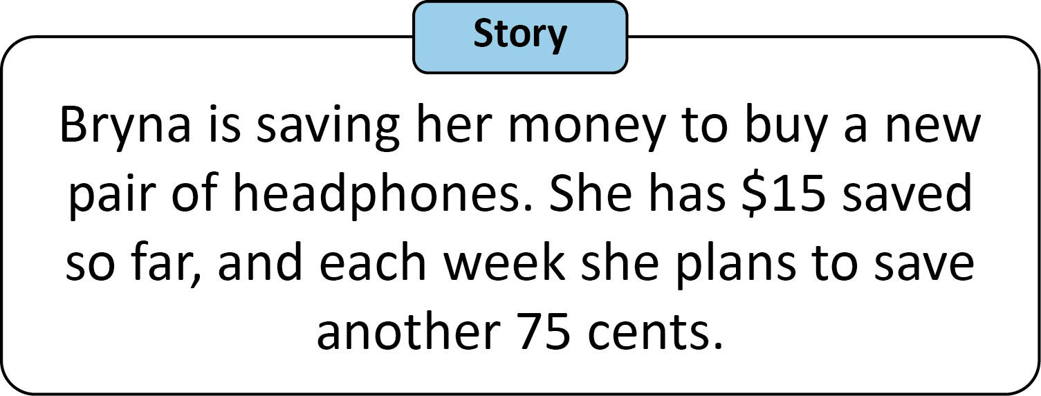
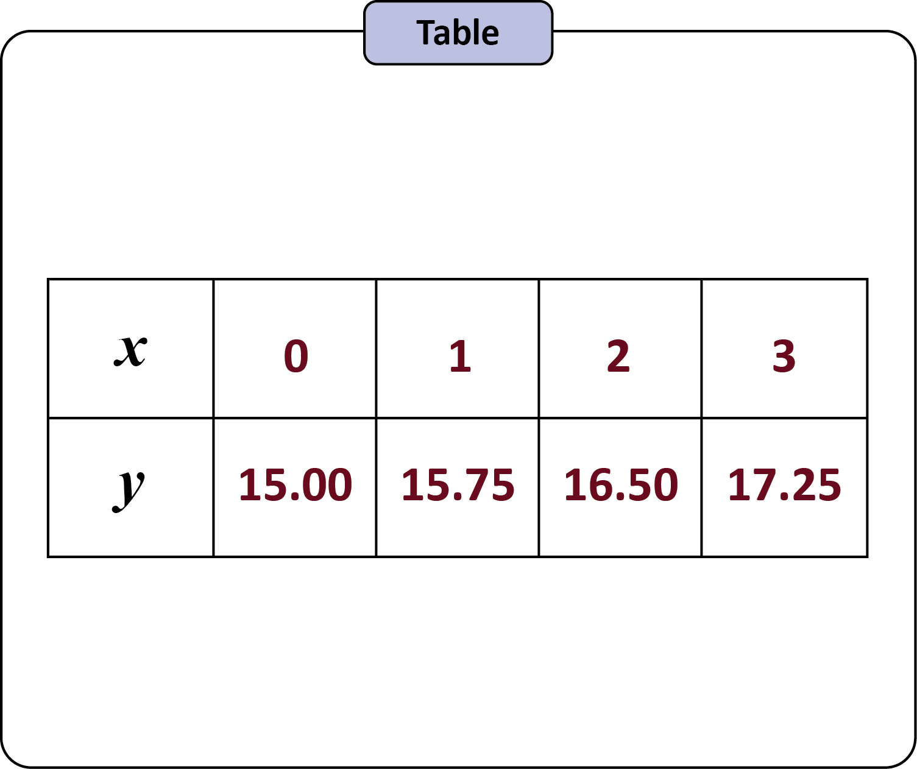
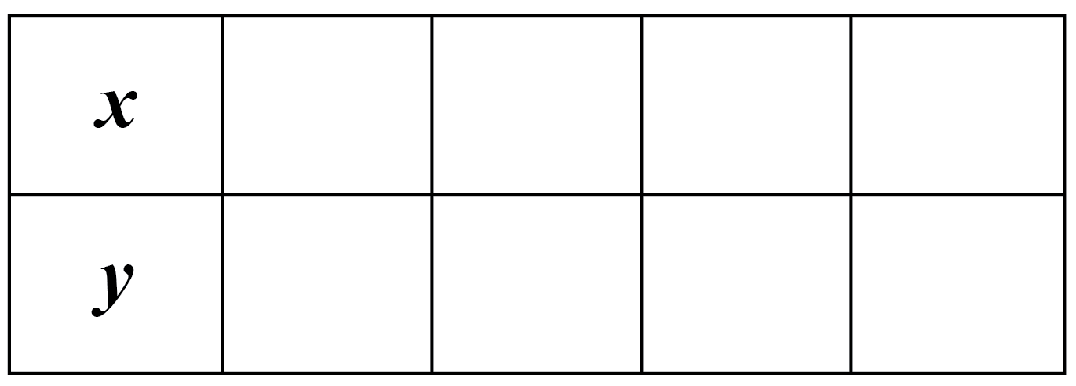
Story and Table

Slide 24
Story and Table

Slide 25
Table and Equation With a Calculator

Slide 26
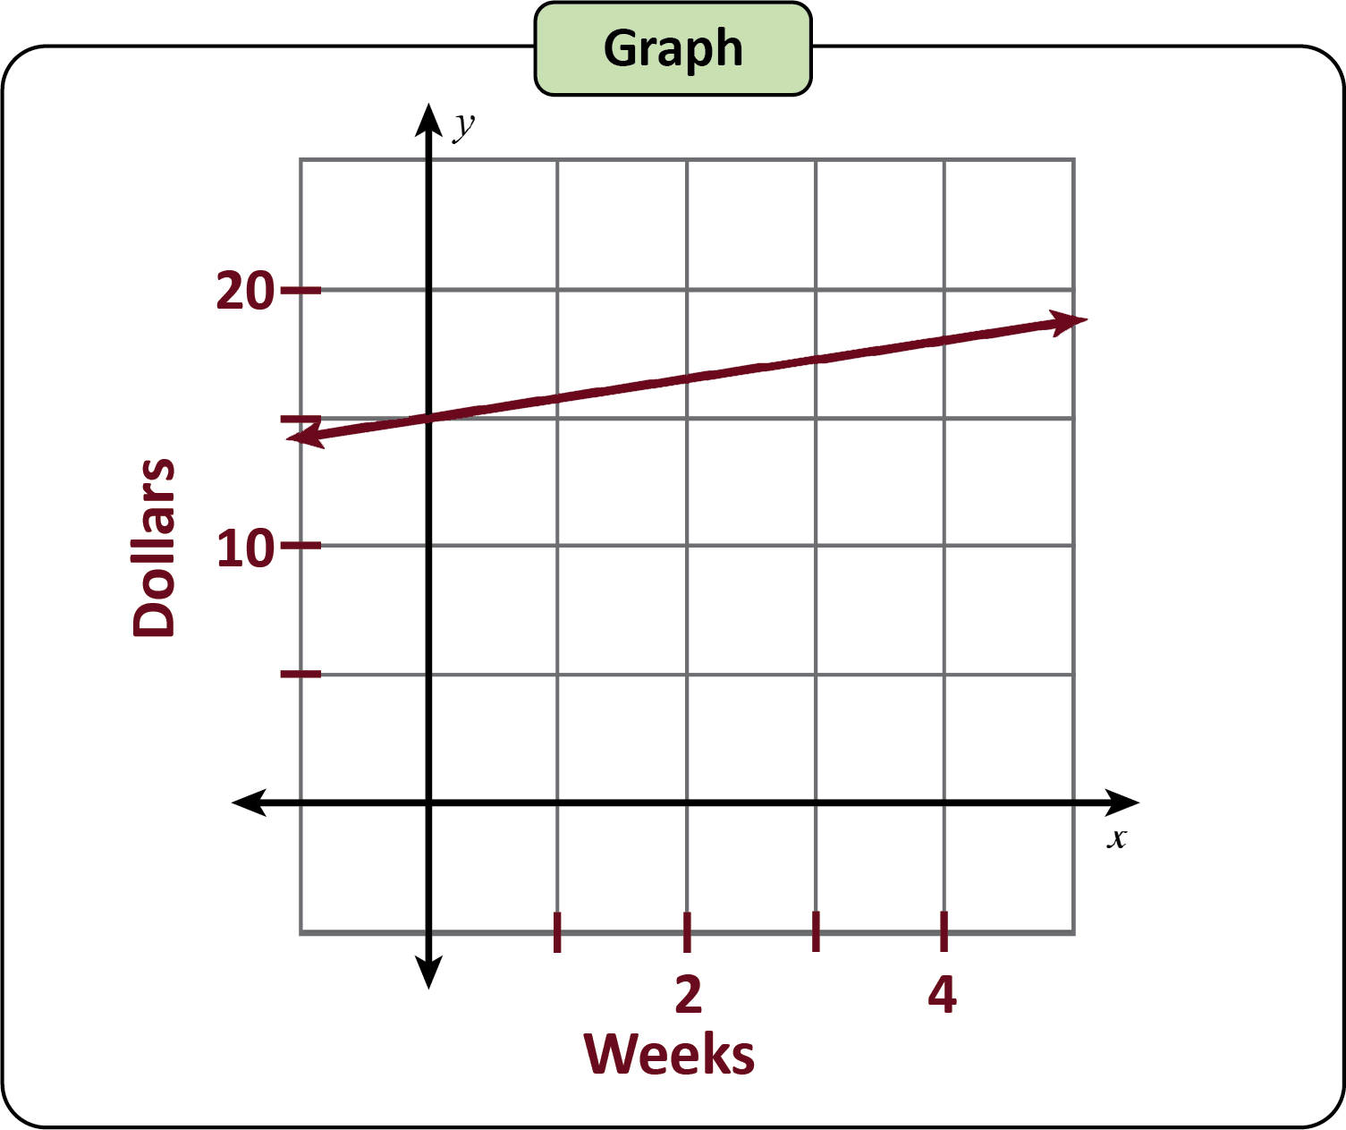
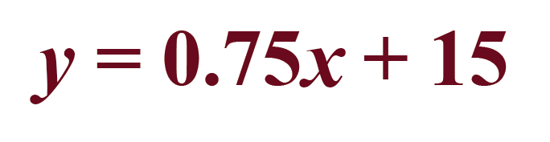
Graph: Check Your Work

Slide 27




Function Fieldwork
Within your group, decide who has each job:
Ecologist
Wildlife Biologist
Solar Technician
Climatologist
Notes:
Amethyst Studio. (2022, January 14). Augmented reality developer. [Illustration]. Noun Project. https://thenounproject.com/icon/augmented-reality-developer-4581888/
Amethyst Studio. (2022, January 14). Solar energy technician. [Illustration]. Noun Project. https://thenounproject.com/icon/solar-energy-technician-4581913/
Amethyst Studio. (2022, January 18). Biologist. [Illustration]. Noun Project. https://thenounproject.com/icon/biologist-4579644/
Amethyst Studio. (2022, January 18). Farmer. [Illustration]. Noun Project. https://thenounproject.com/icon/farmer-4579632/
Bahrul Ulum. (2024, July 4). Climate change. [Illustration]. Noun Project. https://thenounproject.com/icon/climate-change-7040284/

Slide 28
Function Fieldwork: Overview
Each station has 1 linear representation.
Your group is to create the other 3 representations.
Your job title determines which representation you are to create.
When you are done, compare work and discuss.

Slide 29
Function Fieldwork
At your station, use your job title to determine what you are supposed to do.
  Are you creating the story, the table, the graph, or the equation?
  Are you supporting your team and leading the discussion?

Slide 30
Function Fieldwork: Discussion
Compare your results.
Does the equation support the table?
Does the story describe the graph?
Does the graph match the equation?
Does the table represent the story?

Slide 31
Algebra Mad Libs
Ask your partner for the part of speech written below each blank.
Record each response.

Slide 32
Algebra Mad Libs: Example
Given: The newly discovered creature
through the water is so fast!
Ask: What’s a verb that ends with -ing?
  eating
Record: The newly discovered creature eating
through the water is so fast!
Every blank needs a different word.
verb ending with -ing

Slide 33
Algebra Mad Libs
Trade papers.
Use your story to create:
  Table
  Graph (with labels)
  Equation
Remember, you can create these in any order you want.

