Slide 2
Cutting Edge: Design to Prototype
Application of Laser Cutters

Slide 3
Partner Speaks
With your partner, discuss…
what do you know about lasers?
what are some safety rules for working with laser cutters?
1 partner talks for 2 minutes then switch.
At the end, you will be asked to summarize what your partner said about lasers.
K20 4 Minute Timer
Notes:
K20 Center. (n.d.). Partner speaks. Strategies. https://learn.k20center.ou.edu/strategy/62

Slide 4
Essential Questions
How do laser cutters use light and technology to precisely cut and engrave materials?
What factors influence their effectiveness and accuracy?

Slide 5
Lesson Objectives
Determine the rules for laser cutting.
Understand the parts and the process of laser cutting.
Create a product using laser cutters.

Slide 6
Card Sort
Use the “Label Cards” to identify the components with blank lines on the diagram.
Once you have completed labeling the diagram, have your teacher check your work.
Notes:
K20 Center. (n.d.). Card Sort. Strategies. https://learn.k20center.ou.edu/strategy/147

Slide 7
Card Sort
Add the “Function” cards next to your labeled components. These cards describe what each component does in the laser cutter.
Notes:
K20 Center. (n.d.). Card Sort. Strategies. https://learn.k20center.ou.edu/strategy/147

Slide 8
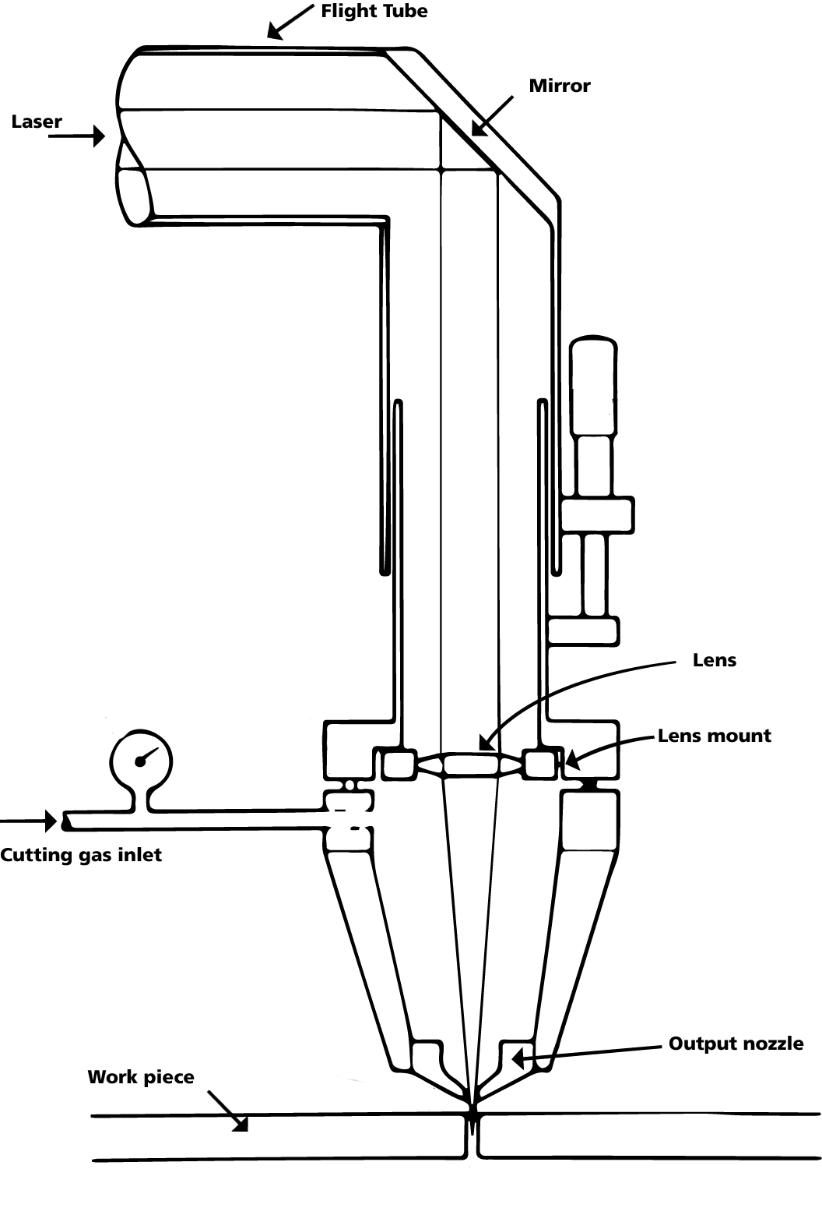

Slide 9
Why is it called a laser?
L.A.S.E.R is an acronym that stands for Light Amplification by Stimulated Emission of Radiation.
Laser cutting uses high-energy beams to cut through different materials.
Mirrors amplify the light.
Lens focuses the beam to the point of contact.

Slide 10
Laser Cutting Parameters
Power (kW) - determines the thickness and type of material that can be cut.
Wavelength (nm) - determines how a laser interacts with a material.
Cutting speed (m/min) - ensures smooth cuts through optimal speeds.
Pulse Frequency (Hz) - higher frequency is better for thin material, low frequency is better for thick material.

Slide 11
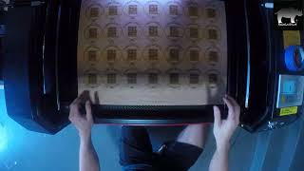
Laser Cutting Timelapse
Notes:
Johnston, R. (n.d.). Satisfying Ornament Laser Cutting Timelapse. YouTube. https://www.youtube.com/watch?v=BFoRgz9tVsM

Slide 12
Types of Cutting
Vaporization - laser heats solids until they turn into vapor (sublimation).
Fusion - laser melts material to separate pieces.
Laser Flame - laser combines with oxygen to create a focused flame.

Slide 13
Follow the law
Law of conservation of matter/energy - it cannot be created or destroyed, only changed.
How do laser cutters follow the laws of conservation of matter and energy?

Slide 14
Tangram
You will now design a puzzle called a tangram.
A tangram is a dissection puzzle, usually consisting of 7 polygons.
On your handout, inside the frame of your tangram, create 5-7 shapes, with at least 3 distinct shapes.
Make sure all the space inside your frame is filled.

Slide 15
Alternative Activity
Access the “Tangram Frame” slide deck.
•Type in [insert url]
•Scan QR code
Transfer your drawing to an open slide.
Export your slide as an SVG and submit to your teacher.

Slide 16
Triangle-Circle-Square
Think of three points (ideas, topics, etc.) that came up during this lesson that have direct real-world applications.
How does knowledge of laser cutters address these problems?
List four things that squared with your thinking, meaning you found them to be interesting or relatable.
Are there any questions about laser cutters still circling your mind? Record at least one here.
Notes:
K20 Center. (n.d.b.). Triangle-square-circle. Strategies. https://learn.k20center.ou.edu/strategy/65

