Slide 2
Pythagor-eatin' Theorem
Constructing the Pythagorean Theorem

Slide 3
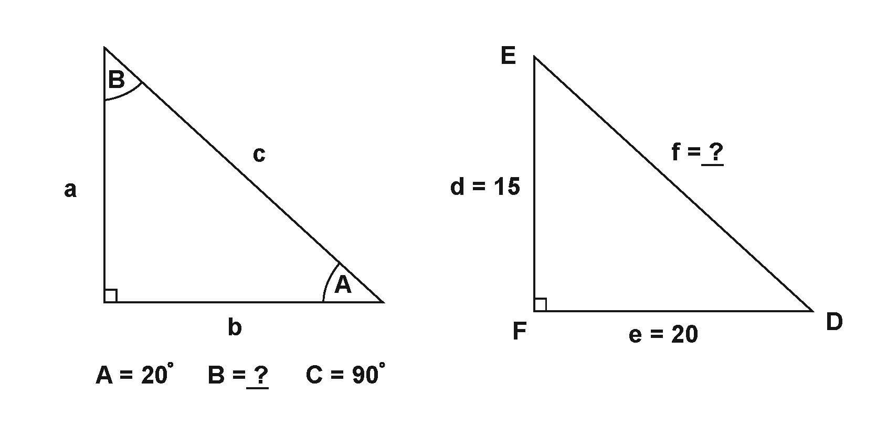
Preflections
On your paper, answer the following questions:
How can you tell if a triangle is a "right" triangle?
What are the legs and what is the hypotenuse in a right triangle?
If Triangle ABC has angles of A = 20° and C = 90°, how can you determine the measure of angle B?
If Triangle DEF is a right triangle, with angle F being the right angle, and side d = 15 and side e = 20, how do you think you could figure out the length of side f?

Slide 4
Essential Question
What is the Pythagorean theorem and does it work for all right triangles?

Slide 5
Lesson Objective
Construct the Pythagorean theorem using Cheez-It® crackers to visually understand the relationship between the sides of a right triangle.
Prove the Pythagorean theorem by applying it to various right triangles, demonstrating its validity across different scenarios.

Slide 6

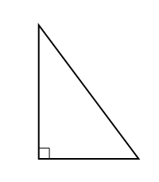
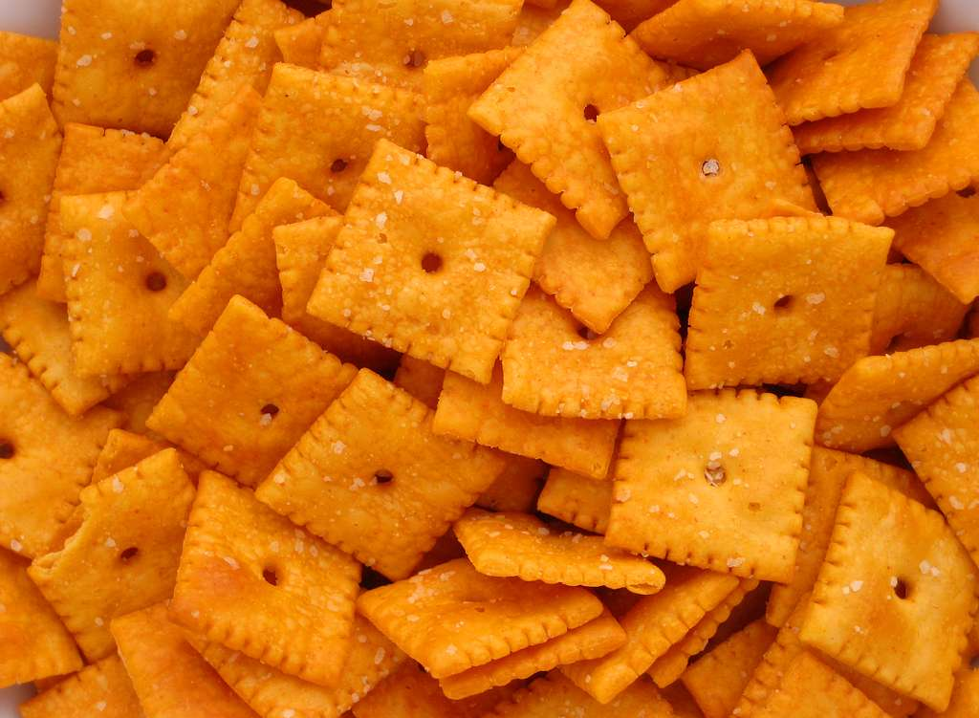
Right on Target
c
b
a

Slide 7
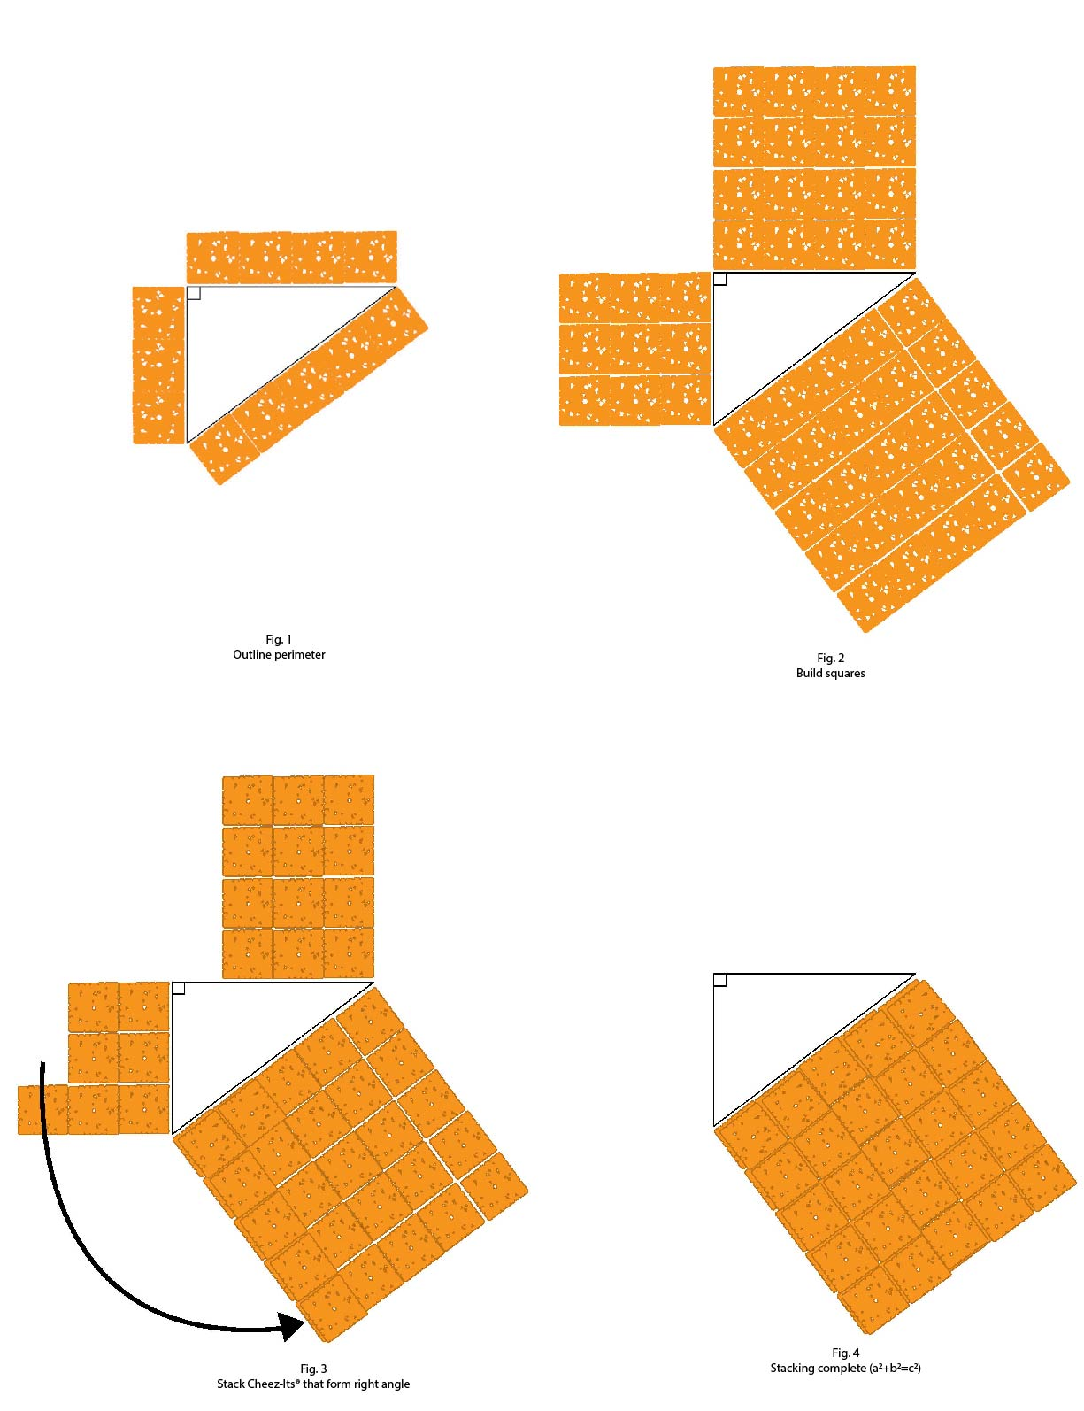
Right on Target
Outline the perimeter with Cheez-Its®
Build perfect squares off the perimeters

Slide 8
Right on Target
Using the Cheez-Its® from the two sides forming the right angle (sides a and b), and stack them onto the perfect square of side c.
Hint: Stack only one Cheez-it® on top of the existing Cheez-it®

Slide 9
Vocabulary
Term | Definition
Triangle
Right Triangle
Legs of a Triangle
A polygon with three sides, three vertices(corners), and three angles that add up to 180º
An angle measuring 90º; intersection of two perpendicular lines.
Two shorter sides of a right triangle; two sides adjacent to the right angle.

Slide 10
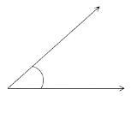
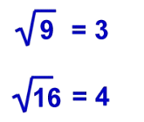
Vocabulary
Term | Definition | Example
Hypotenuse of a Triangle
Angle
Square Root
The side of the triangle opposite of the right angle; the longest side of the right triangle.
The space between two straight lines(rays) that meet at a point
A value that can be multiplied by itself to get the original number

Slide 11
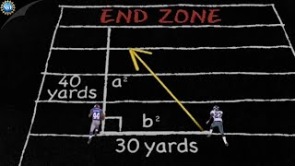
NSF’s Pythagorean Theorem:
Science of NFL Football

Slide 12
Pythagorean Theorem Trifold
What is the relationship among a², b², and c²?
Using a², b², and c², write an equation to describe the mathematical relation for Pythagorean theorem

Slide 13
Pythagorean Theorem Trifold
What is the relationship among a², b², and c²?
Using a², b², and c², write an equation to describe the mathematical relation for Pythagorean theorem
  a² + b² = c²
b²
c²
Legs
Hypotenuse
Legs
a²

Slide 14

Pythagorean Theorem Trifold: Am I Right?
Using the Pythagorean Theorem, complete the Am I Right section of the trifold on your own.

Slide 15
Pythagorean Theorem Trifold: What’s My Hypotenuse?
Continuing to work with your partner, complete the What’s My Hypotenuse section of your trifold.

Slide 16
Pythagorean Theorem Trifold: What’s My Leg Length?
Continuing to work with your partner, complete the What’s My Leg Length section of your trifold.

Slide 17
Reflection
Open your envelope and look at your previous responses from the beginning of the lesson.
What are the main differences you noticed between what you learned during the lesson compared to what you initially wrote down in your preflection?
What is the Pythagorean theorem and what is it used for?
What are the two major takeaways from today’s lesson that you will remember?

