Slide 2

Pythagor-eatin’
Theorem
Constructing the
Pythagorean Theorem

Slide 3

Before and After Thoughts
Do your best to independently
answer the Preflection questions on
your handout.
Use what you know to make your best educated guess if you are unsure.
Notes:
K20 Center. (n.d.). Preflections. Strategies. https://learn.k20center.ou.edu/strategy/191

Slide 4
Before and After Thoughts
Write your name on your paper and
on your envelope.
Fold your paper so that it fits in the envelope.
Place your paper in your envelope.
Seal your envelope.
Notes:
K20 Center. (n.d.). Preflections. Strategies. https://learn.k20center.ou.edu/strategy/191

Slide 5
Essential Question
What is the Pythagorean theorem, and does it work for all right triangles?

Slide 6
Learning Objectives
Represent the Pythagorean theorem both visually and algebraically.
Use the Pythagorean theorem to find the missing side of a triangle.

Slide 7
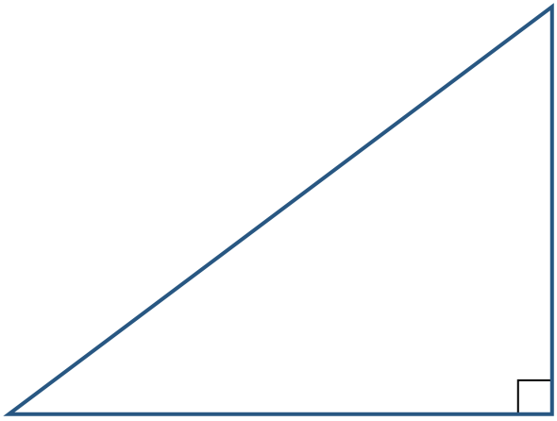
Right on Target
Gather materials:
  Cheez-It® crackers
  Right Triangle
Label your triangle:
  Shortest side: a
  Longest side (opposite the right angle): c
  Other side: b
c
a
b

Slide 8
Right on Target
Outline the perimeter with crackers.
Build squares off the sides.

Slide 9
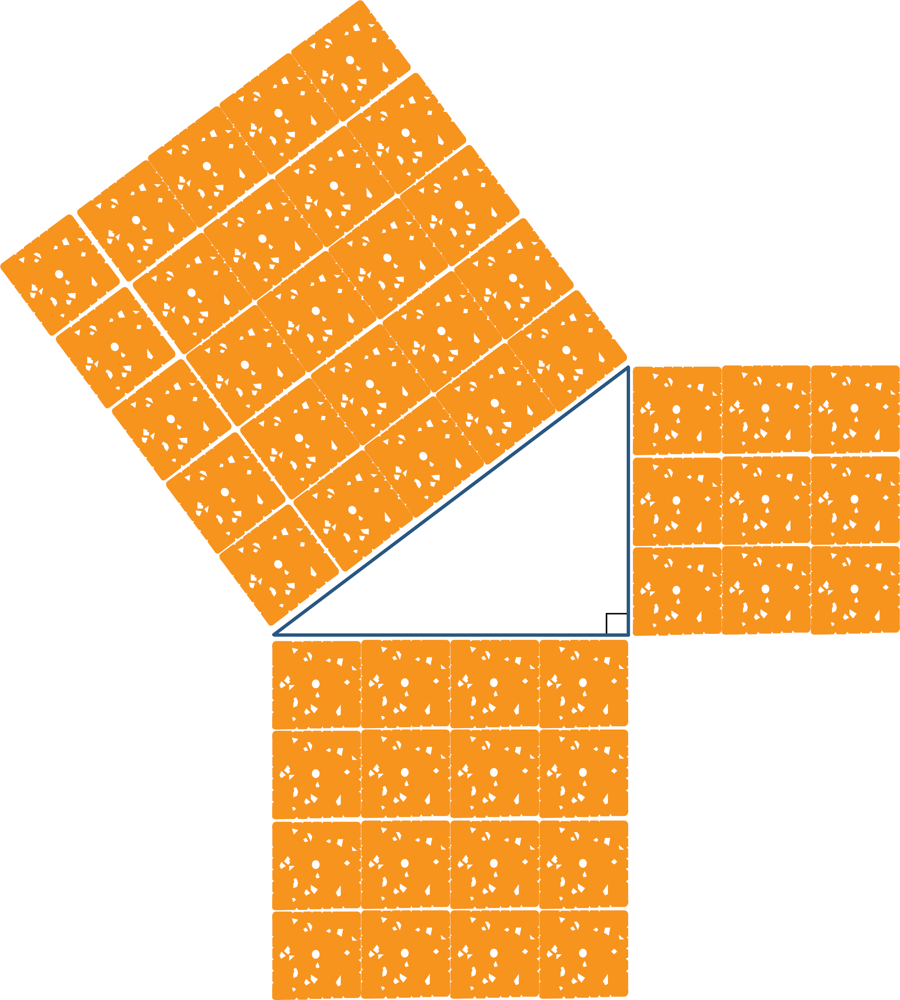
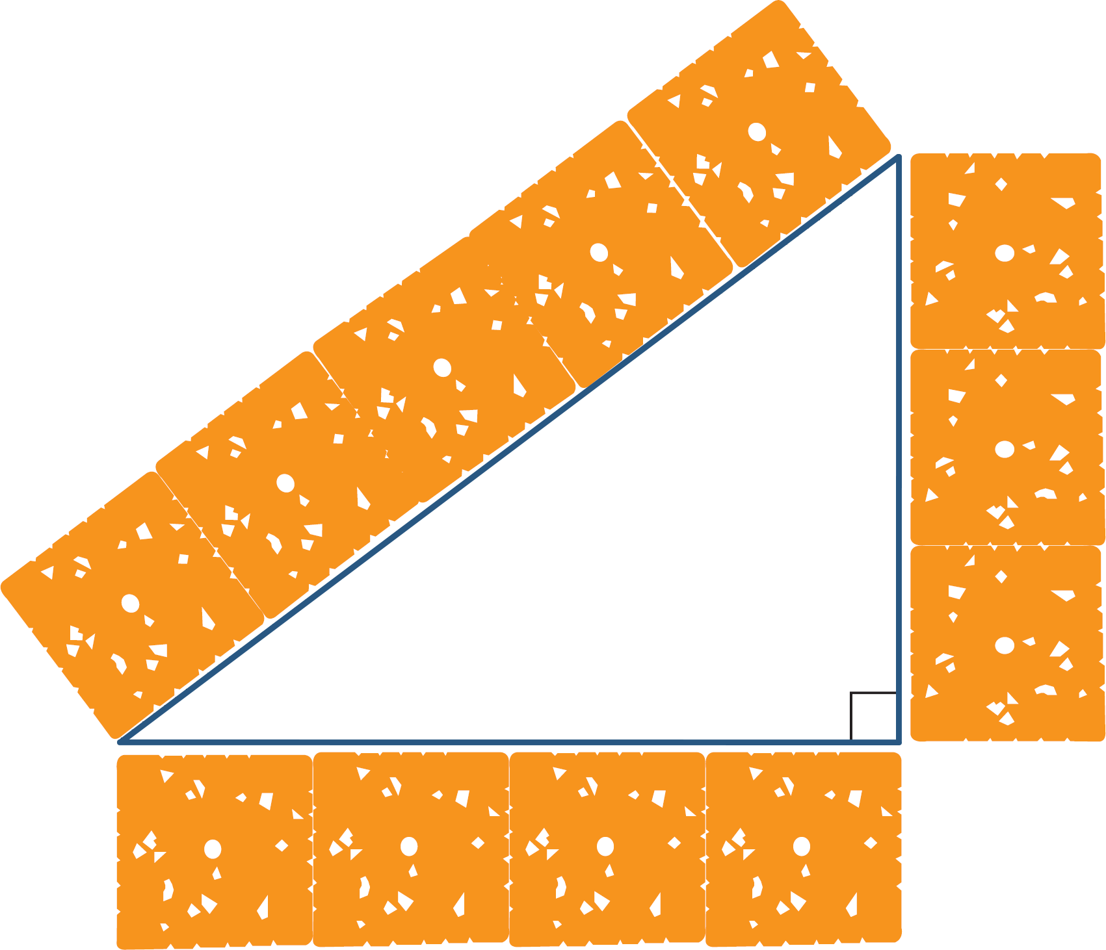
Right on Target
Outline perimeter.
Build squares.

Slide 10
Right on Target
Move the crackers from the 2 sides forming the right angle (sides a and b), and stack them onto the crackers that make up the square on side c.
Hint: Stack only one cracker on top of an existing cracker.

Slide 11
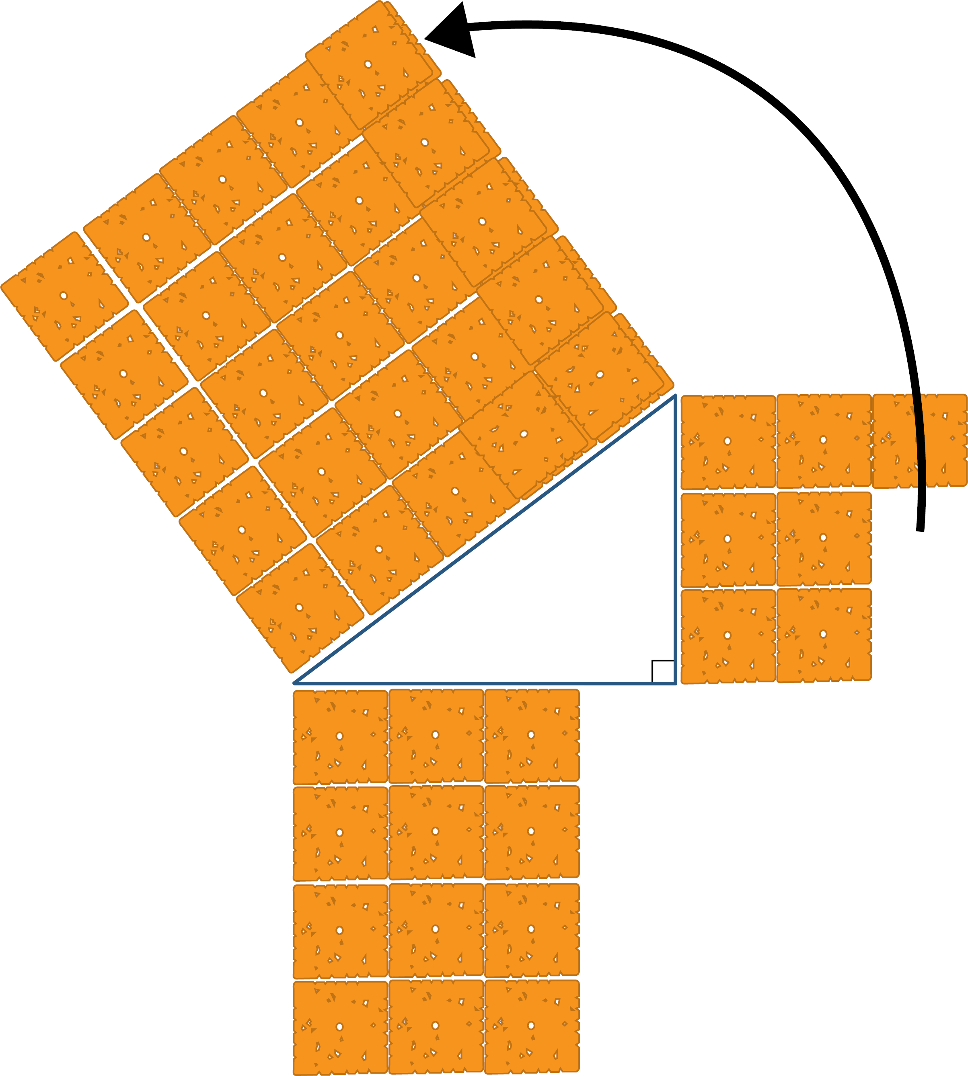
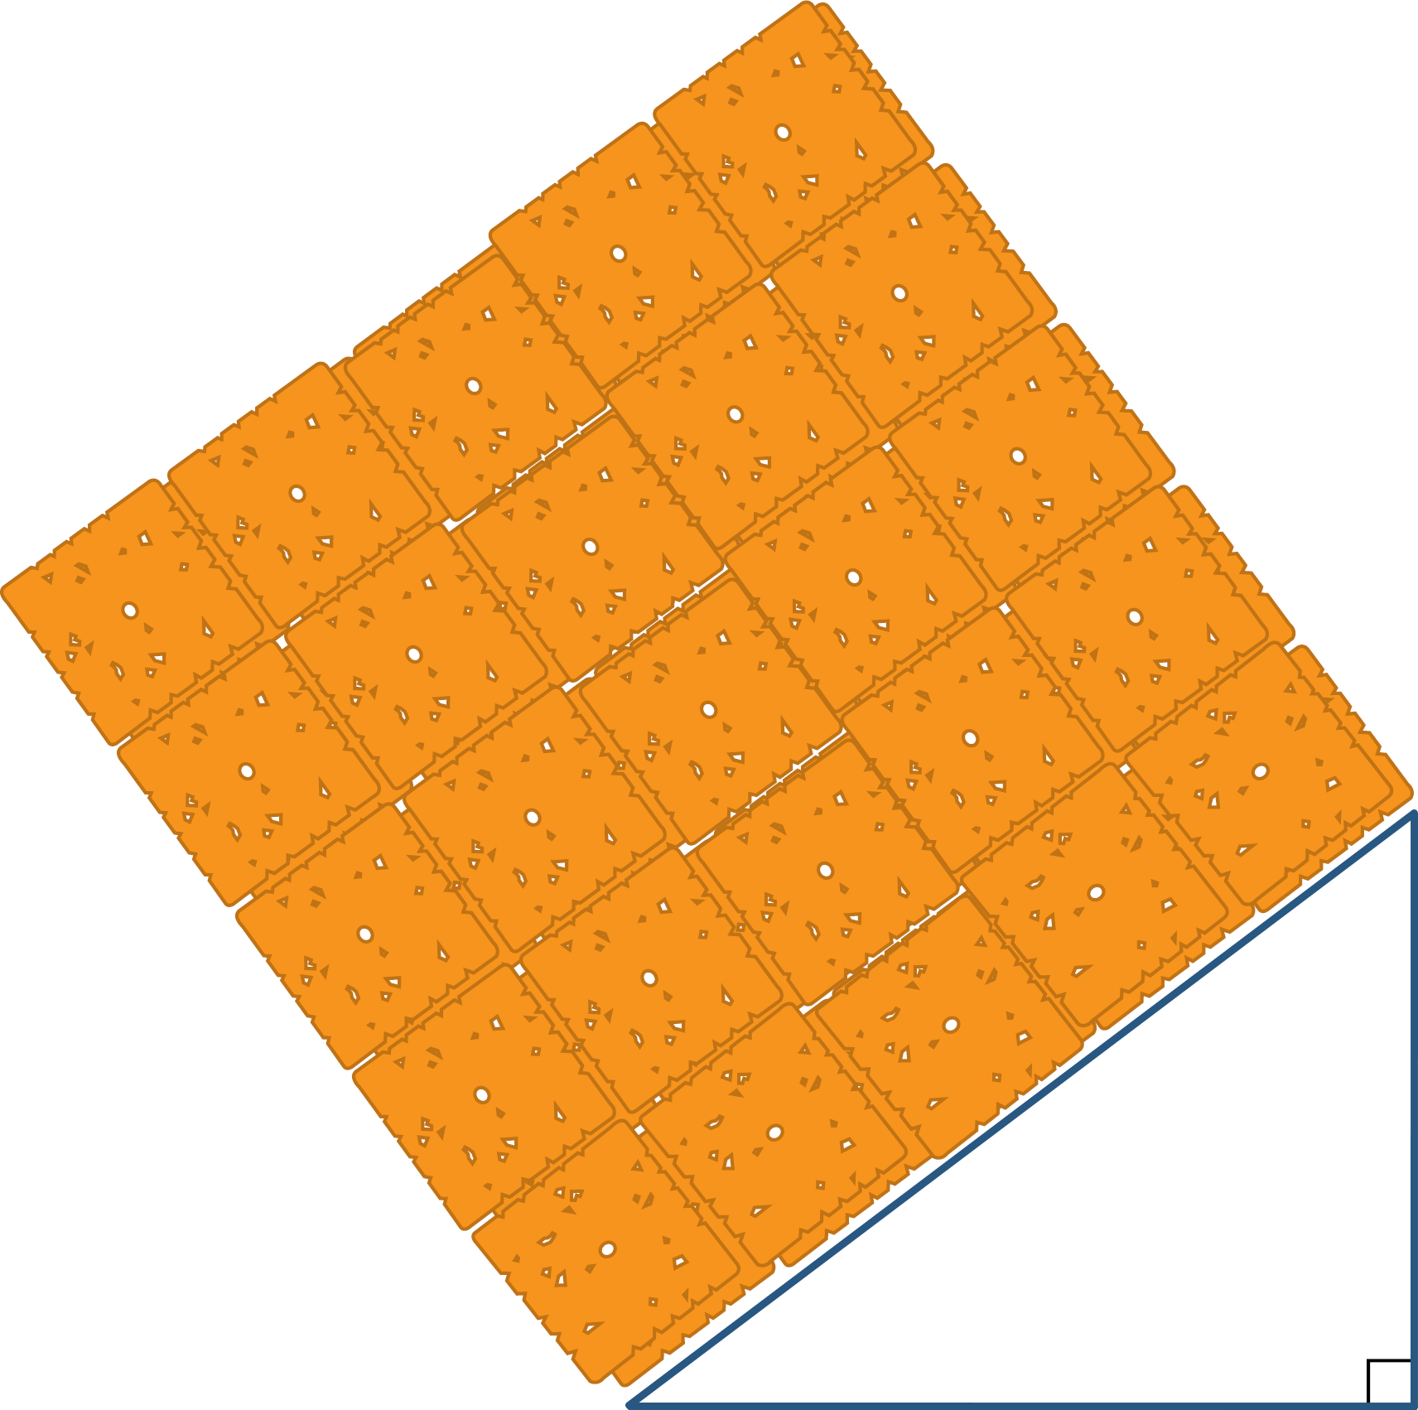
Right on Target
Stack Cheez-Its.
Stacking complete:

Slide 12
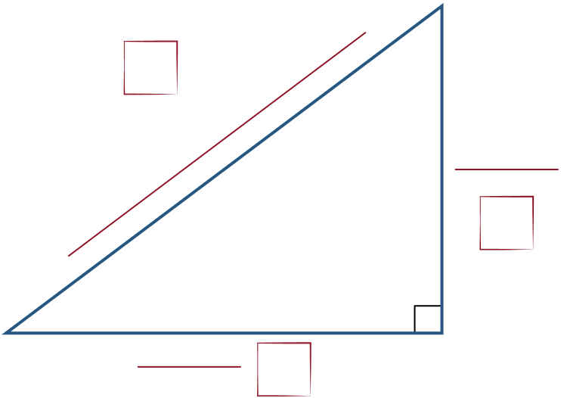
Pythagorean Theorem
c
Label the triangle on your
foldable in the same way as
your previous triangle.
Think about what you did with the
Cheez-Its to answer the following question:
What is the relationship between a², b², and c²?
a
b

Slide 13
Pythagorean Theorem
What is the relationship between a², b², and c²?
c
a
b

Slide 14
Pythagorean Theorem
c²
Using a², b², and c², write
an equation to describe the mathematical relationship for the Pythagorean theorem.
a²
b²

Slide 15
Pythagorean Theorem
c²
c
a²
a
b
b²
a² + b² = c²

Slide 16
Vocabulary and Symbols
Describe each vocabulary term in your own words. Draw the symbol, if there is one. Sketch a picture if you find it helpful.
Right Triangle: a triangle with an
angle measuring 90°

Slide 17
Vocabulary and Symbols
Angle: the space between two rays
that meet at a point
Triangle: a polygon with three sides,
three vertices (corners), and three angles
that add up to 180°

Slide 18
Vocabulary and Symbols
Legs of a Triangle: two shorter sides of a right triangle; two sides adjacent to the right angle
Hypotenuse: the side of the triangle opposite of the right angle; the longest side of a right triangle
hypotenuse
leg
leg

Slide 19
Pythagorean Theorem
For any right triangle, the sum of the squares of the lengths of the legs (a² + b²) is equal (=) to the square of the length of the hypotenuse (c²).
c
hypotenuse
leg
a
leg
b

Slide 20
Am I Right?
Use the following side lengths to decide if this triangle is a right triangle.
  a = 6 ft.
  b = 8 ft.
  c = 10 ft.
Does a² + b² = c²? Is this a right triangle?
  a² = ?
  b² = ?
  c² = ?

Slide 21
Am I Right?
Use the following side lengths to decide if this triangle is a right triangle.
  a = 6 ft.
  b = 8 ft.
  c = 10 ft.
Does a² + b² = c²? Is this a right triangle?
  a² = 36 ft.²
  b² = 64 ft.²
  c² = 100 ft.²

Slide 22
Am I Right?
Use the following side lengths to decide if this triangle is a right triangle.
  a = 7 in.
  b = 8 in.
  c = 12 in.
Does a² + b² = c²? Is this a right triangle?
  a² = ?
  b² = ?
  c² = ?

Slide 23
Am I Right?
Use the following side lengths to decide if this triangle is a right triangle.
  a = 7 in.
  b = 8 in.
  c = 12 in.
Does a² + b² = c²? Is this a right triangle?
  a² = 49 in.²
  b² = 64 in.²
  c² = 144 in.²

Slide 24
Am I Right?
Use the following side lengths to decide if this triangle is a right triangle.
Does a² + b² = c²? Is this a right triangle?
  a² = ?
  b² = ?
  c² = ?
  A triangle has sides that are
  15 m, 12 m, and
  9 m long.

Slide 25
Am I Right?
Use the following side lengths to decide if this triangle is a right triangle.
Does a² + b² = c²? Is this a right triangle?
  a² = 81 m²
  b² = 144 m²
  c² = 225 m²
  A triangle has sides that are
  15 m, 12 m, and
  9 m long.

Slide 26
Am I Right? Discussion
What is similar about the side lengths of questions 1 & 3 with the side lengths of the triangle from the Cheez-It activity?
Cheez-It Triangle: (3–4–5) cm
Question 1 Triangle: (6–8–10) ft
Question 3 Triangle: (9–12–15) m

Slide 27
Vocabulary and Symbols: Perfect Squares
9 is a perfect square.
16 is a perfect square.
25 is a perfect square.
Why do you think we call
these numbers perfect squares?
49 is a perfect square.
100 is a perfect square.
121 is a perfect square.

Slide 28
Vocabulary and Symbols
Square Root Symbol: is asking what number can be multiplied by itself to get the number under the symbol
3 is the square root of 9 because 3 squared (times itself) is 9

Slide 29
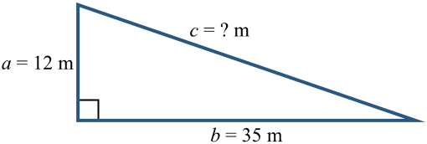
What’s My Hypotenuse?
Find the length of c, in meters (m).

Slide 30
What’s My Hypotenuse?
Find the length of c, in meters (m).

Slide 31
What’s My Hypotenuse?
Can the length of the leg or
hypotenuse have a decimal?
  Why or why not?

Slide 32
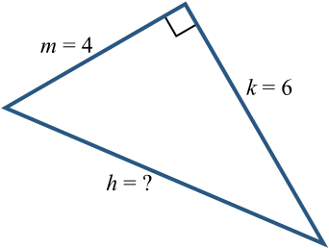
What’s My Hypotenuse?
Find the length of h.

Slide 33
What’s My Hypotenuse?
Find the length of h.

Slide 34
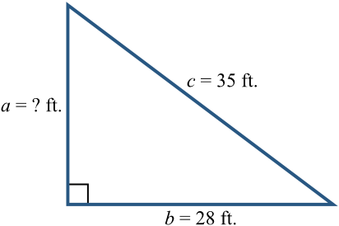
What’s My Leg Length?
Find the length of a.

Slide 35
What’s My Leg Length?
Find the length of a.

Slide 36
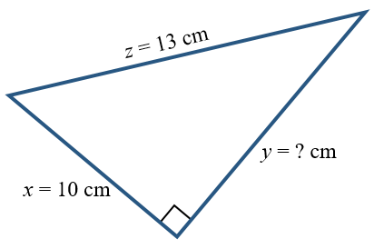
What’s My Leg Length?
Find the length of y.

Slide 37
What’s My Leg Length?
Find the length of y.

Slide 38
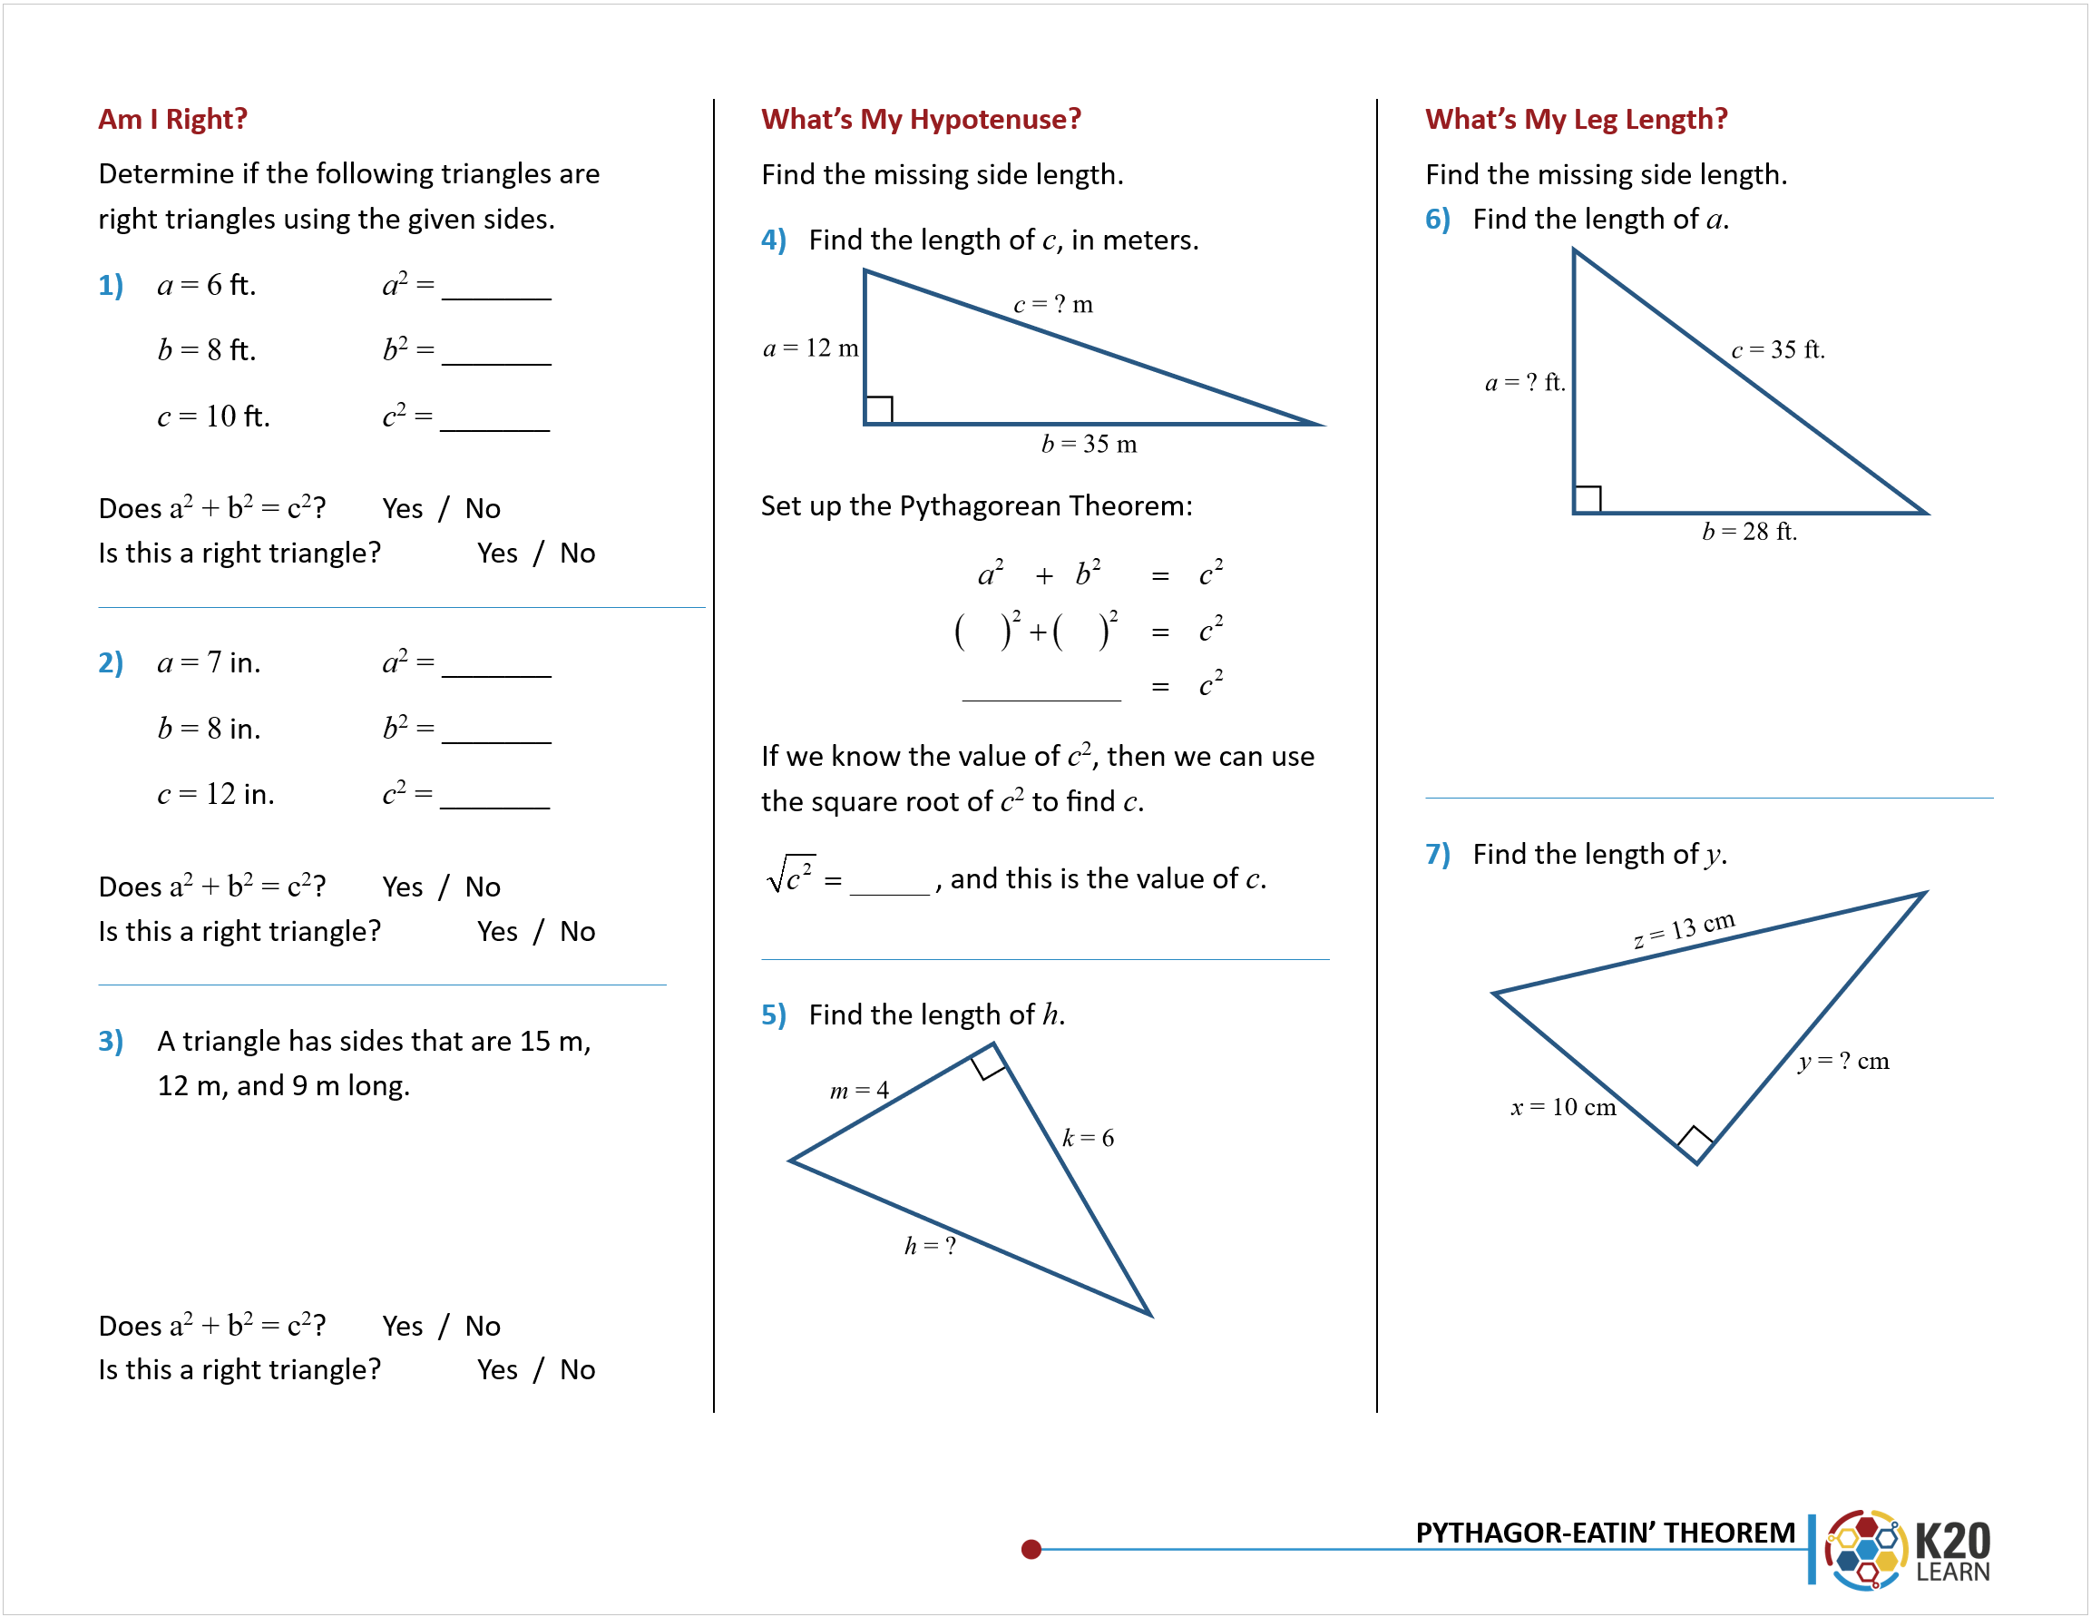
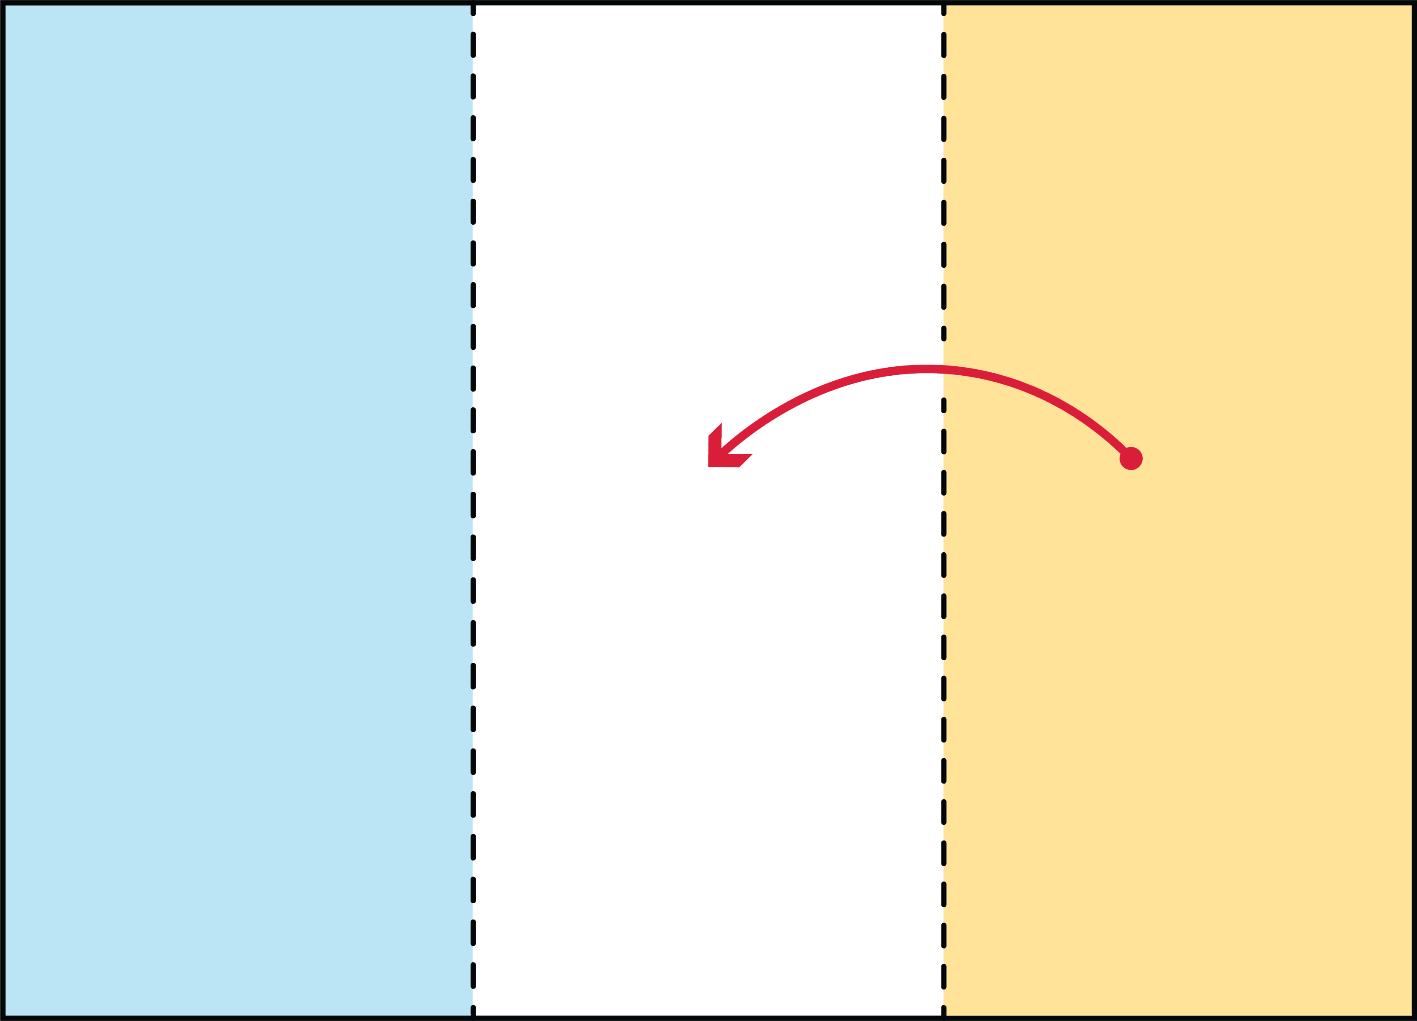
Fold Your Trifold
Place the paper such that the
practice problems are facing you.
Take the right edge of the paper and match it up with the vertical line. Fold the paper along the vertical line.

Slide 39
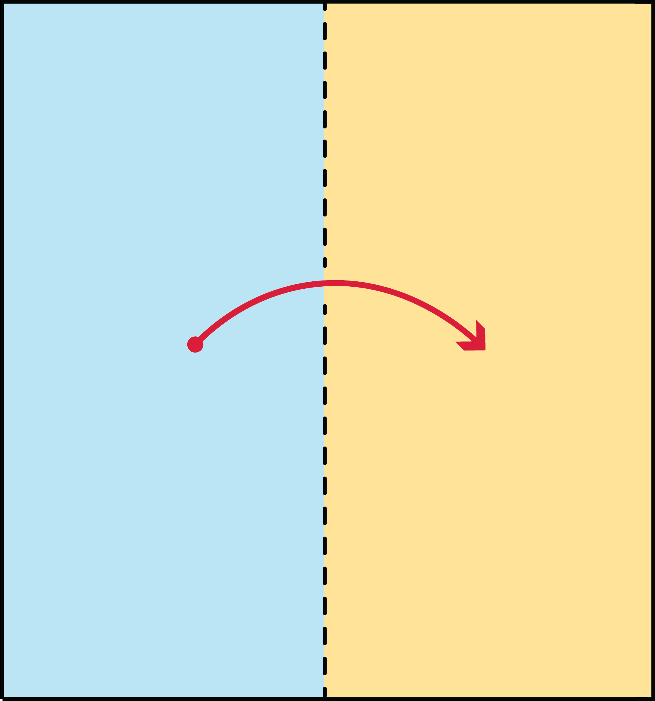
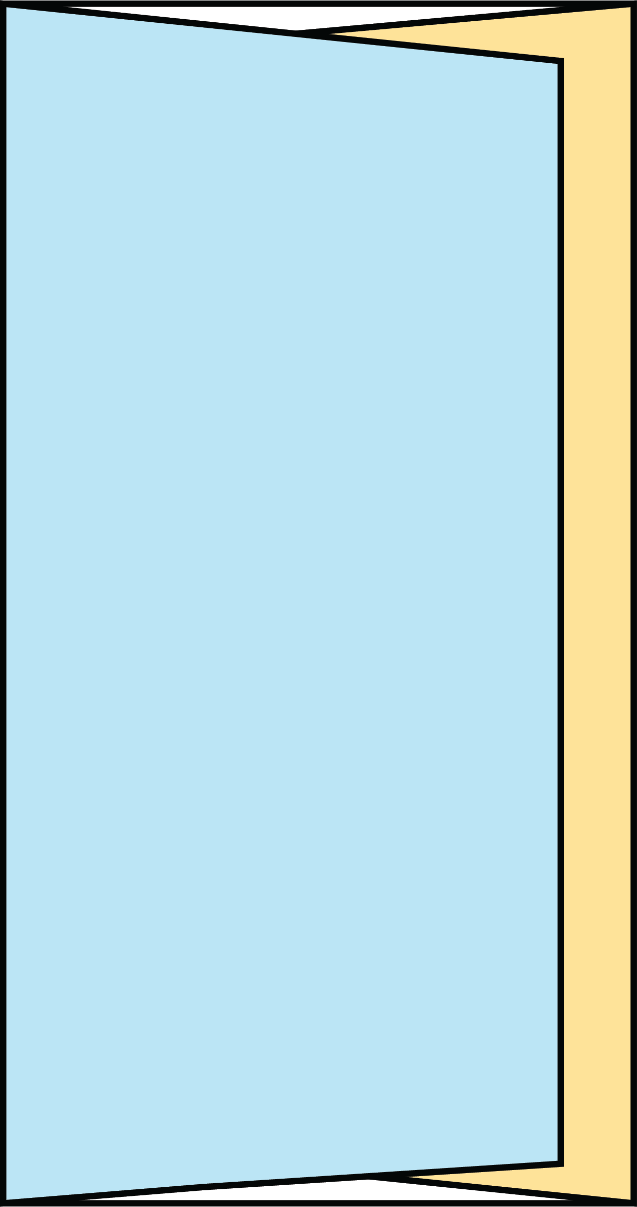
Fold Your Trifold
Take the left edge of the paper and match it up with the previous fold. Fold the paper along the vertical line.

Slide 40
Before and After Thoughts
Open your envelope and review your
earlier responses from the beginning
of the lesson.
Answer the following questions on your handout.
Notes:
K20 Center. (n.d.). Preflections. Strategies. https://learn.k20center.ou.edu/strategy/191

Slide 41
Before and After Thoughts
What are the main differences you
notice between what you learned
during the lesson, and what you initially wrote?
What is the Pythagorean theorem, and what is it used for?
What are 2 major takeaways from today’s lesson that you will remember?
Notes:
K20 Center. (n.d.). Preflections. Strategies. https://learn.k20center.ou.edu/strategy/191

