Slide 2
Cutting Edge: Science of Precision
Introduction to Lasers and Laser Cutters

Slide 3
Essential Question
How do lasers work?

Slide 4
Learning Objectives
Identify what makes a laser different from other sources of light.
Describe how lasers precisely cut and shape materials.
Pitch a product that could be created with a laser cutter.

Slide 5
Wakelet
Access The Lit World of Lasers Wakelet.
Type in the URL
Scan QR Code
Choose at least one column or theme to focus on.
Explore the content.
If time remains, view the resources in a different column.
https://bit.ly/4gyaTDN
Notes:
McDonald, M. (2024). The Lit World of Lasers. Wakelet. https://wakelet.com/wake/RE8nTJkTnEq8DJSvsZ1Ut

Slide 6
I Notice, I Wonder
What are some details that stand out to you about lasers and their uses?
What do you still wonder about lasers?
Notes:
K20 Center. (n.d.). I notice, I wonder. Strategies. https://learn.k20center.ou.edu/strategy/180

Slide 7
Stations + Frayer Models
With your assigned group, find your station.
Read the Station Card and follow the “Procedures” to explore different parts of how a laser cutter works.
Fill in your group’s Frayer Model handout as you work.
Notes:
K20 Center. (n.d.). Frayer model. Strategies. https://learn.k20center.ou.edu/strategy/126

Slide 8
Stations + Frayer Models
Finish the station and Frayer Model handout.
Share your observations with other group(s) at your station.
Compare your Frayer Models.
On the chart paper, create a combined Frayer Model that mirrors your handout.
Notes:
K20 Center. (n.d.). Frayer model. Strategies. https://learn.k20center.ou.edu/strategy/126

Slide 9
Share Observations
Share your combined Frayer Model posters!
At the bottom or on the back of your group Frayer Model, make a conclusion. Think about your station:
How does that relate to the others?

Slide 10
Muddiest Point
As you watch the video, reflect on the following:
What’s still confusing about how a laser cutter works?
Notes:
K20 Center. (n.d.). Muddiest point. Strategies. https://learn.k20center.ou.edu/strategy/109

Slide 11
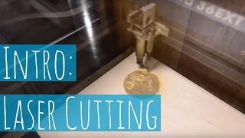
Learn to Laser Cut
Notes:
Beauty and the Bolt. (2017, January 21). Learn to laser cut! [Video]. YouTube. https://www.youtube.com/watch?v=P7s3KXXJYHg

Slide 12
Beam Me Up!
What is a laser and what makes it different from regular light?
What happens to the material when a laser beam hits it at high intensity?
What kinds of things do you think laser cutters are most useful for making or designing?

Slide 13
Time to Define
On your own, answer the following question:
How does a laser function?
K20 4 Minute Timer
Notes:
K20 Center. (2021, September 21). 4 Minute Timer [Video]. YouTube. https://youtu.be/kpCsfuvzQeY?feature=shared

Slide 14
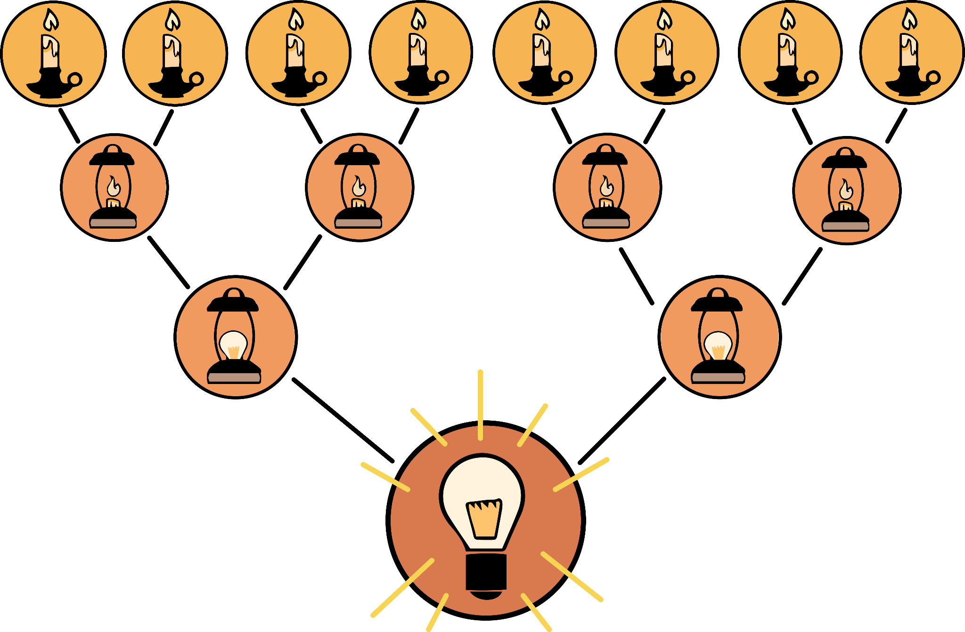
8 Up
With your group:
Share your individual definitions from before.
How does a laser function?
Narrow your combined groups’ definitions down to 2 definitions.
K20 4 Minute Timer
Notes:
K20 Center. (n.d.). 8-up. Strategies. https://learn.k20center.ou.edu/strategy/2494
K20 Center. (2021, September 21). 4 Minute Timer [Video]. YouTube. https://youtu.be/kpCsfuvzQeY?feature=shared

Slide 15
8 Up
With your new group:
Take your 4 responses and whittle them down to just 2.
K20 3 Minute Timer
Notes:
K20 Center. (n.d.). 8-up. Strategies. https://learn.k20center.ou.edu/strategy/2494
K20 Center. (2021, September 21). 3 Minute Timer [Video]. YouTube. https://youtu.be/iISP02KPau0?feature=shared

Slide 16
8 Up
With the whole class:
Share your 2 responses with one another.
Whittle these definitions down to 1.
What’s our class definition?
K20 3 Minute Timer
Notes:
K20 Center. (n.d.). 8-up. Strategies. https://learn.k20center.ou.edu/strategy/2494
K20 Center. (2021, September 21). 3 Minute Timer [Video]. YouTube. https://youtu.be/iISP02KPau0?feature=shared

Slide 17
Example Projects

Slide 18
Time to Pitch!
What is your idea/product?
Draw an image of your product.
What are some things to consider in the design?
What material will you use?
How big will it be?
Why is a laser cutter needed for this product?

