Slide 2
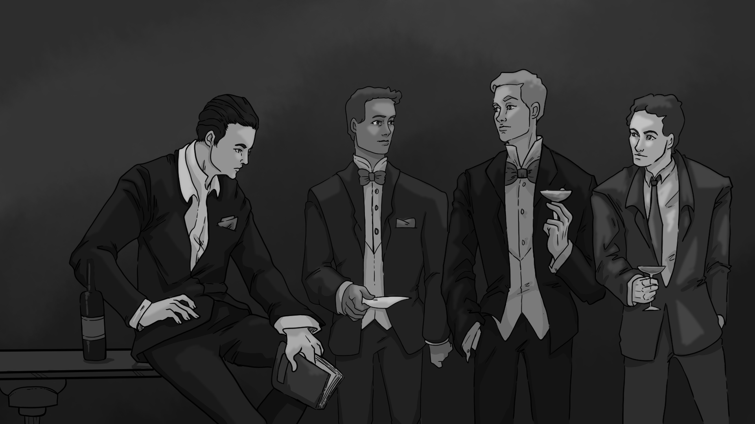
The Sound of Solitude
Argumentative Writing

Slide 3
Essential Question
How do media and literature influence our opinions on meaningful life issues?

Slide 4
Lesson Objectives
Write an argumentative essay.
Evaluate the decisions of characters.
Analyze motives of characters decisions.

Slide 5


Collaborative Word Cloud–Mentimeter
Go to www.menti.com
Join the class Menti using this code: XXXX-XXXX
Respond to the prompt for the word cloud:
  What is something you would be willing to sacrifice to prove a point?
List up to 3 ideas on the word cloud.
Notes:
K20 Center. (n.d.). Collaborative word cloud. Strategies. https://learn.k20center.ou.edu/strategy/103
K20 Center. (n.d.). Mentimeter. Tech tools. https://learn.k20center.ou.edu/tech-tool/645

Slide 6
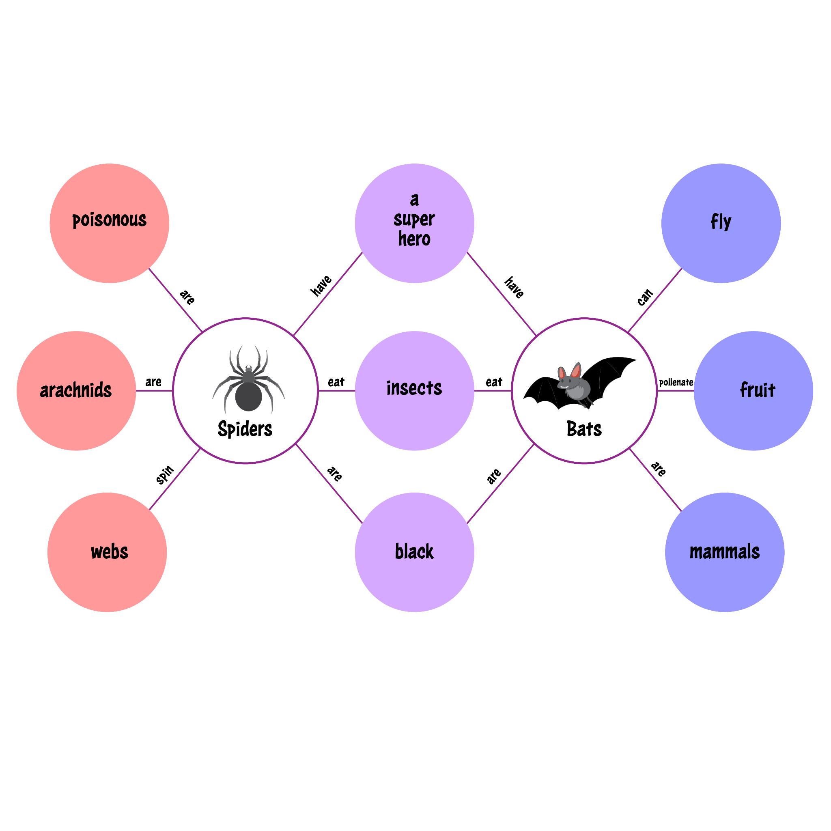

Double Bubble Maps
Death Penalty vs. Life in Prison
On this first map, fill out as many of the bubbles as you can with ideas, examples, feelings, and points of view corresponding to the topics until the time runs out.
Notes:
K20 Center. (n.d.). Double bubble map. Strategies. https://learn.k20center.ou.edu/strategy/3035
K20 Center. (2021, September 21). K20 Center 4 minute timer. [Video]. YouTube.https://www.youtube.com/watch?v=kpCsfuvzQeY&list=PL-aUhEQeaZXLMF3fItNDxiuSkEr0pq0c2&index=6

Slide 7
Double Bubble Maps
Material Wealth versus Freedom
Fill out as many of the bubbles as you can with ideas, examples, feelings, and points of view corresponding to the topics until the time runs out.
Notes:
K20 Center. (n.d.). Double bubble map. Strategies. https://learn.k20center.ou.edu/strategy/3035
K20 Center. (2021, September 21). K20 Center 4 minute timer. [Video]. YouTube.https://www.youtube.com/watch?v=kpCsfuvzQeY&list=PL-aUhEQeaZXLMF3fItNDxiuSkEr0pq0c2&index=6

Slide 8
Double Bubble Maps
With a partner, share about each map.
Write down any additional information they share with you that stands out—add bubbles if you need to!
Be prepared to share with the whole class.

Slide 9
The Bet by Anton Chekhov
While reading, highlight any pertinent information about the banker or the young lawyer that gives what their thoughts and opinions are.

Slide 10

Step In, Step Out, Step Back
Step In | Step Out | Step Back
Given what you see and know at this time, what do you think this person might feel, believe, know, or experience? | What else would you like or need to learn to understand this person’s perspective better? | Given your exploration of this perspective so far, what do you notice about your own perspective and what it takes to take somebody else’s?
Notes:
K20 Center. (n.d.). Step in, step out, step back. Strategies. https://learn.k20center.ou.edu/strategy/1585

Slide 11
The Twilight Zone—The Silence
While viewing, follow along with the script, highlight any pertinent information about Colonel Archie Taylor or Jamie Tennison that gives what their thoughts and opinions are.

Slide 12
Step In, Step Out, Step Back
Step In | Step Out | Step Back
Given what you see and know at this time, what do you think this person might feel, believe, know, or experience? | What else would you like or need to learn to understand this person’s perspective better? | Given your exploration of this perspective so far, what do you notice about your own perspective and what it takes to take somebody else’s?
Notes:
K20 Center. (n.d.). Step in, step out, step back. Strategies. https://learn.k20center.ou.edu/strategy/1585

Slide 13
Thesis Stems
“What defines right and wrong depends who you ask, especially in the world of [work].”
“[Character A] believes in [value/idea], which contrasts directly with [Character B]’s stance on…”
“Throughout [work], [issue] remains central conflict, particularly from the perspective of…”
“By examining [Character A]’s and [Character B]’s views, this essay will argue that…”
“Through [Character A] and [Character B], [author/playwright] invites us to question our own beliefs about…”
“[Character] made the choice to [blank] and it was a [good/bad] choice because…”
“[Value/idea] is the better choice because [reason 1], [reason 2], [reason 3].”

Slide 14
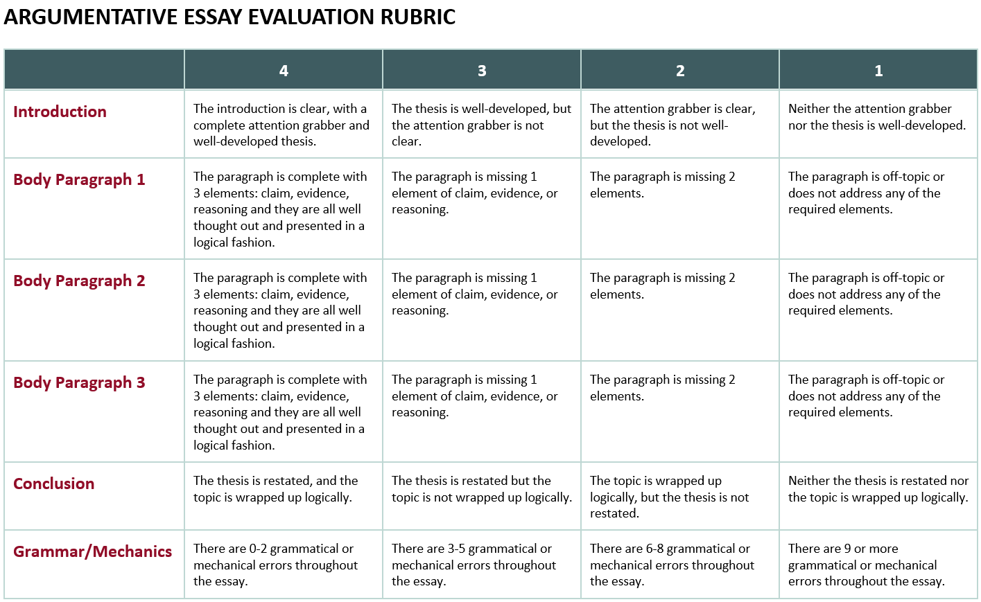

Slide 15
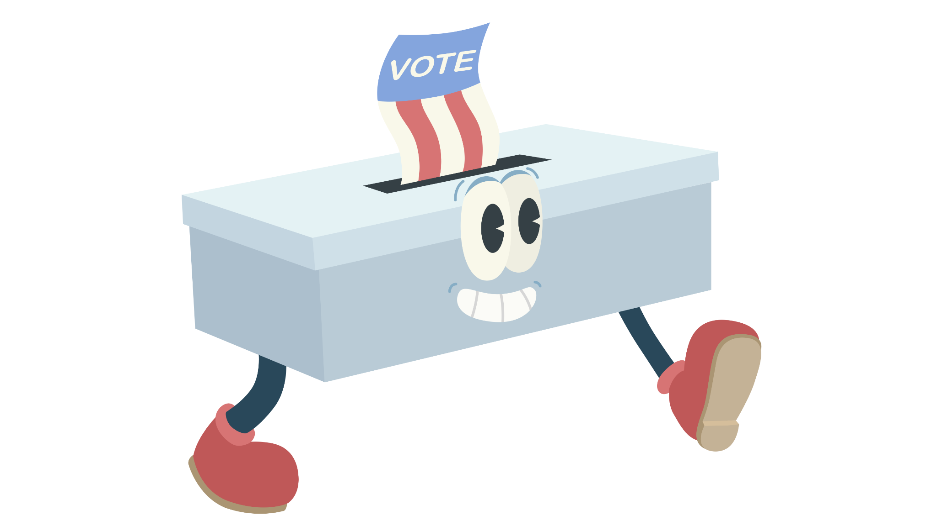
Walking Vote
What is more humane– the death penalty or life in prison?
Why did you choose the way you did?
What in the story/episode influenced you?
What in real life or the news has influenced you?
Notes:
K20 Center. (n.d.). Walking vote. Strategies. https://learn.k20center.ou.edu/strategy/4126

Slide 16
Walking Vote
What is more meaningful—material wealth or personal freedom?
Why did you choose the way you did?
What in the story/episode influenced you?
What in real life or the news has influenced you?
Notes:
K20 Center. (n.d.). Walking vote. Strategies. https://learn.k20center.ou.edu/strategy/4126

