Slide 2
Nose Like a Cherry: Understanding Similes and Metaphors
ELA
7th or 8th Grade

Slide 3
Guiding Questions:
What are metaphors and similes?
How do we recognize them?
Why do we use metaphors and similes in writing?

Slide 4
Sticky Bars Activity
Place your name at the top of the sticky note.
Choose the sentence that tells you the LEAST about Leeza’s feelings.
Write the reason you chose that sentence on the sticky note.

Slide 5
Choose the sentence that LEAST describes Leeza’s feelings.
1. Leeza cried large tears down her cheeks. | 2. Leeza's tears were the Pacific Ocean—rushing and salty. | 3. Leeza cried. | 4. Leeza's tears were flowing down her cheeks like a river.

Slide 6
Choose the sentence that MOST describes Leeza’s feelings.
1. Leeza cried large tears down her cheeks. | 2. Leeza's tears were the Pacific Ocean—rushing and salty. | 3. Leeza cried. | 4. Leeza's tears were flowing down her cheeks like a river.

Slide 7
Elbow Partners
Which sentence below contains a simile? Which contains a metaphor?
Leeza’s hair was as golden as morning sunshine.
Leeza had blonde and curly hair.
Leeza’s hair was golden curly ribbons.

Slide 8
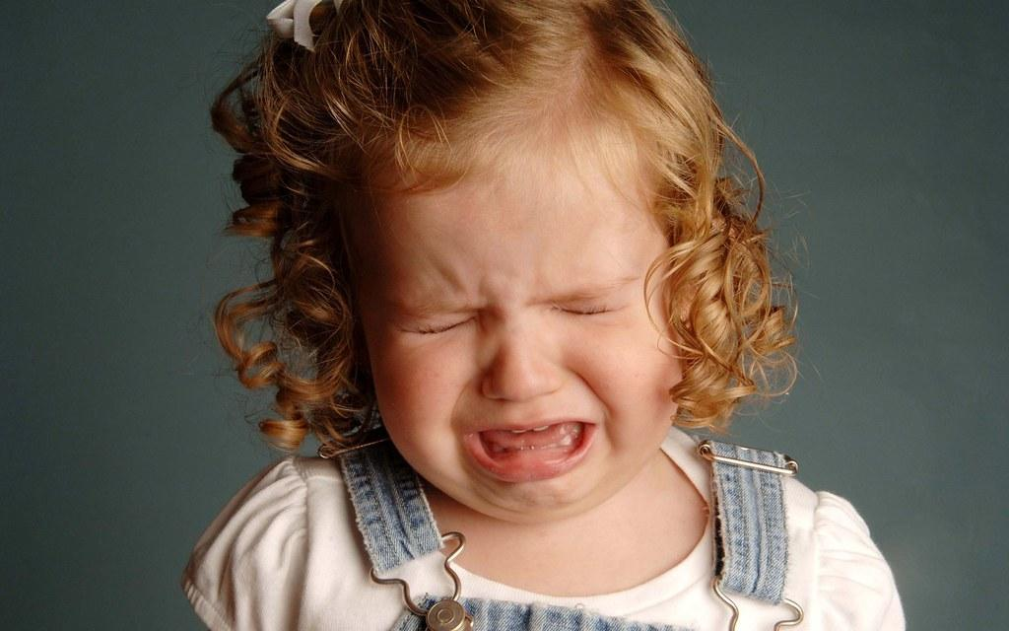
Leeza is young…
With your elbow partner, create two sentences to describe how young Leeza is. In the first sentence, use a simile. In the second sentence, create a metaphor.
This Photo by Unknown Author is licensed under CC BY

Slide 9
Partner Work
Find the similes in the text from the “Twas the Night Before Christmas”.
Write three metaphor sentences describing St. Nick further.

Slide 10
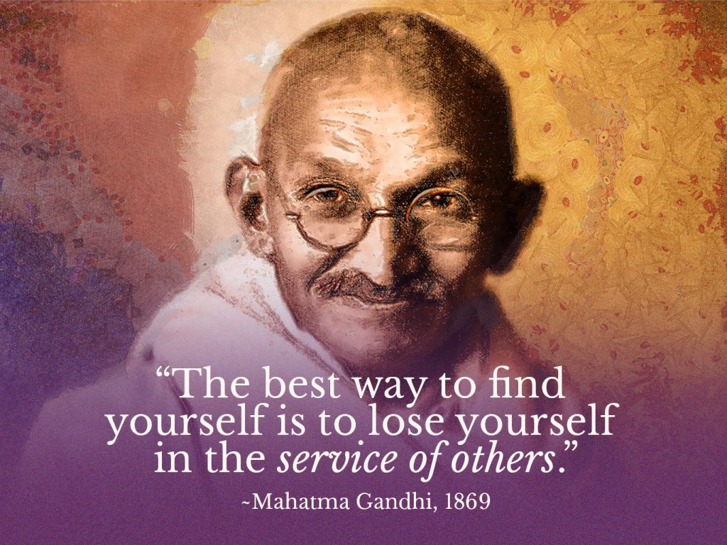
Mahatma Ghandi
I admire Mahatma Ghandi for his courage. He led his people in peaceful protests against an unfair government, always stressing non-violence. His courage was like a lion but his heart was a lamb, working for justice for all people. Although a small man in height and barely 90 pounds, Ghandi was a giant among men.
This Photo by Unknown Author is licensed under CC BY

