Slide 2
Paul Revere & The Boston Massacre
US History
8th Grade Social Studies

Slide 3
Guiding Questions
How do we know what really happened in the past?
How did Patriots influence colonists against British rule?

Slide 4
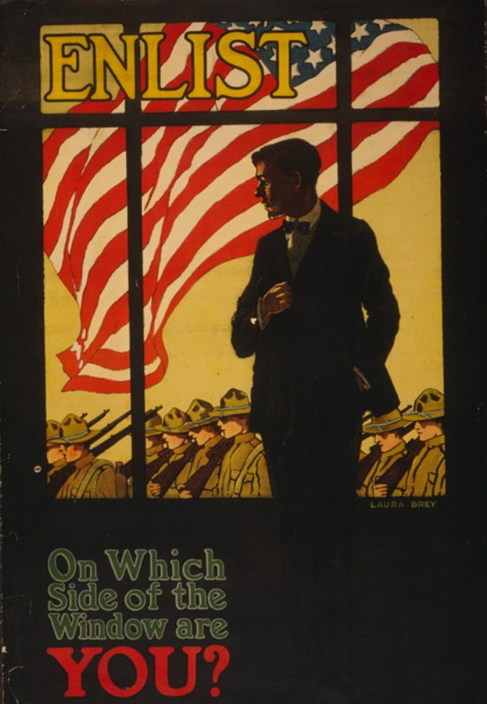
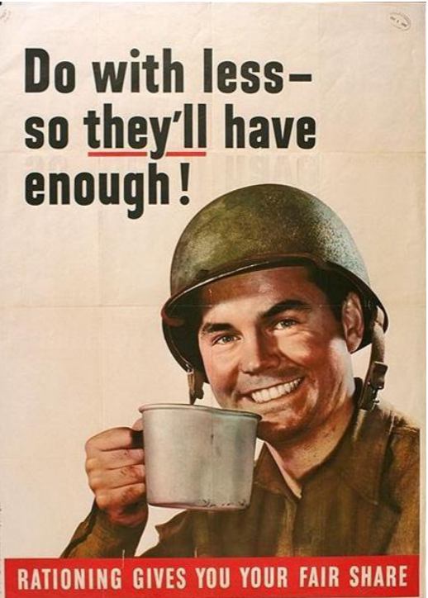
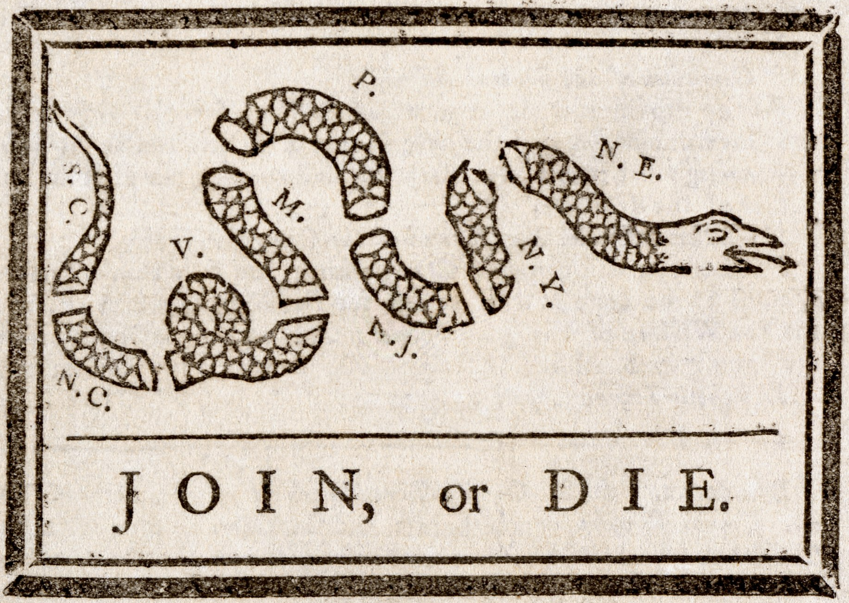
What do these images have in common? What was their importance?
French & Indian War, 1754
World War II, 1943
World War I, 1917
Notes:
Poster Image: Brey, L. (1917). Enlist, On which side of the window are you. Poster image. Library of Congress. Retrieved from: https://www.loc.gov/pictures/item/98503178/
Image: Franklin, B. (1754). Join or die. Library of Congress. Retrieved from: https://www.loc.gov/pictures/item/2002695523/
Poster Image: Do with less so they’ll have enough.(1943). Library of Congress. Retrieved from: https://www.loc.gov/pictures/item/2017696750/

Slide 5
These images are examples of Propaganda
Propaganda is information purposely intended to promote a political cause or point of view.
Republished in newspapers in 1765 to unite colonists against the British.

Slide 6
Opinion Line
If you were a colonist in the 1770s, would you be willing to overthrow your government?
1
2
3
4
5
No way
Not Likely
Maybe
Possibly
Definitely

Slide 7
Would you have really joined the American Revolution?
Link to Video
Would you have joined the American Revolution (2018). YouTube video. PBS digital studios. Retrieved from https://www.youtube.com/watch?v=XNqVKV465CM
Notes:
Show only 1:26 of this video to demonstrate to students that not all of the colonists felt comfortable in joining the revolution.
https://www.youtube.com/watch?v=XNqVKV465CM

Slide 8
CUS & Discuss
Read the article about the Boston Massacre.
Circle main ideas.
Underline supporting details
Star any questions or confusion.

Slide 9
Summarize the reading
Compare your main ideas with your partner.
Together, summarize the reading in 25 words or less.

Slide 10
H Chart Partner Work
Summary of the Facts
This Photo by Unknown Author is licensed under CC BY-SA-NC

Slide 11
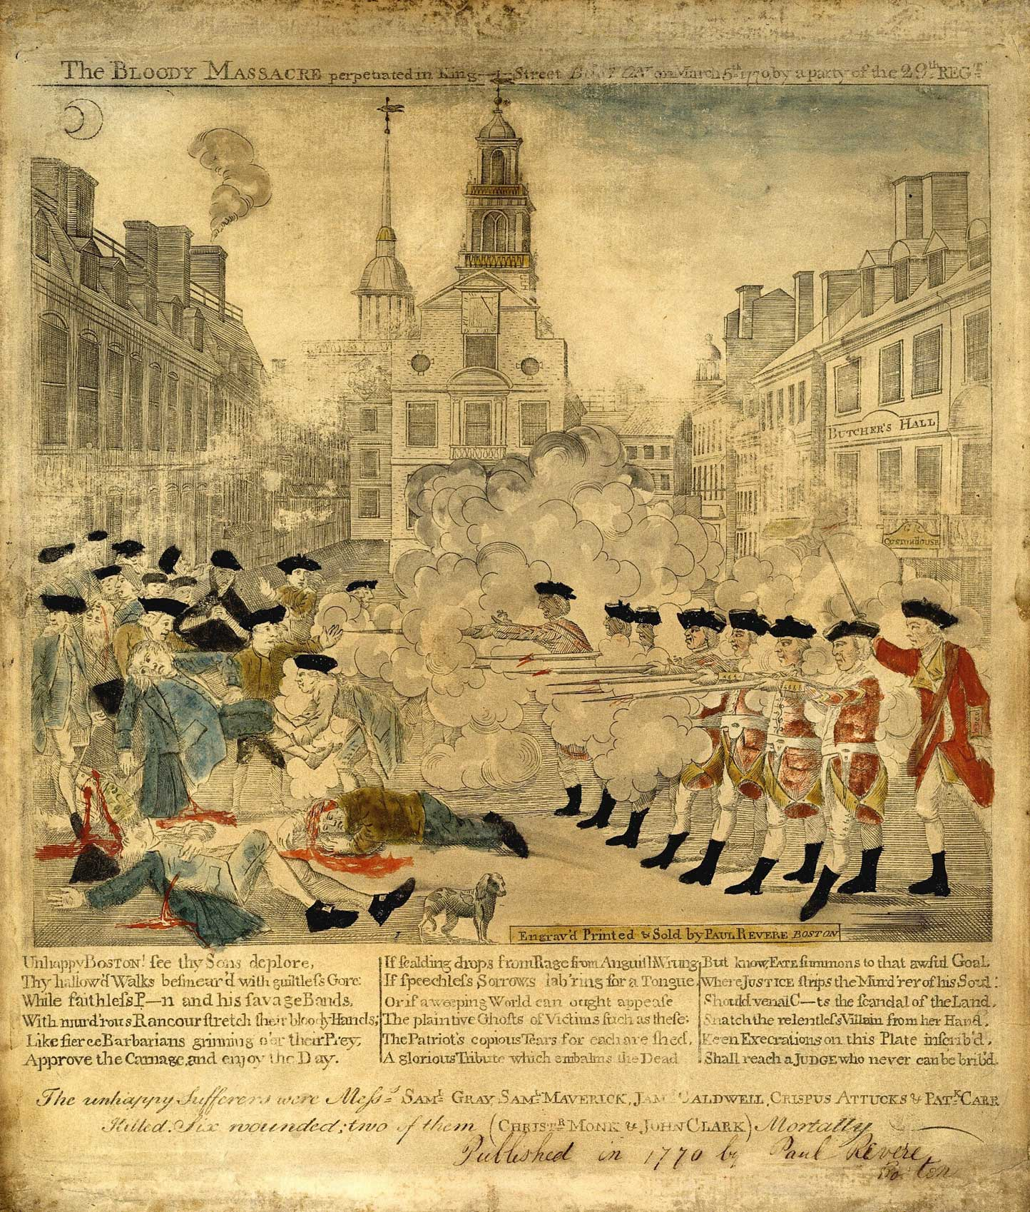
Paul Revere’s Engraving
A few weeks after the Boston Massacre, Paul Revere created a print of the event.
Historians believe he made the engraving and wrote the poem about the Boston Massacre as propaganda to persuade others to the side of the patriots.
Can you spot the differences between the facts and Paul Revere’s engraving?

Slide 12
H Chart Partner Work
Summary of the Facts
Differences in Paul Revere’s Engraving
This Photo by Unknown Author is licensed under CC BY-SA-NC

Slide 13
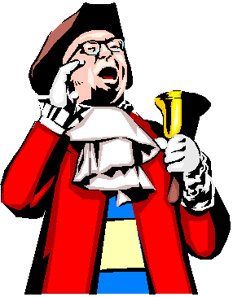
Loyalist? Or Patriot?
Create a propaganda poster in favor of your cause.
Use facts from the Boston Massacre to support your cause.
This Photo by Unknown Author is licensed under CC BY

