Slide 2



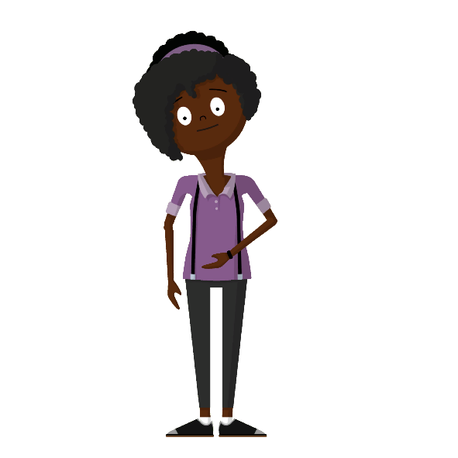
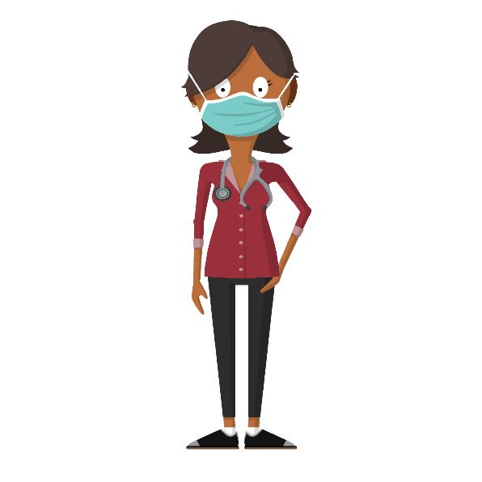
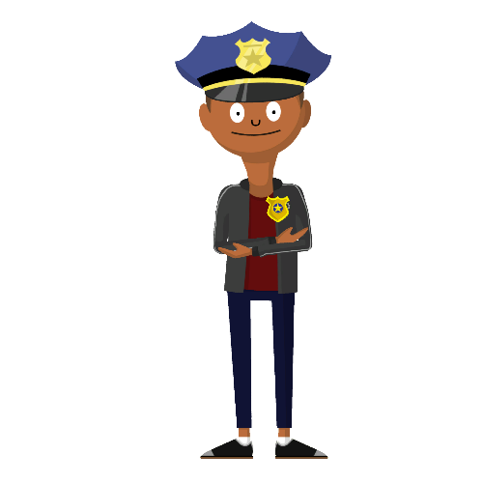

Get a Life!
A lesson in balancing goals for future career development

Slide 3
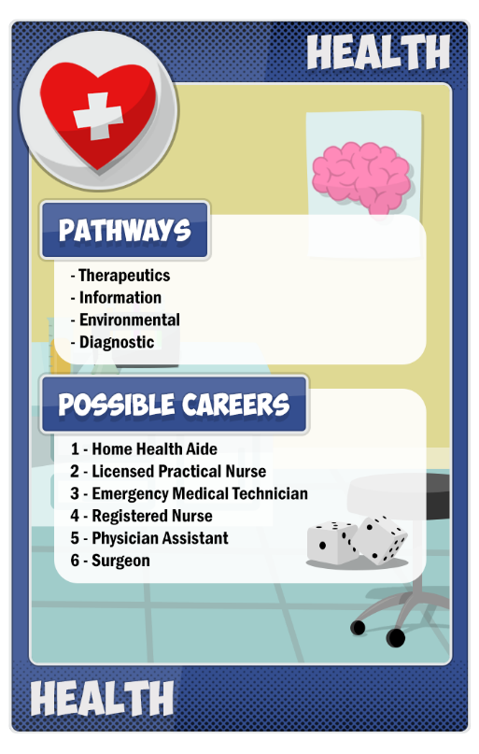
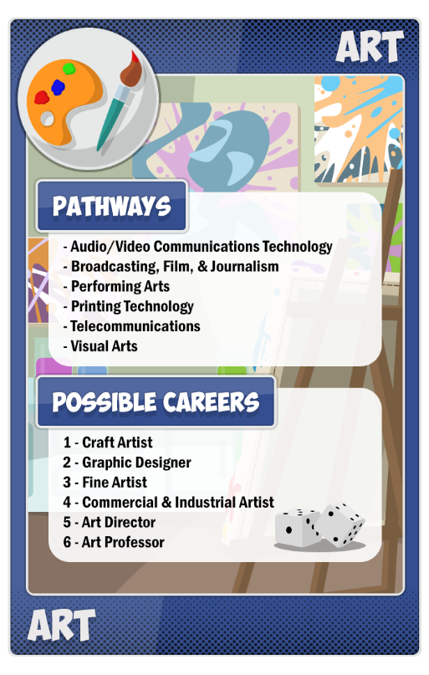
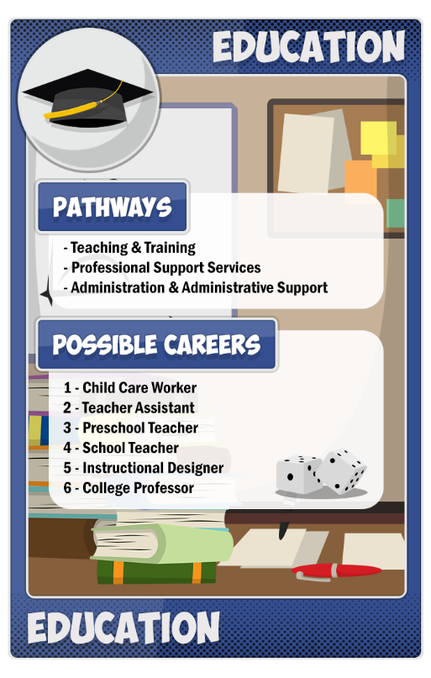
Career Roulette
Choose a career cluster.
Roll the die.
Check the table on your character sheet to find out what career you rolled.

Slide 4
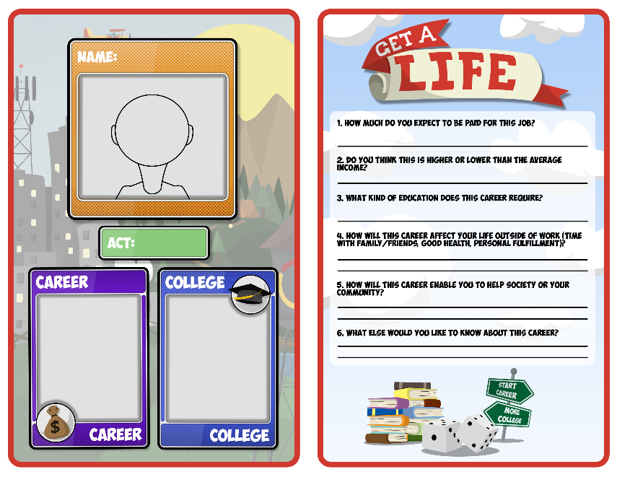
Fill Out Your Character Card
How much do you expect to be paid for this job?
Do you think this is higher or lower than the average income?
What kind of education does this career require?
How will this career affect your life outside of work (time with family/friends, good health, personal fulfillment)?
How will this career enable you to help society or your community?
What else would you like to know about this career?

Slide 5
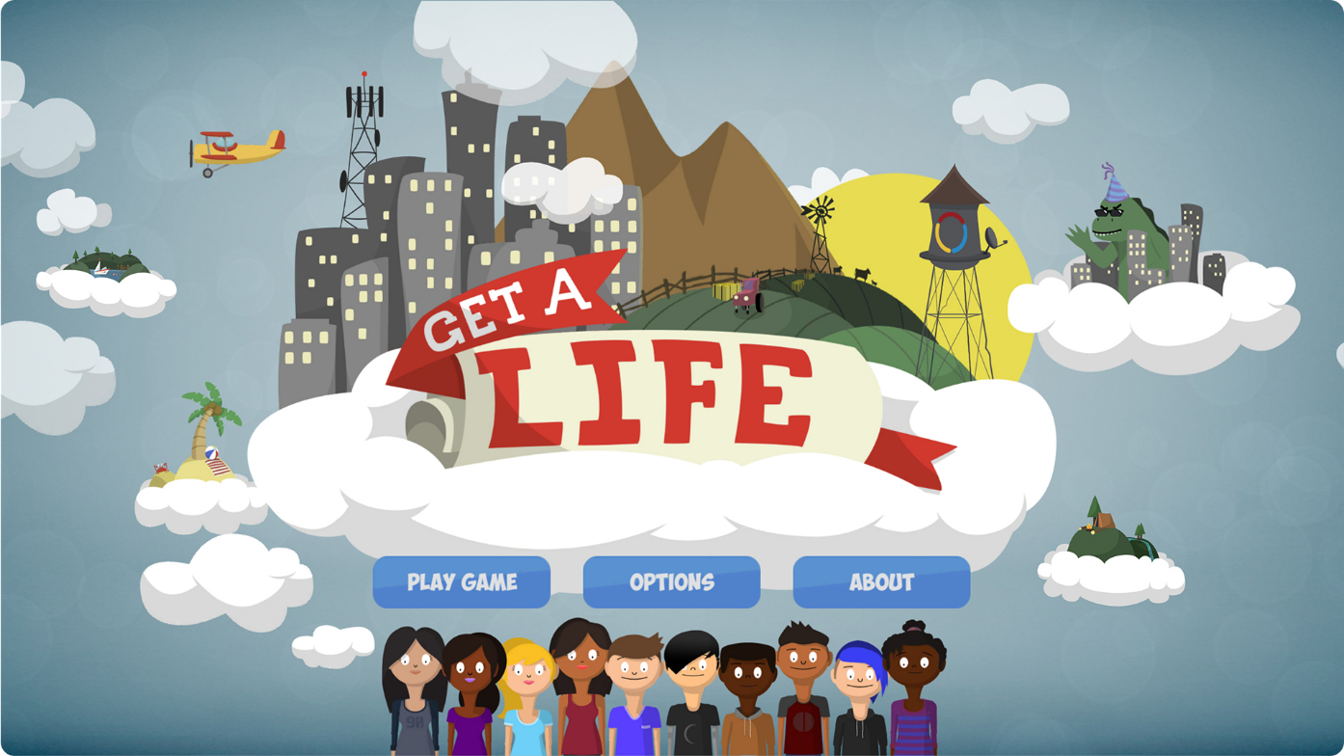
Let’s Play!

Slide 6
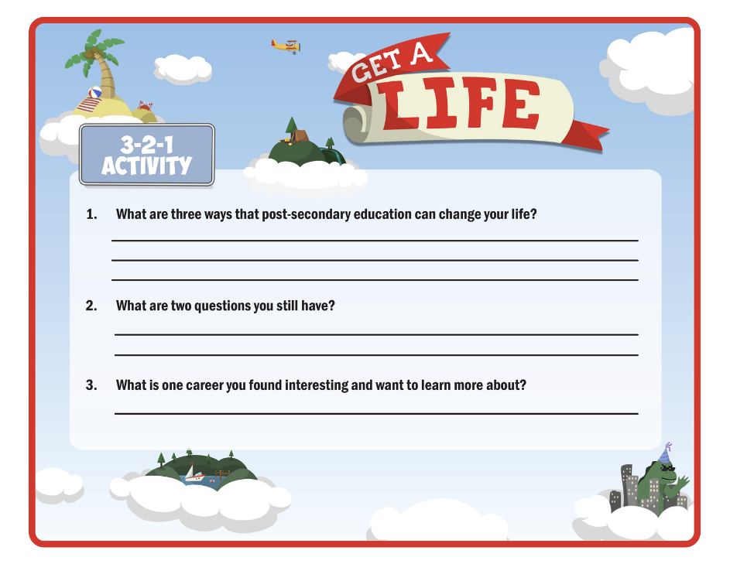
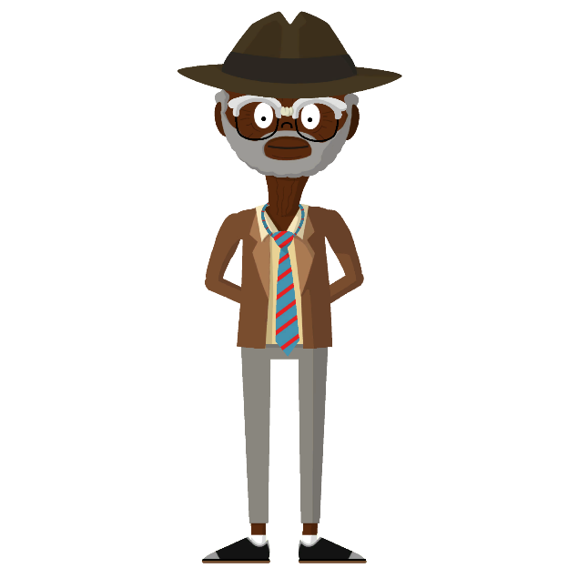
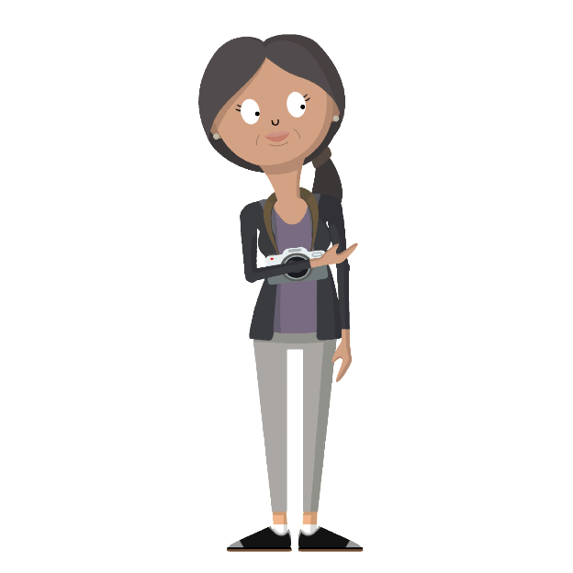
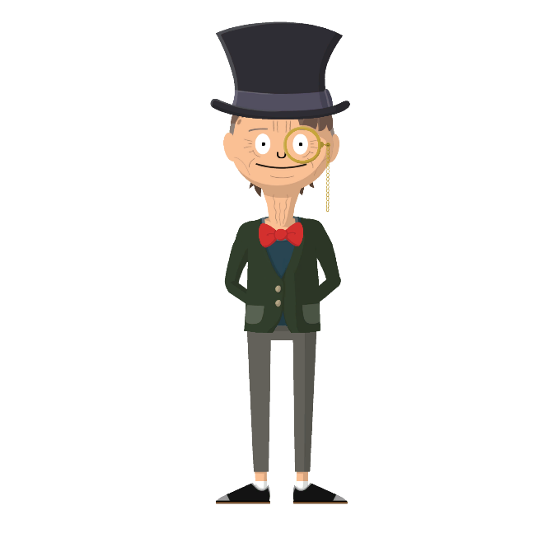
3-2-1
What three things did you learn or notice about the relationship between income, career, and education?
What are two questions you still have?
What is one thing you found interesting?

Slide 7
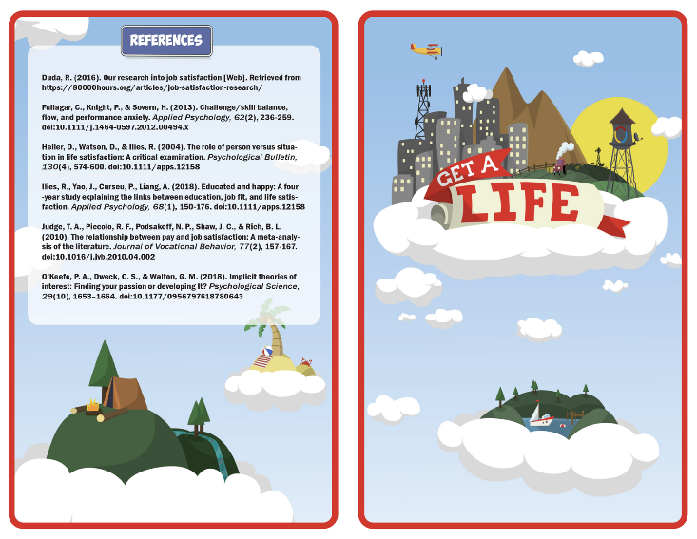
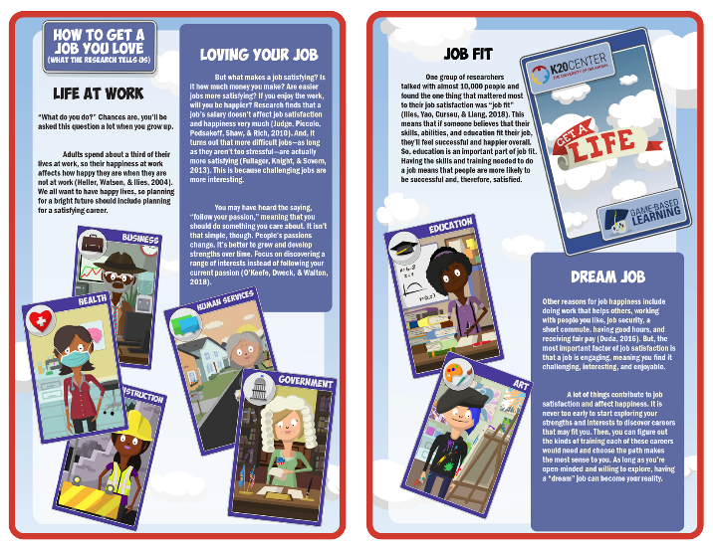


Research
Read the research brief and career cluster overview sheet assigned to your group.
Highlight at least three ideas in the report that are the most interesting to you. Note in the margins why you highlighted those ideas.
On the cluster overview, highlight at least one career you would like to learn more about.
Discuss with your group what you highlighted and why.

Slide 8
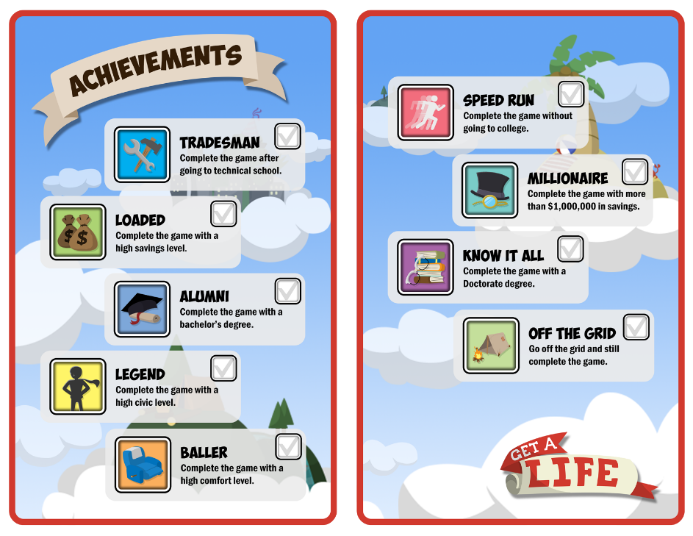
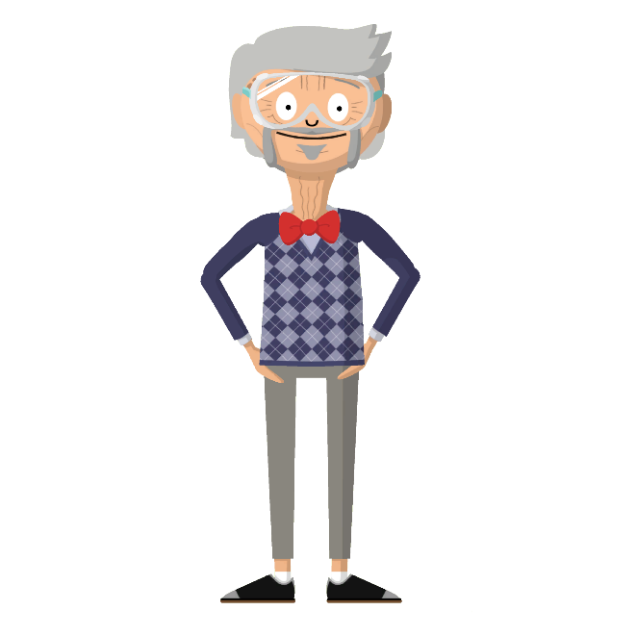
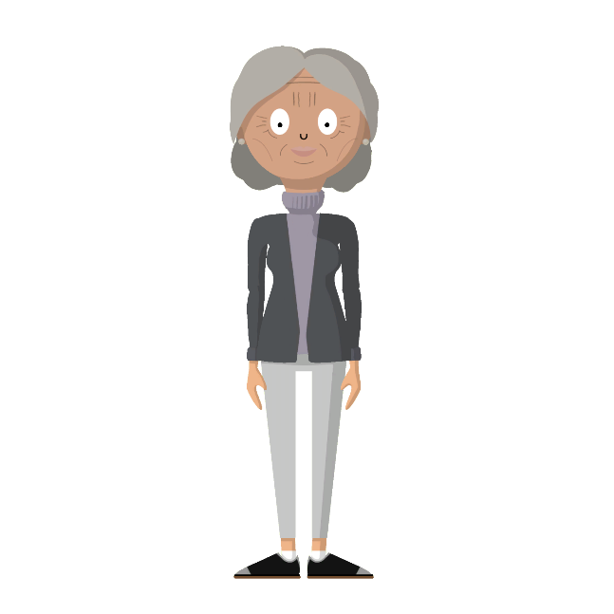
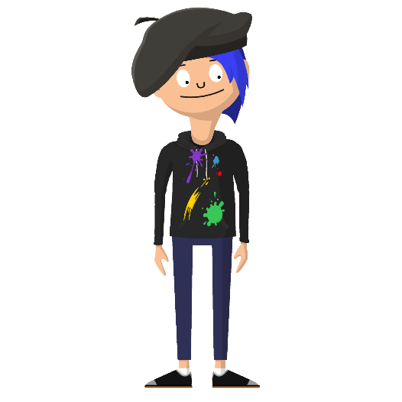
Game Challenges
Look at the game challenges provided on the back of your character sheet.
Pick a few to guide you as you play through the game a few more times.
Record your results after every successful playthrough.

Slide 9



Agree or Disagree?
The higher the education, the higher the pay.
College is too expensive for me.
Do you still want to pursue the same career as you did before playing the game?
Were you right about the level of education needed?
Have your thoughts on higher education changed?
Did you learn of jobs that you’d consider that you didn’t know existed before this activity?

Slide 10
What can you do over the next two years to increase your chances of attaining a career and lifestyle with comfort, balance, and purpose?

