Slide 2
Give Me Liberty or Give Me Death!
US History
8th Grade

Slide 3
Essential Questions
How does conflict create change?
How did the speeches and writings of patriots influence revolution?

Slide 4
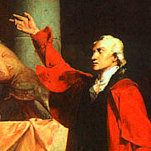
“As for me…give me liberty or give me
death!”
Patrick Henry, Delegate
2nd Virginia Convention
March 20, 1775
This Photo by Unknown Author is licensed under CC BY-SA

Slide 5
Commit and Toss Activity
On a half-sheet of notebook paper, write down an answer to this question:
“What might you be willing to fight and die for?”

Slide 6
Patrick Henry’s (video)
speech here
This Photo by Unknown Author is licensed under CC BY-SA
Notes:
https://www.youtube.com/watch?v=DbghWFMLyiA

Slide 7
Categorical Highlighting
In Patrick Henry’s speech, look for any additional reasons given for resistance to British rule.
Highlight them.
Add these to your T Chart in the second column.

Slide 8
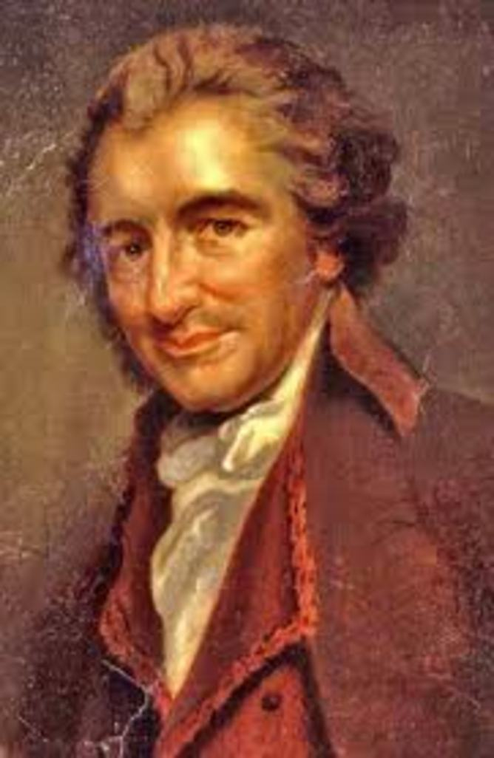
Thomas Paine & Common Sense
Common Sense was a pamphlet of reasons for declaring independence from Britain.
It was published in January 1776. Battles between the British and the Continental Army had already begun.
120,000 copies were distributed in three months throughout the colonies.
This Photo by Unknown Author is licensed under CC BY-ND

Slide 9
Categorical Highlighting
In Common Sense, look for reasons Paine gives for independence from British rule.
Highlight them.
Add these to your T Chart in the second column.

Slide 10
Summary
With your partner, summarize the reasons both men give for rebellion, and eventually, independence from Britain.

Slide 11
RAFT Activity
Apply and demonstrate what you have learned from the Patrick Henry’s speech and Thomas Paine’s pamphlet in your RAFT writing.
Use your completed T-Chart as notes to inform your writing.

