Slide 2
Slay the Slang!
ELA
7th or 8th Grade

Slide 3
Essential Questions
How can I make meaning when I read?
What strategies can I use when reading?
How do people use slang to express themselves?

Slide 4
Slang
Definition: Informal language used by a particular group of people; words or phrases used as figures of speech
Synonym: jargon
Source: Slang (n.d.) Meriam-webster dictionary. Retrieved from: https://www.merriam-webster.com/dictionary/slang

Slide 5
Example of Slang
“Oklahoma City Thunder stans, like Amber, watch every game.”
“Amber has been stanning for the OKC Thunder this year.”
How is the slang word “stan” used in these sentences?

Slide 6
Definition: Stan
stan (noun):
an extremely or excessively enthusiastic and devoted fan (plural: stans)
stan (verb):
to exhibit fandom to an extreme or excessive degree; to be an extremely devoted and enthusiastic fan of someone on something (tenses: stanned, stanning, stans)
Source: Stan. (n.d.). Retrieved from https://www.merriam-webster.com/dictionary/stan

Slide 7
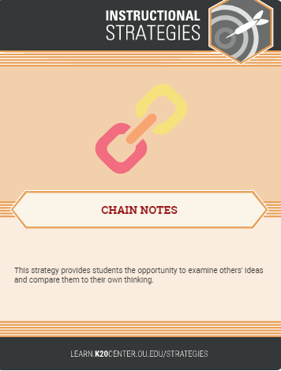
Chain Notes
At the top of each piece of notebook paper is a word that is a slang term used by previous generations.
Write your guess about what the word means with your name beside it.
Pass the notebook paper to someone else. They will add their guess and their name.
We will pass each notebook paper to someone new at least five times until all class members have contributed to one chain note.

Slide 8
What does “boffo” mean?
Sentence example:
Kevin Hart is a comedian whose movies are always so boffo!

Slide 9
What does “cheesed” mean?
Sentence Example:
The waitress was really cheesed off at the customer’s bad attitude.

Slide 10
What does “boonies” mean?
Sentence Example:
Her house was way out in the boonies. Even her grandmother got lost trying to find it.

Slide 11
What does “hot dog” mean?
Sentence Example:
When he does wheelies on his motorcycle, he’s a
real hot dog!

Slide 12
What does “bounce” mean?
Sentence Example:
Let’s bounce outta here and grab a burger.

Slide 13
What does “peeps” mean?
Sentence Example:
After school, I am going to hang with my peeps at the mall.

Slide 14
CUS and Discuss
As you read:
Circle main ideas.
Underline details that support the main idea.
Star any unfamiliar words to discuss later.

Slide 15
CUS and Discuss
Discuss and determine with your group:
Three main ideas of the reading
At least one supporting detail for each main idea
Within your group, write a summary about the reading in your own words (25 words or less).

Slide 16
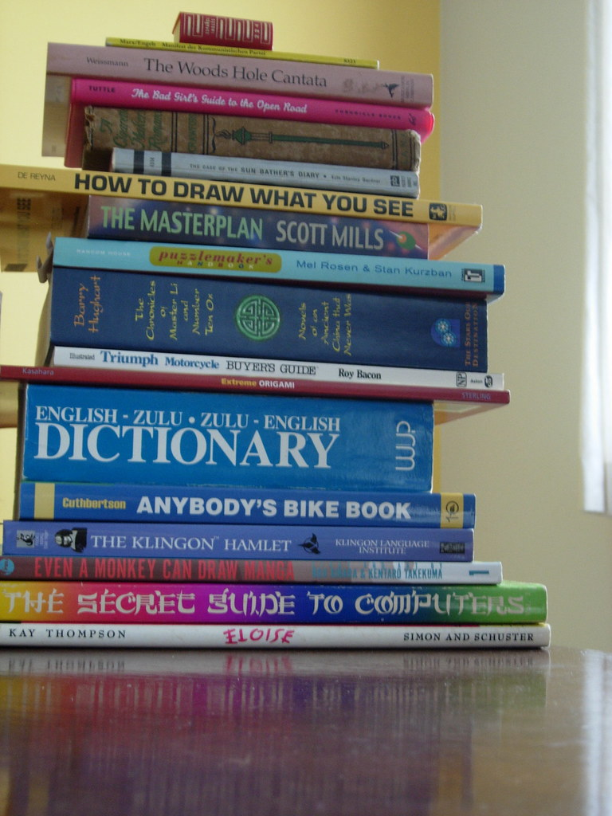
Gen Z Dictionary
“Go viral”
Definition: “To make something widespread or widely distributed.”
Sentence example:
“His FB post went viral.”
Source: Bookstack image. Creative commons image. bookstack-right.JPG" by darahgna is licensed under CC BY-NC-SA 2.0

