Slide 2
Symmetric Designs
Reflections and Osage Ribbonwork

Slide 3
Essential Question
How are reflections and symbolism used within indigenous cultures?

Slide 4
Lesson Objectives
Represent coordinate-plane transformations graphically, algebraically, and verbally.
Apply transformations to solve problems.

Slide 5

Osage Ribbonwork and Reflections
You are about to watch a video of Dana Daylight sharing her knowledge of her tribe and the craft of
making Osage ribbonwork.
Keep in mind the following questions
as you watch the video:
  What did you notice?
  What do you wonder?
Notes:
K20 Center. (n.d.). I notice, I wonder. Strategies. https://learn.k20center.ou.edu/strategy/180

Slide 6
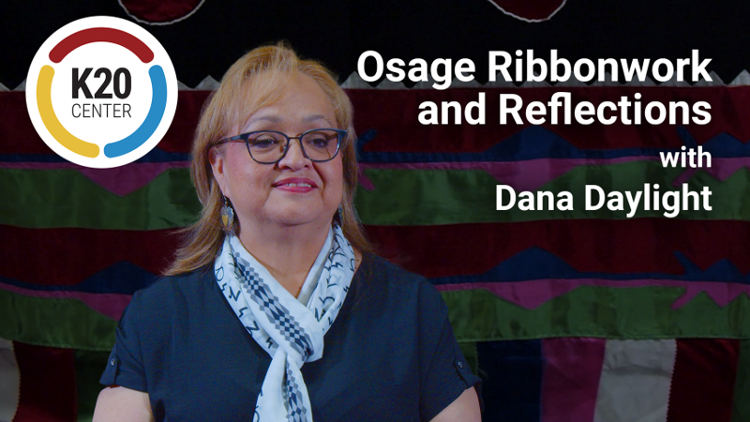
Osage Ribbonwork and Reflections
Notes:
K20 Center. (2023, July 5). Osage ribbonwork and reflections [Video]. YouTube. https://www.youtube.com/watch?v=CCU7hBirn9c

Slide 7
Osage Ribbonwork and Reflections
Think about what Dana Daylight shared about her culture and the mathematics of her ribbonwork.
What did you notice?
What do you wonder?
Notes:
K20 Center. (n.d.). I notice, I wonder. Strategies. https://learn.k20center.ou.edu/strategy/180

Slide 8
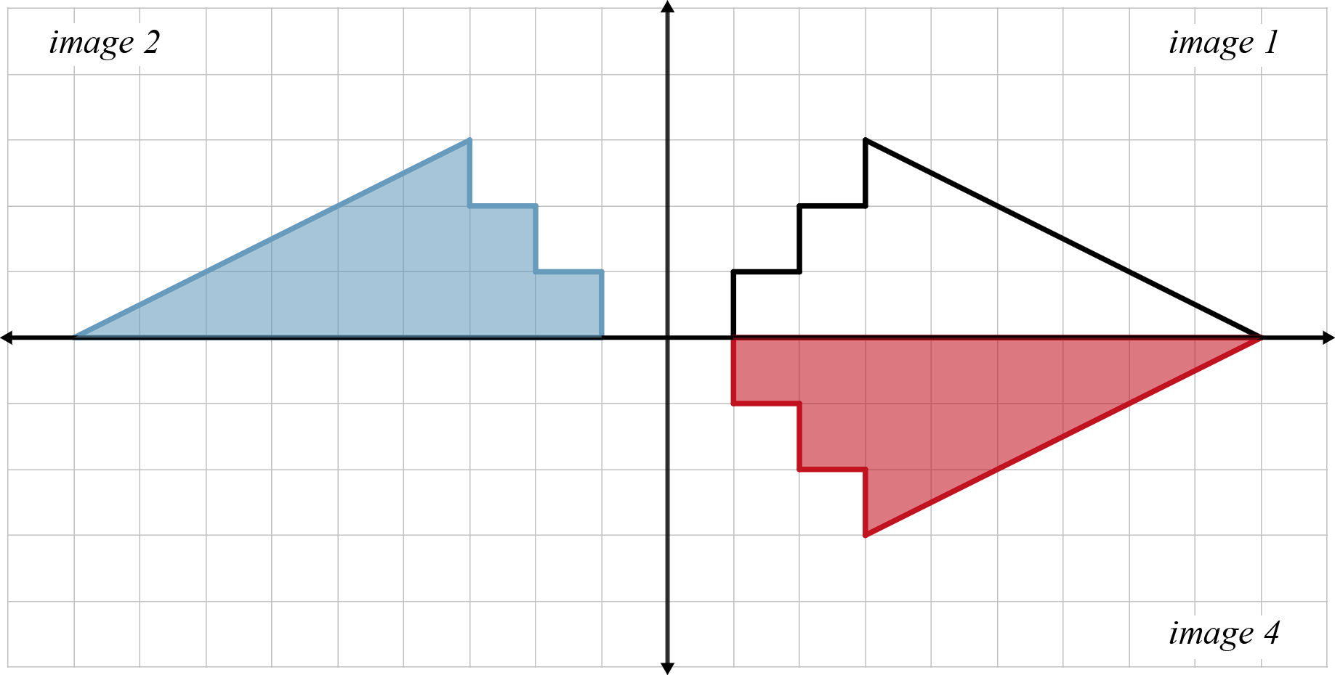
Exploring Ribbonwork (Part A)
Work individually to complete the pattern
on the graph. Then answer the following prompts:
How did you complete the pattern?
Describe how the preimage transformed into image 2.
Describe how the preimage transformed into image 4.

Slide 9
Exploring Ribbonwork (Part B)
Use your Exploring Ribbonwork (Part A) handout for reference.
Work with a partner and to complete the tables and answer questions 4–7 on your handout.

Slide 10
Guided Notes
Let’s complete the Guided Notes together.

Slide 11
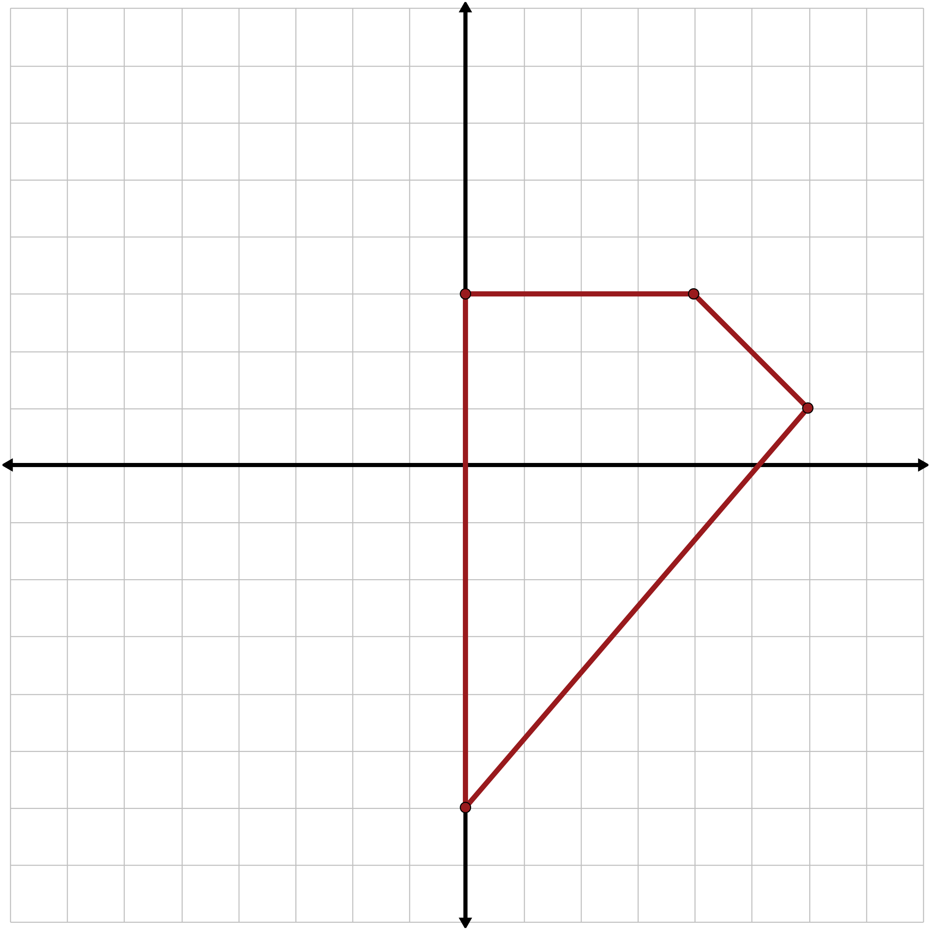
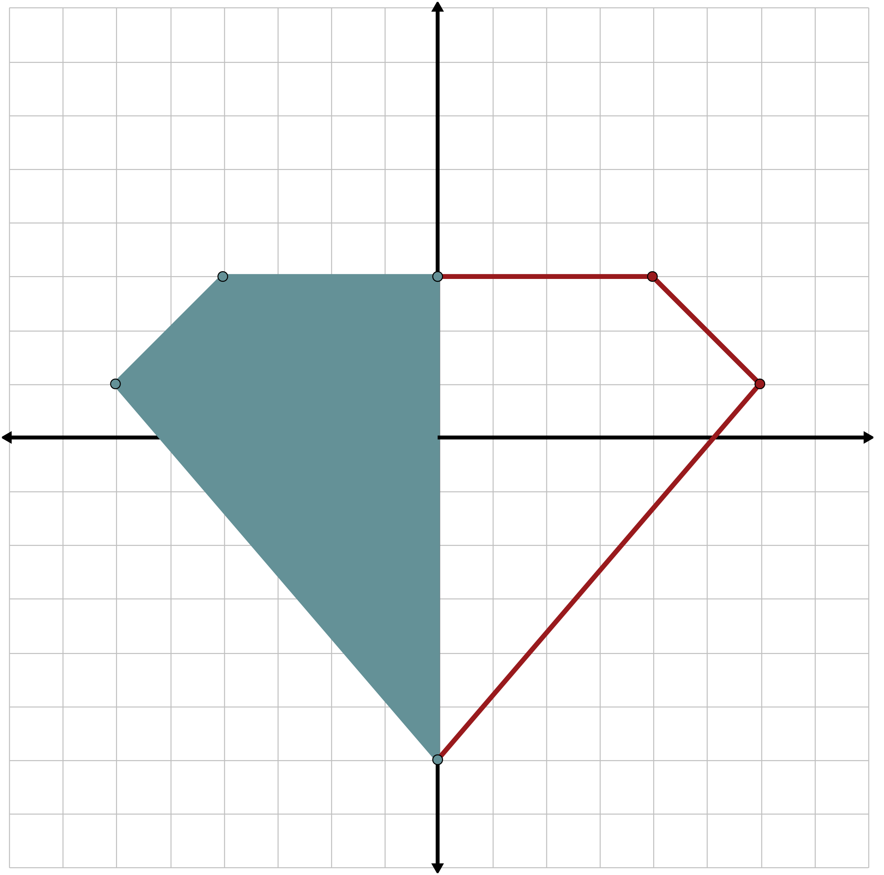
Guided Notes: Check Your Work

Slide 12
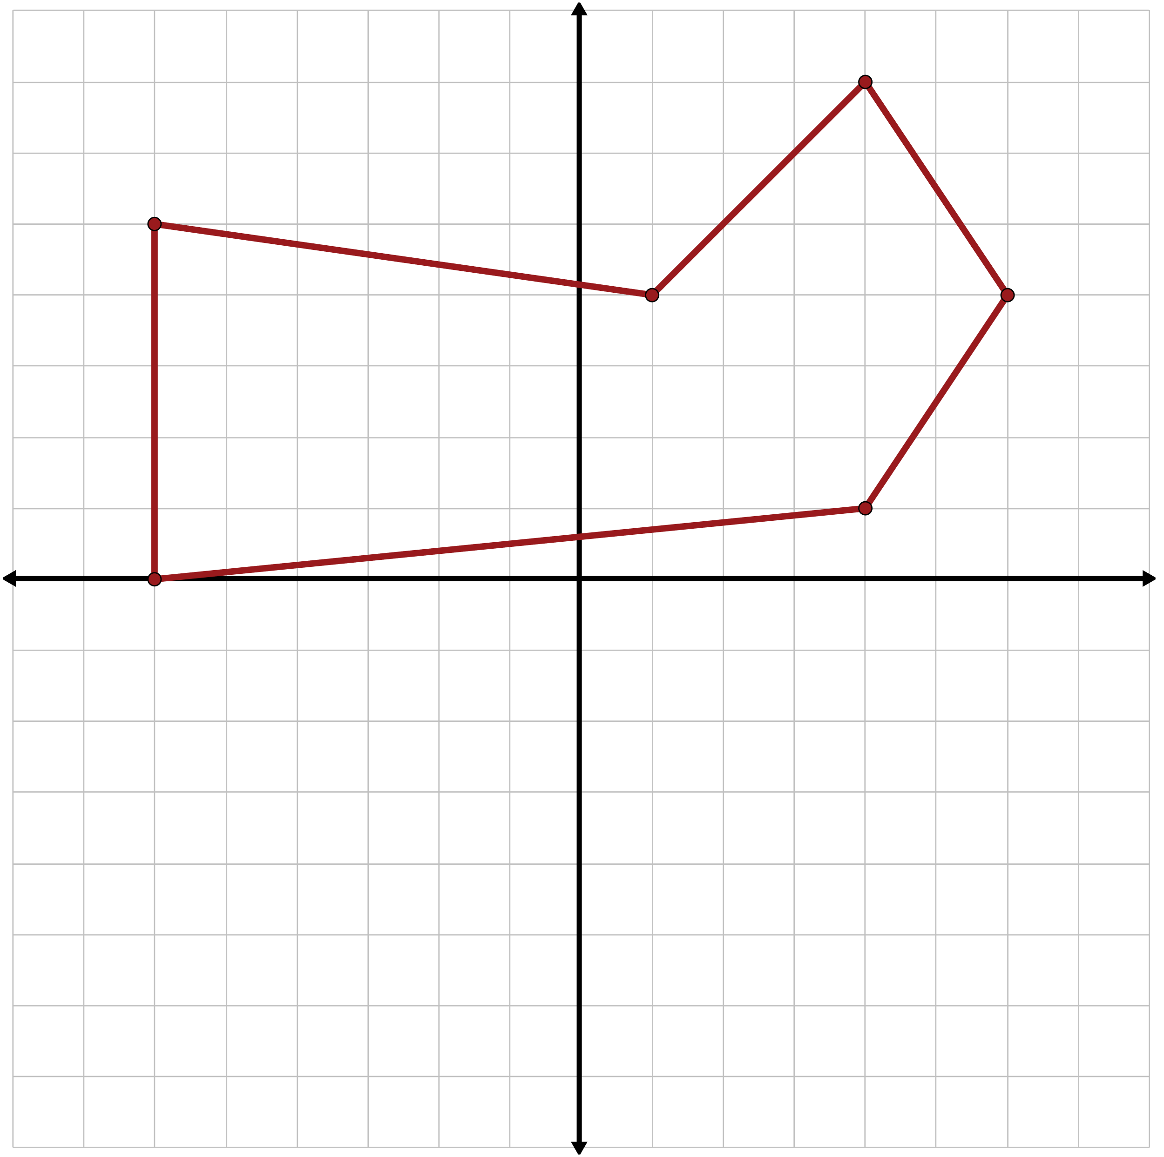
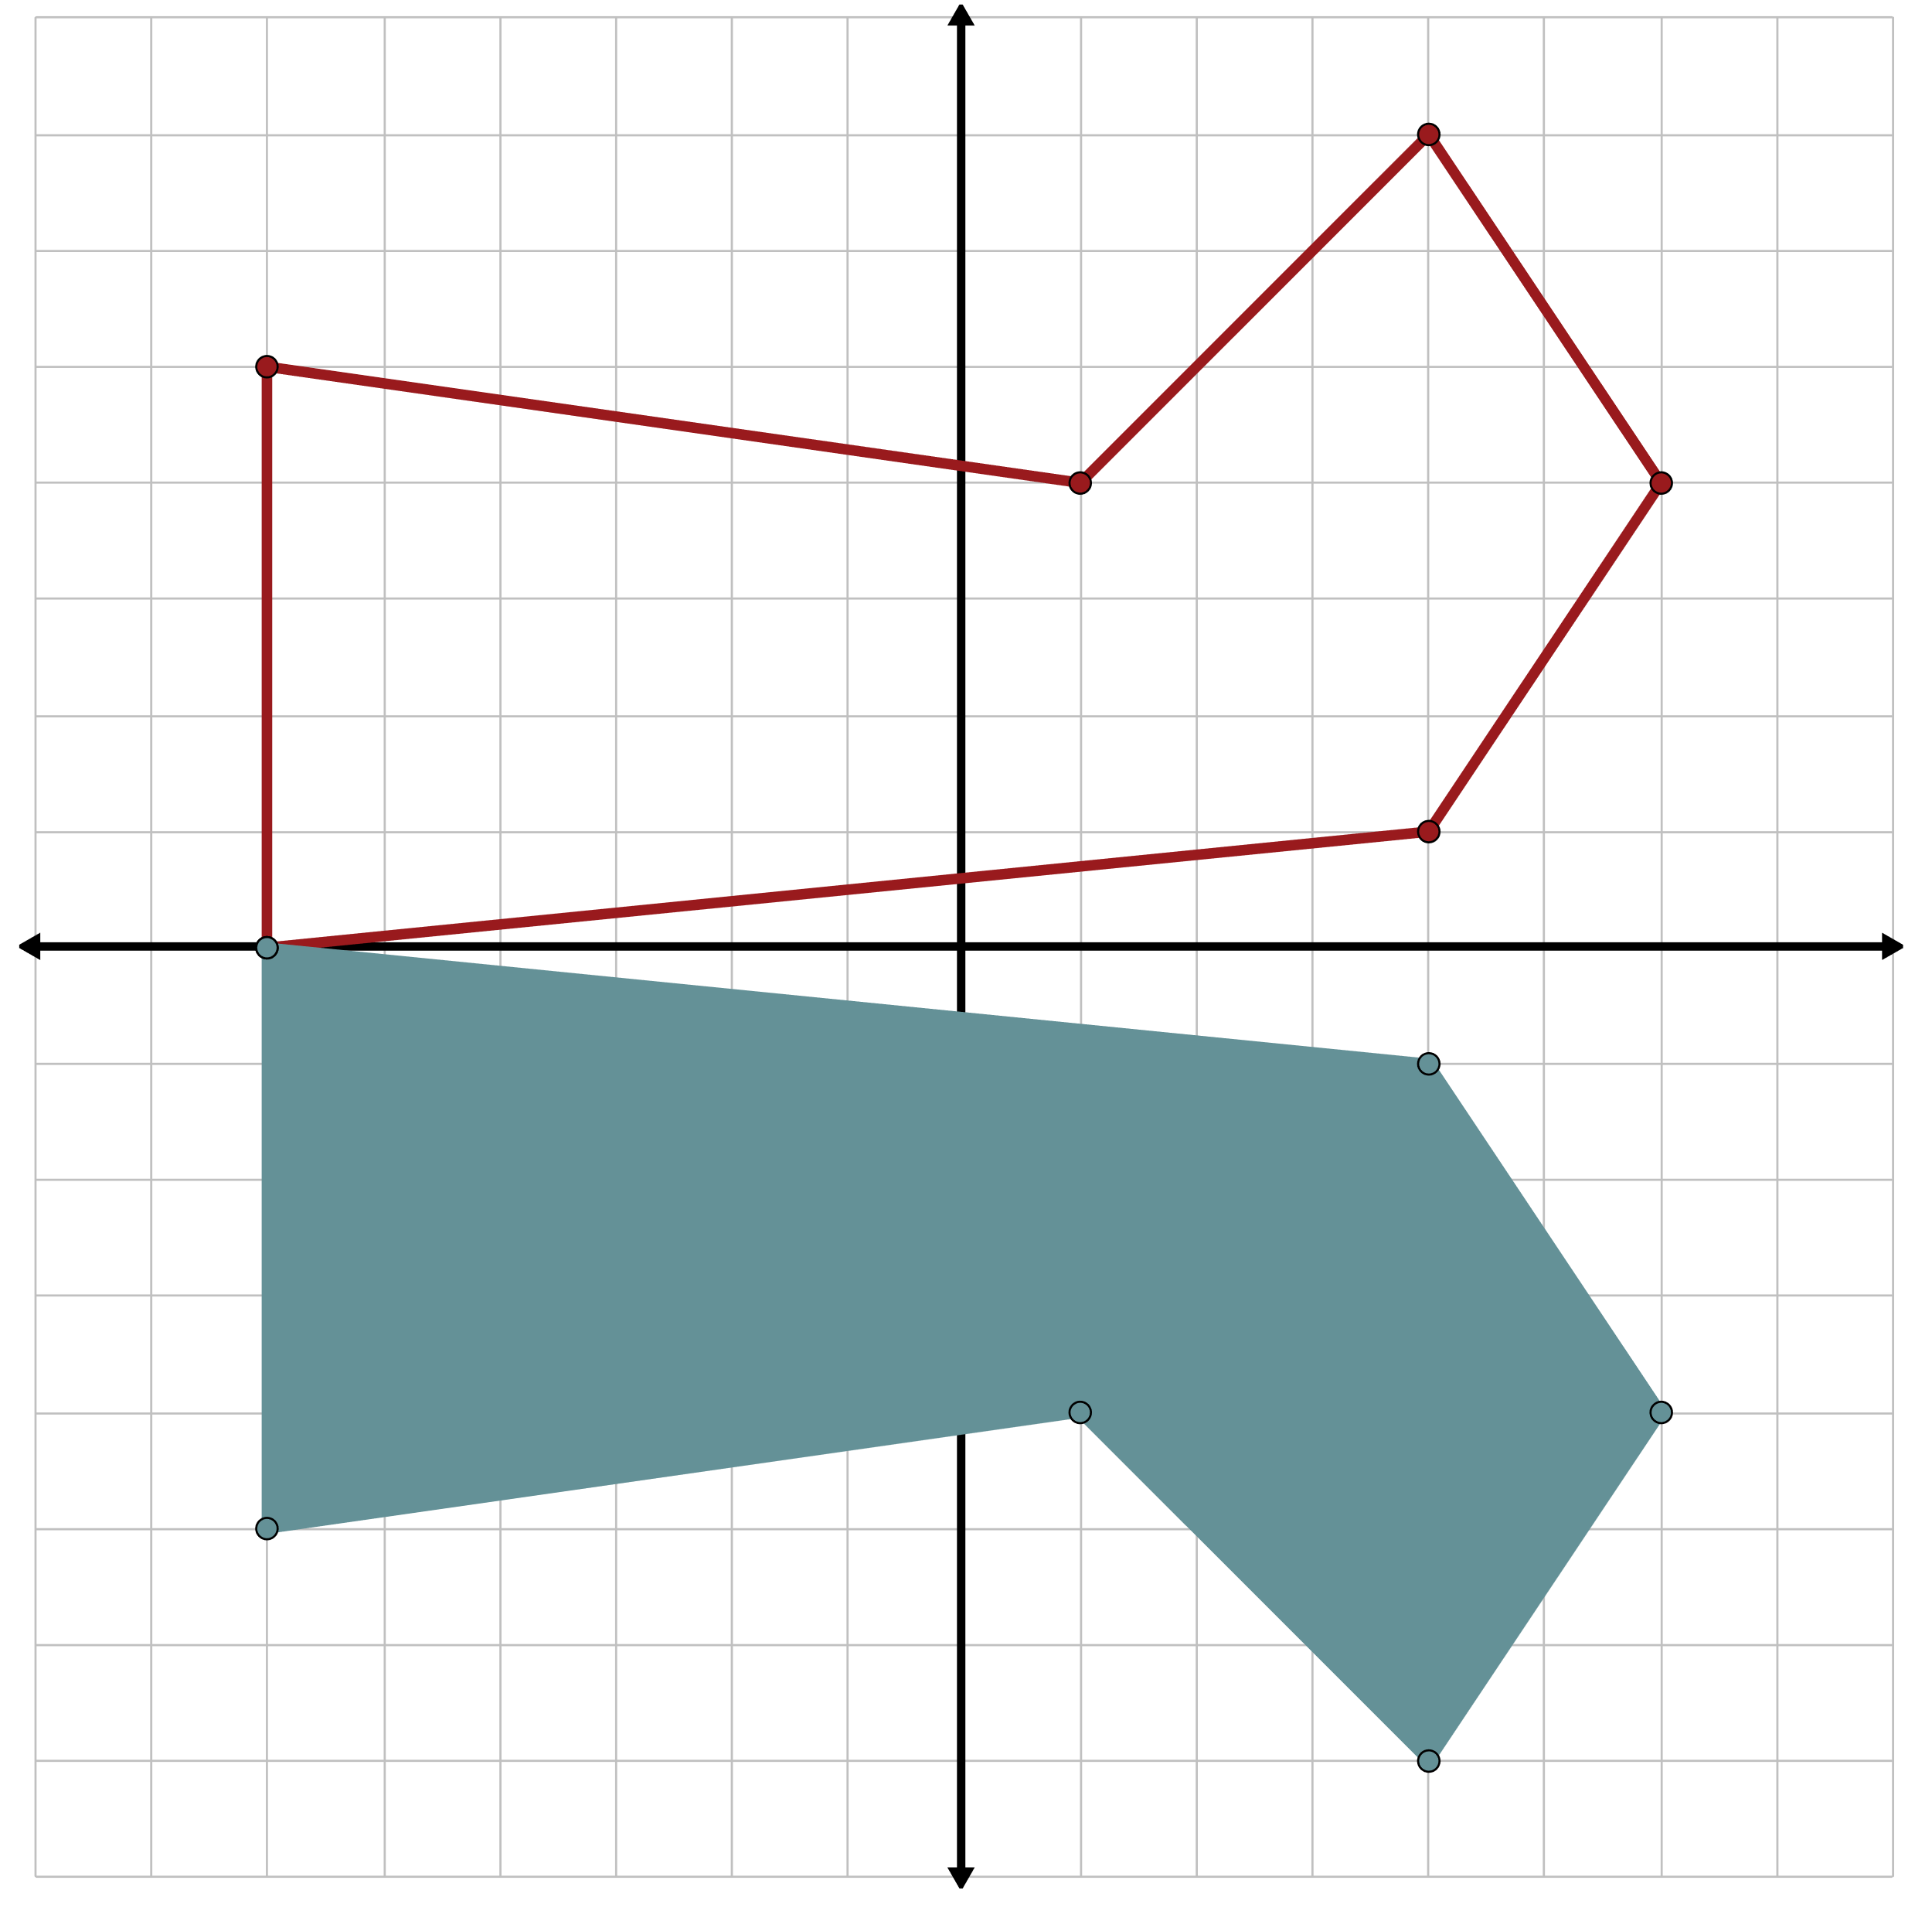
Guided Notes: Check Your Work

Slide 13
Notecatcher
You are about to watch a video of Leslie Deer sharing her knowledge of her tribe and how her culture influences her work.
Use your handout to take notes as you watch the video.
Notes:
K20 Center. (n.d.). Pass the problem. Strategies. https://learn.k20center.ou.edu/strategy/151

Slide 14
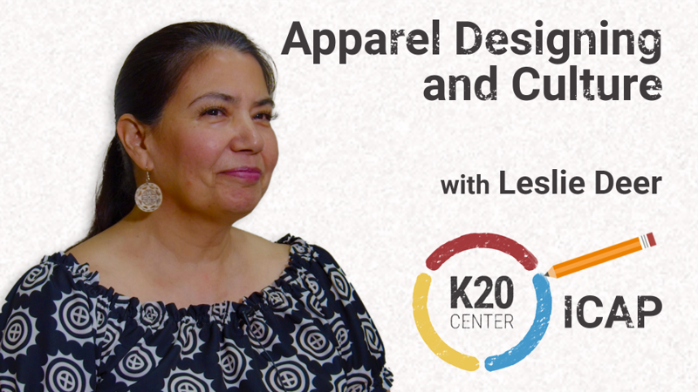
Apparel Designing and Culture
Notes:
K20 Center. (2023, July 5). K20 ICAP - Apparel designing and culture [Video]. YouTube. https://www.youtube.com/watch?v=nKjKx2iDJnM

Slide 15
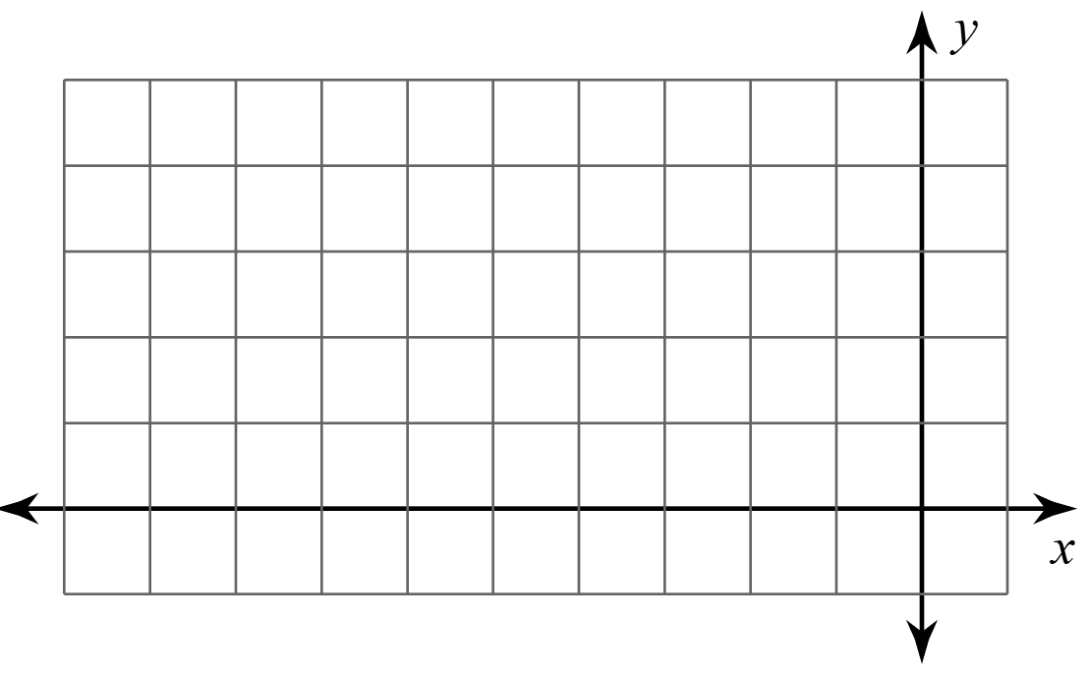
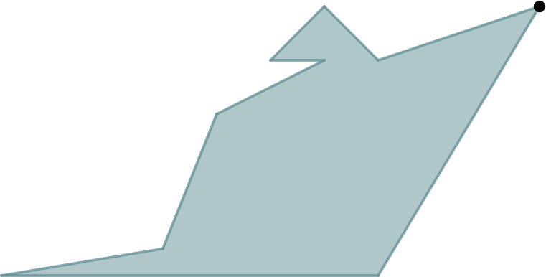
Perfecting Patterns: Step 1
Write your name on your paper for Student A.
Create your own preimage
design in Quadrant II.
  Have ≤ 5 vertices.
  Be creative!
Notes:
K20 Center. (n.d.). Pass the problem. Strategies. https://learn.k20center.ou.edu/strategy/151

Slide 16
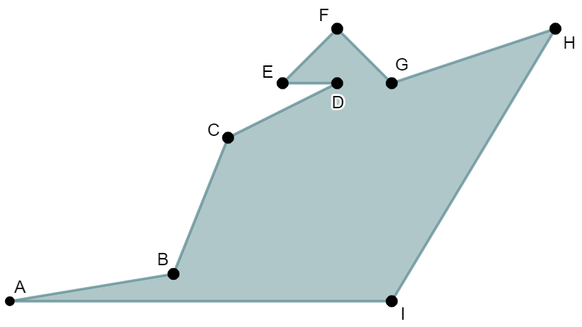
Perfecting Patterns: Step 2
Pass your paper to your right. You are now Student B.
Label the vertices of
Student A’s design.
Imagine their preimage is
reflected over the x-axis.
Create a table and identify
the new corresponding ordered pairs.
Notes:
K20 Center. (n.d.). Pass the problem. Strategies. https://learn.k20center.ou.edu/strategy/151

Slide 17
Perfecting Patterns: Step 3
Pass your paper to your right. You are now Student C.
Check Student B’s work.
Imagine the preimage is
reflected over the y-axis.
Create a table and identify
the new corresponding
ordered pairs.
Notes:
K20 Center. (n.d.). Pass the problem. Strategies. https://learn.k20center.ou.edu/strategy/151

Slide 18
Perfecting Patterns: Step 4
Pass your paper back to Student A.
Copy your preimage onto a piece of graph paper.
Plot the points from Student B’s and Student C’s tables.
Are their points reflections of the vertices of your preimage?
Notes:
K20 Center. (n.d.). Pass the problem. Strategies. https://learn.k20center.ou.edu/strategy/151

Slide 19
Perfecting Patterns: Step 5
Complete your design in Quadrant IV by using the
reflective symmetry of your choice:
over the x-axis or over the y-axis.
Use four colors to color your ribbonwork design. Remember to contrast light and dark colors like the Osage tribe does.
Cut out your ribbonwork and use it as a bookmark!
Notes:
K20 Center. (n.d.). Pass the problem. Strategies. https://learn.k20center.ou.edu/strategy/151

Slide 20

Over the Line
What are the coordinates of the point B′
after reflecting B(1, –3) over the y-axis?
Notes:
K20 Center. (n.d.). Bell ringers and exit tickets. Strategies. https://learn.k20center.ou.edu/strategy/125

Slide 21
Over the Line (Solution)
Reflecting over the y-axis means that B′ is to the left or right (a horizontal reflection) of B.
This means that the x-value will change, and the y-value will not change.
B(1, –3) → B′(opposite, same)
Therefore, B′ is at (–1, –3).
Notes:
K20 Center. (n.d.). Bell ringers and exit tickets. Strategies. https://learn.k20center.ou.edu/strategy/125

Slide 22
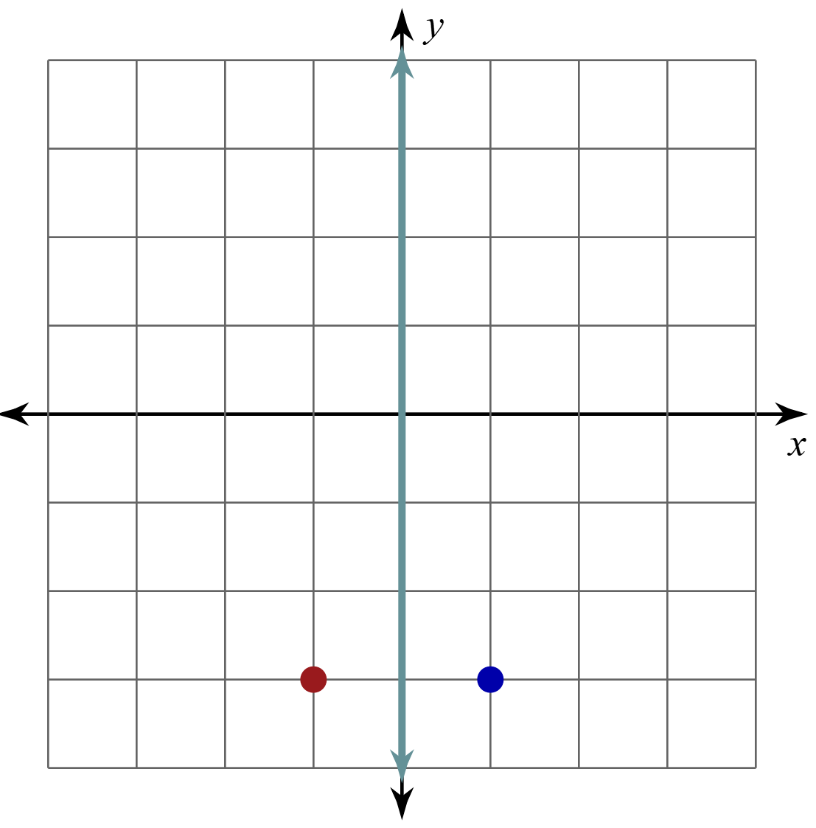
Over the Line (Solution)
B reflected over the y-axis:
B(1, –3) → B′(opposite x, same y)
Therefore, B′ is at (–1, –3).
Notes:
K20 Center. (n.d.). Bell ringers and exit tickets. Strategies. https://learn.k20center.ou.edu/strategy/125

