Slide 2
Lights, Camera, Questions!
How to Conduct an Interview

Slide 3
Essential Questions
What questions and techniques help to make a good interview?
How do you conduct a successful interview?

Slide 4
Lesson Objectives
Develop interviewing techniques and employ best practices in a peer interview.
Analyze a classmate’s interview according to rules and guidelines developed from research.

Slide 5
Dream Interview
If you could interview one person, from any time period, who would it be?

Slide 6
Chain Notes
With your group, brainstorm a list of questions you would ask to the person listed on your paper.
Record as many questions as you can think of on your chart.
Notes:
K20 Center. (n.d.). Chain notes. Strategies. https://learn.k20center.ou.edu/strategy/52
K20 Center. (2021, September 21). K20 Center 5 minute timer [Video]. YouTube. https://www.youtube.com/watch?v=EVS_yYQoLJg

Slide 7
Chain Notes
Rotate to the next poster.
Read the questions already written on the paper.
Brainstorm a list of additional questions you would ask the person listed on your paper.
Record as many questions as you can think of.
Notes:
K20 Center. (n.d.). Chain notes. Strategies. https://learn.k20center.ou.edu/strategy/52
K20 Center. (2021, September 21). K20 Center 4 minute timer [Video]. YouTube. https://www.youtube.com/watchv=kpCsfuvzQeY

Slide 8
Chain Notes
Rotate to the next poster.
Read the questions already written on the paper.
Brainstorm a list of additional questions you would ask the person listed on your paper.
Record as many questions as you can think of.
Notes:
K20 Center. (n.d.). Chain notes. Strategies. https://learn.k20center.ou.edu/strategy/52
K20 Center. (2021, September 21). K20 Center 3 minute timer [Video]. YouTube. https://www.youtube.com/watch?v=iISP02KPau0

Slide 9
Chain Notes
Rotate to the next poster.
Read the questions already written on the paper.
Brainstorm a list of additional questions you would ask the person listed on your paper.
Record as many questions as you can think of.
Notes:
K20 Center. (n.d.). Chain notes. Strategies. https://learn.k20center.ou.edu/strategy/52
K20 Center. (2021, September 21). K20 Center 2 minute timer [Video]. YouTube. https://www.youtube.com/watch?v=HcEEAnwOt2c

Slide 10
Chain Notes
Rotate to the next poster.
Read the questions already written on the paper.
Brainstorm a list of additional questions you would ask the person listed on your paper.
Record as many questions as you can think of.
Notes:
K20 Center. (n.d.). Chain notes. Strategies. https://learn.k20center.ou.edu/strategy/52
K20 Center. (2021, September 21). K20 Center 1 minute timer [Video]. YouTube. https://www.youtube.com/watch?v=6ilD555O_RE

Slide 11
Chain Notes
Read through all the questions that have been written on your chart paper.
Are there any questions on your paper that you noticed on other groups’ charts?
Which questions do you love?
Which questions are you unsure about?
Notes:
K20 Center. (n.d.). Chain notes. Strategies. https://learn.k20center.ou.edu/strategy/52

Slide 12
Interviewing Techniques and Guidelines
Notes:
Teacher’s Note: To play the video, click the image on the slide or copy and paste the following link into your web browser: https://www.youtube.com/watch?v=Afpgnb_9bA4
ESPN. (2018, June 11). [Full] LeBron James’ ‘The Decision’ (7/8/2010) | ESPN Archives [Video]. YouTube. https://www.youtube.com/watch?v=Afpgnb_9bA4

Slide 13
Analyzing Interview Questions
Watch two additional videos from the “Lights, Camera, Questions!” Wakelet collection.
As you watch, consider the techniques you see the interviewers using.
What kinds of questions are they asking?
How are they responding to the interviewees?
Notes:
K20 Center. (n.d.). Jigsaw. Strategies. https://learn.k20center.ou.edu/strategy/179
K20 Center. (n.d.). Wakelet. Tech Tools. https://learn.k20center.ou.edu/tech-tool/2180

Slide 14
Establishing Norms
Read the questions on your Establishing Norms handout.
Respond to each question individually.
With your partner, discuss what is necessary to make your interviews successful and record your responses.
Notes:
K20 Center. (n.d.). Establishing norms. Strategies. https://learn.k20center.ou.edu/strategy/188

Slide 15
Get to Know Your Partner!
Use your knowledge of interviews to craft 7–10 interview questions to ask your partner.
Your questions should help you get to know your partner better.
Use the questions from the earlier Chain Notes activity to help you get started.

Slide 16
Ready, Set, Record!
Review the procedures for using the recording equipment.
Consider which locations you plan to use for your interviews.
Remember to ask follow-up questions during your interview.
Notes:
Teacher’s Note: Depending on the equipment you choose, you may want to add additional directions to this slide about how to use the equipment.

Slide 17
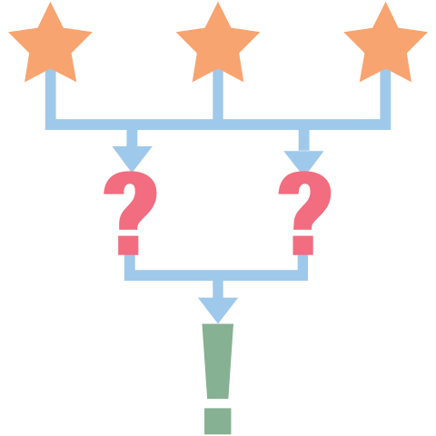
3-2-1
Watch or listen to your partner’s interview and give feedback on:
3 interviewing rules they followed
2 things they should include in their article
1 thing they could improve on in the future
Include the timestamps of any sections you reference so they can be easily found.
Notes:
K20 Center. (n.d.). 3-2-1. Strategies. https://learn.k20center.ou.edu/strategy/117

