Slide 1
A Letter Worth a Thousand Words
Visual Storytelling from Illuminated Manuscripts to Book Covers

Slide 2
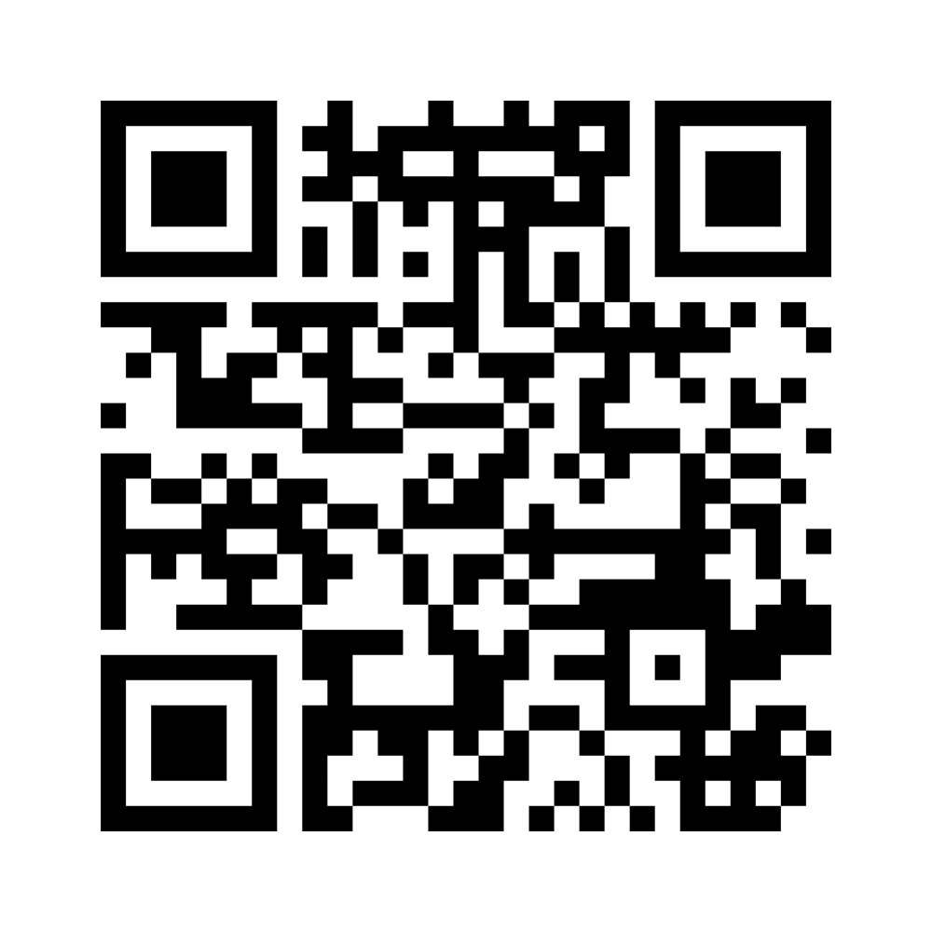
What does it mean?
Join the mentimeter and make up a definition for the word on each slide.

Slide 3
Essential Questions
How can we tell a story in one image?
How can messages be conveyed visually?

Slide 4
Learning Objectives:
Analyze illuminated manuscripts and contemporary book covers, identifying how visual elements communicate stories, themes, and emotions.
Apply watercolor and gold leaf techniques to create an illuminated letter design that visually represents the mood, message, or theme of a chosen song.
Evaluate and reflect on the visual design and storytelling in their own and peers’ artworks through a structured critique.

Slide 5
Triangle-Circle-Square
As you watch the video interview with Aster Stone, complete the Triangle-Circle-Square answering the following questions:
What are three important points that you have learned from the interview?
List four things that squared with your thinking, meaning you found them to be interesting or relatable.
What is one question that is still circling in your head?

Slide 7
Triangle-Circle-Square
Discuss the questions you answered:
What are three important points that you have learned from the interview?
List four things that squared with your thinking, meaning you found them to be interesting or relatable.
What is one question that is still circling in your head?

Slide 8
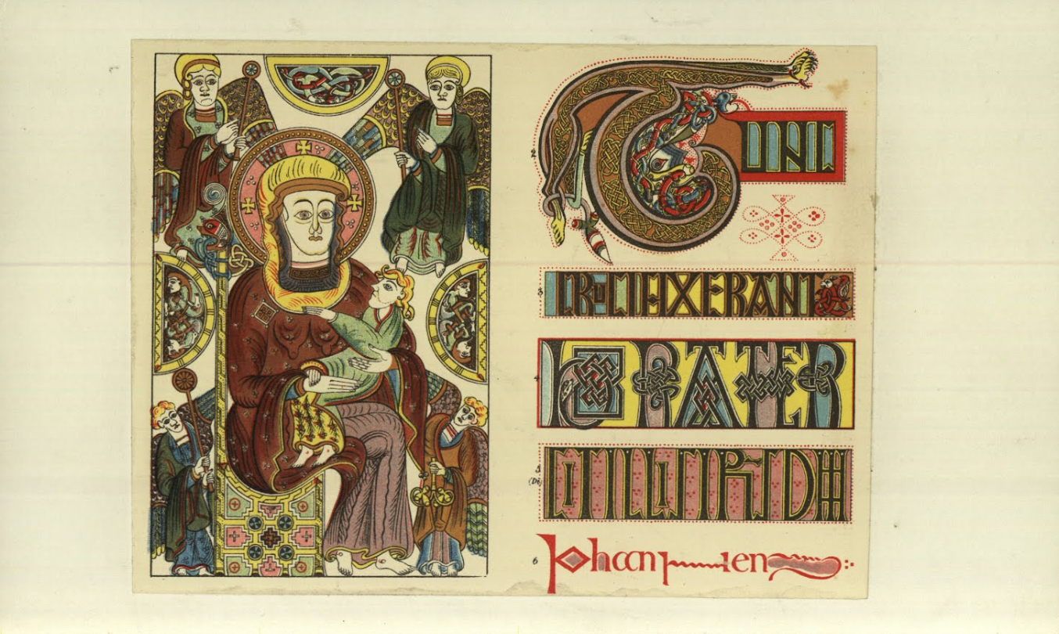
Notes:
Boo Manu Book Of Kells — Google Arts & Culture

Slide 9
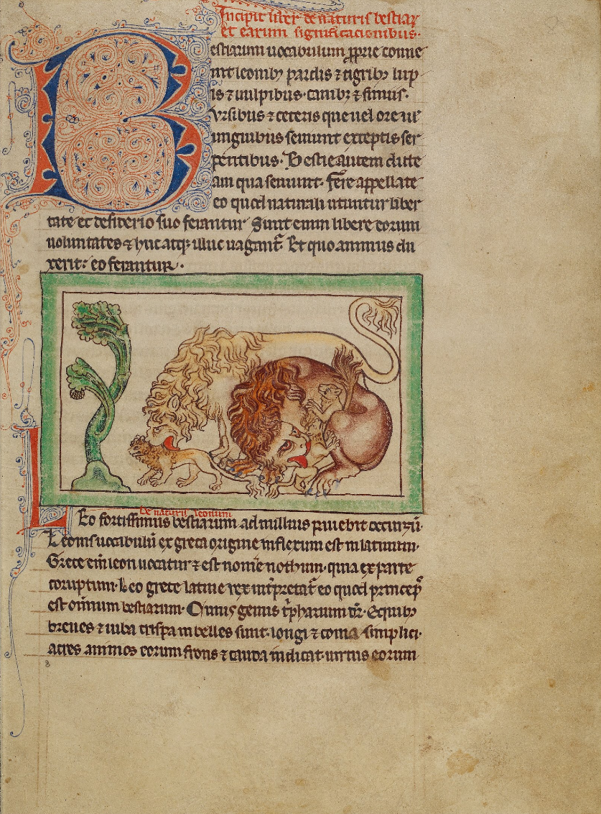
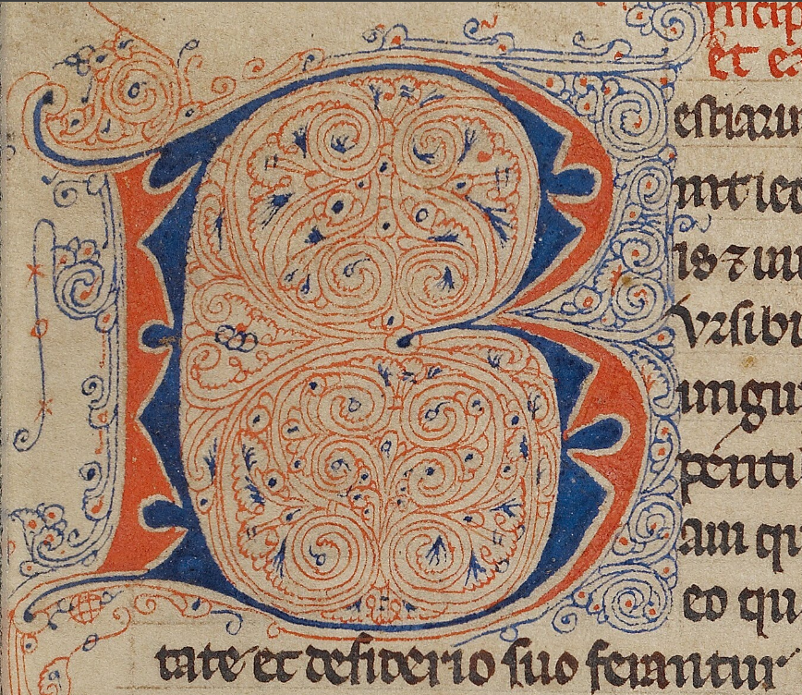
Notes:
1250 - 1260 keep
https://artsandculture.google.com/asset/northumberland-bestiary-unknown/qwEu9LYJYPfBDQ

Slide 10
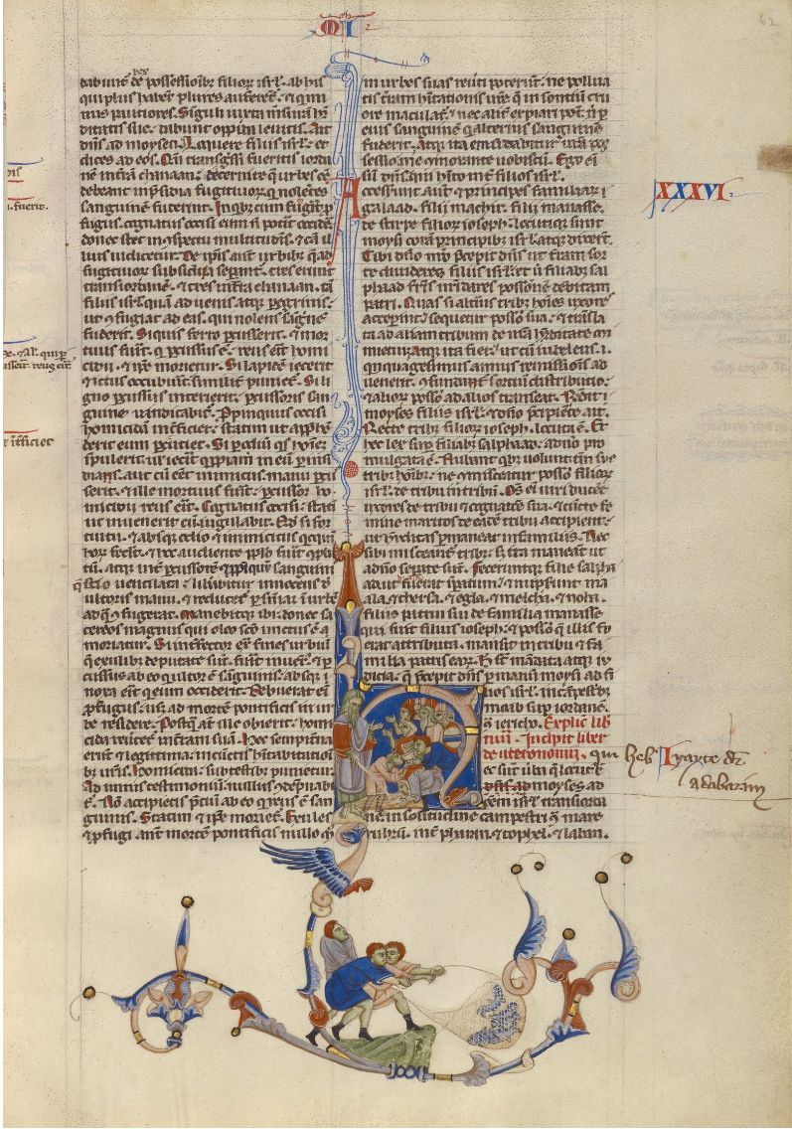
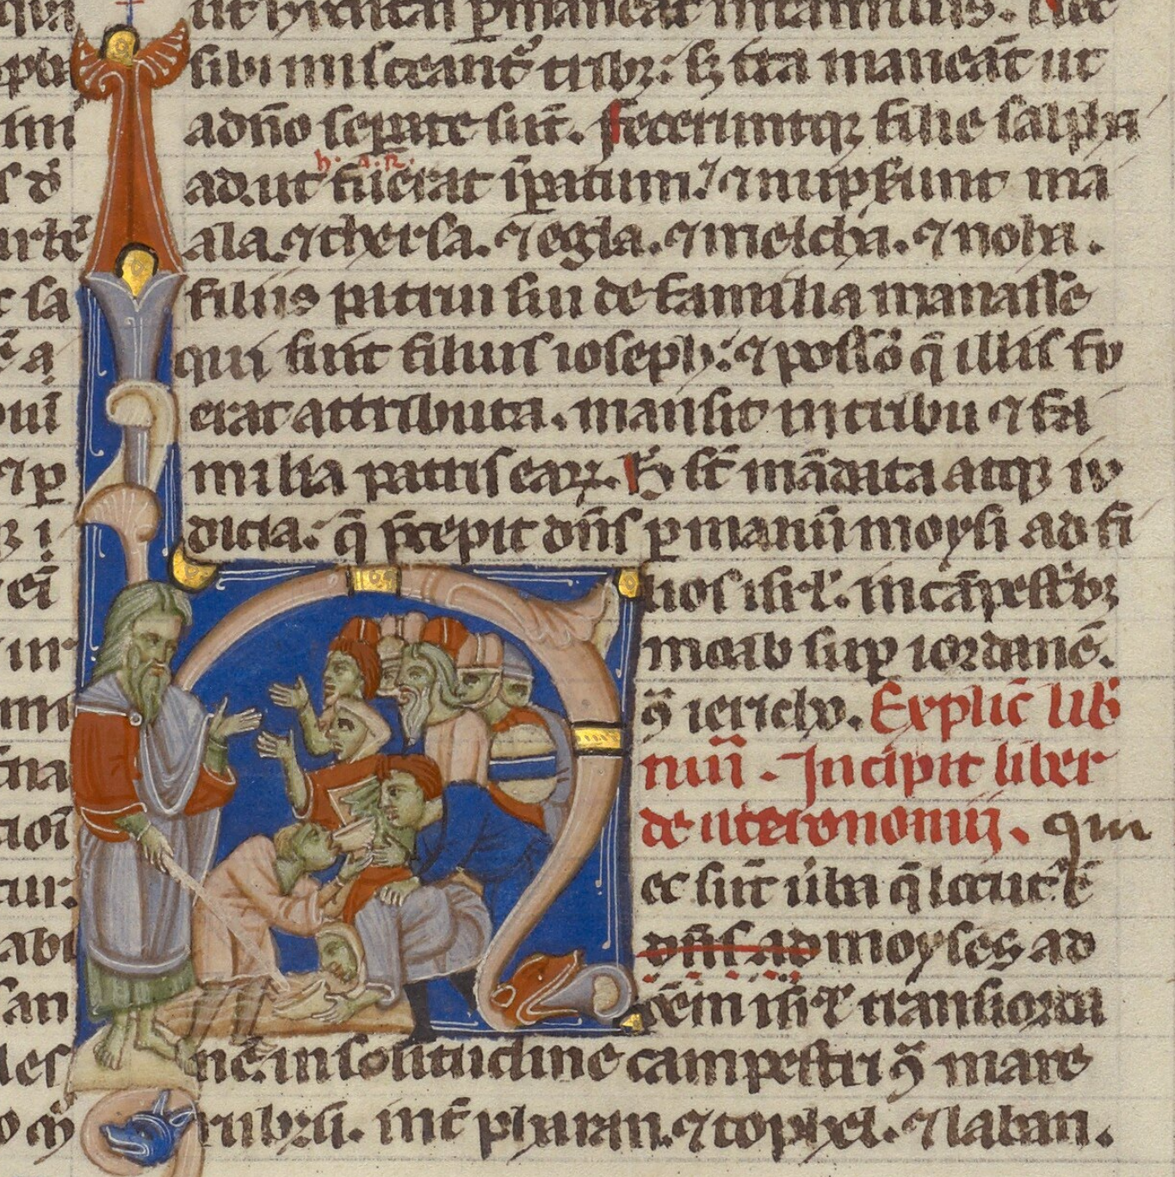
Notes:
1250 - 1262 keep
https://artsandculture.google.com/asset/abbey-bible-unknown/TAExjRfu1iR6Lw

Slide 11
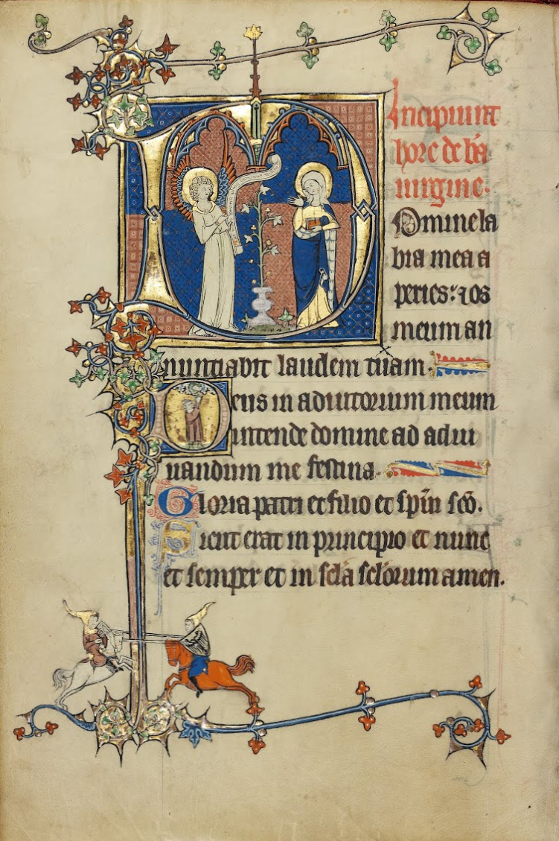
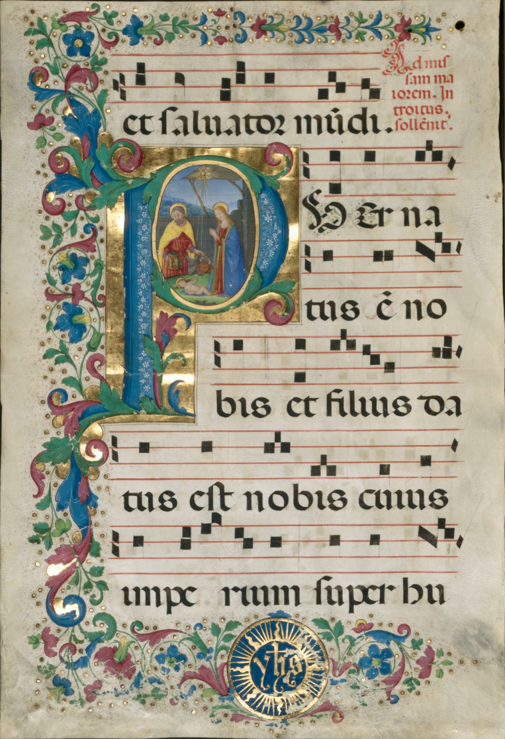
Notes:
1300 keep
Book of Hours (secular vignettes of humours animals and figures playing a counterpart to religious ones) https://artsandculture.google.com/asset/ruskin-hours-unknown/uwEAiVvtex3frw
1500
Christmas chant music from the Puer Natus est Nobis: https://artsandculture.google.com/asset/leaf-from-a-gradual-initial-p-with-the-nativity-attavante-degli-attavanti-italian-c-1452-c-1525-and-workshop/fAGMFgMdy78rJA

Slide 12
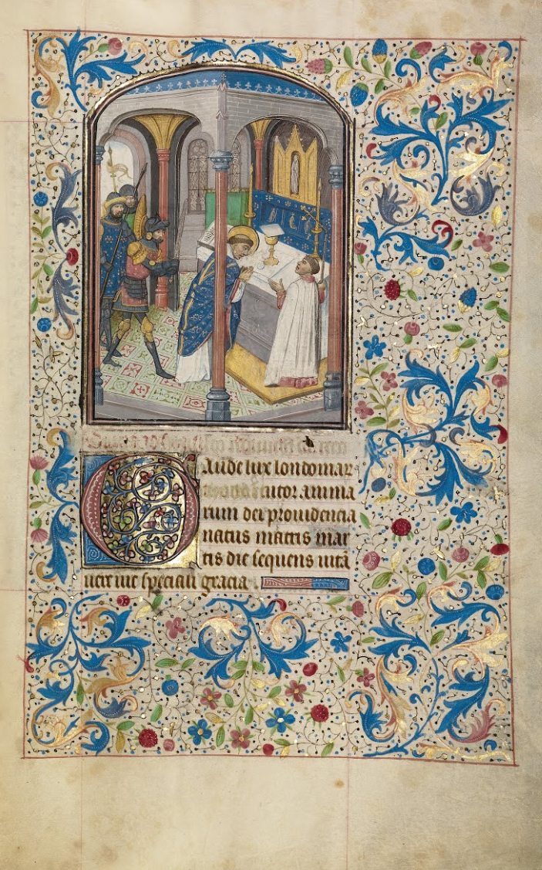
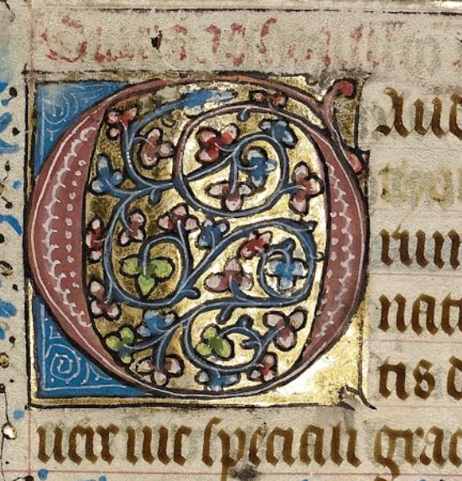
Notes:
1460s keep
https://artsandculture.google.com/asset/the-martyrdom-of-saint-thomas-becket-willem-vrelant/4wFJp7IwhzwXHg?ms=%7B%22x%22%3A0.5%2C%22y%22%3A0.5%2C%22z%22%3A9.945241174759664%2C%22size%22%3A%7B%22width%22%3A3.145805700668653%2C%22height%22%3A1.237509079464591%7D%7D

Slide 13
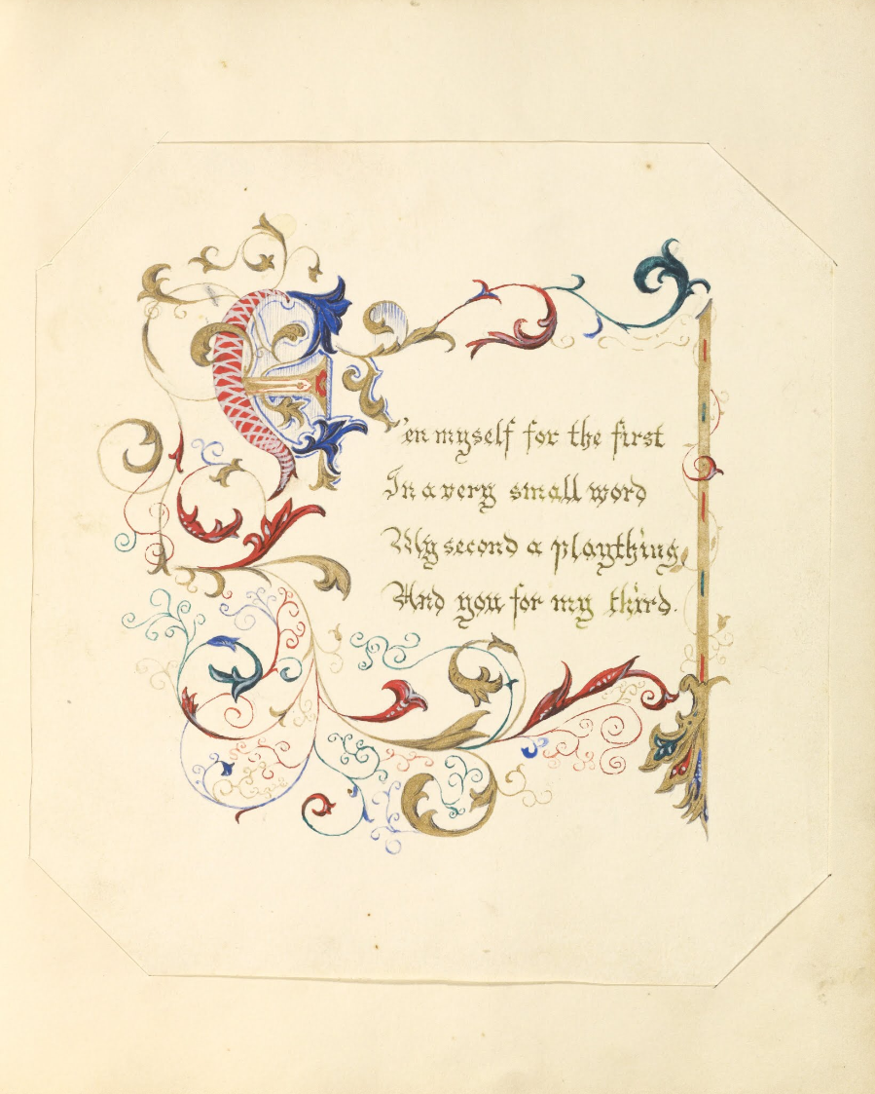
Notes:
1843-1845 keep
https://artsandculture.google.com/asset/illuminated-manuscript-poem-unknown/uAElSwsP2aTZvA

Slide 14
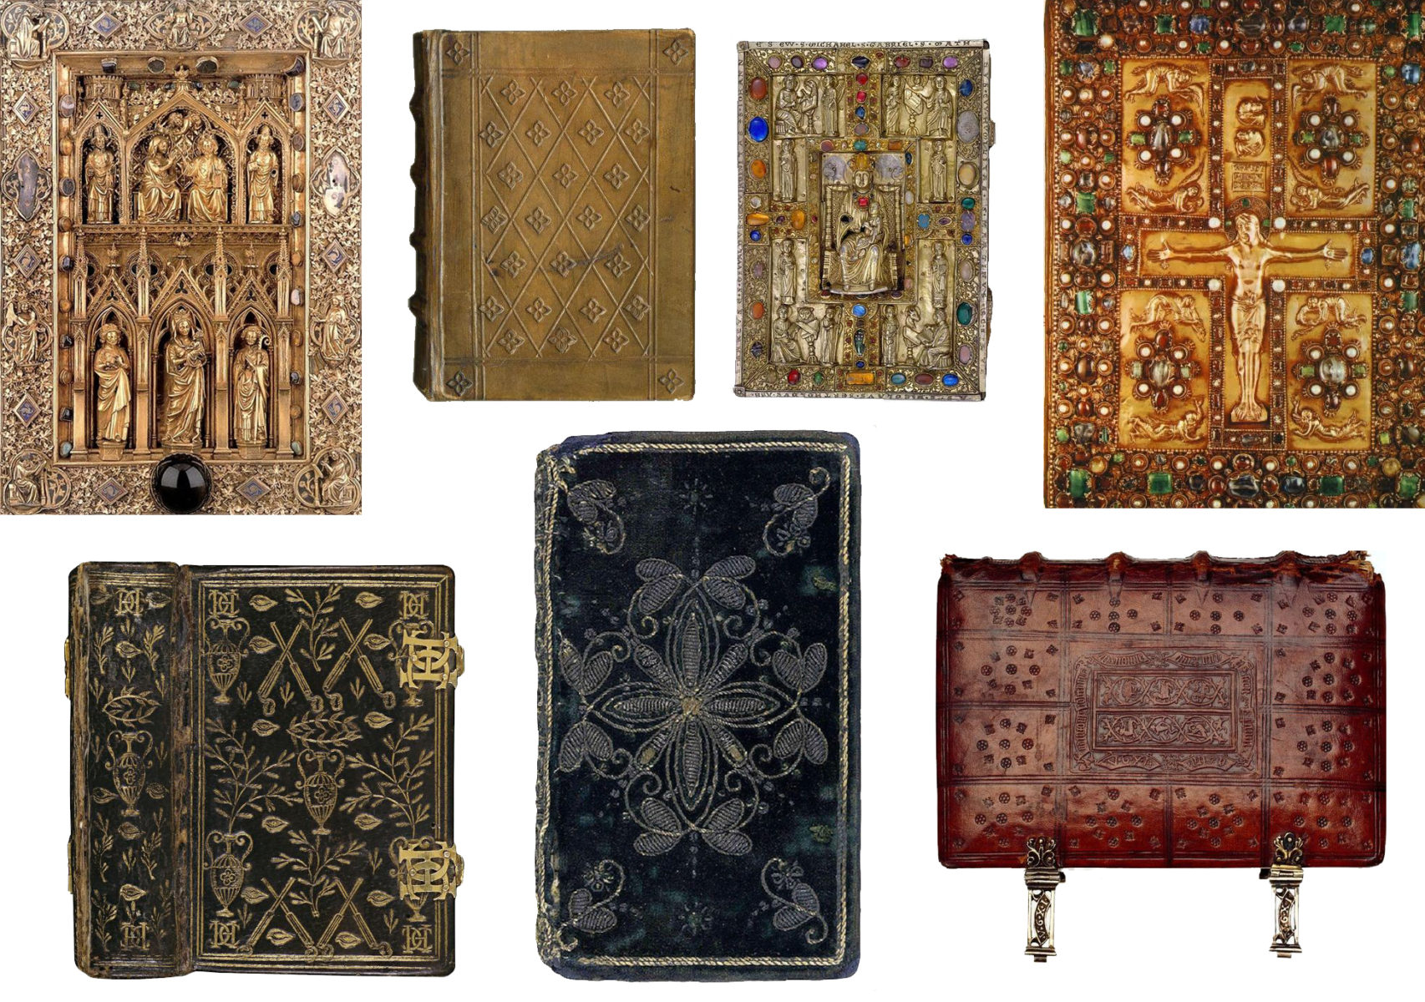
Notes:
keep
https://www.grapheine.com/en/history-of-graphic-design/history-of-book-covers-1
Pre-1450 (printing press)

Slide 15
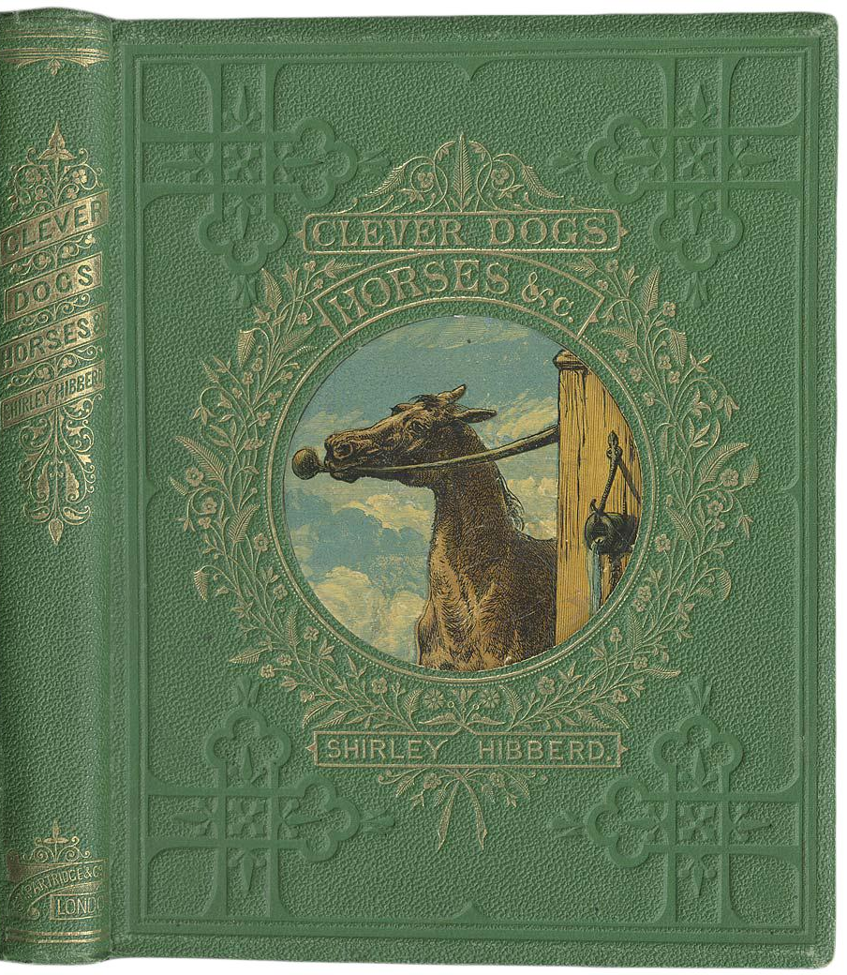
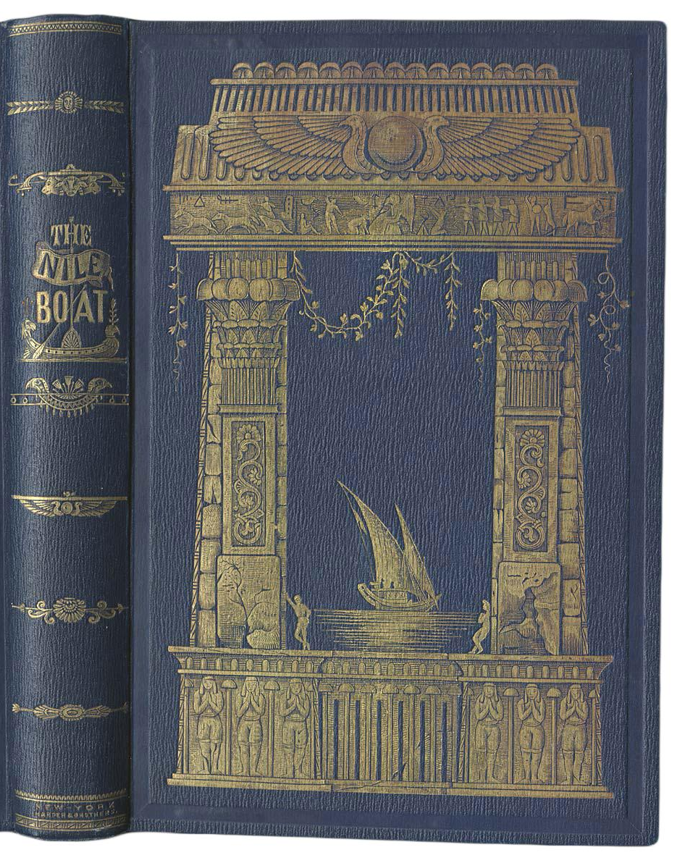
Notes:
keep
1830s-1860s
https://www.grapheine.com/en/history-of-graphic-design/history-of-book-covers-1

Slide 16
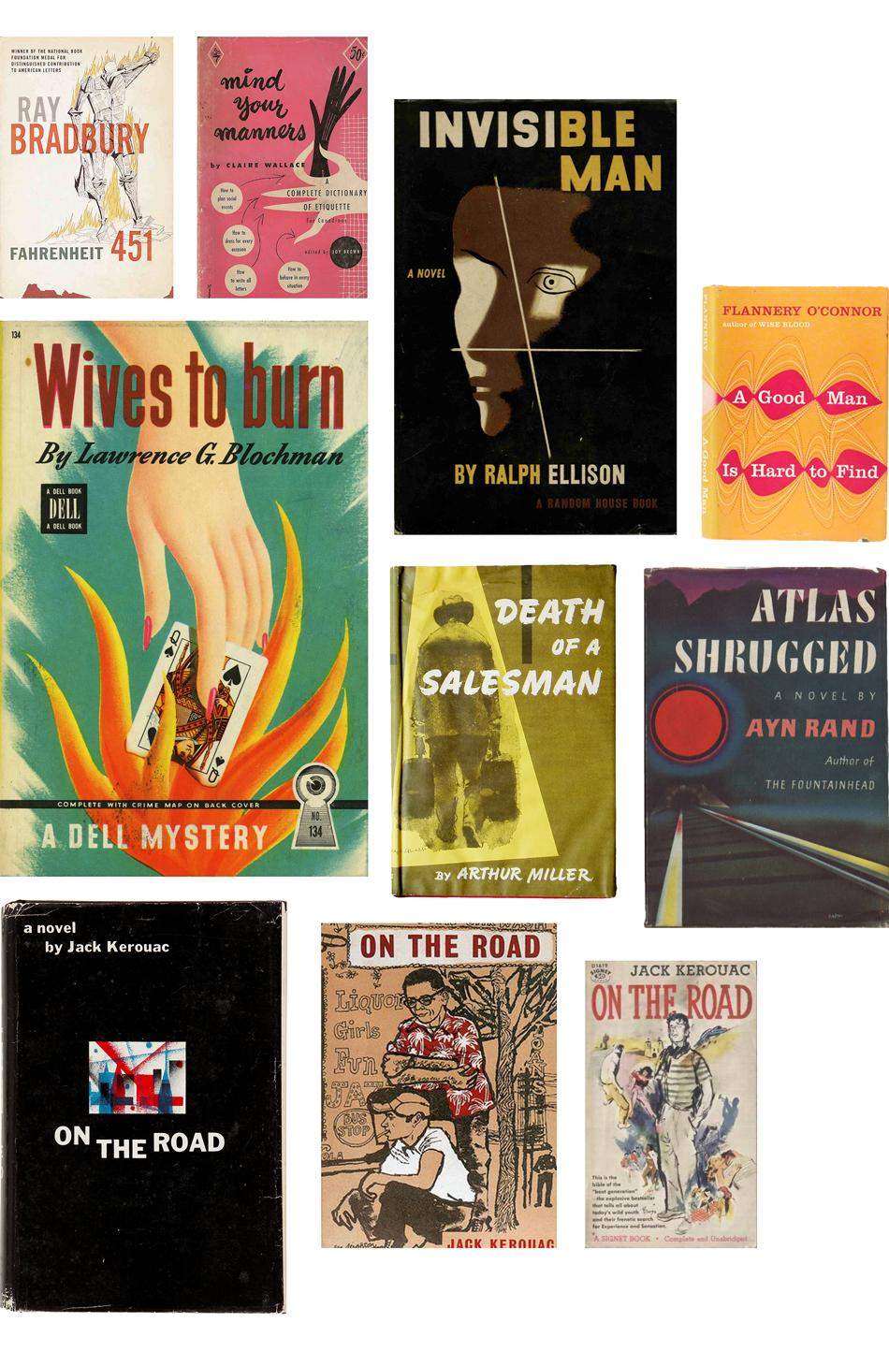
Notes:
1930s-40s-50s keep
https://www.grapheine.com/en/history-of-graphic-design/history-of-book-covers-3

Slide 17
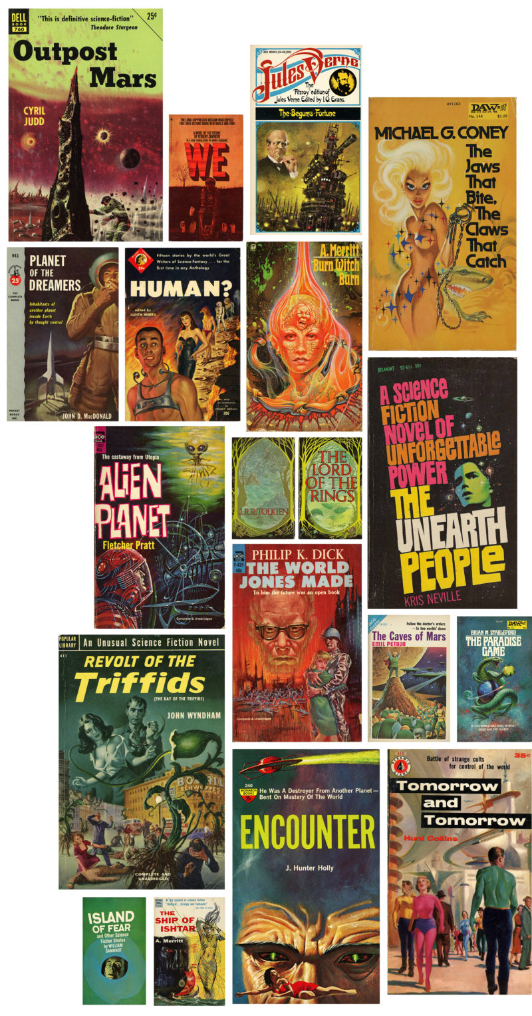
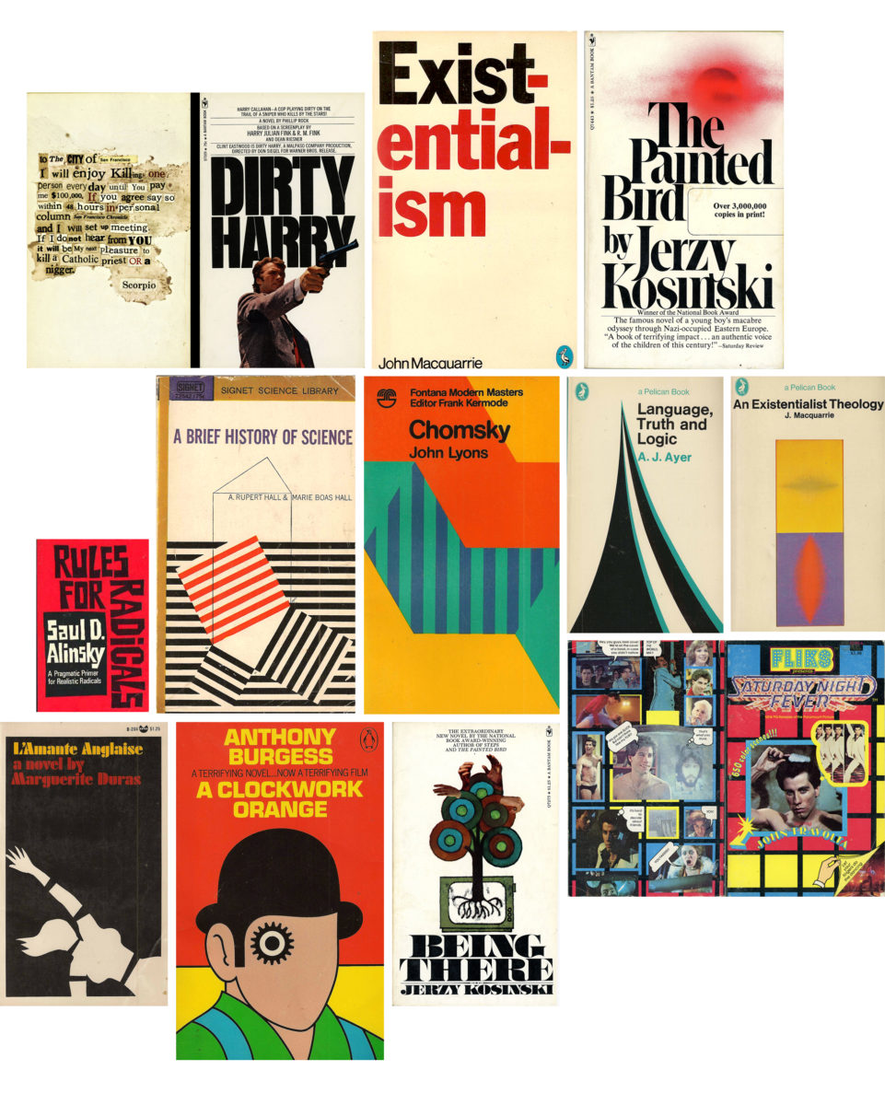
Notes:
1960s-70s keep
https://www.grapheine.com/en/history-of-graphic-design/history-of-book-covers-3

Slide 18
How do both illuminated letters and book covers tell a story in one image?

Slide 19
Notes:
https://www.youtube.com/watch?v=laYxROekO-E
You may also use the Illuminated Letters Art Techniques document attached to this lesson as a guide on some of the skills to demonstrate and practice with students before they make their art.

Slide 20
Pick a song
Think about it overnight
Z
Z
Z

Slide 21
Elements of Design
Notes:
Video: https://youtu.be/wQhuN1iR_9Q?si=7sWQDxGGk1l9BKT5

Slide 22
Principles of Art
Notes:
Video: https://youtu.be/65WjYDEzi88?si=ptXGRVwPtT0eadoX

Slide 23
Magnetic Statements
Which element/principle are you most drawn to use for illuminating the song you have chosen?
Discuss why with others who chose the same.

Slide 24
Magnetic Statements
Find someone across the room who has chosen a different element/principle.
Share your ideas.

Slide 25
How can the message of your song be conveyed visually?
Make 3-5 sketches, each representing a different approach to expressing the main theme/mood/story of the song you’ve chosen

Slide 26
Our Powers Combined…
Take inspiration from the message, mood, themes of your chosen song.
Use the styles and techniques of illuminated manuscripts.
Convey the message through one or more Elements of Art / Principles of Design.

Slide 27
Gallery Walk
As you view others’ artwork take note on your handout:
See: What do you notice? Does anything stand out? How would you describe this art?
Perceive: What emotions/feeling/mood do you feel looking at the art? What message do you feel is being conveyed?
Reflect: What did you learn from this project? What can improve for next time?

