Slide 2
All Shook Up
Science—Earthquakes

Slide 3
Essential Question:
What resources do geologists use to study earthquakes?

Slide 4
Lesson Objectives:
Students will be able to:
Construct an explanation based on evidence for how geoscience processes have changed Earth’s surface at varying time and spatial scales.
Analyze and interpret data on natural hazards to forecast future catastrophic events and inform the development of technologies to mitigate their effect.

Slide 5
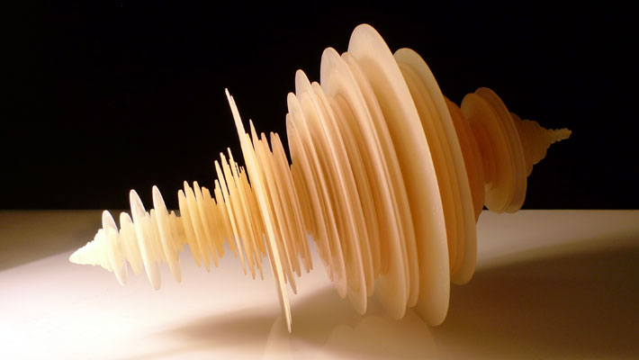
Image credit: Luke Jerram
Come up with descriptive words and possible meanings for the sculpture, and then discuss with your Elbow Partner.
Notes:
Image from https://www.lukejerram.com/tohoku-japanese-earthquake/

Slide 6
Image credit: Luke Jerram
This is a picture of a sculpture created from the Tohoku Japanese earthquake’s seismic wave.
Notes:
Image from https://www.lukejerram.com/tohoku-japanese-earthquake/

Slide 7
Commit and Toss
Listen to this audio clip.
Number your sticky note 1, 2, 3, and answer these questions: How do scientists measure earthquakes? What do they learn from these measurements? How do they use these measurements?
Wad up and toss your sticky note. Pick up a sticky note.
Do any volunteers want to share answers from the sticky note you picked up?
Notes:
Clip is from https://youtu.be/8cOan4FMWxs

Slide 8
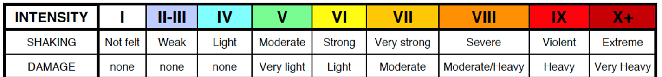
Modified Mercalli Intensity (MMI) Scale
The Modified Mercalli Intensity scale measures the intensity of an earthquake. It is a measure of the effects of an earthquake (i.e., damage and/or eyewitness accounts of earthquake motion).
The Richter scale, on the other hand, is a measure of the amount of energy released during an earthquake. Data is collected by the waves and then recorded on a seismograph.

Slide 9
Modified Mercalli Intensity (MMI) Scale
What do you notice about the amount of damage in the descriptions as the numbers increase?
I. | Not felt. Marginal and long period effects of large earthquakes.
II. | Felt by persons at rest, on upper floors, or favorably placed.
III. | Felt indoors. Hanging objects swing. Vibration like passing of light trucks. Duration estimated. May not be recognized as an earthquake.
IV. | Hanging objects swing. Vibration like passing of heavy trucks; or sensation of a jolt like a heavy ball striking the walls. Standing motor cars rock. Windows, dishes, doors rattle. Glasses clink. Crockery clashes. In the upper range of IV, wooden walls and frame creak.
V. | Felt outdoors; direction estimated. Sleepers wakened. Liquids disturbed, some spilled. Small unstable objects displaced or upset. Doors swing, close, open. Shutters, pictures move. Pendulum clocks stop, start, change rate.
VI. | Felt by all. Many frightened and run outdoors. Persons walk unsteadily. Windows, dishes, glassware broken. Knickknacks, books, etc., off shelves. Pictures off walls. Furniture moved or overturned. Weak plaster and masonry D cracked. Small bells ring (church, school). Trees, bushes shaken (visibly, or heard to rustle).
VII. | Difficult to stand. Noticed by drivers of motor cars. Hanging objects quiver. Furniture broken. Damage to masonry D, including cracks. Weak chimneys broken at roof line. Fall of plaster, loose bricks, stones, tiles, cornices (also unbraced parapets and architectural ornaments). Some cracks in masonry C. Waves on ponds; water turbid with mud. Small slides and caving in along sand or gravel banks. Large bells ring. Concrete irrigation ditches damaged.

Slide 10
Your Team of Geologists
A recent earthquake occurred, and your team of 4 needs to:
Read first-person accounts from the earthquake.
Use the MMI Scale to assign a number to each eyewitness account.
Color in the map according to your team's findings.

Slide 11
For Example…
91377, 91301—I was driving home from my late shift when it felt like the car wasn’t driving normally. Then I noticed dirt sliding down the steep side of the ditch next to the road. I stopped the car on the side of the road and got out. That’s when I noticed the new cracks in the concrete wall on the other side of the ditch. By that time the shaking had stopped, so I got back in my car and drove home.
What number should you give this eyewitness account?
What zip codes was this reported from?
What color should you color those 2 blank spaces on your map?
Notes:
Point out to students that the highlighted green numbers are the zip codes where the eyewitnesses were. Next, guide them in locating them on the blank map of Northridge, CA, that they will be coloring in later.
Source:
Wald, L. & Shindle, W. (2004, July). Magnitude vs. intensity lesson. USGS. https://www.usgs.gov/media/files/magnitude-vs-intensity-lesson

Slide 12
Gallery Walk
Place your group’s completed map on the wall.
You’ll have 3 minutes at each map to investigate the work of each group.
Compare and contrast the maps. Discuss the following:
Were the maps similar or different?
What may have caused any differences across the maps?
Notes:
At the end is where you’d introduce the idea of seismic waves.

Slide 13
Discussion
What pieces of data were you using to determine the intensity at different locations?
What caused the actual damage during the earthquake?
If the earthquake’s epicenter was miles away from us, how is it possible for us to feel the ground move?

Slide 14
Seismic Waves
There are two types of waves that occur during an earthquake:
P waves are “primary waves.” What direction does the wave seem to move?
S waves are “secondary waves.” What direction does the wave seem to move?
Both of these motions can also be demonstrated using a Slinky.
Write a description and draw a model of each type of wave using what you have observed with the Slinky.
Notes:
Both videos are located at https://pnsn.org/outreach/about-earthquakes/eq-waves
Last video is located at https://www.teachertube.com/videos/77594

Slide 15
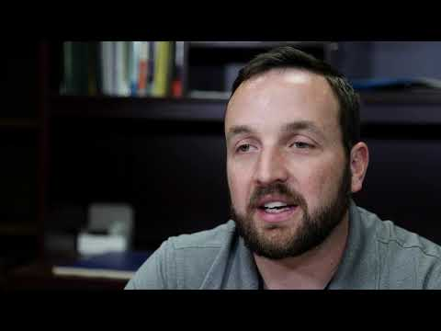
Interview with a Geologist
Notes:
https://www.youtube.com/watch?v=Z_9HL6cK7Gk&feature=youtu.be

Slide 16
Earthquake Research
Select an earthquake for your group to research. Each member of your group should read different articles as you research. Be prepared to share with the class. The information you are documenting on your News Article Analysis handout includes:
Where did the earthquake take place?
Where was the epicenter?
What was the magnitude of the earthquake?
What time was it when the earthquake hit?
What type of damage occurred?
As a geologist, how would you explain the severity of the damage?

Slide 17
Recommendations:
Videos for recent earthquakes you may want to investigate:
California 2019: bit.ly/californiaearthquake
(watch only first 3 minutes)
Jamaica 2020: bit.ly/jamaicaearthquake
Oklahoma 2016: bit.ly/oklahomaearthquake
Greenland 2017: bit.ly/greenlandearthquake
For information about Oklahoma earthquakes, visit the following site: https://earthquakes.ok.gov/
Notes:
California Video: CBS News. (2019, July 6). Southern California reeling after another earthquake strikes [Video]. YouTube. https://www.youtube.com/watch?v=tQ9u2shVXAc&feature=youtu.be
Jamaica Video: CBS Evening News. (2020, January 28). Earthquake hits between Cuba and Jamaica [Video]. YouTube. https://www.youtube.com/watch?v=JnH2UgArC_I&feature=youtu.be
Oklahoma Video: NBC News. (2016, November 7). Oklahoma shaken by magnitude 5.0 earthquake Sunday night [Video]. https://www.nbcnews.com/news/weather/video/oklahoma-shaken-by-magnitude-5-0-earthquake-sunday-night-802678851929
Greenland Video: National Geographic. (2017, June 23). Dramatic video shows deadly tsunami hitting Greenland [Video]. https://www.nationalgeographic.com/news/2017/06/video-shows-greenland-deadly-tsunami-landslide-spd/

Slide 18
Breaking News
You will write a news article covering a fictional earthquake. The earthquake you are reporting on has a magnitude between 6 and 9 on the Richter scale. It can be located anywhere in the world in any type of setting (e.g., urban, rural, or suburban). The key information you should include is:
Epicenter and location
Time and date it occurred
Magnitude
Descriptions of the damage
3-5 first-person accounts from survivors

