Slide 2
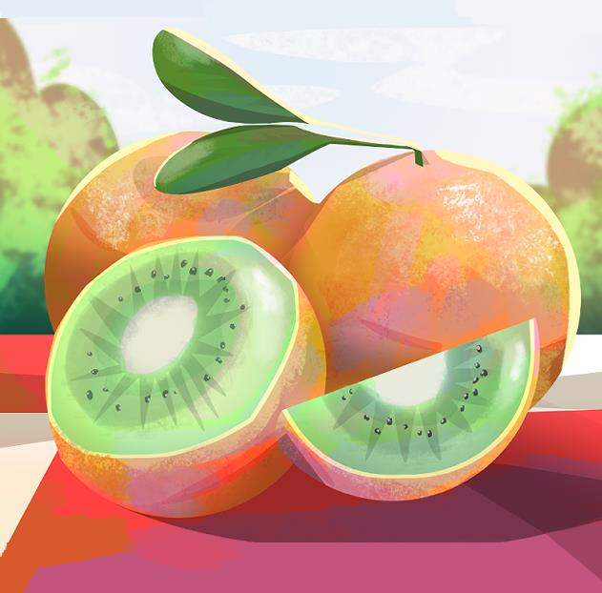
What’s a GMO?
Genetics and Ethics

Slide 3
Essential Question
How does genetic engineering change organisms, and how should scientific evidence guide decisions about its use?

Slide 4
Learning Objective(s)
Analyze scientific evidence to explain how genetically modified organisms (GMOs) are created and how genetic changes impact traits.
Construct and defend an evidence-based argument evaluating the benefits and risks of GMOs using scientific reasoning.

Slide 5

What’s a GMO?
Notes:
Jimmy Kimmel Live. (2014, October 9). What's a GMO? [Video]. YouTube. https://youtu.be/EzEr23XJwFY

Slide 6
Discussion
What do you already know about GMOs?
What are they?
Where do we see them?
Are they good or bad?

Slide 7

Four Corners
After each statement is read aloud, move to a corner based on your thinking:
  Strongly Agree
  Agree
  Disagree
  Strongly Disagree
In your corners, with your peers, discuss the reasoning and develop 1-2 justifications of your stance.
Notes:
K20 Center. (n.d.). Four corners. Strategies. https://learn.k20center.ou.edu/strategy/138

Slide 8
GMOs are safe for humans to eat.
Strongly Agree
Agree
Strongly Disagree
Disagree
Notes:
K20 Center. (n.d.). Four corners. Strategies. https://learn.k20center.ou.edu/strategy/138

Slide 9
GMOs are necessary in order to solve world hunger.
Strongly Agree
Agree
Strongly Disagree
Disagree
Notes:
K20 Center. (n.d.). Four corners. Strategies. https://learn.k20center.ou.edu/strategy/138

Slide 10
GMOs are harmful to the environment.
Strongly Agree
Agree
Strongly Disagree
Disagree
Notes:
K20 Center. (n.d.). Four corners. Strategies. https://learn.k20center.ou.edu/strategy/138

Slide 11
GMOs should be labeled on all food products.
Strongly Agree
Agree
Strongly Disagree
Disagree
Notes:
K20 Center. (n.d.). Four corners. Strategies. https://learn.k20center.ou.edu/strategy/138

Slide 12
The benefits of GMOs outweigh the risks.
Strongly Agree
Agree
Strongly Disagree
Disagree
Notes:
K20 Center. (n.d.). Four corners. Strategies. https://learn.k20center.ou.edu/strategy/138

Slide 13
Using GMOs in farming is unfair to small farmers.
Strongly Agree
Agree
Strongly Disagree
Disagree
Notes:
K20 Center. (n.d.). Four corners. Strategies. https://learn.k20center.ou.edu/strategy/138

Slide 14
GMOs are an example of science helping society.
Strongly Agree
Agree
Strongly Disagree
Disagree
Notes:
K20 Center. (n.d.). Four corners. Strategies. https://learn.k20center.ou.edu/strategy/138

Slide 15
Introduction - Mock Trial Debate
Sometimes scientists have to defend their findings. You will participate in a mock trial debate about GMOs.
Goal: Use scientific evidence, not opinions, to support your team’s stance.

Slide 16
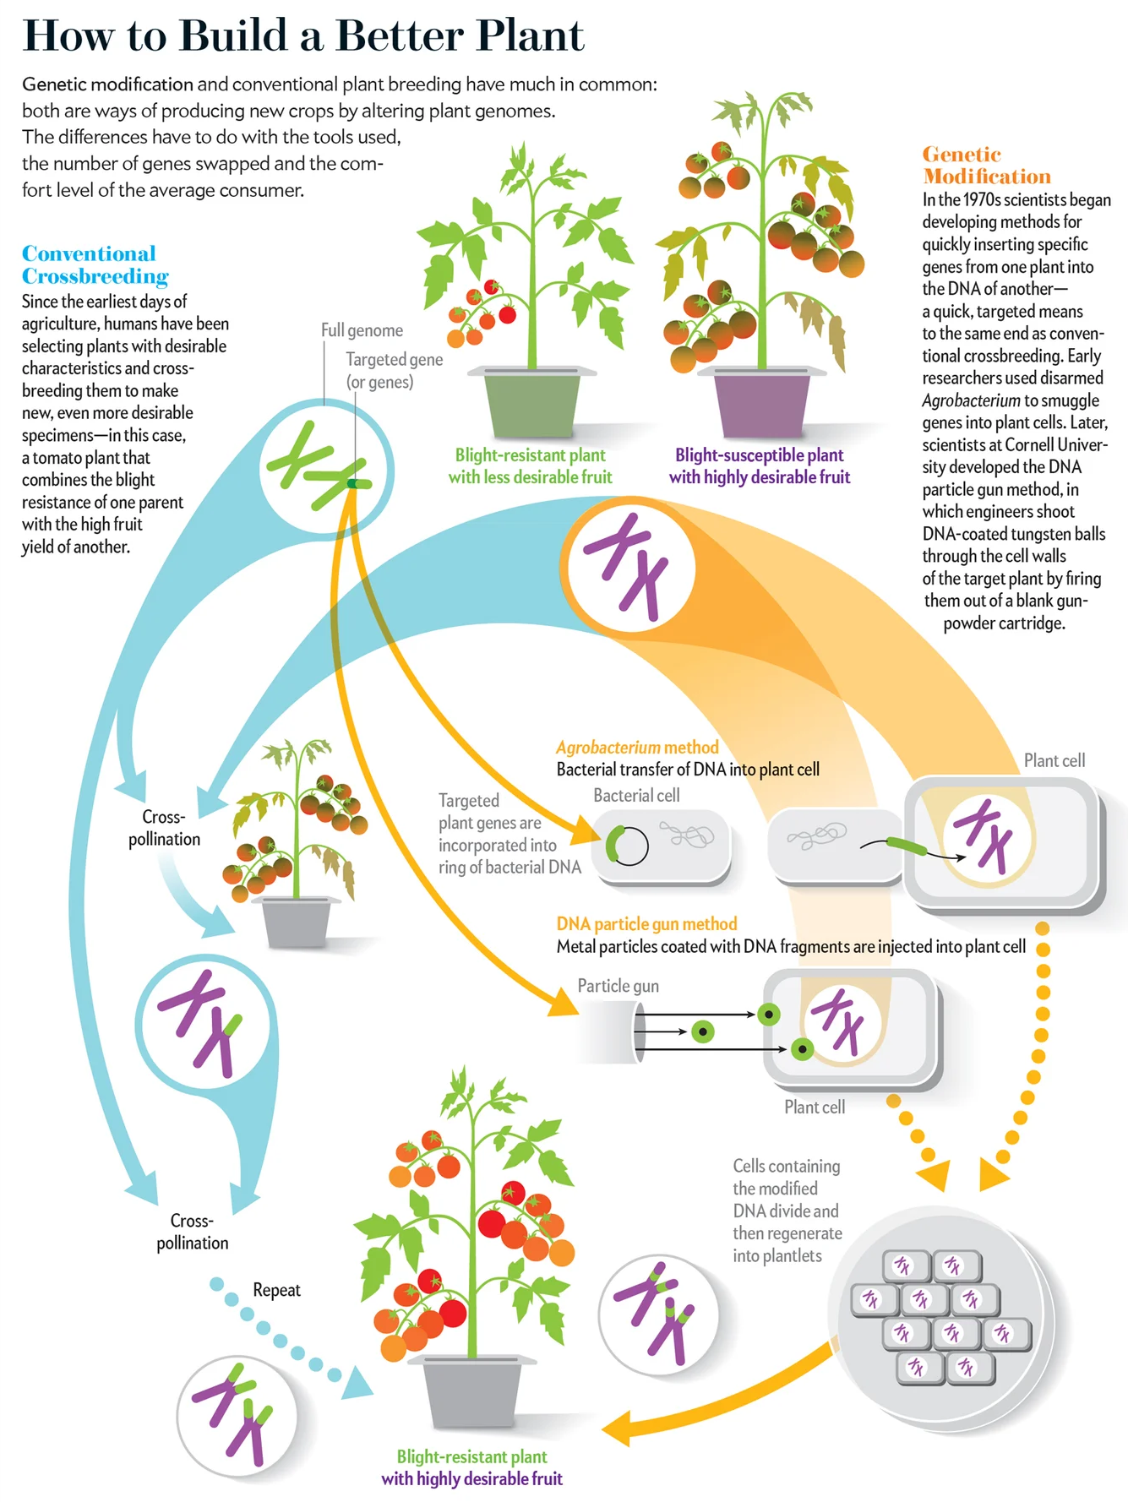
Understanding GMOs
Find a partner.
Together, analyze the diagram and answer the questions on the handout.
Be prepared to share your thoughts with the class.
Notes:
Christiansen, J. (2013). How to Build a Better Plant. [Image]. Scientific American. https://www.scientificamerican.com/article/the-truth-about-genetically-modified-food/

Slide 17
Research Task
In groups, select which real-world case to investigate.
Case 1 | Case 2 | Case 3
Should scientists use modified rice to help prevent blindness in children? | Should we allow genetically modified fish to be sold as food? | Should farmers use modified crops that reduce the need for chemical pesticides?

Slide 18
Evidence Expectations
Gather:
Biological evidence
  Genes/traits
Data-based evidence
  Numbers/studies
Real-world impact
Possible Sources:
“How to Build a Better Plant” diagram
Trusted scientific web pages
Scholarly journal articles

Slide 19
Discuss
What patterns do you notice?
What problems do GMOs solve?
What concerns exist?
Where do you see disagreements or uncertainty in the evidence?

Slide 20
Debate
Structure:
Teams A and B will state their Claims.
Team A will provide their Evidence and Reasoning.
Team B will provide their Evidence and Reasoning.
Team A will have 1 min to counter-argue against Team B.
Team B will have 1 min to counter-argue against Team A.
Jury Role:
Evaluate arguments.
Focus on evidence and reasoning.
Give final judgement!

Slide 21

CER Framework
Claim: What’s your position on the case?
Evidence: Scientific data, research, or biological explanations.
Reasoning: How did your evidence support your claim using scientific concepts?
Notes:
K20 Center. (n.d.). Claim, evidence, reasoning (CER). Strategies. https://learn.k20center.ou.edu/strategy/156

Slide 22


HEAR YE! HEAR YE!
The Honorable Judge declares that court is in session.
Present your argument (using your CER).
Respond to the counterargument.
For the affirmative (Team A)
For the negative (Team B)

Slide 23
Juror Reflection
Access the Juror Reflection Padlet and answer the following:
Did your thinking change?
What argument was most convincing?
What evidence was strongest?
[Add Padlet link and/or QR code]
Notes:
K20 Center. (n.d.). Padlet. Tech Tools. https://learn.k20center.ou.edu/tech-tool/1077

Slide 24
Final CER
Respond: Should GMOs be widely used?
Include:
Claim: Clearly state your position.
Evidence (2+ pieces of evidence)
Explain how the evidence supports their claim using scientific concepts.

Slide 25
What is one thing you learned today about GMOs?

Slide 26
Real-World Application
Scenario: A new genetically modified crop has been developed that can survive extreme drought conditions. Some scientists support its use to help farmers. Others worry about long-term environmental impacts.
Would you support or oppose this GMO?
What additional evidence would you need before making a decision?

