Slide 2
What is your favorite movie and why?

Slide 3
Card Sort
Match the vocabulary words with their definitions.
Once matched, create four categories to organize the matched vocabulary.
Notes:
K20 Center. (n.d.). Card Sort. Strategies. https://learn.k20center.ou.edu/strategy/147

Slide 4
Definition Discussion
Plot
Story
Scene
Shot
Setting
Color
Prop
Costume
High-Angle Shot
Low-Angle Shot
Long Shot
Medium Shot
Long Take
Short Take
Cut
Shot/Reverse Shot
Notes:
K20 Center. (n.d.). Card Sort. Strategies. https://learn.k20center.ou.edu/strategy/147 Narrative
Plot. The events of the story depicted on screen.
Story: In a narrative film, all the events that we see and hear, plus all those that we infer or assume to have occurred, arranged in their presumed causal relations, chronological order, duration, frequency, and spatial location.
Scene. A unit of film composed of a number of interrelated shots, unified usually by a central concern -- a location, an incident, or a minor dramatic climax.
Shot. A single piece of unedited footage (no cuts).
Mise en Scene (‘Meez on sin’ - What’s Shown on the Screen)
Settings can be realistic, fantastical, or limbo (all white). Where the scene takes place.
Color. The color scheme of a shot/scene. Can use warm, cold, or neutral colors (or a mix).
Props. Any non-living objects placed in the frame of the shot.
Costume. The wardrobe of the characters.
Cinematography
High angle shot. A shot in which the subject is photographed from above, usually making the characters appear smaller and weaker.
Low angle shot. A shot in which the subject is photographed from below, usually making the characters appear taller and stronger.
Long shot. Includes an amount of picture within the frame which typically shows at least the whole body of an actor, but may show more.
Medium shot. A relatively close shot, revealing a moderate amount of detail. A medium shot of a figure generally includes the body from the knees or waist up. The most common shot for filming actors and actresses
Editing
Long take. A shot of lengthy duration.
Short take. Quick shots, typically referring to a single scene.
Cut. When the film is ‘sliced’ to introduce a new piece of film. Where different shots are joined.
Shot/reverse shot: Two or more shots edited together that alternate characters, typically in a conversation situation.

Slide 5
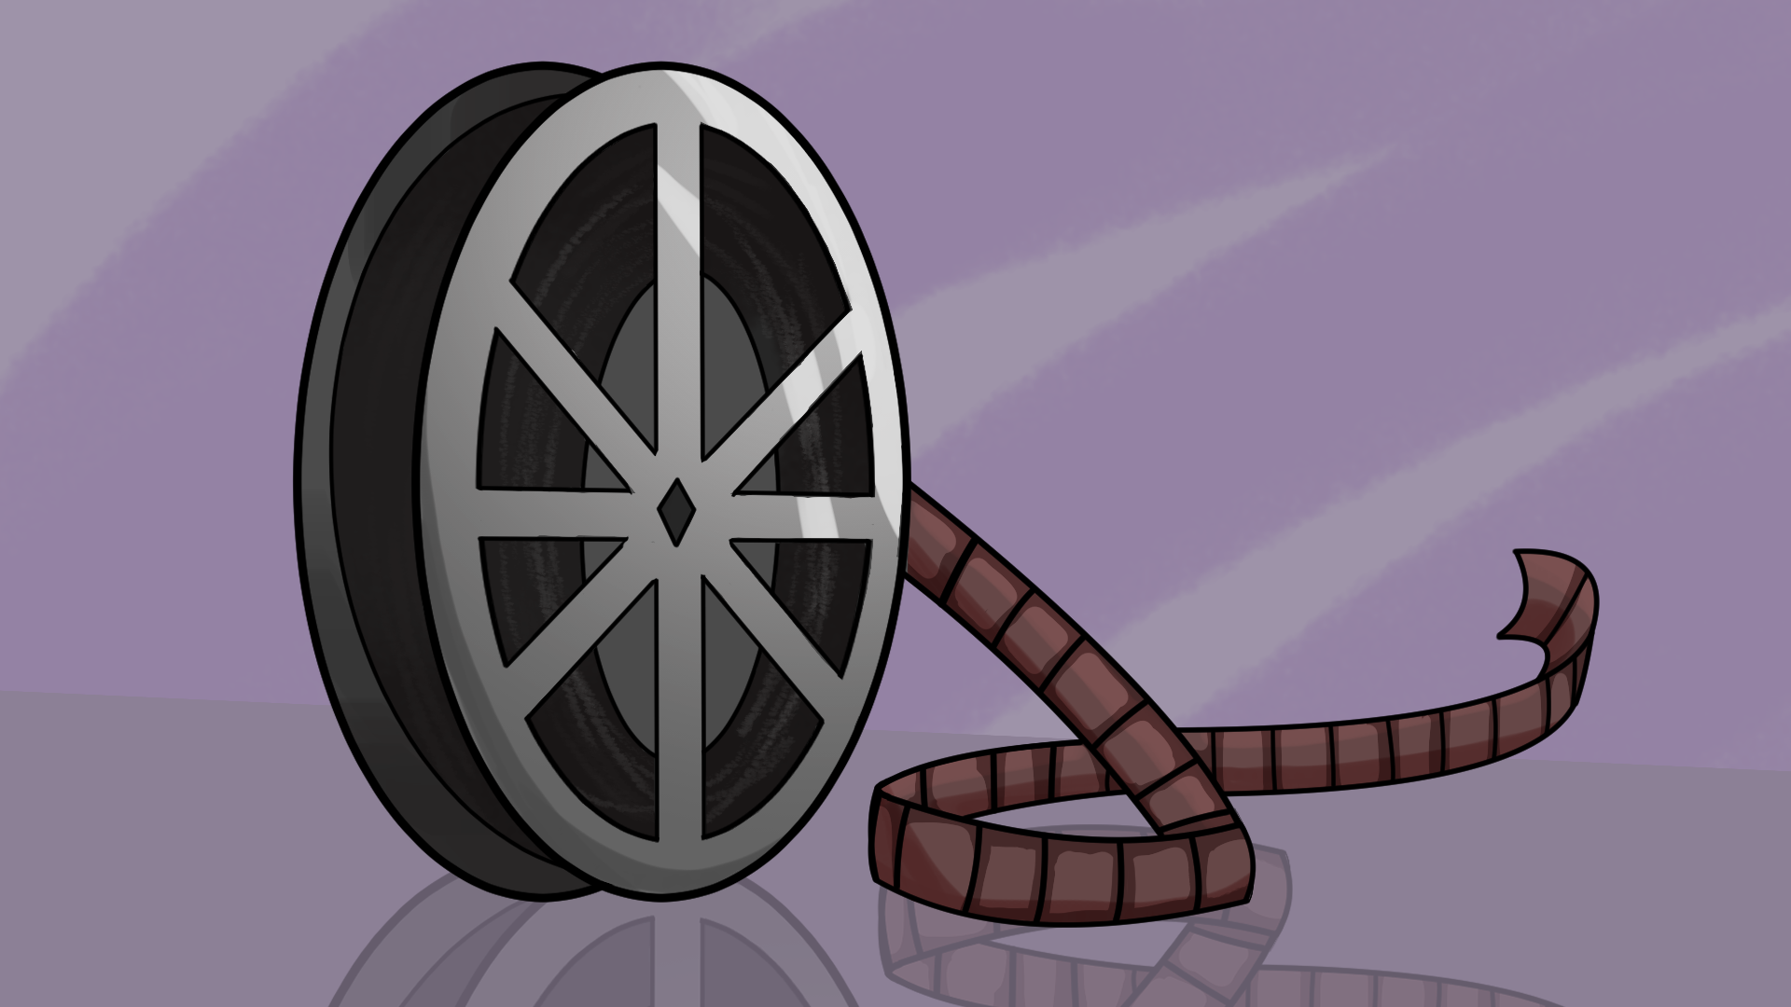
“And, Action!”
Formal Analysis of Moving Images

Slide 6
Essential Question
How do the formal choices made by directors enhance the meaning of their films/moving pictures?

Slide 7
Lesson Objectives
Students will evaluate how a film makes meaning through the director’s formal choices.
Students will deconstruct and interpret the visual composition of a film by analyzing how formal elements contribute to its overall construction and meaning.

Slide 8
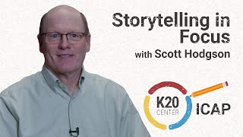
ICAP

Slide 9
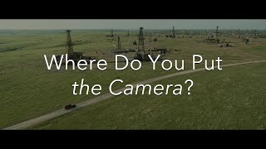
Film Analysis
Notes:
Szhou, T. & Szhou, T. [@everyframeapainting] (2025, Jan. 13). Where do you put the camera? [Video]. YouTube. https://www.youtube.com/watch?v=wa1O3nqW5hQ

Slide 10
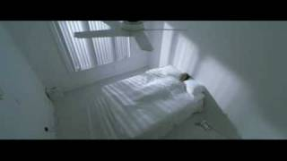
Garden State (Dir. Zach Braff, 2004)
Notes:
Andrew Largeman (Zach Braff) is our protagonist. The plane opens with a symmetrical shot (this does not emphasize who is important). The music is a song that is a prayer song where the singer is asking for his wishes to be fulfilled. We slowly move to Andrew in the middle of the shot (showing he’s who we should be paying attention to). He is the only one not reacting to the plane crash. Cut to the fan (he just wants to be a little more comfortable). The phone connects the dream to the real world. We are in a dutch high angle shot showing the apartment’s pure white space (without emotion). A stack of scripts (he’s an actor) and his cell phone are in the top left. The light from the blinds makes it look like a prison. We cut closer and closer to his face showing that his mother dying doesn’t cause any emotional reaction. The mirror splits his personality, the pills fill the screen and are symetrical (providing some kind of order to his life) and the closing reframes the mirror splitting him into to uneven halves (he’s having problems caused by his medication).
Braff, Z. (Director). (2004). Garden state [Film]. Camelot pictures, Double Features films, and Jersey films.

Slide 11
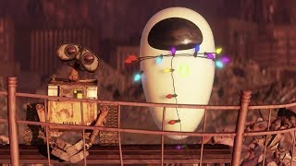
Wall-E (Dir. Andrew Stanton, 2008)
Notes:
Stanton, A. (Director). (2008). WALL-E [Film]. Camelot pictures, Pixar animation studios.

Slide 12
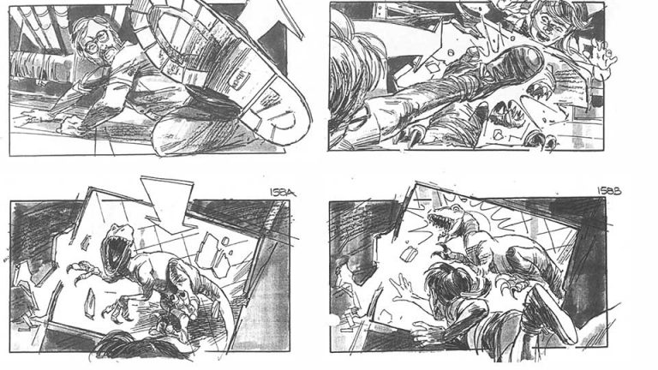
Jurassic Park
Notes:
This scene later became the raptors crashing into the shiny oven during the kitchen scene toward the end of the film.
Lowery, D. & Bell, J. (Artists). (1993) Jurassic park storyboard [Storyboard] in Shay, D. & Duncan, J. (1993). The making of Jurassic Park. Boxtree. ISBN 978-1852837747.

Slide 13
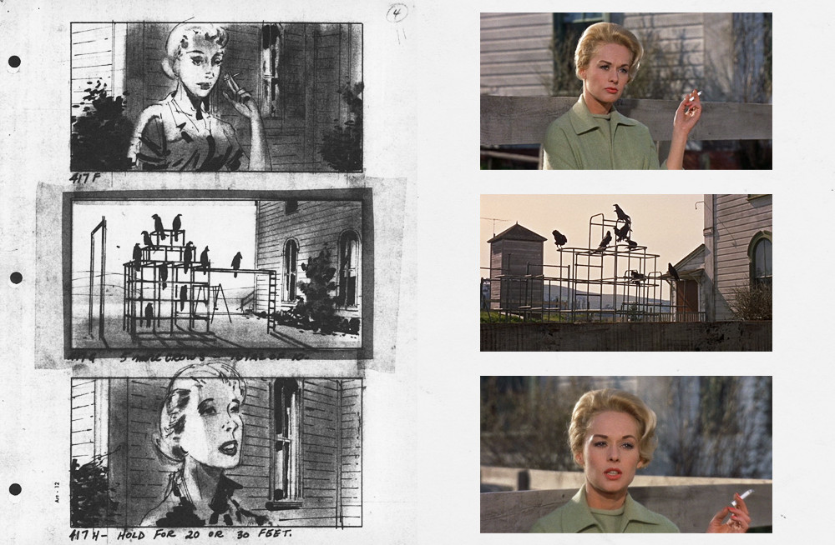
The Birds
Notes:
This scene shows Melanie, a school teacher, taking a break during school. The flocking of birds signals an eminent bird attack.
Hitchcock, A. (Director). (1963). The birds [Film]. Alfred J. Hitchcock productions.
Michelson, H. (Artist). (1963). The birds [Storyboard]. Alfred J. Hitchcock productions.

Slide 14
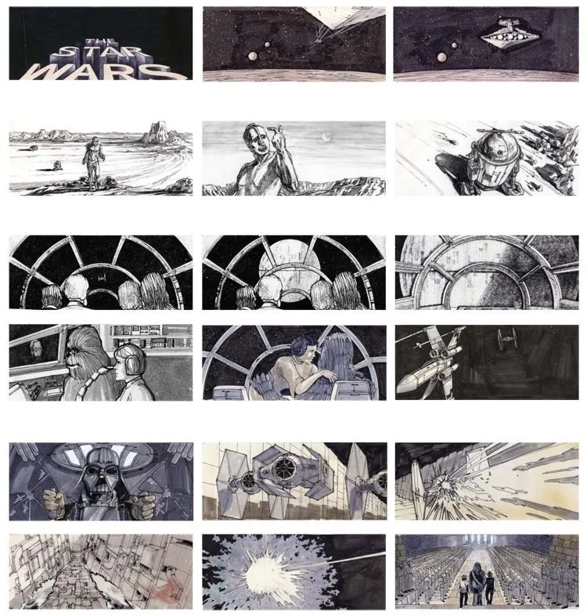
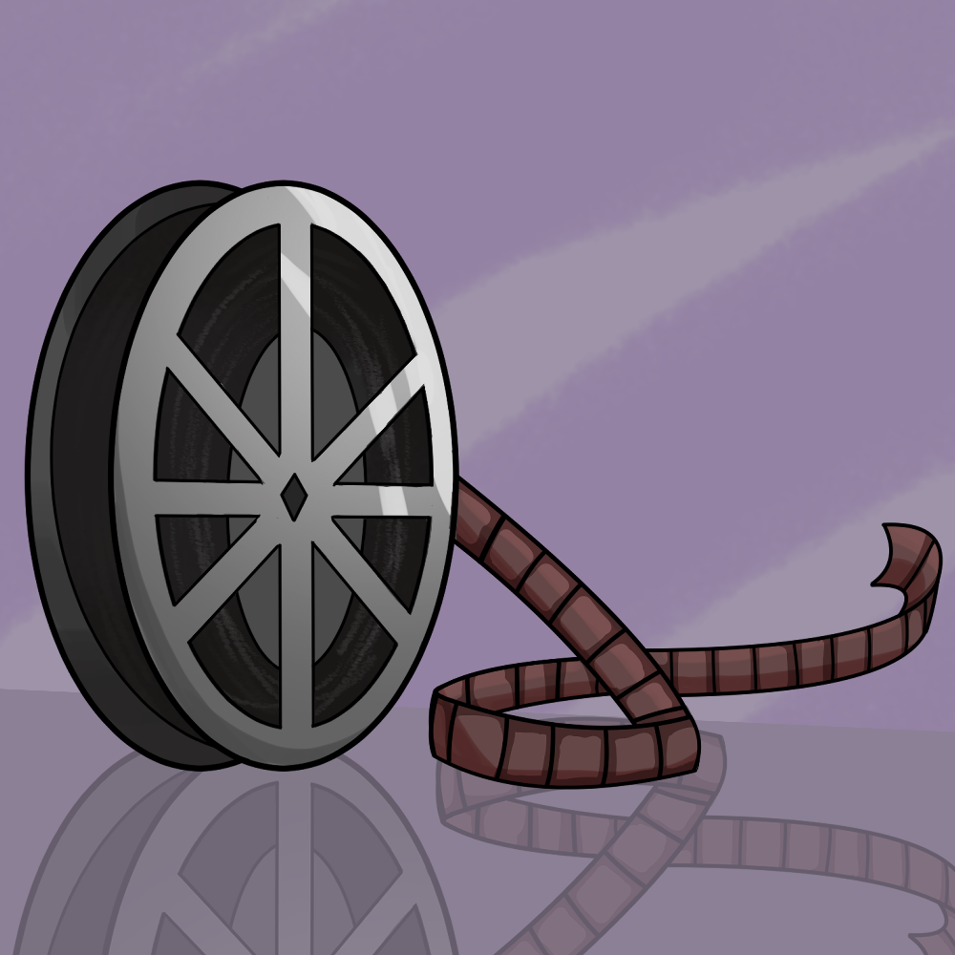
Star Wars
Notes:
The board shows the opening shots of the film, including the title crawl. The second shows R2D2 and C3PO after landing on Tatooine. The third shows the protagonists’ arrival at the Death Star.
Tavoularis, A., Johnston, J., & Beddoes, I. (Artists). (1977). Star wars storyboards. [Storyboards]. Lucasfilm ltd.

Slide 15
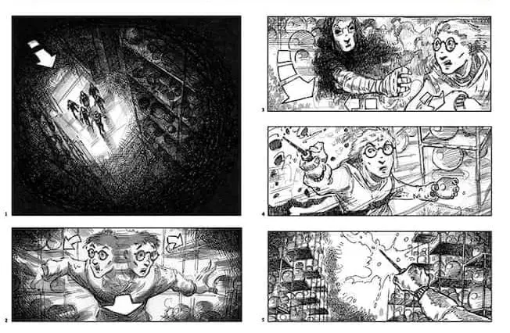
Harry Potter and the Order of the Phoenix
Notes:
Cornish, J. (Artist). (2007). Harry potter and the order of the phoenix: Hall of prophecy storyboards. [Storyboard]. Warner bros. pictures.

Slide 16
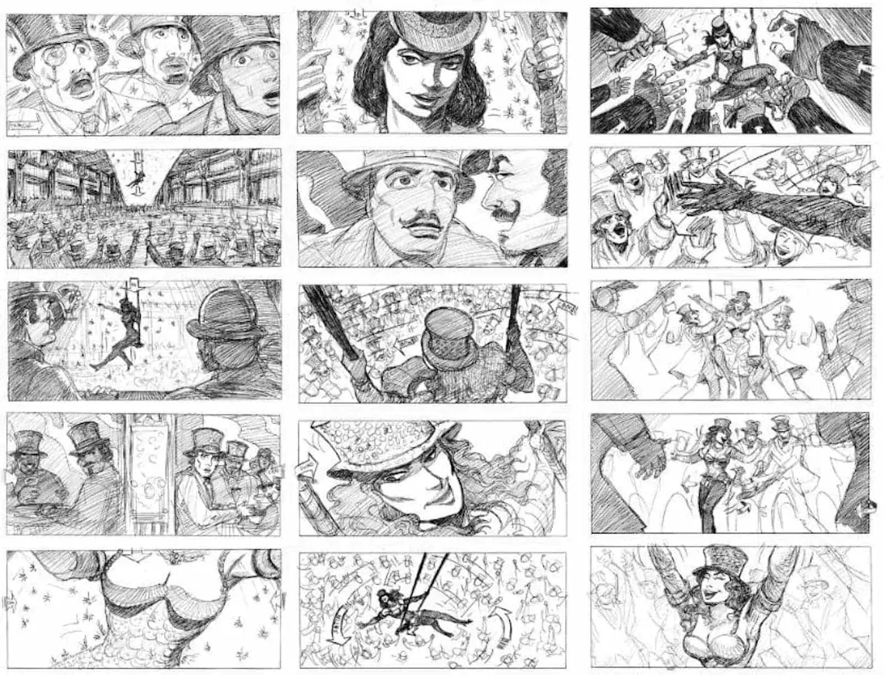
Moulin Rouge
Notes:
This is the scene where Christian (the protagonist) sees Satine (the love interest) for the first time dancing in The Moulin Rouge establishment. She descends from the ceiling on a big swing and then sings/peforms over top of the audience.
Russell, D. (Artist). (2001). Moulin rouge storyboards. [Storyboard]. 20th century fox.

Slide 17
Cognitive Comics (Create a storyboard)
-A character discovers a hidden door in their house that leads to a mysterious room. They hesitate, but curiosity gets the better of them. The room holds something they didn’t expect—something both wondrous and slightly terrifying.
Notes:
K20 Center. (n.d.). Cognitive Comics. Strategies. https://learn.k20center.ou.edu/strategy/198

Slide 18
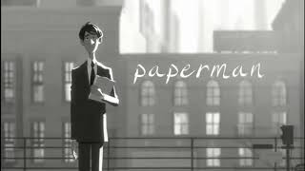
Your turn!
Notes:
Kahrs, J. (Director). (2012). Paperman. [Short Film]. Walt Disney animation studios.

Slide 19
Two Stars and a Wish
What are TWO key things you learned about how film techniques add to the meaning of a film?
What is ONE question that you still have about today’s lesson?
Notes:
K20 Center. (n.d.). Two Stars and a Wish. Strategies. https://learn.k20center.ou.edu/strategy/83

