Slide 2
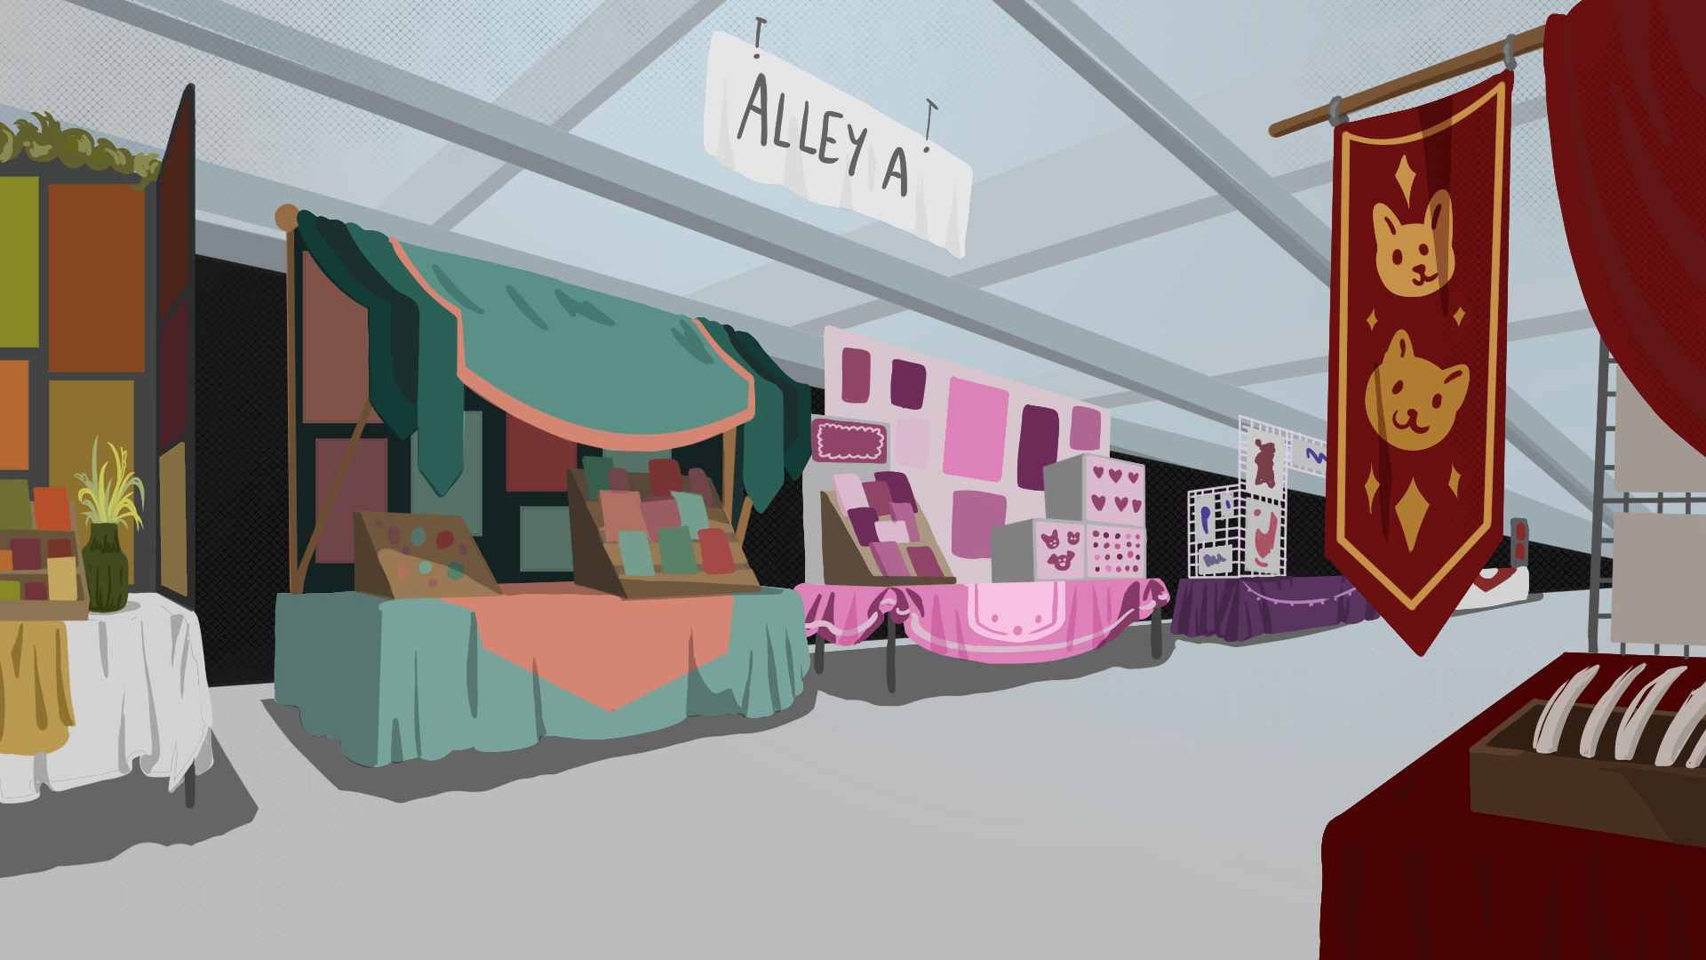
Pages, Panels, and Pop Culture
Exploring Manga and Comic Con

Slide 3
Essential Question
How do manga and Comic Cons engage the community and attract customers?

Slide 4
Lesson Objectives
Identify key elements of manga and convention culture.
Analyze how events, panels, and attractions contribute to a successful Con experience.
Design a conceptual Comic Con, strategically selecting tables, events, and strategies to attract customers.

Slide 5
ABC Graffiti
Work in small groups to brainstorm words or phrases that connect to the following question:
What do you know about manga?
Be prepared to move after time is called. You’ll only need the marker provided to your group.

Slide 6
What do you know about manga ?
Round 1
In your small group, generate words or phrases related to the topic for each letter of the alphabet.

Slide 7
What do you know about manga ?
Round 2
Rotate to the next poster and read through the list. Add words and phrases for the letters that haven’t already been addressed.

Slide 8
What do you know about manga ?
Round 3
Once again, rotate to the next poster and read through the list. Add words and phrases for the letters that haven’t already been addressed.

Slide 9
Gallery Walk
Explore the available manga stations and be prepared to leave sticky notes answering what you noticed and wondered about at least three of the novels.

Slide 10
ICAP Interview
Notes:
K20 Center. (n.d.). K20 ICAP – Small Business Entrepreneurship with Jarrod Tollett [Video]. YouTube. https://www.youtube.com/watch?v=r7YVg5XNIjw

Slide 11
Triangle, Square, Circle
Triangle: What are three important points that you have learned from the interview?
Square: List four things that squared with your thinking.
Circle: What is one thing that is still circling in your head?

Slide 12
Manga 101
Read the Manga 101 article.

Slide 13
Card Sort
Match the image and text sorting cards to the correct category cards.

Slide 14
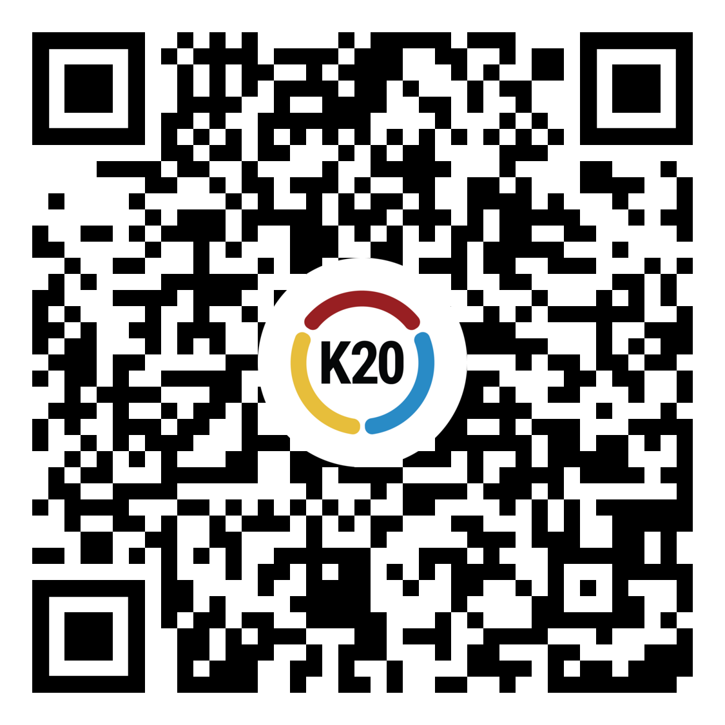
Wakelet Exploration
Explore the All About Cons Wakelet with the QR code below or at bit.ly/43FAQhJ.
Use the 3-2-1 handout to take notes.

Slide 15
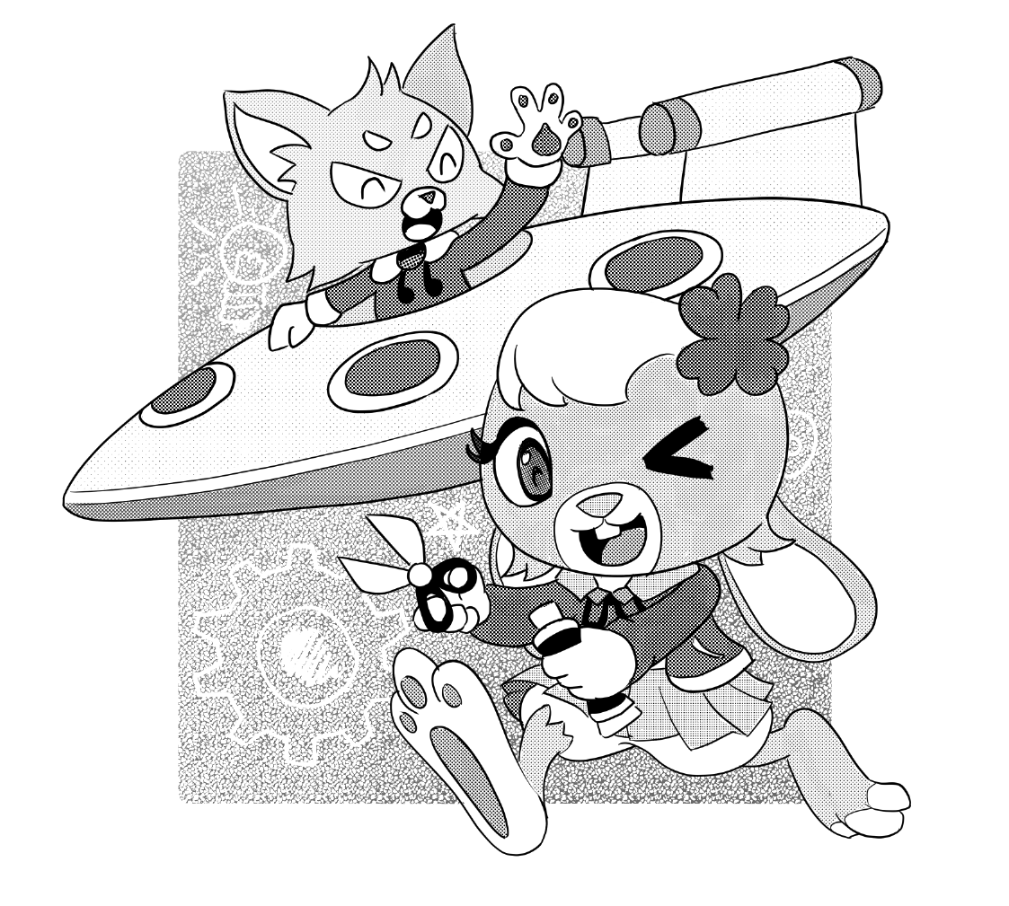
Booth Development
Begin planning your Comic Con booths. Use this time to
Consult the Choice Board and Planning Template
Develop a slideshow with at least three slides and prepare an Elevator Speech explaining your choices
Practice your Elevator Speech, minimum one minute per booth

Slide 16
List of 8
Generate answers to the following question: “What are the most essential elements of running a successful Comic Con?”
Refine your answers to a top 8 list

